Slide 1
Weekly Report
2021.02.26
Hongsik Kim
Mobile & Network Intelligence Laboratory

Slide 2
AI Explanable AI
Kaggle Competition

Slide 3
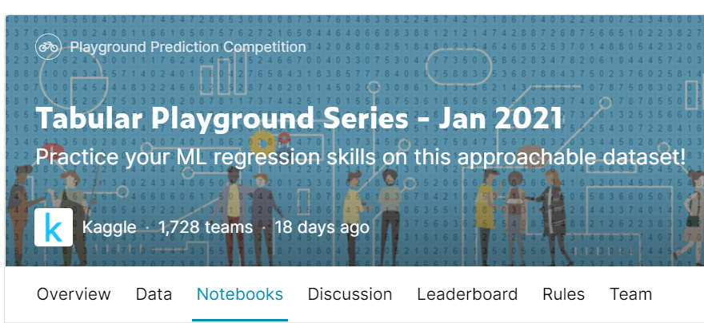
Kaggle Competition
1. Tabular Playground Series – Jan 2021
https://www.kaggle.com/c/tabular-playground-series-jan-2021

Slide 4
Kaggle Competition
1. Tabular Playground Series – Jan 2021
Use of lightGBM
https://lightgbm.readthedocs.io/
Tree 형태로 분기하는 딥러닝 알고리즘
참고: https://www.kaggle.com/gunesevitan/tabular-playground-series-jan-2021-models

Slide 5
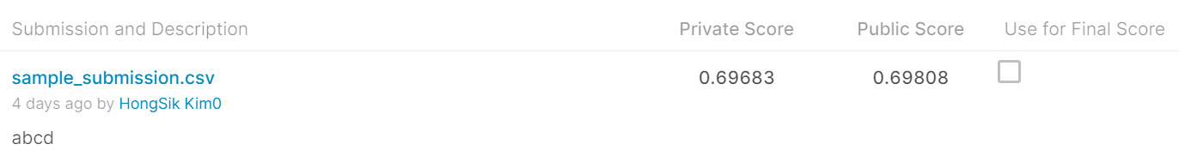
Kaggle Competition
1. Tabular Playground Series – Jan 2021
Public Leaderboard Result (0.69808)
388 / 1728 = 22.45%
Private Leaderboard Result (0.69683)
397 / 1728 = 22.97%

Slide 6
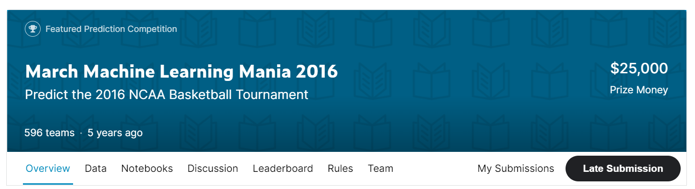
Kaggle Competition
2. March Machine Learning Mania 2016
https://www.kaggle.com/c/march-machine-learning-mania-2016

Slide 7
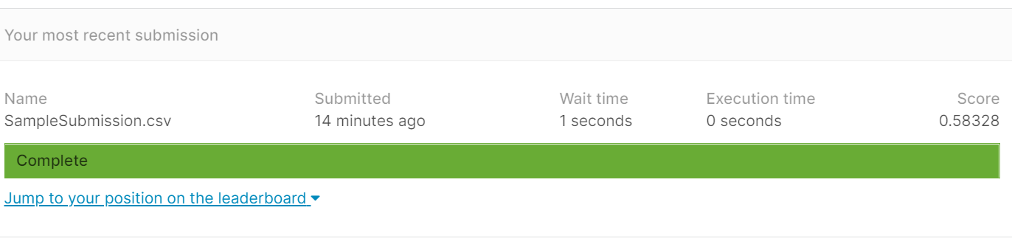
Kaggle Competition
2. March Machine Learning Mania 2016
Traditional Vanilla Deep Learning 사용 (0.58328)
LightGBM 사용 (비교적 성능이 떨어짐)

Slide 8
Github
https://github.com/WannaBeSuperteur/2020/tree/master/

