Slide 1
Weekly Report
2021.04.14
Hongsik Kim
Mobile & Network Intelligence Laboratory

Slide 2
WPCN: Paper
Paper: Sum-Throughput Maximization in NOMA-Based WPCN: A Cluster-Specific Beamforming Approach
Implementation : WPCN-UAV

Slide 3
Current Status
주간 진행 사항
논문 읽기 (완료)
Sum-Throughput Maximization in NOMA-Based WPCN: A Cluster-Specific Beamforming Approach
WPCN-UAV 구현
Deep Q Learning이 동작하도록 구현

Slide 4
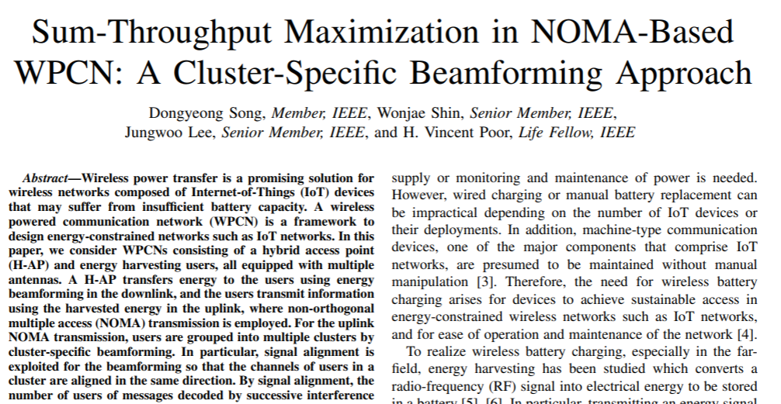
Current Status
Paper: Sum-Throughput Maximization in NOMA-Based WPCN: A Cluster-Specific Beamforming Approach
https://ieeexplore.ieee.org/stamp/stamp.jsp?arnumber=9316713
Refer to 210407_WPCN.pptx

Slide 5
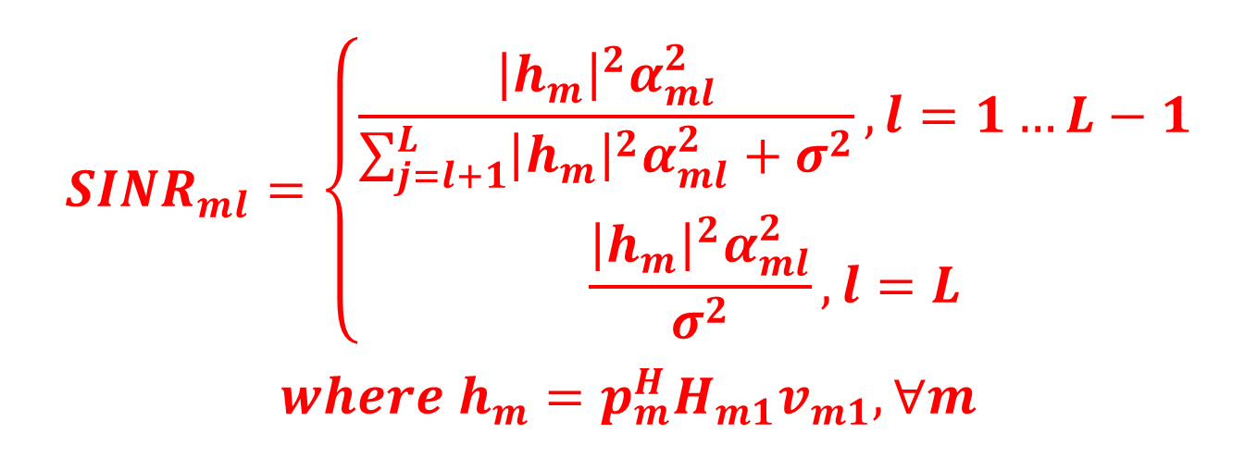
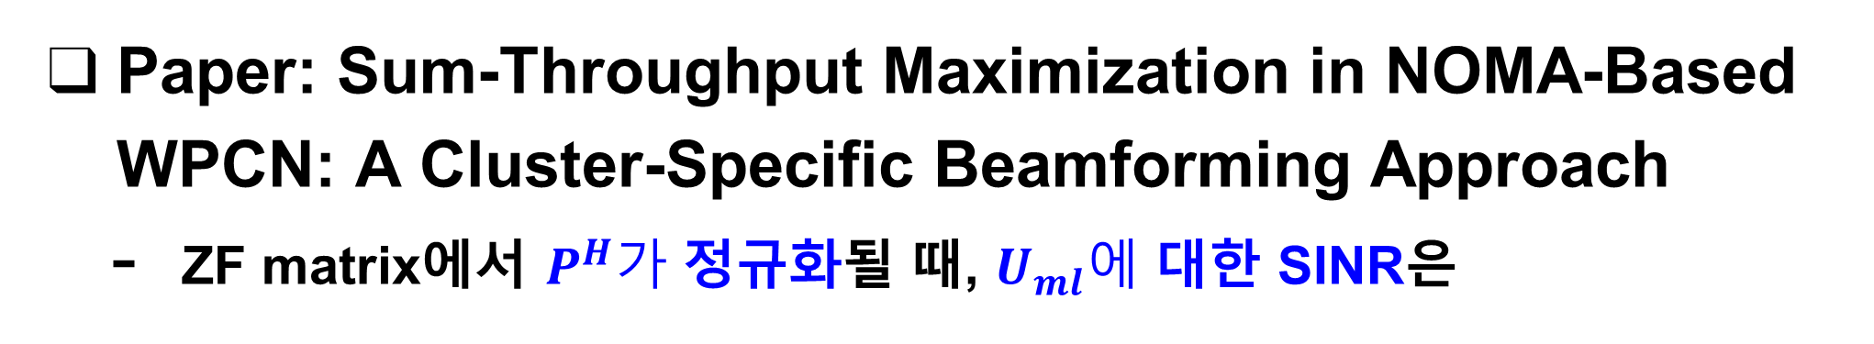
Current Status
Paper: Sum-Throughput Maximization in NOMA-Based WPCN: A Cluster-Specific Beamforming Approach
ZF matrix에서 $P^{H}가$ 정규화될 때, $U_{ml}에$ 대한 SINR은
$$SINR_{ml}=\left\{\begin{aligned}\frac{{\left|h_{m}\right|}^{2}α_{ml}^{2}}{\sum_{j=l+1}^{L}{{\left|h_{m}\right|}^{2}α_{ml}^{2}}+σ^{2}}, l=1…L−1 \\ \frac{{\left|h_{m}\right|}^{2}α_{ml}^{2}}{σ^{2}},l=L\end{aligned}\right.$$
$$where h_{m}=p_{m}^{H}H_{m1}v_{m1}, ∀m$$

Slide 6
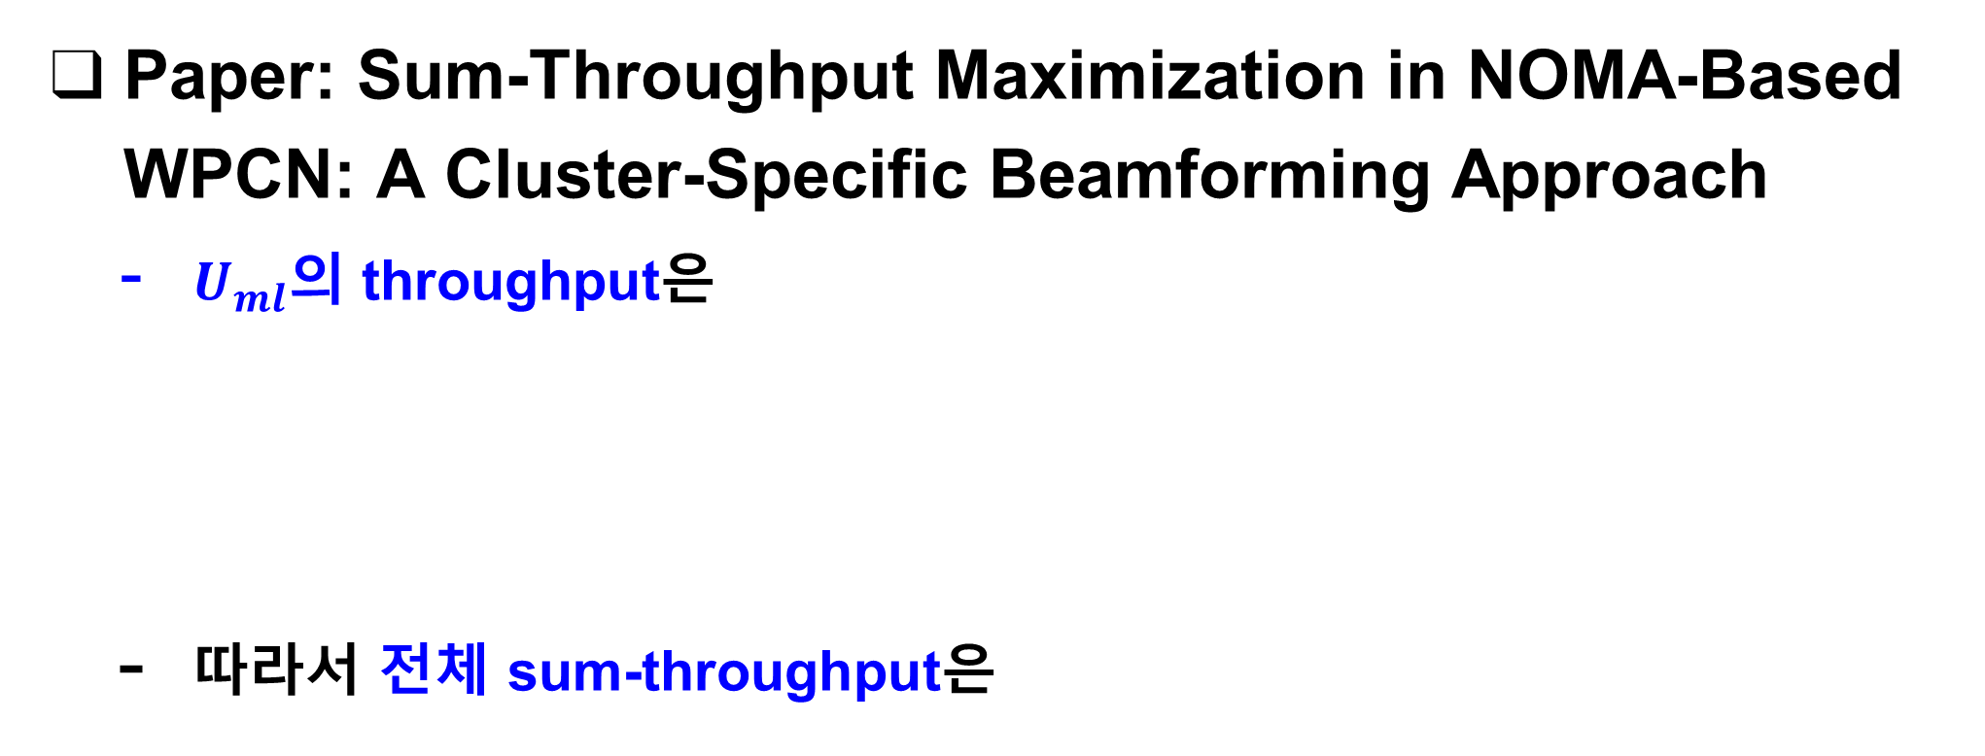
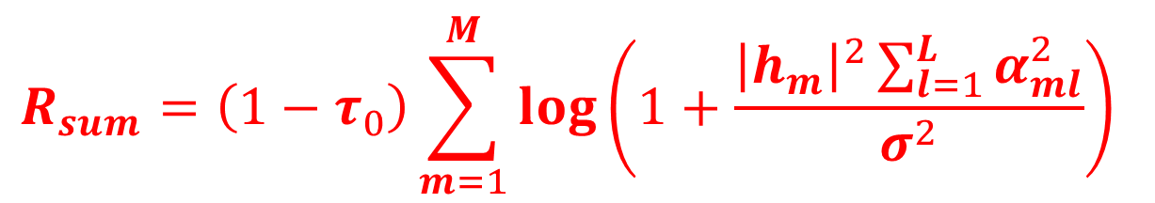
Current Status
Paper: Sum-Throughput Maximization in NOMA-Based WPCN: A Cluster-Specific Beamforming Approach
$U_{ml}$의 throughput은
따라서 전체 sum-throughput은
$$R_{ml}=\left(1−τ_{0}\right)\log\left(1+SINR_{ml}\right), ∀m,l$$
$$R_{sum}=\left(1−τ_{0}\right)\sum_{m=1}^{M}{\log\left(1+\frac{{\left|h_{m}\right|}^{2}\sum_{l=1}^{L}{α_{ml}^{2}}}{σ^{2}}\right)}$$

Slide 7

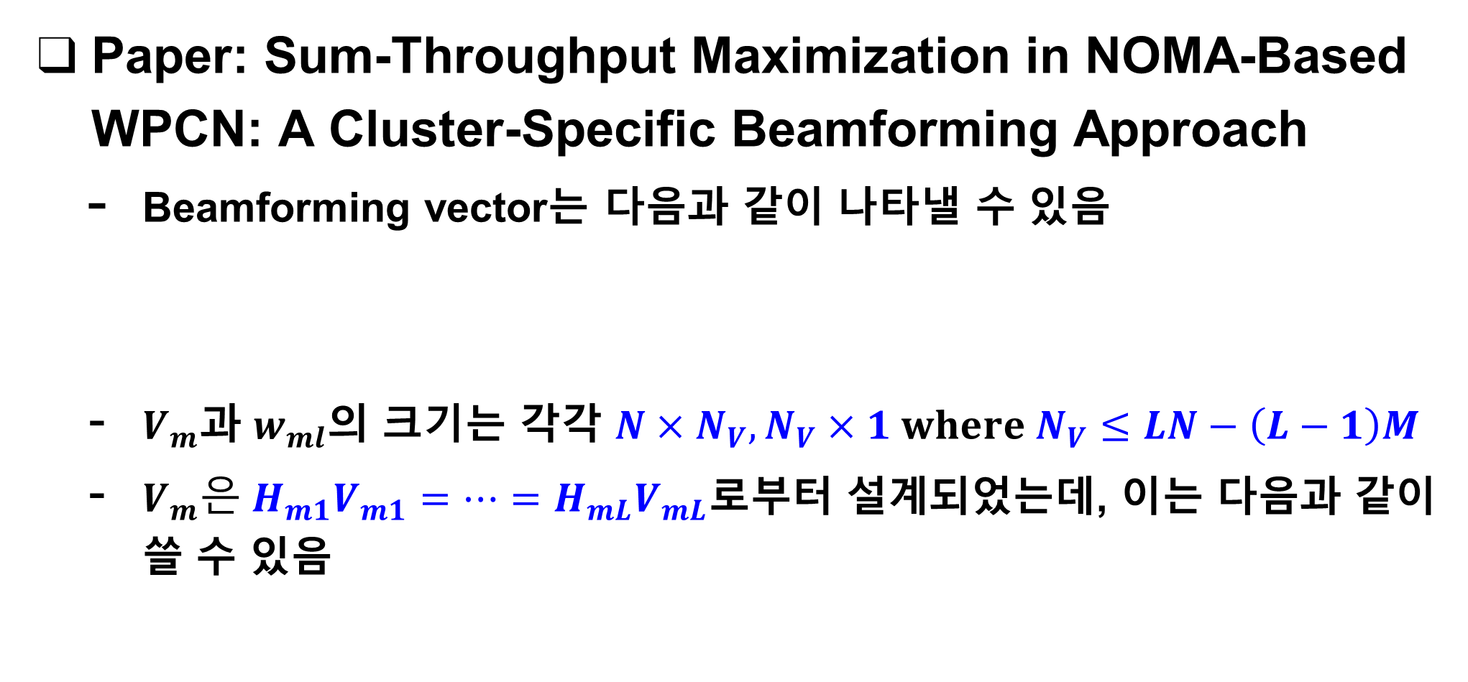
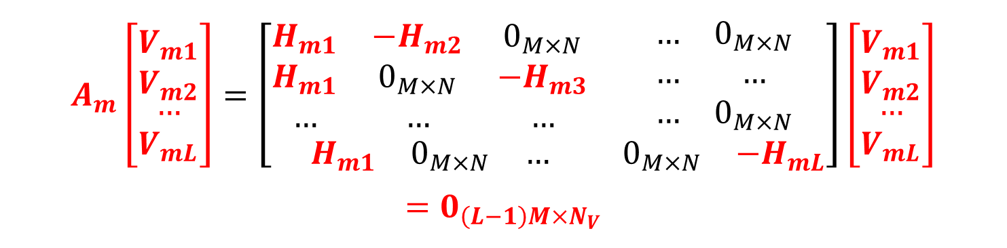
Current Status
Paper: Sum-Throughput Maximization in NOMA-Based WPCN: A Cluster-Specific Beamforming Approach
Beamforming vector는 다음과 같이 나타낼 수 있음
$V_{m}$과 $w_{ml}$의 크기는 각각 $N×N_{V}, N_{V}×1 where N_{V}≤LN−\left(L−1\right)M$
$V_{m}은 H_{m1}V_{m1}=…=H_{mL}V_{mL}$로부터 설계되었는데, 이는 다음과 같이 쓸 수 있음
$$v_{ml}=V_{ml}w_{ml}$$
$$A_{m}\left[\begin{matrix}V_{m1} \\ V_{m2} \\ \begin{matrix}… \\ V_{mL}\end{matrix}\end{matrix}\right]=\left[\begin{matrix}\begin{matrix}H_{m1} & −H_{m2} & 0_{M×N} \\ H_{m1} & 0_{M×N} & −H_{m3} \\ … & … & …\end{matrix} & \begin{matrix}… & 0_{M×N} \\ … & … \\ … & 0_{M×N}\end{matrix} \\ \begin{matrix}H_{m1} & 0_{M×N} & …\end{matrix} & \begin{matrix}0_{M×N} & −H_{mL}\end{matrix}\end{matrix}\right]\left[\begin{matrix}V_{m1} \\ V_{m2} \\ \begin{matrix}… \\ V_{mL}\end{matrix}\end{matrix}\right]$$
$$=0_{\left(L−1\right)M×N_{V}}$$

Slide 8
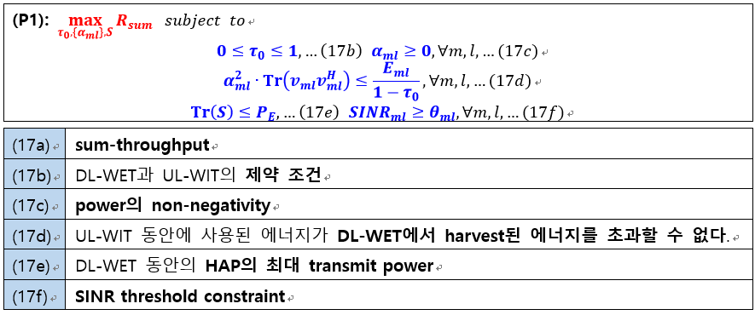
Current Status
Paper: Sum-Throughput Maximization in NOMA-Based WPCN: A Cluster-Specific Beamforming Approach
Sum-throughput maximization problem

Slide 9
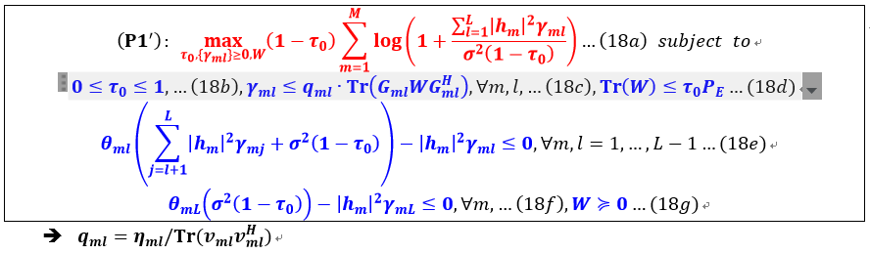
Current Status
Paper: Sum-Throughput Maximization in NOMA-Based WPCN: A Cluster-Specific Beamforming Approach
Sum-throughput maximization problem의 변형

Slide 10
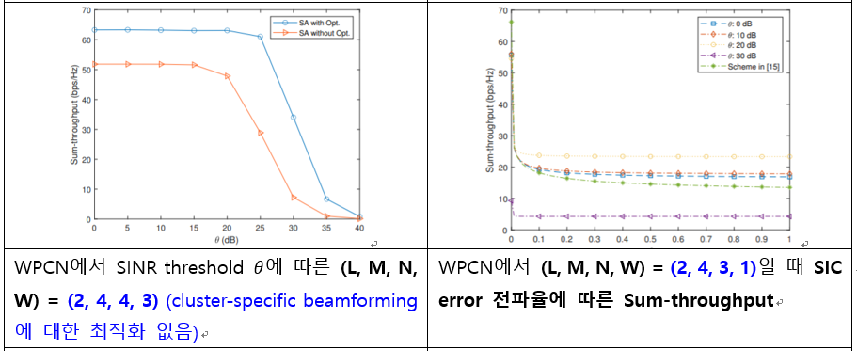
Current Status
Paper: Sum-Throughput Maximization in NOMA-Based WPCN: A Cluster-Specific Beamforming Approach
시뮬레이션 결과 (1)

Slide 11
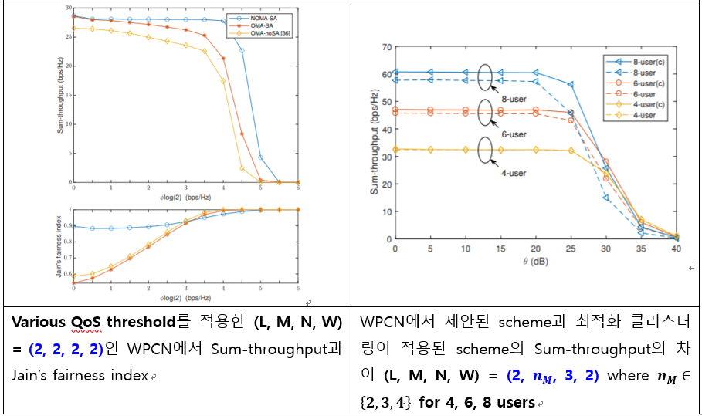
Current Status
Paper: Sum-Throughput Maximization in NOMA-Based WPCN: A Cluster-Specific Beamforming Approach
시뮬레이션 결과 (2)

Slide 12
Current Status
Implementation of WPCN-UAV
Action별 reward output 결정 방법
Deep Q Learning에서 해당 action의 reward 값만 새로운 reward로 learning rate만큼 이동시키고, 다른 reward 값은 모두 deep learning output으로 결정
state={1,2,3,4}, action=2, output=5, learning rate=0.2
input
output
1
3
-1
-2
0
1
1
1
3
0.2
-2
0
1
1
1
2
3
4
Append to Q Table:
Input: [1, 2, 3, 4]
Output: [1, 3, -1*0.8 + 5*0.2, -2, 0, 1, 1]
NN

Slide 13
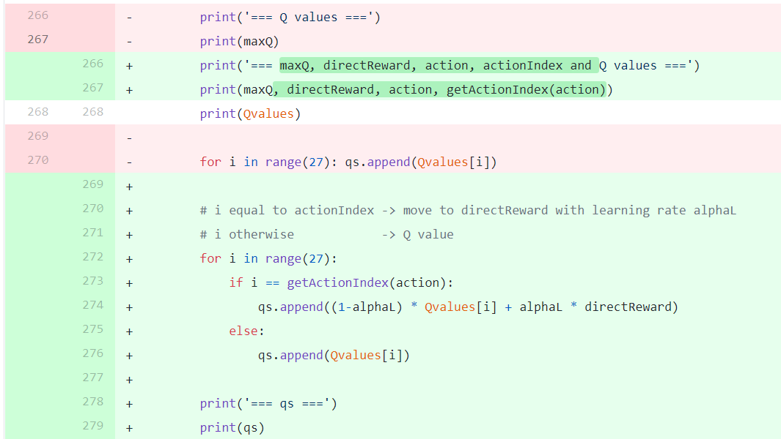
Current Status
Implementation of WPCN-UAV
Action별 reward output 결정 방법
Deep Q Learning에서 해당 action의 reward 값만 새로운 reward로 learning rate만큼 이동시키고, 다른 reward 값은 모두 deep learning output으로 결정

Slide 14
Current Status
Implementation of WPCN-UAV
향후 deep Q learning 작동 및 오류 수정
경우에 따라 learning rate 대폭 향상 가능
기존 learning rate가 매우 작아서 학습 진행을 확인하기 어려움

Slide 15
Github
https://github.com/WannaBeSuperteur/2020/tree/master/WPCN

