Slide 1
Weekly Report
2021.02.19
Hongsik Kim
Mobile & Network Intelligence Laboratory

Slide 2
AI Explanable AI
Kaggle Competition

Slide 3
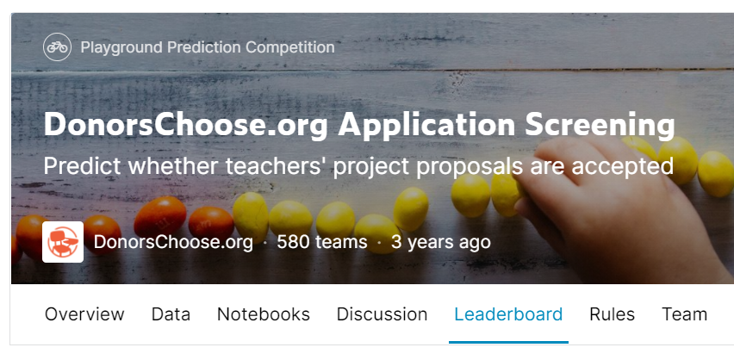
Kaggle Competition
1. DonorsChoose.org Application Screening
https://www.kaggle.com/c/donorschoose-application-screening

Slide 4
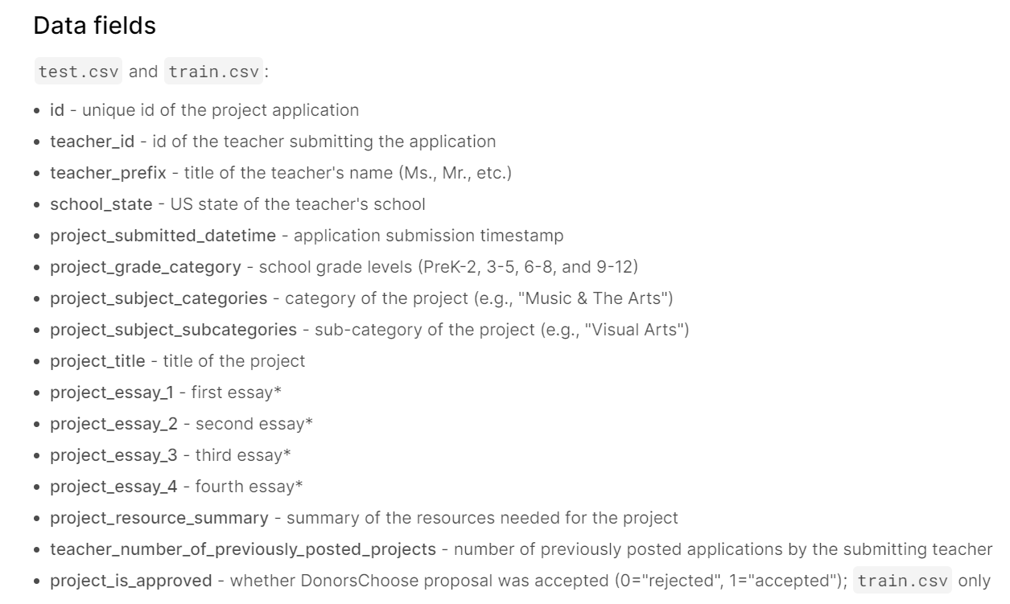
Kaggle Competition
1. donorschoose-application-screening

Slide 5
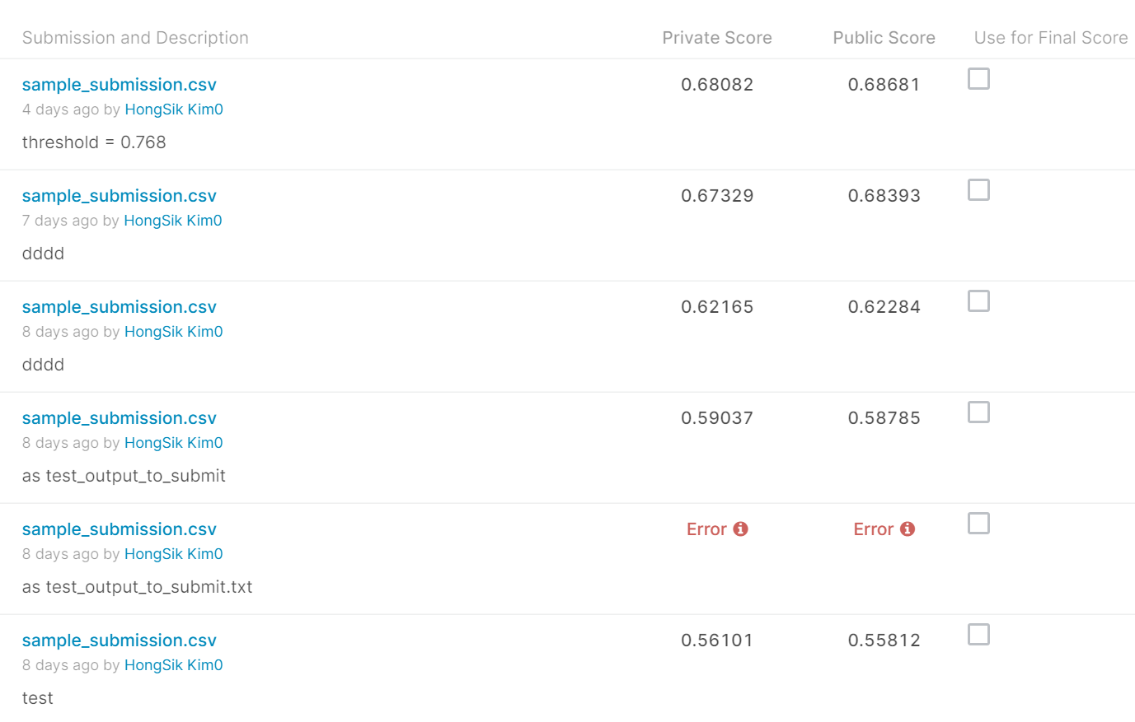
Kaggle Competition
1. donorschoose-application-screening

Slide 6
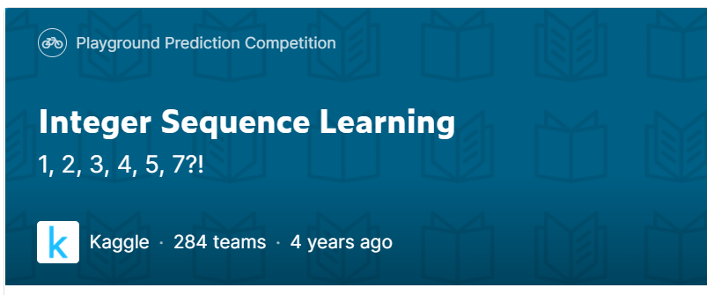
Kaggle Competition
2. Integer Sequence Learning
https://www.kaggle.com/c/integer-sequence-learning/overview

Slide 7
Kaggle Competition
2. Integer Sequence Learning
해결 방법: 각 숫자 값 사이의 차이인 difference를 이용
original
1 | 2 | 3 | 4 | 3 | 2 | 1 | 2 | 3 | 4 | 3 | 2 | 1
1 | 1 | 1 | -1 | -1 | -1 | 1 | 1 | 1 | -1 | -1 | -1
0 | 0 | -2 | 0 | 0 | 2 | 0 | 0 | -2 | 0 | 0
0 | -2 | 2 | 0 | 2 | -2 | 0 | -2 | 2 | 0
-2 | 4 | -2 | 2 | -4 | 2 | -2 | 4 | -2
dif
dif2
dif3
dif4

Slide 8
Kaggle Competition
2. Integer Sequence Learning
최근 일정 개수의 숫자를 패턴으로 하여 해당 패턴 직후의 값들 중 가장 자주 나타나는 값을 이용
original
1 | 2 | 3 | 4 | 3 | 2 | 1 | 2 | 3 | 4 | 3 | 2 | 1
1 | 1 | 1 | -1 | -1 | -1 | 1 | 1 | 1 | -1 | -1 | -1
0 | 0 | -2 | 0 | 0 | 2 | 0 | 0 | -2 | 0 | 0
0 | -2 | 2 | 0 | 2 | -2 | 0 | -2 | 2 | 0
-2 | 4 | -2 | 2 | -4 | 2 | -2 | 4 | -2
dif
dif2
dif3
dif4

Slide 9
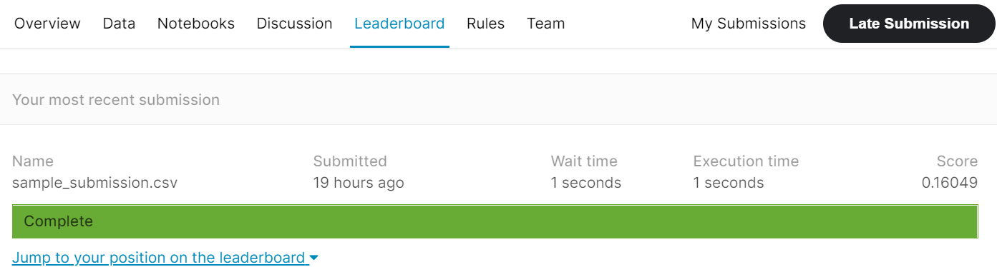
Kaggle Competition
2. Integer Sequence Learning
결과: 107 / 284 = 37.68%

Slide 10
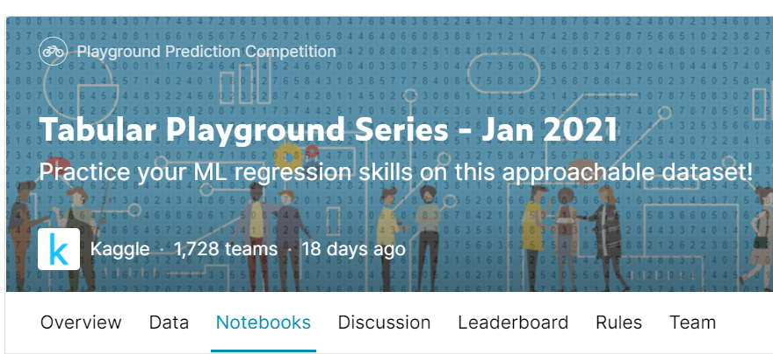
Kaggle Competition
3. Tabular Playground Series – Jan 2021
https://www.kaggle.com/c/tabular-playground-series-jan-2021

Slide 11
Github
https://github.com/WannaBeSuperteur/2020/tree/master/

