Slide 1
Weekly Report
2021.05.07
Hongsik Kim
Mobile & Network Intelligence Laboratory

Slide 2
AI Explanable AI
Kaggle Competition
Patent Idea (not public)

Slide 3
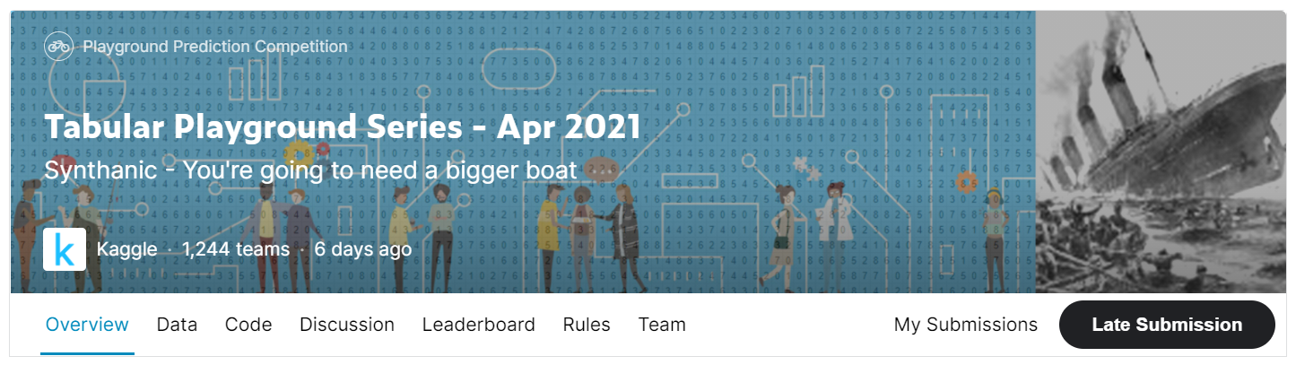
Kaggle Competition
Tabular Playground Series - Apr 2021
https://www.kaggle.com/c/tabular-playground-series-apr-2021/overview

Slide 4
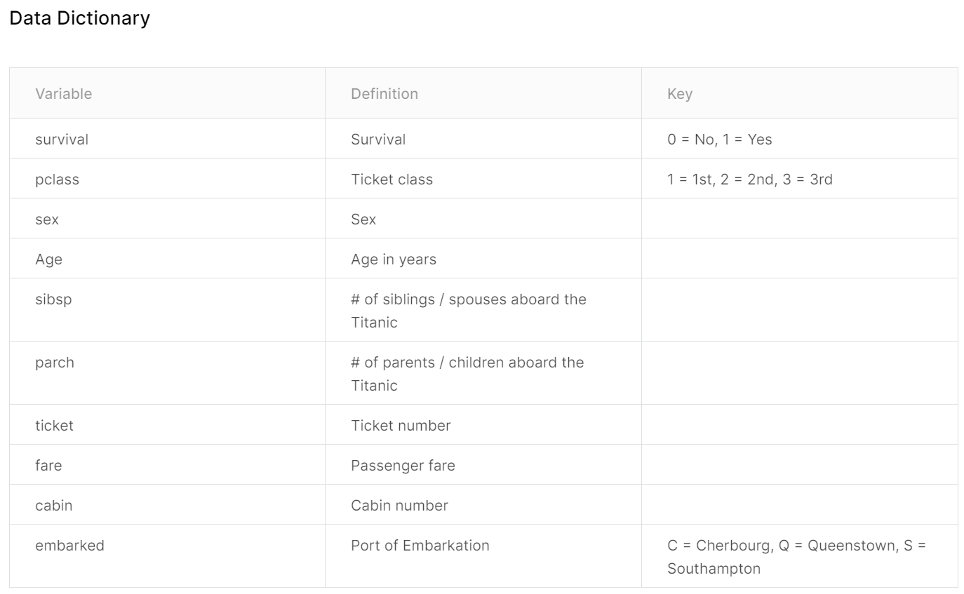
Kaggle Competition
Tabular Playground Series - Apr 2021
Survival의 값을 예측, 정확도(accuracy)로 측정

Slide 5
Kaggle Competition
Tabular Playground Series - Apr 2021
Data Preprocessing
-> to predict
-> one-hot
-> one-hot
-> (X – average) / stddev
-> (X – average) / stddev
-> (X – average) / stddev
-> (Y – average) / stddev where Y = log(X)
-> one-hot

Slide 6
Kaggle Competition
Tabular Playground Series - Apr 2021
Data Preprocessing - Ticket Number Preprocessing
0-9, A-Z를 제외한 모든 문자 제거
One-hot for A-Z part
One-hot for 0-9 part
7 Categories: {CA, A, AS, PC, WC, ‘’, (others)}
3 Categories: {<100,000, <1,000,000, >=1,000,000}

Slide 7
Kaggle Competition
Tabular Playground Series - Apr 2021
Data Preprocessing - Cabin Number Preprocessing
(알파벳 1글자) + (숫자) 형식의 데이터
첫 번째 문자를 이용
One-hot 적용
10 Categories: {A, B, C, D, E, F, G, T, X, ‘’}

Slide 8
Kaggle Competition
Tabular Playground Series - Apr 2021
Used Model
lightGBM
XGBoost
deepLearning (기본적인 형태의 Neural Network)
How to test
Sum = Output of lightGBM + output of XGBoost + output of deepLearning
Average = Sum / 3
Return 1 if Average >= 0.5
Return 0 if Average < 0.5

Slide 9
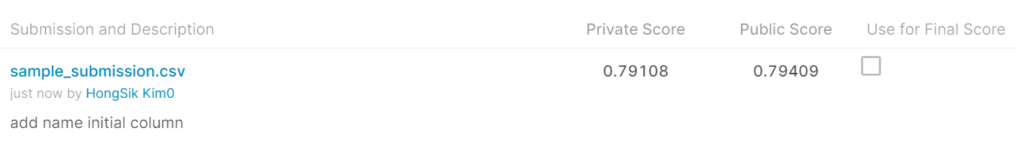
Kaggle Competition
Result (NOT in Top 40% -> continue)

Slide 10
Github
https://github.com/WannaBeSuperteur/2020/tree/master/

