Slide 1
Weekly Report
2021.02.24
Hongsik Kim
Mobile & Network Intelligence Laboratory

Slide 2
WPCN: Paper
Paper: Multi-Agent Deep Reinforcement Learning for Distributed Resource Management in Wirelessly Powered Communication Network

Slide 3
Current Status
주간 진행 사항
논문 학습: Multi-Agent Deep Reinforcement Learning for Distributed Resource Management in Wirelessly Powered Communication Network
https://arxiv.org/pdf/2010.09171.pdf

Slide 4
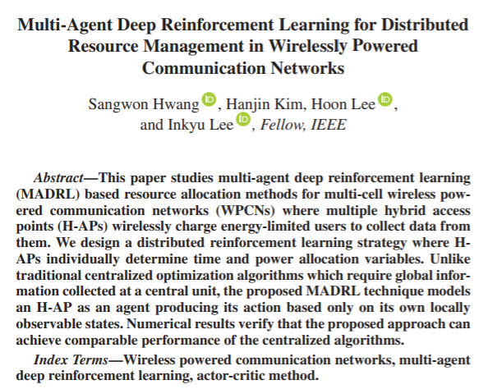
Current Status
Paper: Multi-Agent DRL for Distributed Resource Management in WPCN

Slide 5
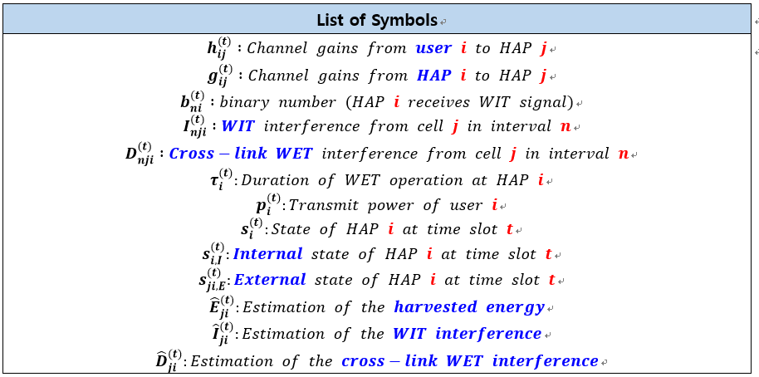
Current Status
Paper: Multi-Agent DRL for Distributed Resource Management in WPCN
Symbols

Slide 6
Current Status
Paper: Multi-Agent DRL for Distributed Resource Management in WPCN
Accomplishes…
Agent 간의 simple interaction을 위한 목적의 distributed learning
지역적으로만 관측 가능한 정보에 대한 distributed execution
전통적인 중앙 집중형 알고리즘에 비해 계산 복잡도 감소

Slide 7
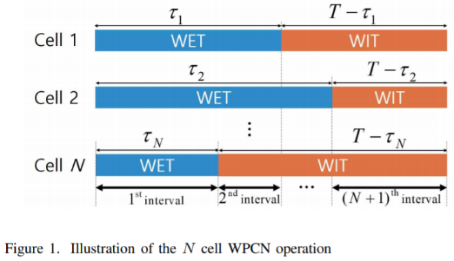
Current Status
Paper: Multi-Agent DRL for Distributed Resource Management in WPCN
Figures (N개의 cell이 있는 WPCN의 연산)

Slide 8
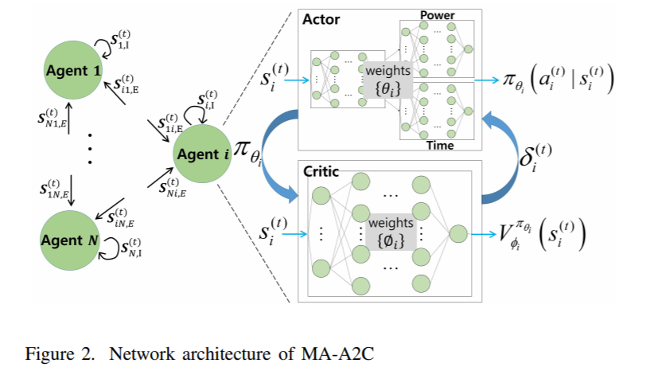
Current Status
Paper: Multi-Agent DRL for Distributed Resource Management in WPCN
Figures (MA-A2C의 네트워크 구조)
Actor DNN
Critic DNN

Slide 9
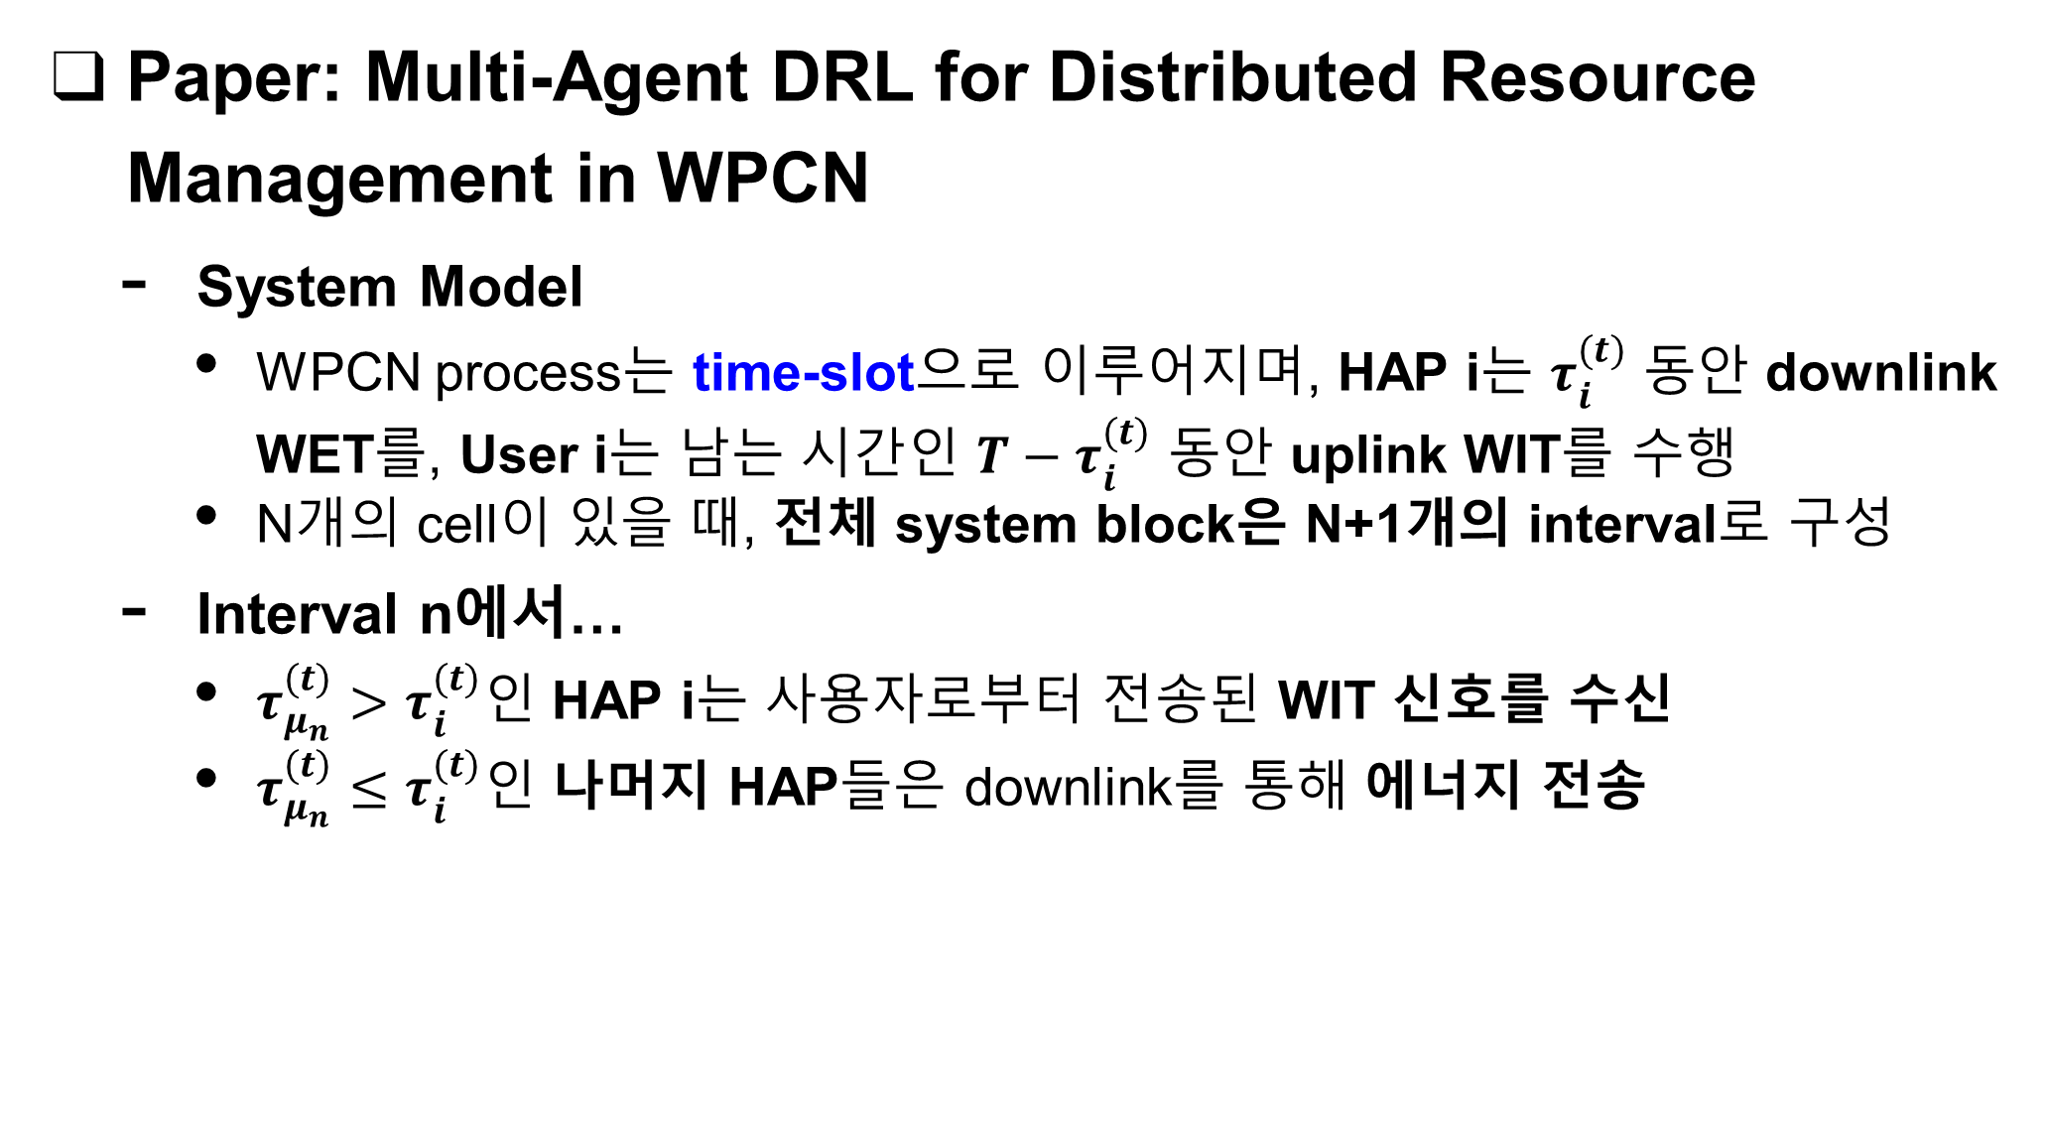
Current Status
Paper: Multi-Agent DRL for Distributed Resource Management in WPCN
System Model
WPCN process는 time-slot으로 이루어지며, HAP i는 $τ_{i}^{(t)}$ 동안 downlink WET를, User i는 남는 시간인 $T−τ_{i}^{(t)}$ 동안 uplink WIT를 수행
N개의 cell이 있을 때, 전체 system block은 N+1개의 interval로 구성
Interval n에서…
$τ_{μ_{n}}^{(t)}>τ_{i}^{(t)}$인 HAP i는 사용자로부터 전송된 WIT 신호를 수신
$τ_{μ_{n}}^{(t)}≤τ_{i}^{(t)}$인 나머지 HAP들은 downlink를 통해 에너지 전송

Slide 10

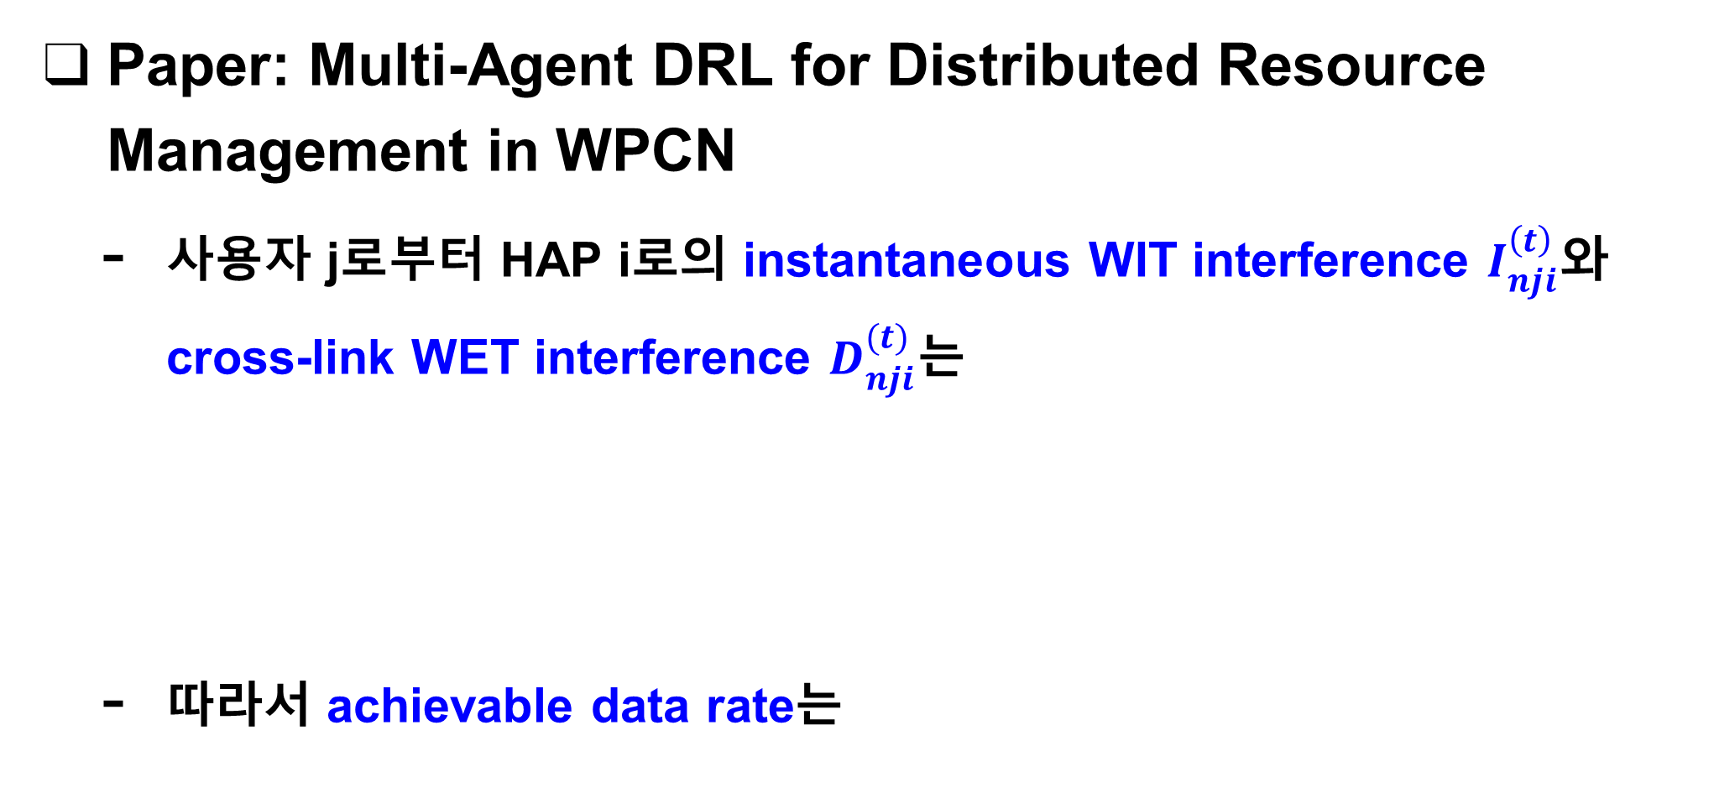
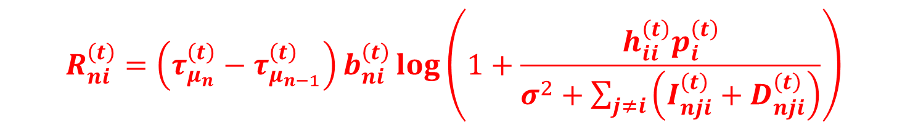
Current Status
Paper: Multi-Agent DRL for Distributed Resource Management in WPCN
사용자 j로부터 HAP i로의 instantaneous WIT interference $I_{nji}^{\left(t\right)}$와 cross-link WET interference $D_{nji}^{(t)}$는
따라서 achievable data rate는
$$I_{nji}^{(t)}=h_{ji}^{\left(t\right)}p_{j}^{\left(t\right)}b_{nj}^{\left(t\right)}$$
$$D_{nji}^{(t)}=βg_{ji}^{\left(t\right)}P\left(1−b_{nj}^{\left(t\right)}\right)$$
$$R_{ni}^{\left(t\right)}=\left(τ_{μ_{n}}^{\left(t\right)}−τ_{μ_{n−1}}^{\left(t\right)}\right)b_{ni}^{\left(t\right)}\log\left(1+\frac{h_{ii}^{\left(t\right)}p_{i}^{\left(t\right)}}{σ^{2}+\sum_{j≠i}{\left(I_{nji}^{\left(t\right)}+D_{nji}^{\left(t\right)}\right)}}\right)$$

Slide 11
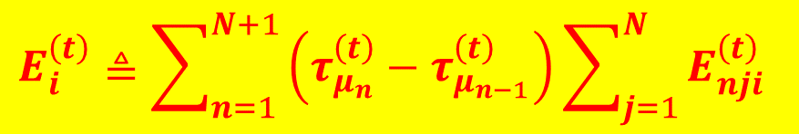
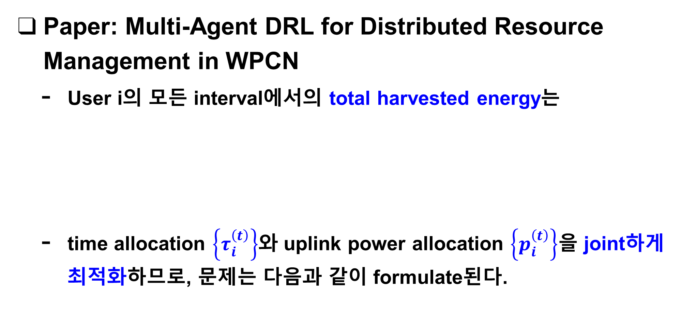
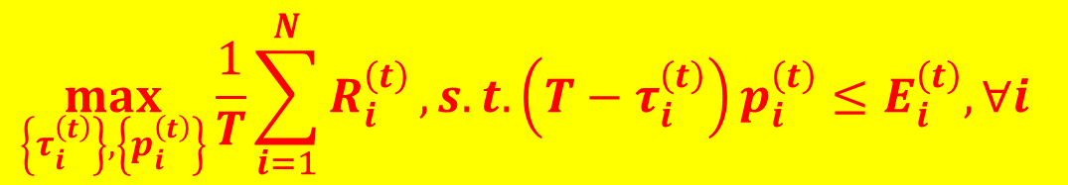
Current Status
Paper: Multi-Agent DRL for Distributed Resource Management in WPCN
User i의 모든 interval에서의 total harvested energy는
time allocation $\left\{τ_{i}^{\left(t\right)}\right\}$와 uplink power allocation $\left\{p_{i}^{\left(t\right)}\right\}$을 joint하게 최적화하므로, 문제는 다음과 같이 formulate된다.
$$E_{i}^{\left(t\right)}≜\sum_{n=1}^{N+1}{\left(τ_{μ_{n}}^{\left(t\right)}−τ_{μ_{n−1}}^{\left(t\right)}\right)}\sum_{j=1}^{N}{E_{nji}^{\left(t\right)}}$$
$$\max_{\left\{τ_{i}^{\left(t\right)}\right\},\left\{p_{i}^{\left(t\right)}\right\}}{\frac{1}{T}\sum_{i=1}^{N}{R_{i}^{\left(t\right)}}}, s.t. \left(T−τ_{i}^{\left(t\right)}\right)p_{i}^{\left(t\right)}≤E_{i}^{\left(t\right)}, ∀i$$

Slide 12
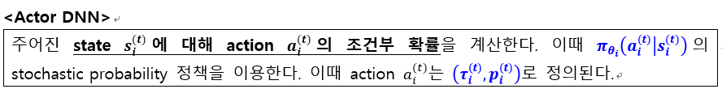
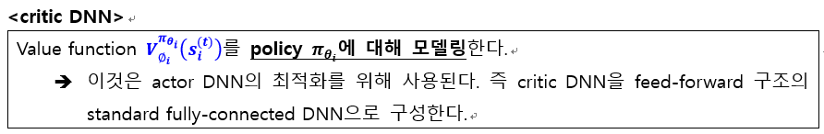
Current Status
Paper: Multi-Agent DRL for Distributed Resource Management in WPCN
Actor DNN
Critic DNN

Slide 13
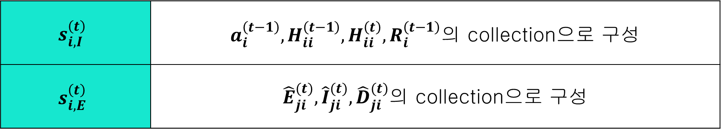
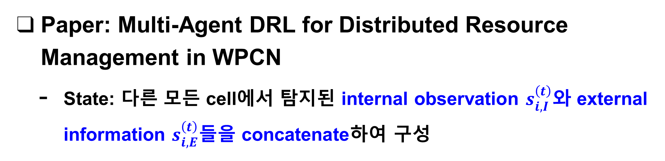
Current Status
Paper: Multi-Agent DRL for Distributed Resource Management in WPCN
State: 다른 모든 cell에서 탐지된 internal observation $s_{i,I}^{\left(t\right)}$와 external information $s_{i,E}^{\left(t\right)}$들을 concatenate하여 구성
$$s_{i,I}^{\left(t\right)}$$ | $a_{i}^{\left(t−1\right)}, H_{ii}^{\left(t−1\right)}, H_{ii}^{\left(t\right)}, R_{i}^{\left(t−1\right)}$의 collection으로 구성
$$s_{i,E}^{\left(t\right)}$$ | ${\hat{E}}_{ji}^{(t)},{\hat{I}}_{ji}^{(t)},{\hat{D}}_{ji}^{(t)}$의 collection으로 구성

Slide 14
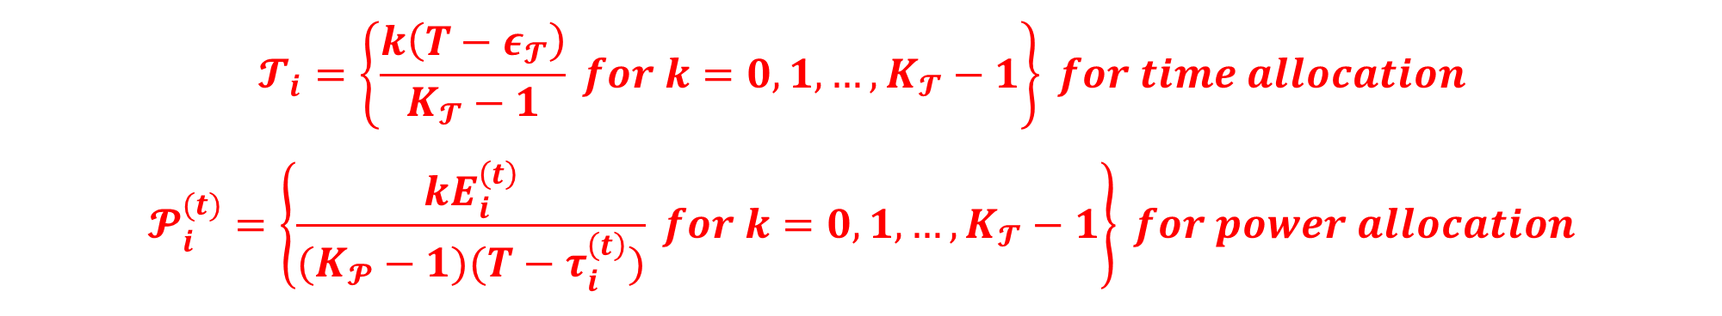
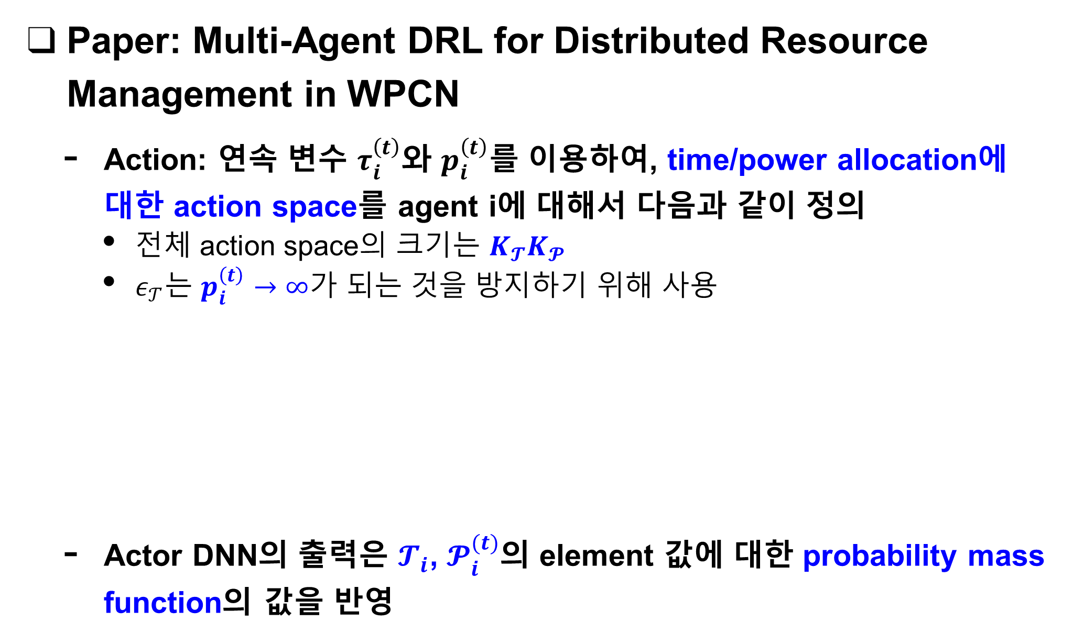
Current Status
Paper: Multi-Agent DRL for Distributed Resource Management in WPCN
Action: 연속 변수 $τ_{i}^{\left(t\right)}$와 $p_{i}^{\left(t\right)}$를 이용하여, time/power allocation에 대한 action space를 agent i에 대해서 다음과 같이 정의
전체 action space의 크기는 $K_{𝓣}K_{𝓟}$
$ε_{𝒯}$는 $p_{i}^{\left(t\right)}→∞$가 되는 것을 방지하기 위해 사용
Actor DNN의 출력은 $𝓣_{i}$, $𝓟_{i}^{(t)}$의 element 값에 대한 probability mass function의 값을 반영
$$𝓣_{i}=\left\{\frac{k\left(T−ε_{𝓣}\right)}{K_{𝓣}−1} for k=0,1,…,K_{𝓣}−1\right\} for time allocation$$
$$𝓟_{i}^{(t)}=\left\{\frac{kE_{i}^{\left(t\right)}}{(K_{𝓟}−1)(T−τ_{i}^{\left(t\right)})} for k=0,1,…,K_{𝓣}−1\right\} for power allocation$$

Slide 15
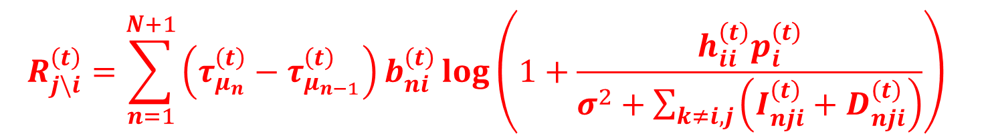
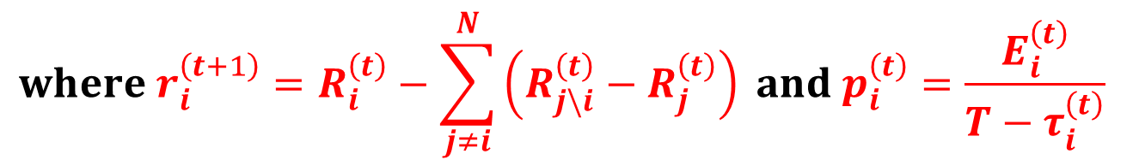
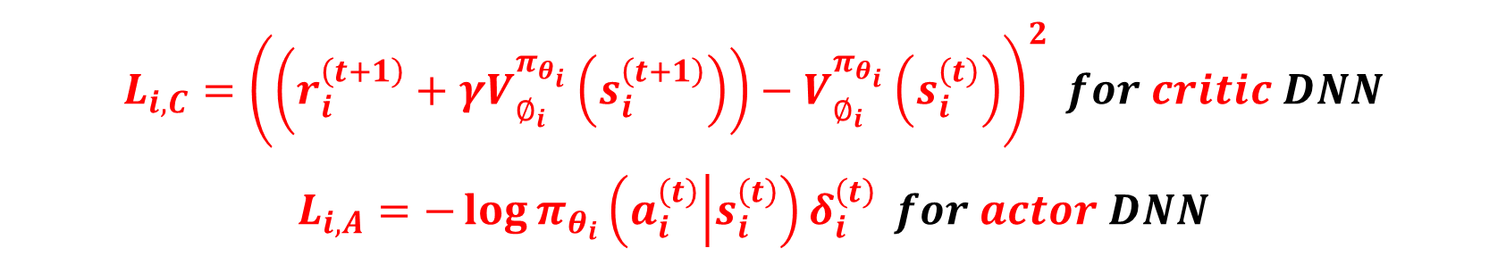
Current Status
Paper: Multi-Agent DRL for Distributed Resource Management in WPCN
Reward:
Loss Function:
$$R_{j\backslash i}^{\left(t\right)}=\sum_{n=1}^{N+1}{\left(τ_{μ_{n}}^{\left(t\right)}−τ_{μ_{n−1}}^{\left(t\right)}\right)b_{ni}^{\left(t\right)}\log\left(1+\frac{h_{ii}^{\left(t\right)}p_{i}^{\left(t\right)}}{σ^{2}+\sum_{k≠i,j}{\left(I_{nji}^{\left(t\right)}+D_{nji}^{\left(t\right)}\right)}}\right)}$$
$$where r_{i}^{\left(t+1\right)}=R_{i}^{\left(t\right)}−\sum_{j≠i}^{N}{\left(R_{j\backslash i}^{\left(t\right)}−R_{j}^{\left(t\right)}\right)} and p_{i}^{\left(t\right)}=\frac{E_{i}^{\left(t\right)}}{T−τ_{i}^{\left(t\right)}}$$
$$L_{i,C}={\left(\left(r_{i}^{\left(t+1\right)}+γV_{∅_{i}}^{π_{θ_{i}}}\left(s_{i}^{\left(t+1\right)}\right)\right)−V_{∅_{i}}^{π_{θ_{i}}}\left(s_{i}^{\left(t\right)}\right)\right)}^{2} for critic DNN$$
$$L_{i,A}=−\log{π_{θ_{i}}\left(a_{i}^{\left(t\right)} | s_{i}^{\left(t\right)}\right)δ_{i}^{\left(t\right)}} for actor DNN$$

Slide 16
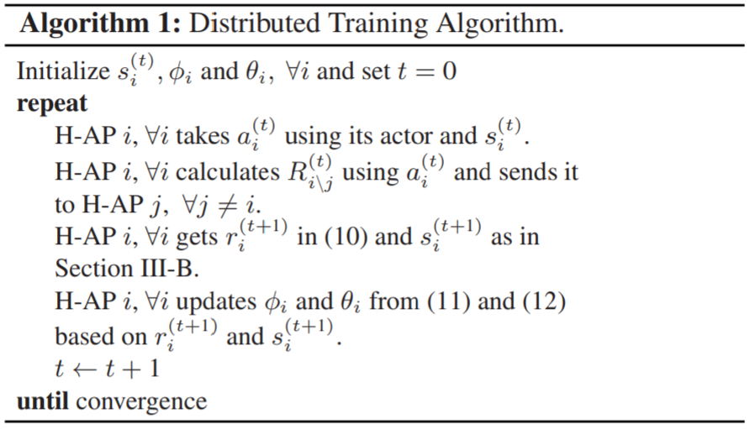
Current Status
Paper: Multi-Agent DRL for Distributed Resource Management in WPCN
Learning Algorithm:

Slide 17
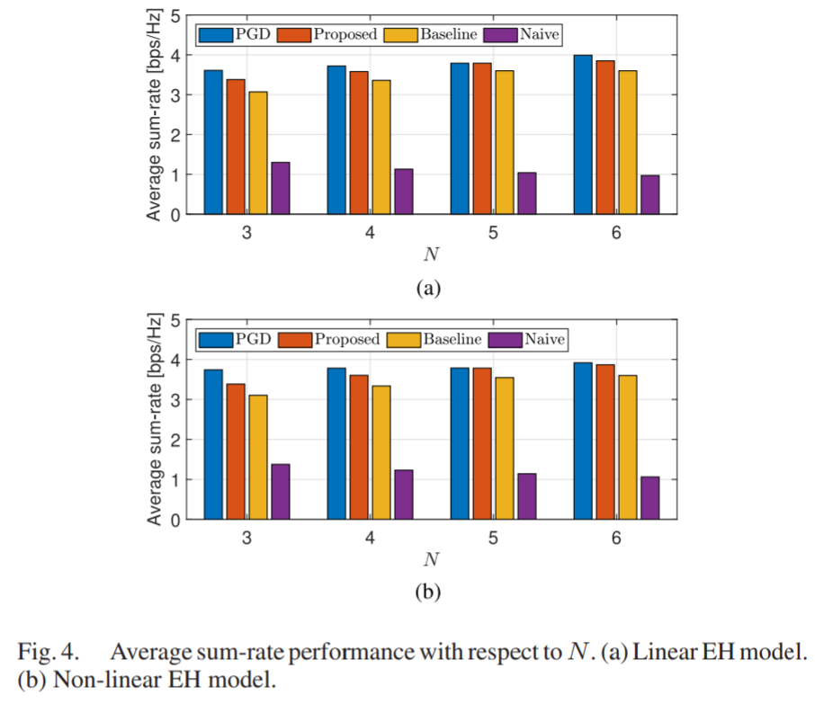
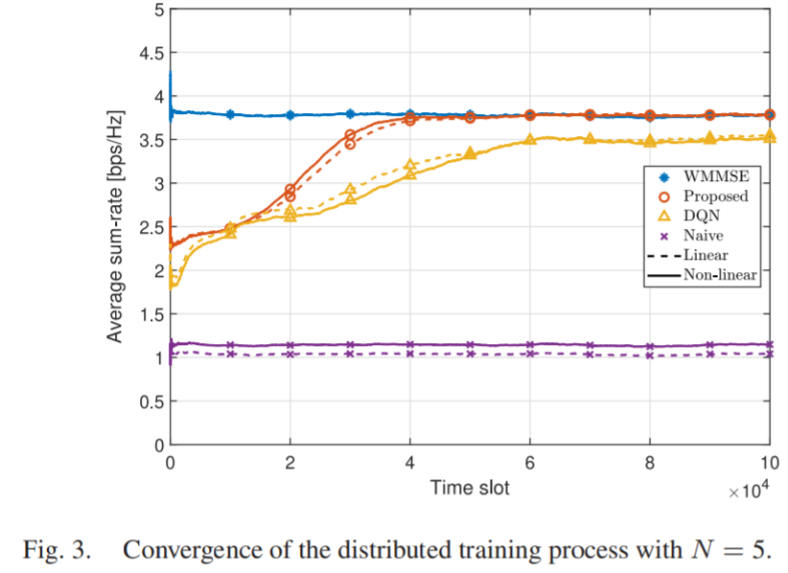
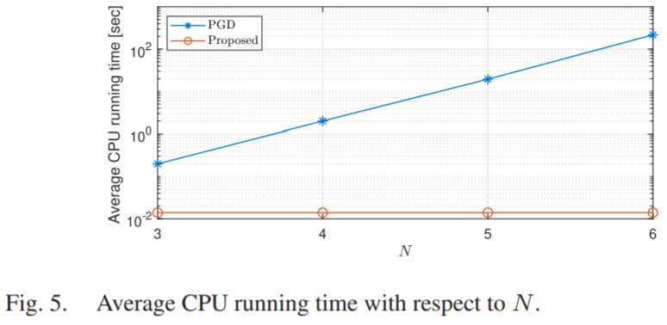
Current Status
Paper: Multi-Agent DRL for Distributed Resource Management in WPCN
Simulation Results
Proposed (for all the figures)

Slide 18
Github
https://github.com/WannaBeSuperteur/2020/tree/master/WPCN

