Slide 1
Weekly Report
2021.04.02
Hongsik Kim
Mobile & Network Intelligence Laboratory

Slide 2
AI Explanable AI
Kaggle Competition
Paper for the Patent

Slide 3

1st Anniversary of Our Project
(Pixabay)

Slide 4
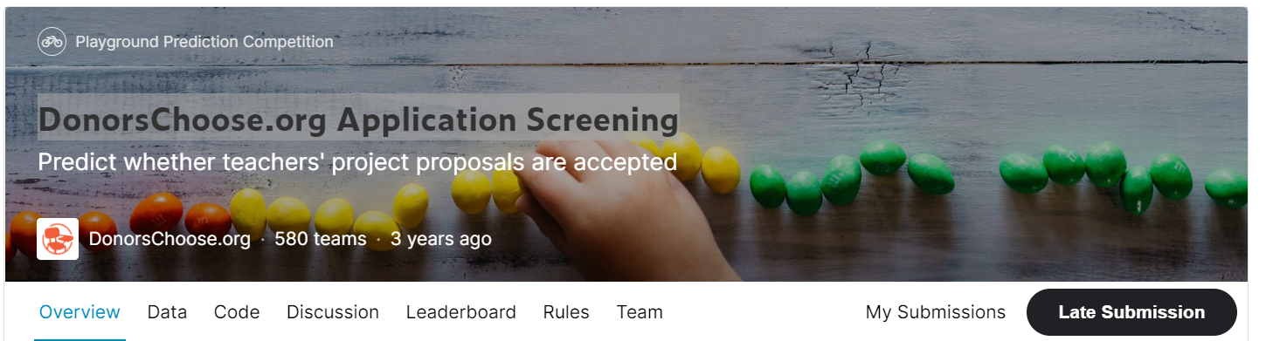
Kaggle Competition
DonorsChoose.org Application Screening
https://www.kaggle.com/c/donorschoose-application-screening/overview

Slide 5
Kaggle Competition
One-Hot Encoding for the data
Teacher_prefix : 6 unique cases
School_state : 51 unique cases
Projected_submitted_datetime : year(2), month(12), DOW(7), hour(24)
Project_grade_category : 4 unique cases
Project_subject_categories : 51 -> 9 unique cases
Project_subject_subcategories : 407 -> 30 unique cases
BERT (One-hot): Project_essay_2
Continuous : teacher_number_of_..._projects

Slide 6
Kaggle Competition
Project_subject_categories 변환
쉼표로 구분한 one-hot 방법을 이용
Project_subject_subcategories에 대해서도 마찬가지로 적용
결과: unique cases의 개수가 각각 51->9, 407->30으로 축소, 빠른 학습 가능
Class | Vector
A | [1, 0, 0, 0, 0, 0, 0]
A, B | [0, 1, 0, 0, 0, 0, 0]
A, B, C | [0, 0, 1, 0, 0, 0, 0]
A, C | [0, 0, 0, 1, 0, 0, 0]
B | [0, 0, 0, 0, 1, 0, 0]
B, C | [0, 0, 0, 0, 0, 1, 0]
C | [0, 0, 0, 0, 0, 0, 1]
Class | Vector : [A, B, C]
A | [1, 0, 0]
A, B | [1, 1, 0]
A, B, C | [1, 1, 1]
A, C | [1, 0, 1]
B | [0, 1, 0]
B, C | [0, 1, 1]
C | [0, 0, 1]

Slide 7
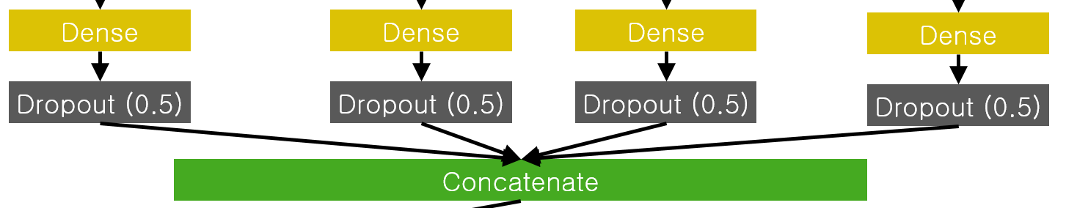
Kaggle Competition
Early Stopping 실행 (50k train -> 30k train, 20k valid)
Concatenation Dense #: 각 요소들을 concatenate하는 지점에서 각 요소 당 사용되는 Dense Layer unit의 개수
Concatenation Dense # | Correlation Coefficient | ROC-AUC
4 | 0.2715 | 0.7168
8 | 0.3304 | 0.7352
12 | 0.3271 | 0.7310

Slide 8
Kaggle Competition
Next to do
전체 학습 데이터를 이용해서 트레이닝
상황에 따라 모델 개선 진행
경우에 따라 해당 Competition의 Code에 나와 있는 모델로 바꿔서 진행 시도

Slide 9
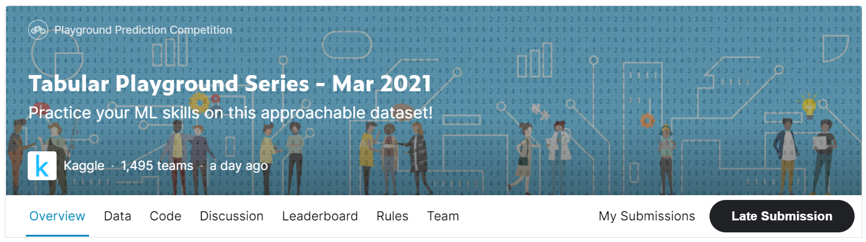
Kaggle Competition
Tabular Playground Series – Mar 2021
https://www.kaggle.com/c/tabular-playground-series-mar-2021
2021.04.01 ~

Slide 10
Kaggle Competition
Tabular Playground Series – Mar 2021
19 categorical input columns -> ONE-HOT
11 continuous input columns -> NORMALIZE
1 binary output column
Metric: ROC-AUC (Area under ROC curve)

Slide 11
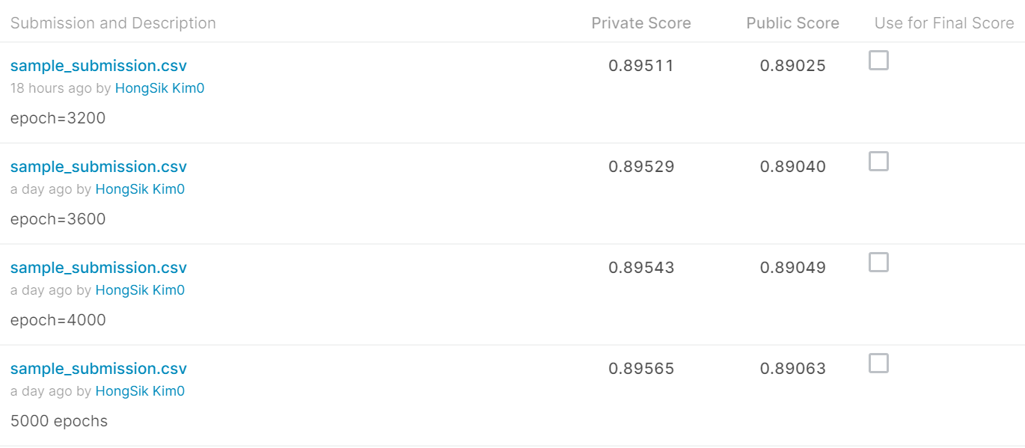
Kaggle Competition
Result
Current Best Result: 445 / 1495 (TOP 29.77%)

Slide 12
Paper for the Patent
초안 수정 완료
Title 및 Abstract 일부 수정
IEEE Access Format에 맞게 일부 수정
Figure 등을 포맷에 맞게 수정
WPCN 논문이 reject된 이유를 다시 한번 확인하고 이를 보충하여 IEEE Access에 제출 예정

Slide 13
Github
https://github.com/WannaBeSuperteur/2020/tree/master/

