Slide 1
Weekly Report
2021.05.28
Hongsik Kim
Mobile & Network Intelligence Laboratory

Slide 2
AI Explanable AI
Kaggle Competition
Paper for the patent (Self-driving car) (not public)

Slide 3
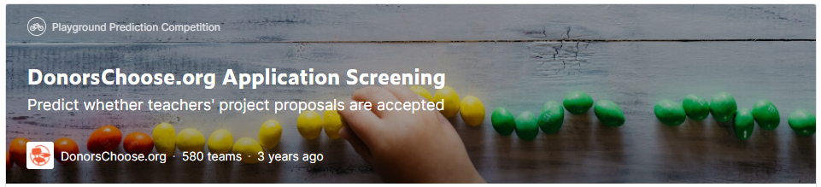
Kaggle Competition
DonorsChoose.org Application Screening
https://www.kaggle.com/c/donorschoose-application-screening

Slide 4
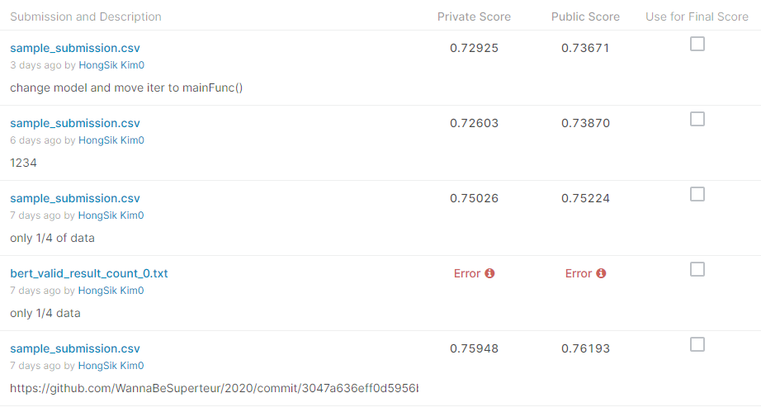
Kaggle Competition
DonorsChoose.org Application Screening
Results

Slide 5
Github
https://github.com/WannaBeSuperteur/2020/tree/master/

