Slide 1
Weekly Report
2021.09.10
Hongsik Kim
Mobile & Network Intelligence Laboratory

Slide 2
AI Explanable AI
Kaggle Competition
SOTA method for Paper Revision : Explainable CNN

Slide 3
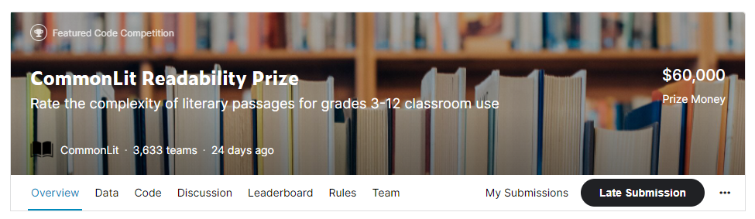
Kaggle Competition
1. CommonLit Readability Prize
https://www.kaggle.com/c/commonlitreadabilityprize

Slide 4
Kaggle Competition
1. CommonLit Readability Prize
Dataset:
Columns:
Train dataset | 2834 rows
Test dataset | Only 7 rows
Excerpt | Text to predict reading ease of
Target | Reading ease
Standard error | 여러 명이 판단한 reading ease의 분산

Slide 5
Kaggle Competition
1. CommonLit Readability Prize
각 단어의 index 분포 및 문장의 길이 분포를 활용한 모델
inputs
Inputs_text
Inputs_info
(텍스트)
(index 분포,
문장의 길이 분포)
embedding
LSTM
CNN2
CNN3
CNN4
dense
dense
merged
output

Slide 6
Kaggle Competition
1. CommonLit Readability Prize
roBERTa model
https://huggingface.co/transformers/model_doc/roberta.html
Google에서 2018년에 발표한 BERT 모델에 기반
거대한 양의 텍스트 데이터를 이용하여 pre-trainin된 모델
텍스트 입력에 대해 그 텍스트의 token별로 768개의 last hidden layer output을 도출하므로, output size는 (tokens, 768)이 됨

Slide 7

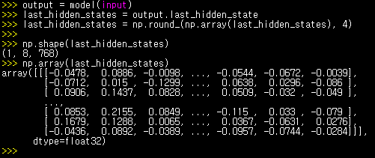
Kaggle Competition
1. CommonLit Readability Prize
roBERTa model

Slide 8
Kaggle Competition
1. CommonLit Readability Prize
roBERTa model을 활용하여 전처리한 데이터를 이용한 모델
inputs
Inputs_text
Inputs_info
(전처리)
(텍스트)
(문장의 길이 분포)
roBERTa
CNN2
CNN3
CNN4
dense
dense
merged
output

Slide 9
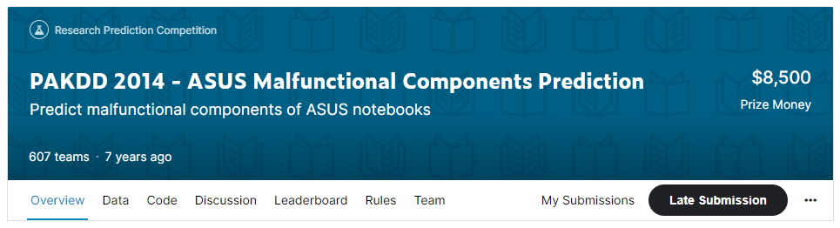
Kaggle Competition
2. PAKDD 2014 – ASUS Malfunctional Components Prediction
https://www.kaggle.com/c/pakdd-cup-2014

Slide 10
Kaggle Competition
2. PAKDD 2014 – ASUS Malfunctional Components Prediction
kNN (k-Nearest Neighbors) 방법 이용
For Module Type (M1~M9) and Component Type (P1~P31)
연도별, 월별 repair count를 이용하여 Mx, My 또는 Px, Py 간 correlation coefficient (CORR)를 계산
Distance = 1.0 - CORR
For Year*12+month
Distance = (absolute distance) / 24
For Month (1~12)
Using Circle Distance
Use distance_month_weight (dm_weight)
Distance = (Circle Distance) * (dm_weight)

Slide 11
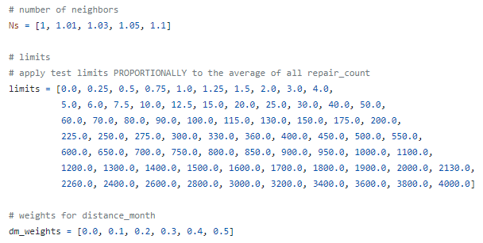
Kaggle Competition
2. PAKDD 2014 – ASUS Malfunctional Components Prediction
dm_weight을 조절해 가면서 실험

Slide 12
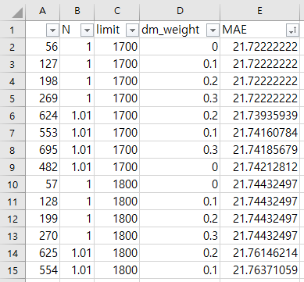
Kaggle Competition
2. PAKDD 2014 – ASUS Malfunctional Components Prediction
실험 결과
기존 minimum MAE를 도출하는 parameter setting (N=1, limit=1700, dm_weight=0.3)보다 더 좋아진 것이 없음
추후 weight을 최적화하는 방향으로 진행

Slide 13
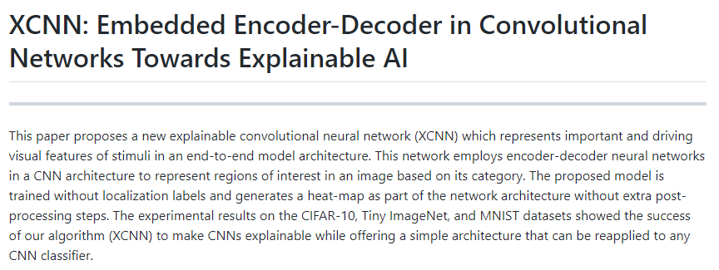
SOTA method for Paper Revision : Explainable CNN
Explainable CNN
https://github.com/tavanaei/ExplainableCNN/tree/master

Slide 14
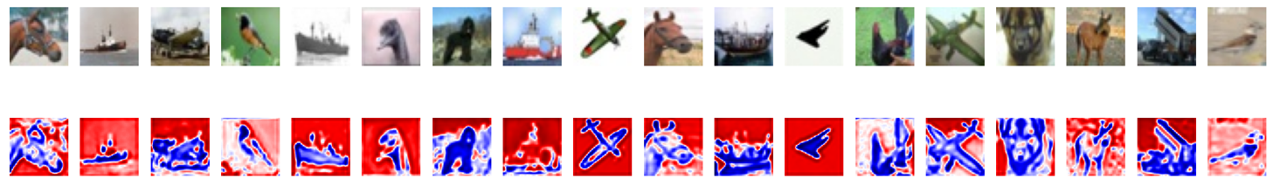
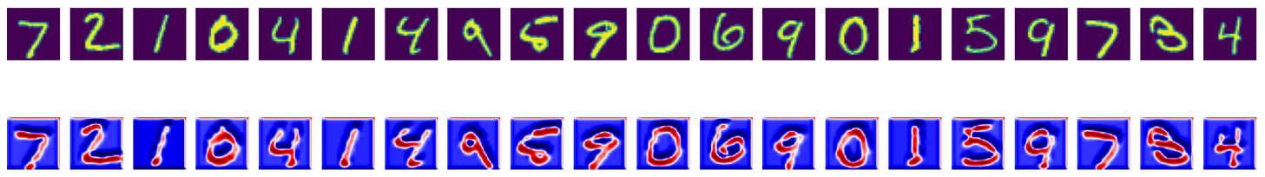
SOTA method for Paper Revision : Explainable CNN
Explainable CNN
실험 결과
(epochs=50)
(epochs=25)

Slide 15
Github
https://github.com/WannaBeSuperteur/2020/tree/master/

