Slide 1
Weekly Report
2021.11.26
Hongsik Kim
Mobile & Network Intelligence Laboratory

Slide 2
AI Explanable AI
Kaggle Competition
Paper: Explainable Reinforcement Learning for Broad-XAI: A Conceptual Framework and Survey

Slide 3
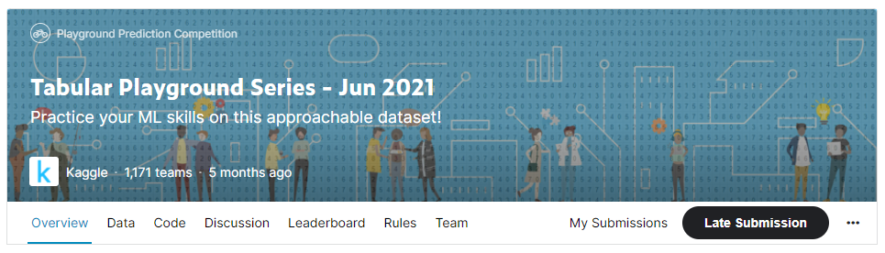
Kaggle Competition
Tabular Playground Series – Jun 2021
https://www.kaggle.com/c/tabular-playground-series-jun-2021

Slide 4
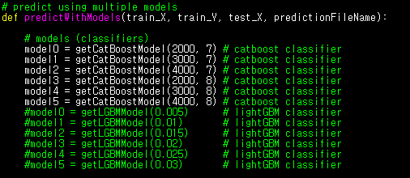
Kaggle Competition
Tabular Playground Series – Jun 2021
실행 알고리즘: CatBoost Model
Iterations=2000,3000,4000, depth=7,8
각 k-fold 당 1h 40m 소요 -> 5개의 k-fold에 대해서 8h 20m 소요

Slide 5
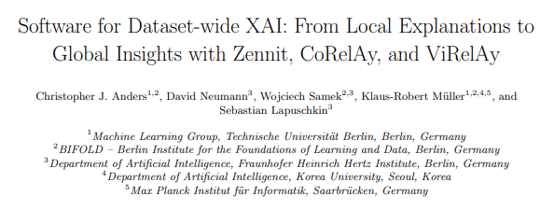
Paper: Software for Dataset-wide XAI: From Local Explanations to Global Insights with Zennit, CoRelAy, and ViRelAy
Software for Dataset-wide XAI: From Local Explanations to Global Insights with Zennit, CoRelAy, and ViRelAy
https://arxiv.org/pdf/2106.13200.pdf

Slide 6
Paper: Software for Dataset-wide XAI: From Local Explanations to Global Insights with Zennit, CoRelAy, and ViRelAy
Software for Dataset-wide XAI: From Local Explanations to Global Insights with Zennit, CoRelAy, and ViRelAy
Zennit | Rule-based attribution Mapping rules with composites Temporary Model Modification with Canonizers Attributors, Heatmaps
CoRelAy | Processors, Params, Pipelines and Tasks
ViRelAy | Data loading and Explorative user interaction

Slide 7

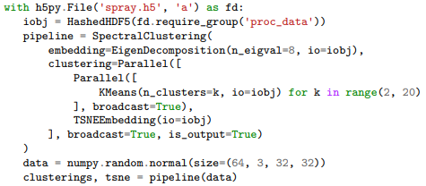
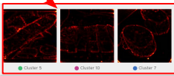
Paper: Software for Dataset-wide XAI: From Local Explanations to Global Insights with Zennit, CoRelAy, and ViRelAy
Software for Dataset-wide XAI: From Local Explanations to Global Insights with Zennit, CoRelAy, and ViRelAy (Heatmap)
Zennit | CoRelAy (code) | ViRelAy

Slide 8
Github
https://github.com/WannaBeSuperteur/2020/tree/master/

