Slide 1
Weekly Report
2021.03.12
Hongsik Kim
Mobile & Network Intelligence Laboratory

Slide 2
AI Explanable AI
Kaggle Competition
Paper for the Patent

Slide 3
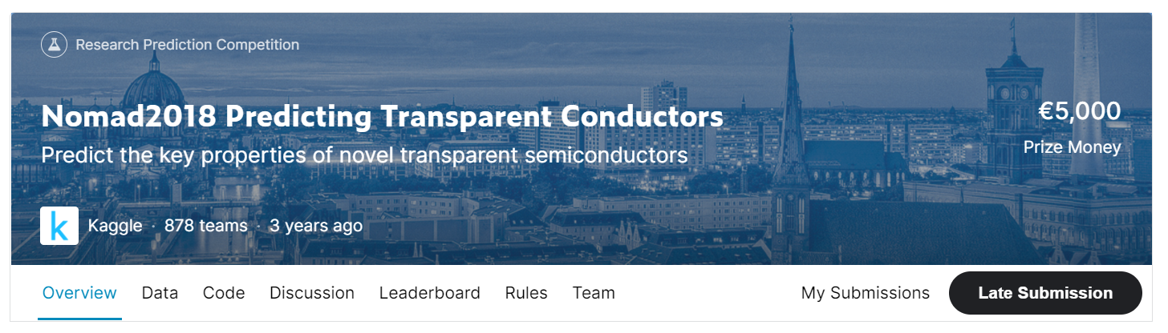
Kaggle Competition
Nomad2018 Predicting Transparent Conductors
https://www.kaggle.com/c/nomad2018-predict-transparent-conductors

Slide 4
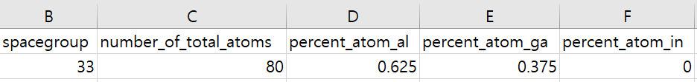
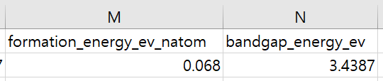
Kaggle Competition
Nomad2018 Predicting Transparent Conductors
Training data : 2400 rows
Test data : 600 rows
Input :
Output:

Slide 5
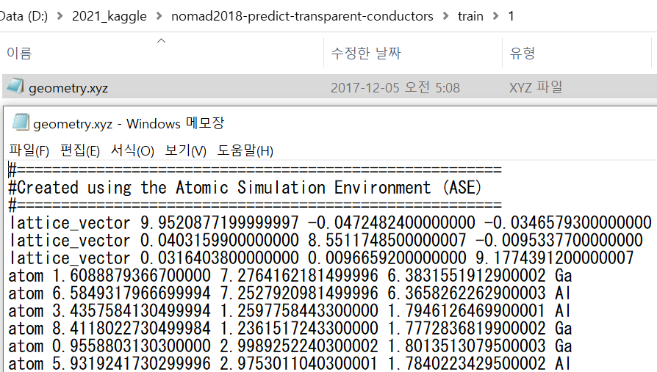
Kaggle Competition
Nomad2018 Predicting Transparent Conductors
Additional input data :

Slide 6
Kaggle Competition
Nomad2018 Predicting Transparent Conductors
Method 1: using original input / output data
Method 2: use ‘spacegroup’ input as categorical
Method 3: use ‘spacegroup’ input as categorical and convert lattice_alpha/beta/gamma_degrees
각 값을 15를 단위로 반올림하여 몫과 나머지 (-7.5 ~ +7.5)로 변환, 이 중 나머지에 대해서는 +, -인지에 따라 서로 다르게 log를 적용
모든 방법에 대해 input data를 표준정규분포로 normalization하는 과정을 포함

Slide 7
Paper for the Patent
Abstract 초안 작성 완료
Introduction 초안 작성 완료
Methods 초안 작성 중
앞으로 Methods (ing), Experiments, Experimental Results, Discussion, Conclusion 작성

Slide 8
Github
https://github.com/WannaBeSuperteur/2020/tree/master/

