Slide 1
Weekly Report
2021.07.07
Hongsik Kim
Mobile & Network Intelligence Laboratory

Slide 2
WPCN: Paper
Paper: Robust Beamforming Design and Time Allocation for IRS-assisted Wireless Powered Communication Networks

Slide 3
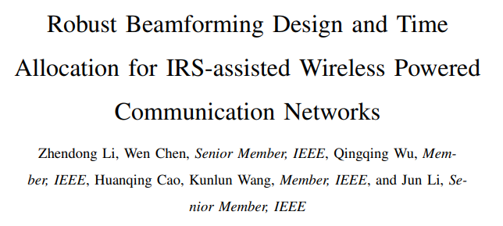
Current Status
Paper: Robust Beamforming Design and Time Allocation for IRS-assisted Wireless Powered Communication Networks
https://arxiv.org/pdf/2105.06226.pdf

Slide 4
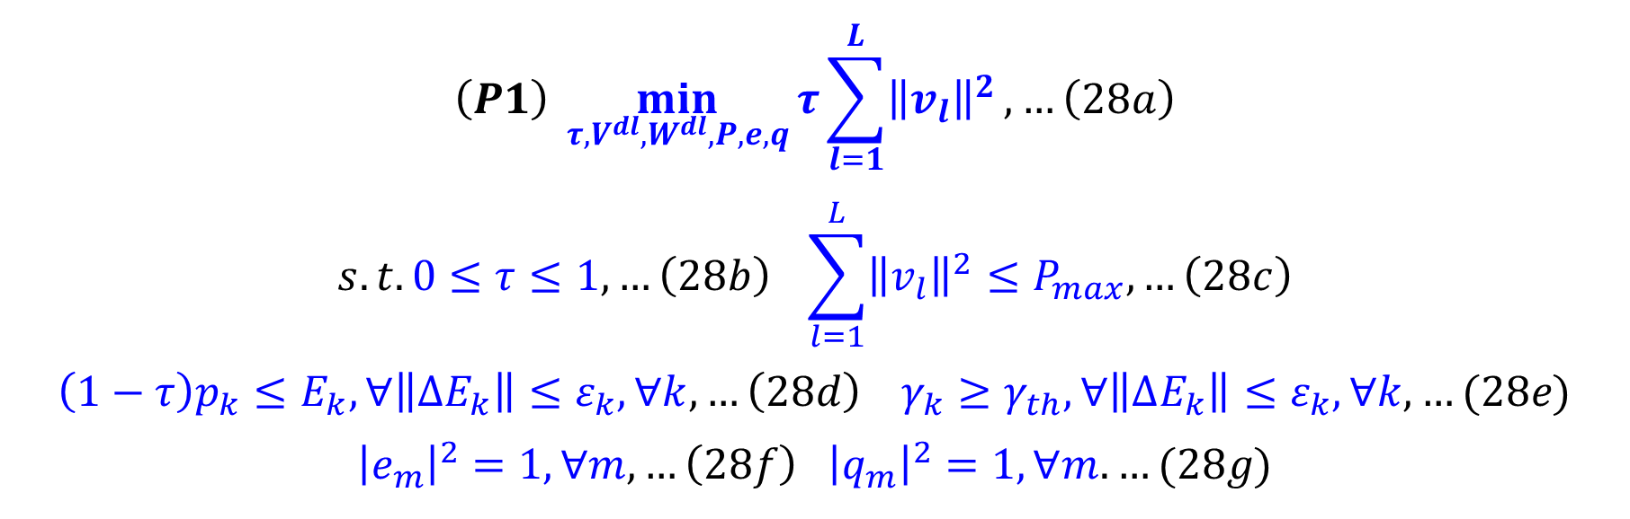
Current Status
Paper: Robust Beamforming Design and Time Allocation for IRS-assisted Wireless Powered Communication Networks
HAP의 transmission energy를 minimize하는 최적화 문제
$$\left(P1\right) \min_{τ,V^{dl},W^{dl}, P,e,q}{τ\sum_{l=1}^{L}{{\left\|v_{l}\right\|}^{2}}, …\left(28a\right)}$$
$$s.t. 0≤τ≤1, …\left(28b\right) \sum_{l=1}^{L}{{\left\|v_{l}\right\|}^{2}}≤P_{max},…\left(28c\right)$$
$$\left(1−τ\right)p_{k}≤E_{k}, ∀\left\|ΔE_{k}\right\|≤ε_{k}, ∀k, …\left(28d\right) γ_{k}≥γ_{th}, ∀\left\|ΔE_{k}\right\|≤ε_{k}, ∀k,…(28e)$$
$${\left|e_{m}\right|}^{2}=1, ∀m, …\left(28f\right) {\left|q_{m}\right|}^{2}=1,∀m. …(28g)$$

Slide 5
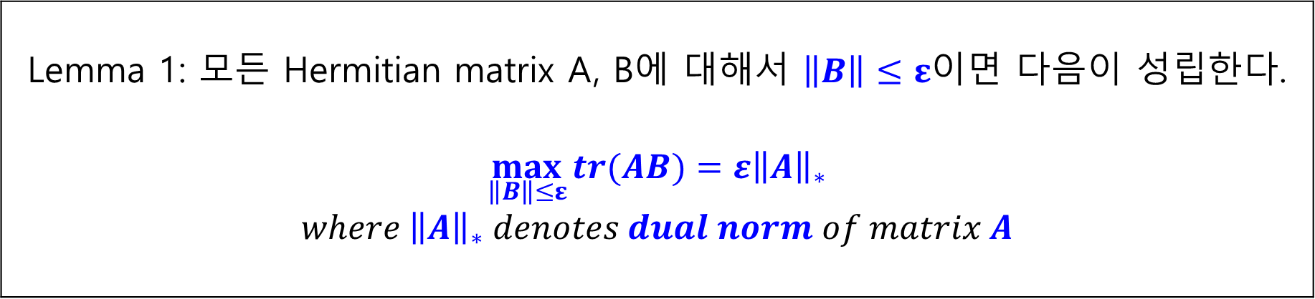
Current Status
Paper: Robust Beamforming Design and Time Allocation for IRS-assisted Wireless Powered Communication Networks
Robust Beamforming Design of HAP and user transmit power allocation을 위한 문제 (P1)은 non-convex한 최적화 문제이므로 직접 해결 불가능, (28d)와 (28e)를 Lemma 1에 의해 변환
Lemma 1: 모든 Hermitian matrix A, B에 대해서 $\left\|B\right\|≤ε$이면 다음이 성립한다. $$\max_{\left\|B\right\|≤ε}{tr(AB)}=ε{\left\|A\right\|}_{∗}$$ $$where {\left\|A\right\|}_{∗} denotes dual norm of matrix A$$

Slide 6
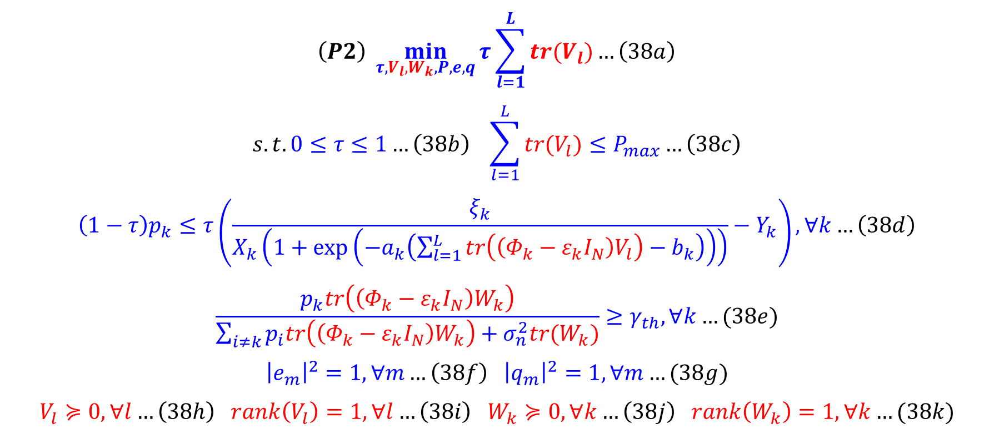
Current Status
Paper: Robust Beamforming Design and Time Allocation for IRS-assisted Wireless Powered Communication Networks
(P1)은 다음과 같이 (P2)로 변환됨
$$\left(P2\right) \min_{τ,V_{l}, W_{k}, P,e,q}{τ\sum_{l=1}^{L}{tr(V_{l})}…\left(38a\right)}$$
$$s.t. 0≤τ≤1…\left(38b\right) \sum_{l=1}^{L}{tr(V_{l})}≤P_{max}…\left(38c\right)$$
$$\left(1−τ\right)p_{k}≤τ\left(\frac{ξ_{k}}{X_{k}\left(1+\exp\left(−a_{k}\left(\sum_{l=1}^{L}{tr\left(\left(Φ_{k}−ε_{k}I_{N}\right)V_{l}\right)}−b_{k}\right)\right)\right)}−Y_{k}\right), ∀k…\left(38d\right)$$
$$\frac{p_{k}tr\left(\left(Φ_{k}−ε_{k}I_{N}\right)W_{k}\right)}{\sum_{i≠k}{p_{i}tr\left(\left(Φ_{k}−ε_{k}I_{N}\right)W_{k}\right)+σ_{n}^{2}tr(W_{k})}}≥γ_{th}, ∀k…(38e)$$
$${\left|e_{m}\right|}^{2}=1, ∀m…\left(38f\right) {\left|q_{m}\right|}^{2}=1,∀m…(38g)$$
$$V_{l}≽0, ∀l…\left(38h\right) rank\left(V_{l}\right)=1, ∀l…\left(38i\right) W_{k}≽0, ∀k…\left(38j\right) rank\left(W_{k}\right)=1,∀k…(38k)$$

Slide 7
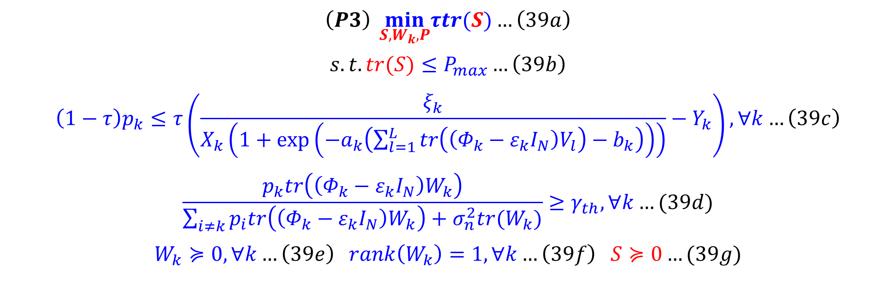
Current Status
Paper: Robust Beamforming Design and Time Allocation for IRS-assisted Wireless Powered Communication Networks
(P2)는 다음과 같이 (P3)으로 변환됨
$$\left(P3\right) \min_{S,W_{k},P}τtr(S){…\left(39a\right)}$$
$$s.t. tr(S)≤P_{max}…\left(39b\right)$$
$$\left(1−τ\right)p_{k}≤τ\left(\frac{ξ_{k}}{X_{k}\left(1+\exp\left(−a_{k}\left(\sum_{l=1}^{L}{tr\left(\left(Φ_{k}−ε_{k}I_{N}\right)V_{l}\right)}−b_{k}\right)\right)\right)}−Y_{k}\right), ∀k…\left(39c\right)$$
$$\frac{p_{k}tr\left(\left(Φ_{k}−ε_{k}I_{N}\right)W_{k}\right)}{\sum_{i≠k}{p_{i}tr\left(\left(Φ_{k}−ε_{k}I_{N}\right)W_{k}\right)+σ_{n}^{2}tr(W_{k})}}≥γ_{th}, ∀k…(39d)$$
$$W_{k}≽0, ∀k…\left(39e\right) rank\left(W_{k}\right)=1,∀k…\left(39f\right) S≽0…(39g)$$

Slide 8
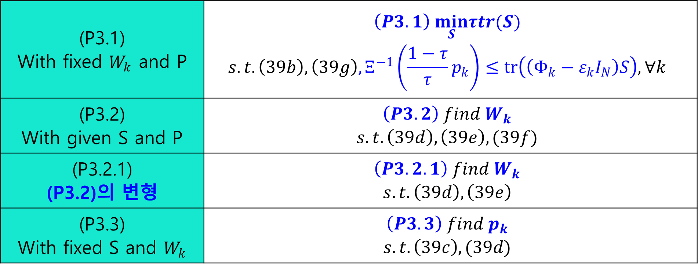
Current Status
Paper: Robust Beamforming Design and Time Allocation for IRS-assisted Wireless Powered Communication Networks
(P3)은 여전히 non-convex 최적화 문제로, 3개의 부분으로 나누어 해결
(P3.1) With fixed $W_{k}$ and P | $$\left(P3.1\right) \min_{S}τtr(S)$$ $$s.t. \left(39b\right), \left(39g\right), Ξ^{−1}\left(\frac{1−τ}{τ}p_{k}\right)≤tr\left(\left(Φ_{k}−ε_{k}I_{N}\right)S\right), ∀k$$
(P3.2) With given S and P | $$\left(P3.2\right) find W_{k}$$ $$s.t. \left(39d\right), \left(39e\right), (39f)$$
(P3.2.1) (P3.2)의 변형 | $$\left(P3.2.1\right) find W_{k}$$ $$s.t. \left(39d\right), \left(39e\right)$$
(P3.3) With fixed S and $W_{k}$ | $$\left(P3.3\right) find p_{k}$$ $$s.t. \left(39c\right), (39d)$$

Slide 9
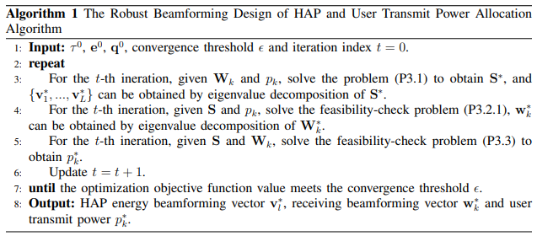
Current Status
Paper: Robust Beamforming Design and Time Allocation for IRS-assisted Wireless Powered Communication Networks
(P3.3)은 linear programming (LP) problem이므로 CVX toolbox를 이용하여 해결 가능하므로, 알고리즘은 다음과 같음

Slide 10
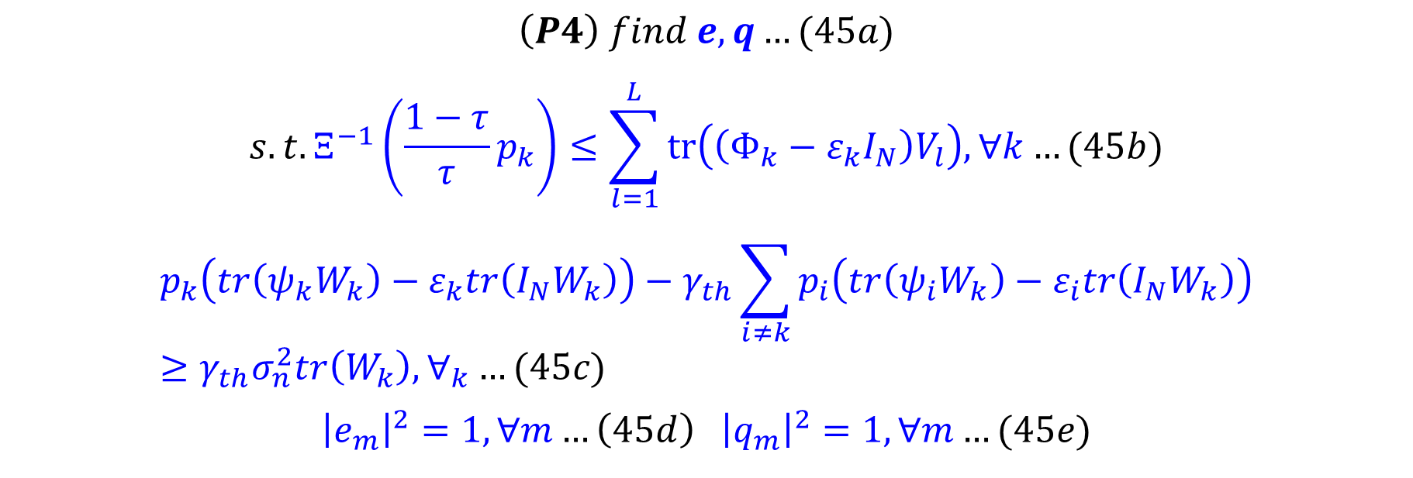
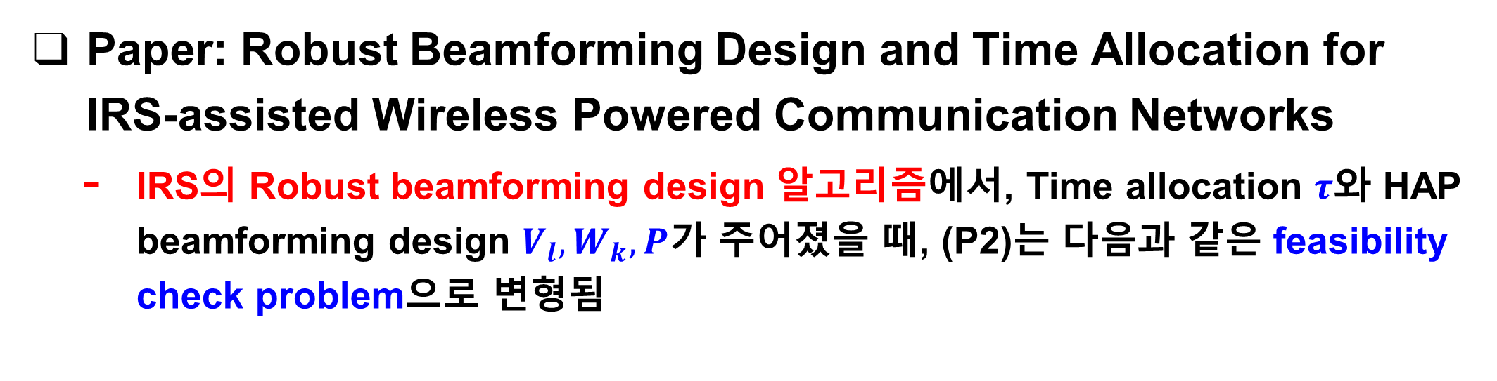
Current Status
Paper: Robust Beamforming Design and Time Allocation for IRS-assisted Wireless Powered Communication Networks
IRS의 Robust beamforming design 알고리즘에서, Time allocation $τ$와 HAP beamforming design $V_{l}, W_{k}, P$가 주어졌을 때, (P2)는 다음과 같은 feasibility check problem으로 변형됨
$$\left(P4\right) find e, q…(45a)$$
$$s.t. Ξ^{−1}\left(\frac{1−τ}{τ}p_{k}\right)≤\sum_{l=1}^{L}{tr\left(\left(Φ_{k}−ε_{k}I_{N}\right)V_{l}\right), ∀k}…(45b)$$
$$p_{k}\left(tr\left(ψ_{k}W_{k}\right)−ε_{k}tr\left(I_{N}W_{k}\right)\right)−γ_{th}\sum_{i≠k}{p_{i}\left(tr\left(ψ_{i}W_{k}\right)−ε_{i}tr\left(I_{N}W_{k}\right)\right)}≥γ_{th}σ_{n}^{2}tr\left(W_{k}\right), ∀_{k}…(45c)$$
$${\left|e_{m}\right|}^{2}=1, ∀m…\left(45d\right) {\left|q_{m}\right|}^{2}=1,∀m…(45e)$$

Slide 11
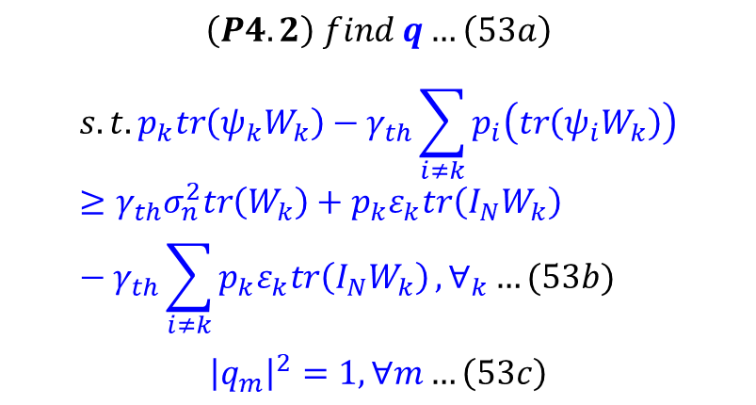
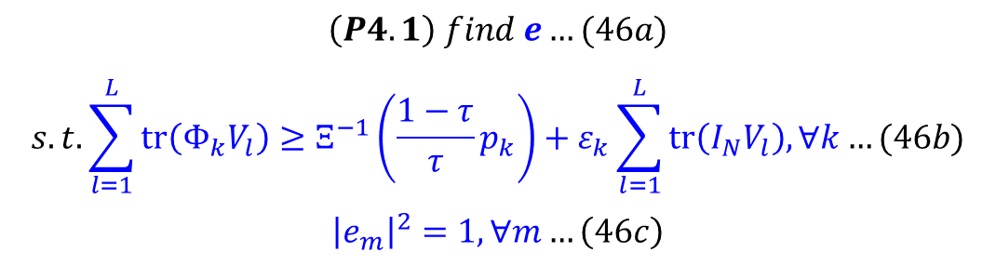
Current Status
Paper: Robust Beamforming Design and Time Allocation for IRS-assisted Wireless Powered Communication Networks
(P4)는 convex optimization problem이 아니므로, e와 q를 찾는 각각의 problem으로 분리
$$\left(P4.2\right) find q…\left(53a\right)$$
$$s.t. p_{k}tr\left(ψ_{k}W_{k}\right)−γ_{th}\sum_{i≠k}{p_{i}\left(tr\left(ψ_{i}W_{k}\right)\right)}≥γ_{th}σ_{n}^{2}tr\left(W_{k}\right)+p_{k}ε_{k}tr\left(I_{N}W_{k}\right)−γ_{th}\sum_{i≠k}{p_{k}ε_{k}tr\left(I_{N}W_{k}\right)}, ∀_{k}…(53b)$$
$${\left|q_{m}\right|}^{2}=1, ∀m…\left(53c\right)$$
$$\left(P4.1\right) find e…(46a)$$
$$s.t. \sum_{l=1}^{L}{tr\left(Φ_{k}V_{l}\right)}≥Ξ^{−1}\left(\frac{1−τ}{τ}p_{k}\right)+ε_{k}\sum_{l=1}^{L}{tr\left(I_{N}V_{l}\right), ∀k}…(46b)$$
$${\left|e_{m}\right|}^{2}=1, ∀m…\left(46c\right)$$

Slide 12
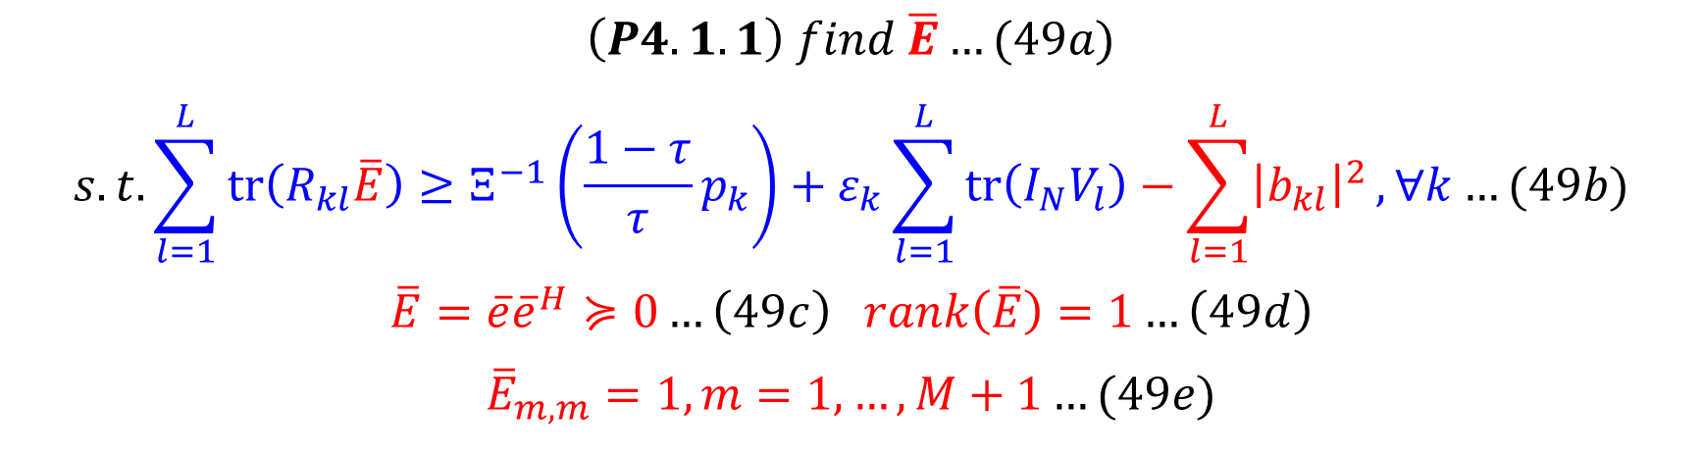
Current Status
Paper: Robust Beamforming Design and Time Allocation for IRS-assisted Wireless Powered Communication Networks
(P4.1)은 다음과 같이 (P4.1.1)로 변환
(P4.1.1)을 해결하기 위해 보통 SDR을 이용하여 non-convex한 rank-1 constraint인 (49d)를 relax함
$$\left(P4.1.1\right) find \overline{E}…(49a)$$
$$s.t. \sum_{l=1}^{L}{tr\left(R_{kl}\overline{E}\right)}≥Ξ^{−1}\left(\frac{1−τ}{τ}p_{k}\right)+ε_{k}\sum_{l=1}^{L}{tr\left(I_{N}V_{l}\right)}−\sum_{l=1}^{L}{{\left|b_{kl}\right|}^{2}},∀k…(49b)$$
$$\overline{E}=\overline{e}{\overline{e}}^{H}≽0…\left(49c\right) rank\left(\overline{E}\right)=1…\left(49d\right)$$
$${\overline{E}}_{m,m}=1,m=1,…,M+1…(49e)$$

Slide 13
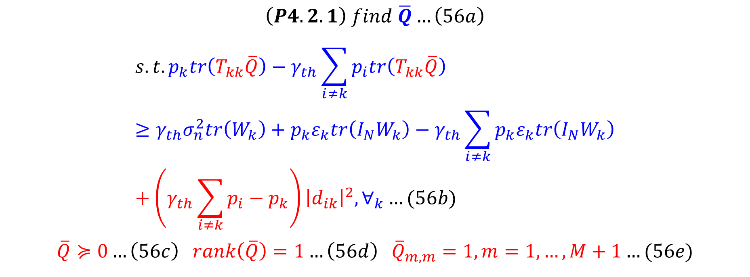
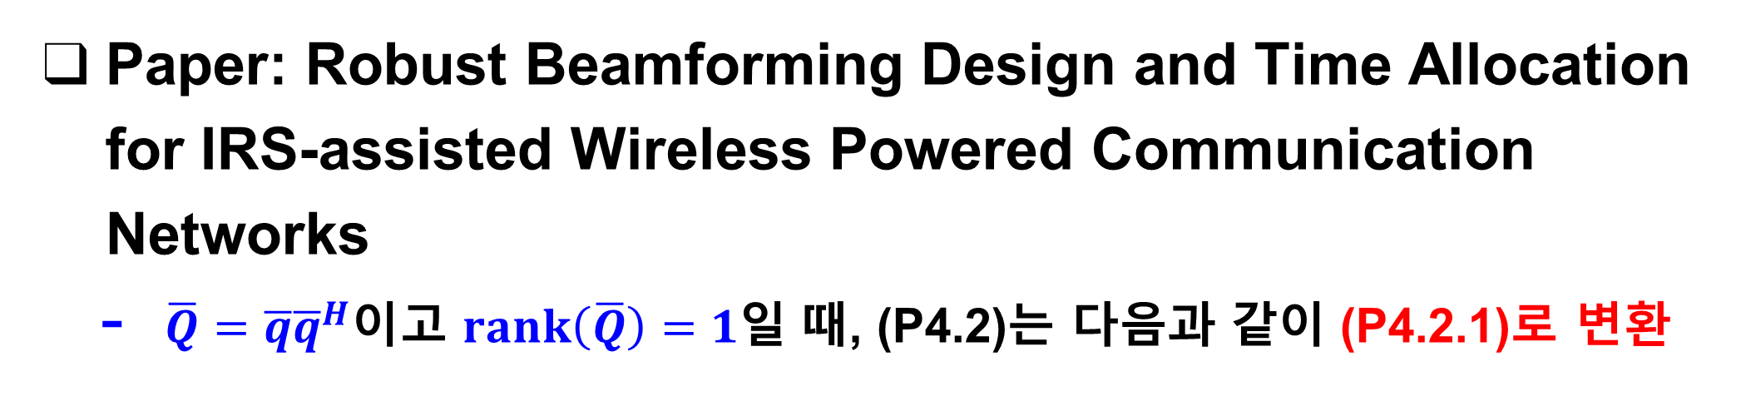
Current Status
Paper: Robust Beamforming Design and Time Allocation for IRS-assisted Wireless Powered Communication Networks
$\overline{Q}=\overline{q}{\overline{q}}^{H}$이고 $rank\left(\overline{Q}\right)=1$일 때, (P4.2)는 다음과 같이 (P4.2.1)로 변환
$$\left(P4.2.1\right) find \overline{Q}…\left(56a\right)$$
$$s.t. p_{k}tr\left(T_{kk}\overline{Q}\right)−γ_{th}\sum_{i≠k}{p_{i}tr\left(T_{kk}\overline{Q}\right)}≥γ_{th}σ_{n}^{2}tr\left(W_{k}\right)+p_{k}ε_{k}tr\left(I_{N}W_{k}\right)−γ_{th}\sum_{i≠k}{p_{k}ε_{k}tr\left(I_{N}W_{k}\right)}+\left(γ_{th}\sum_{i≠k}{p_{i}}−p_{k}\right){\left|d_{ik}\right|}^{2}, ∀_{k}…(56b)$$
$$\overline{Q}≽0…\left(56c\right) rank\left(\overline{Q}\right)=1…\left(56d\right) {\overline{Q}}_{m,m}=1,m=1,…,M+1…(56e)$$

Slide 14
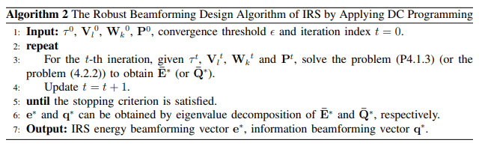
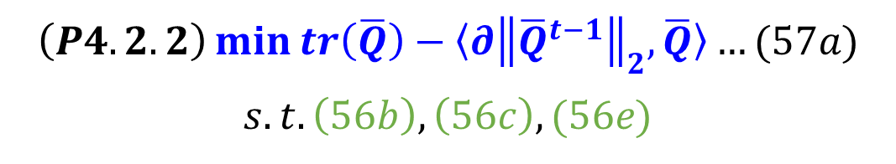
Current Status
Paper: Robust Beamforming Design and Time Allocation for IRS-assisted Wireless Powered Communication Networks
(P4.2.1)은 다음과 같이 (P4.2.2)로 변환
IRS의 robust beamforming design 알고리즘은 다음과 같음
$$\left(P4.2.2\right)\min{tr\left(\overline{Q}\right)}−〈∂{\left\|{\overline{Q}}^{t−1}\right\|}_{2},\overline{Q}〉…(57a)$$
$$s.t. \left(56b\right),\left(56c\right),(56e)$$

Slide 15
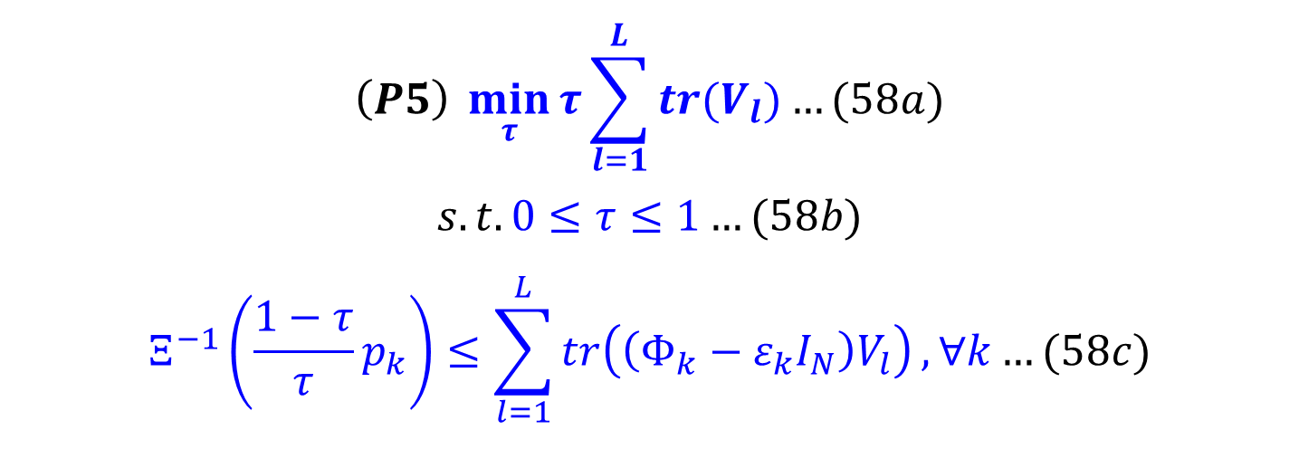
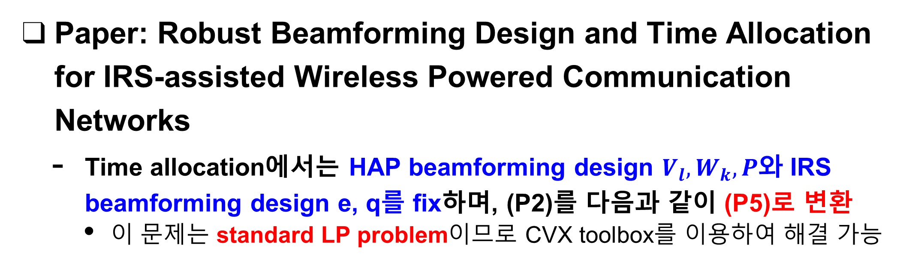
Current Status
Paper: Robust Beamforming Design and Time Allocation for IRS-assisted Wireless Powered Communication Networks
Time allocation에서는 HAP beamforming design $V_{l}, W_{k}, P$와 IRS beamforming design e, q를 fix하며, (P2)를 다음과 같이 (P5)로 변환
이 문제는 standard LP problem이므로 CVX toolbox를 이용하여 해결 가능
$$\left(P5\right) \min_{τ}{τ}\sum_{l=1}^{L}{tr(V_{l})}…(58a)$$
$$s.t. 0≤τ≤1…(58b)$$
$$Ξ^{−1}\left(\frac{1−τ}{τ}p_{k}\right)≤\sum_{l=1}^{L}{tr\left(\left(Φ_{k}−ε_{k}I_{N}\right)V_{l}\right)}, ∀k…(58c)$$

Slide 16
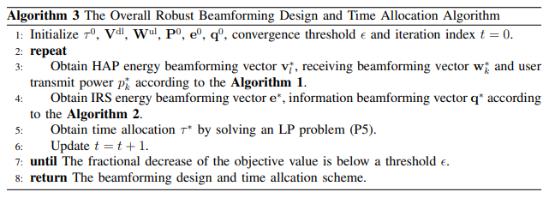
Current Status
Paper: Robust Beamforming Design and Time Allocation for IRS-assisted Wireless Powered Communication Networks
IRS-assisted WPCN에서의 전체적인 Robust Optimization 알고리즘은 다음과 같음
Algorithm 1 : HAP beamforming design과 user power control 결정
Algorithm 2 : IRS beamforming design 결정

Slide 17
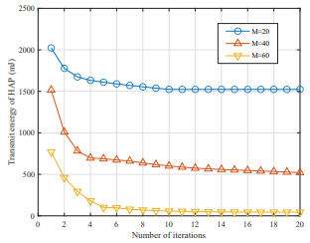
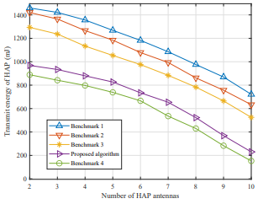
Current Status
Paper: Robust Beamforming Design and Time Allocation for IRS-assisted Wireless Powered Communication Networks
Numerical Results
제안된 robust beamforming 설계 및 time allocation 알고리즘의 convergence | HAP 안테나의 개수에 따른 HAP transmit energy

Slide 18
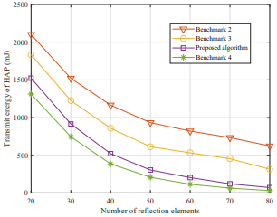
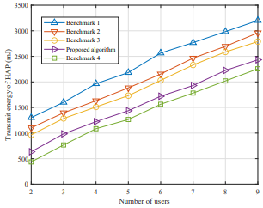
Current Status
Paper: Robust Beamforming Design and Time Allocation for IRS-assisted Wireless Powered Communication Networks
Numerical Results
Reflection element의 개수에 따른 HAP transmit energy | 사용자의 수에 따른 HAP transmit energy

Slide 19
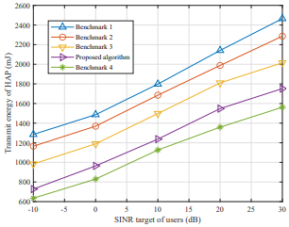
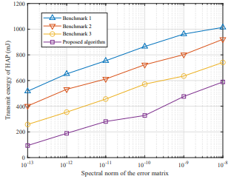
Current Status
Paper: Robust Beamforming Design and Time Allocation for IRS-assisted Wireless Powered Communication Networks
Numerical Results
사용자의 SINR target에 따른 HAP transmit energy | Error matrix의 spectral norm에 따른 HAP transmit energy

Slide 20
Github
https://github.com/WannaBeSuperteur/2020/tree/master/WPCN

