Slide 1
Weekly Report
2021.04.23
Hongsik Kim
Mobile & Network Intelligence Laboratory

Slide 2
AI Explanable AI
Kaggle Competition
Paper for the Patent

Slide 3
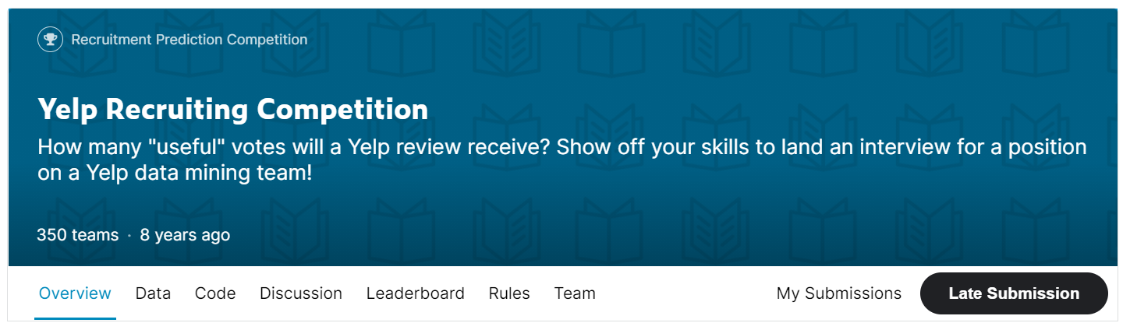
Kaggle Competition
Yelp Recruiting Competition
https://www.kaggle.com/c/yelp-recruiting

Slide 4
Kaggle Competition
Yelp Recruiting Competition
활용한 데이터 columns
Column name | table | Foreign key | Data type
Text State Date Review_count Average_stars Longitude Stars Latitude Open Review_count Checkin_info | Review Review Review User User Business Business Business Business Business Checkin_info | User_id User_id Business_id Business_id Business_id Business_id Business_id Business_id | Length Continuous yyyy-mm-dd Continuous Continuous Continuous Continuous Continuous Binary Continuous Length

Slide 5
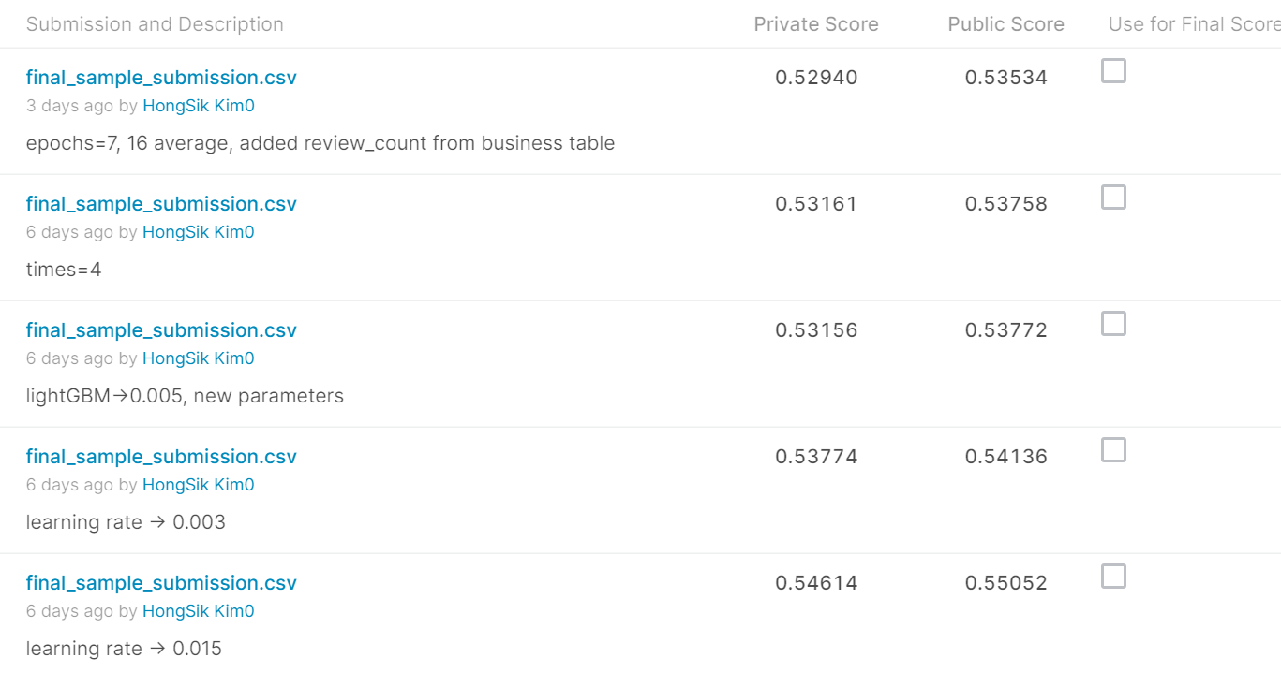
Kaggle Competition
Yelp Recruiting Competition
결과: 125 / 350 (35.71%)

Slide 6
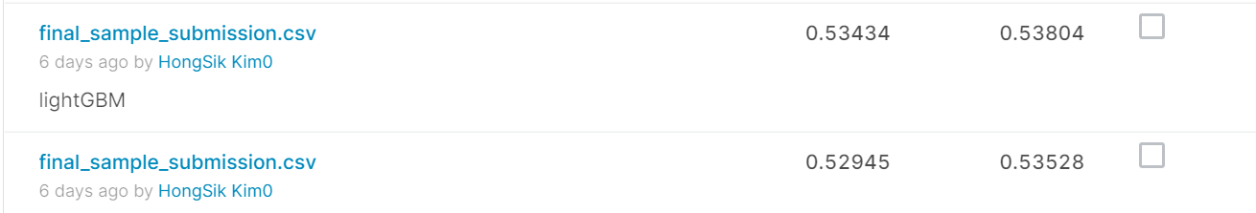
Kaggle Competition
Yelp Recruiting Competition
lightGBM을 사용하였으나 기본적인 Deep Neural Network 학습보다 오히려 성능이 떨어짐
lightGBM
기본적인 Deep Neural Network

Slide 7
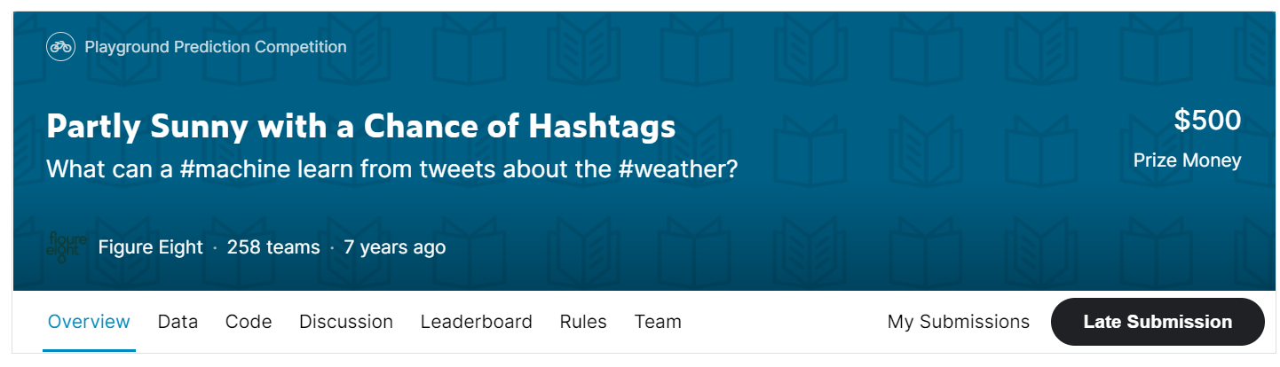
Kaggle Competition
Partly Sunny with a Chance of Hashtags
https://www.kaggle.com/c/crowdflower-weather-twitter

Slide 8
Kaggle Competition
Partly Sunny with a Chance of Hashtags
Input and Output
Input | Tweet (text -> using BERT) State (convert into 51 one-hot) Location (not used)
Output (Confidence score) | Sentiment: s1 (I can’t tell), s2 (negative), …, s5 When: w1 (current), w2 (future), w3, w4 Kind: k1 (clouds), k2 (cold), …, k15 (total 24 output columns)

Slide 9
Kaggle Competition
Partly Sunny with a Chance of Hashtags
Used Model
Text (BERT, 53)
State (one-hot, 51)
embedding
Dense0
CNN1
CNN2
CNN3
Dense1
Pool1
Pool2
Pool3
Dense2
Concatenate
Dense_final
Dense
dropout
dropout

Slide 10
Kaggle Competition
Partly Sunny with a Chance of Hashtags
Used Model
Dense
Dense_final
dropout
dropout
Concatenate
Dense
dropout
Output (24)

Slide 11
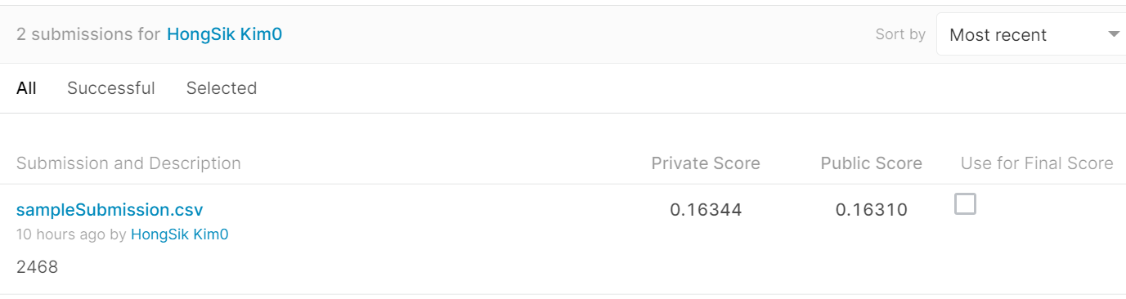
Kaggle Competition
Partly Sunny with a Chance of Hashtags
결과: 100 / 258 (38.76%, 0.16344) in Private Leaderboard

Slide 12
Paper for Patent
논문 진행 사항
논문 최종 제출 완료 (IEEE Access)

Slide 13
Github
https://github.com/WannaBeSuperteur/2020/tree/master/

