Slide 1
Weekly Report
2021.02.10
Hongsik Kim
Mobile & Network Intelligence Laboratory

Slide 2
AI Explanable AI
Implementation of Patent (non-public)
Paper: Introducing and assessing the explainable AI (XAI) method: SIDU

Slide 3
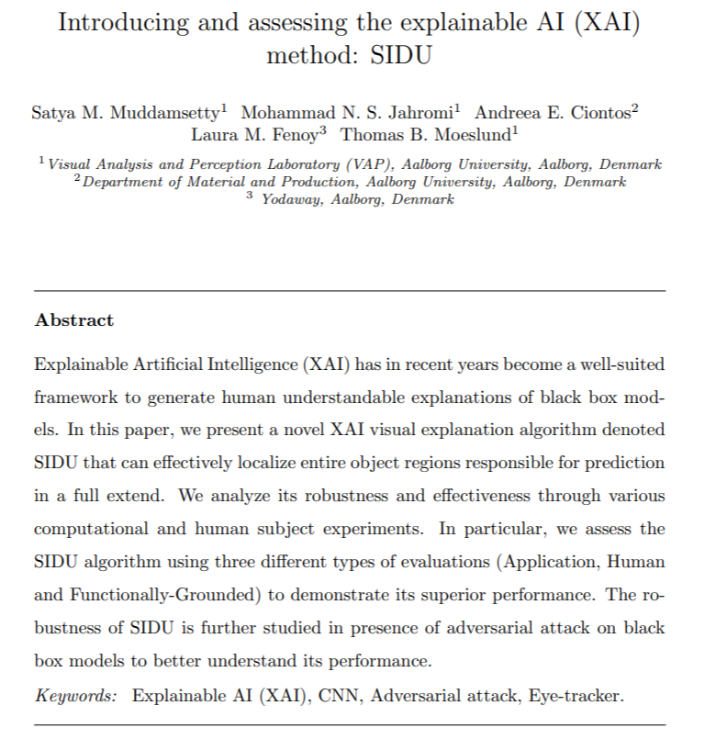
Paper: Introducing and assessing the explainable AI (XAI) method: SIDU
CNN용 XAI method인 SIDU에 대한 논문
https://arxiv.org/pdf/2101.10710.pdf

Slide 4
Paper: Introducing and assessing the explainable AI (XAI) method: SIDU
Related Works: Visual Explanation
Saliency maps | Visual explanation을 위해 사용
Back-propagation methods | Feature signal을 output neuron으로부터 input neurons까지 single pass를 통해 전달
Gradient-based methods | Backpropagation 알고리즘에 Gradient 적용 CNN의 output의 derivative를 input에 대해 시각화
Perturbation-based methods | Output의 전체적인 변화를 트래킹하는 동안 input이 perturb됨
Approximation-based methods | Deep CNN을 보다 간단한 approximation으로 대체 Visual explanation을 보다 쉽게 생성

Slide 5
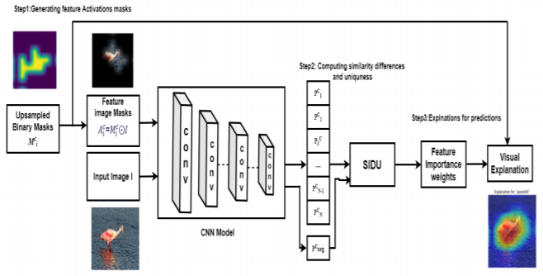
Paper: Introducing and assessing the explainable AI (XAI) method: SIDU
SIDU: Proposed Method

Slide 6
Paper: Introducing and assessing the explainable AI (XAI) method: SIDU
SIDU: Proposed Method
문제점: Gradient-based 모델과 perturbation explanation method에 의해 생성된 visual explanation은 object class의 전체 salient region을 localize하는 데 실패
어떤 주어진 CNN 모델에 대해서도 계속해서 더 좋은 explanation method를 제공할 수 있는 XAI method
마지막 Convolutional Layer를 이용하여 mask를 생성

Slide 7
Paper: Introducing and assessing the explainable AI (XAI) method: SIDU
SIDU: Proposed Method
1. CNN으로부터 마지막 convolutional layer를 추출, 그 layer를 이용하여 mask를 생성
2. 예측된 class에 대해 각 mask에 대한 similarity difference를 계산
3. 각 mask에 대한 weight을 계산하고, prediction을 설명할 수 있는 final map으로 합성

Slide 8
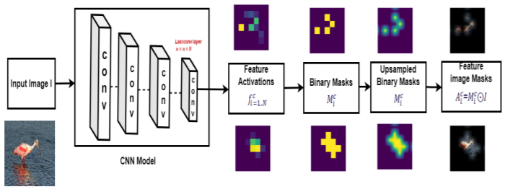
Paper: Introducing and assessing the explainable AI (XAI) method: SIDU
SIDU: Proposed Method – Step 1. Getting Feature Activation Masks
$$Feature Image Mask: A_{c}^{i}=F(I⊙M_{i}^{c})$$

Slide 9
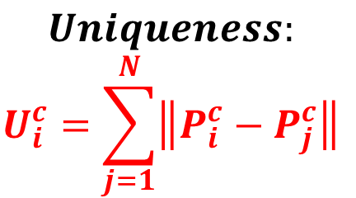
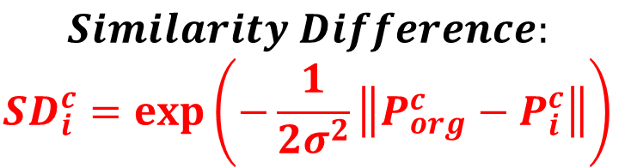
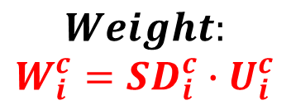
Paper: Introducing and assessing the explainable AI (XAI) method: SIDU
SIDU: Proposed Method – Step 2. Computing Similarity Differences and Uniqueness
$$Similarity Difference:$$
$$SD_{i}^{c}=\exp\left(−\frac{1}{2σ^{2}}\left\|P_{org}^{c}−P_{i}^{c}\right\|\right)$$
$$Uniqueness:$$
$$U_{i}^{c}=\sum_{j=1}^{N}{\left\|P_{i}^{c}−P_{j}^{c}\right\|}$$
$$Weight:$$
$$W_{i}^{c}=SD_{i}^{c}∙U_{i}^{c}$$

Slide 10
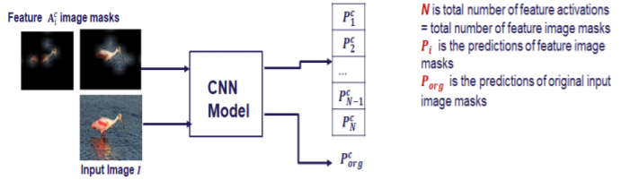
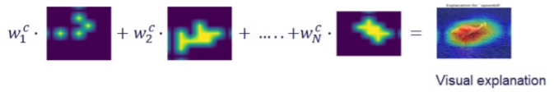
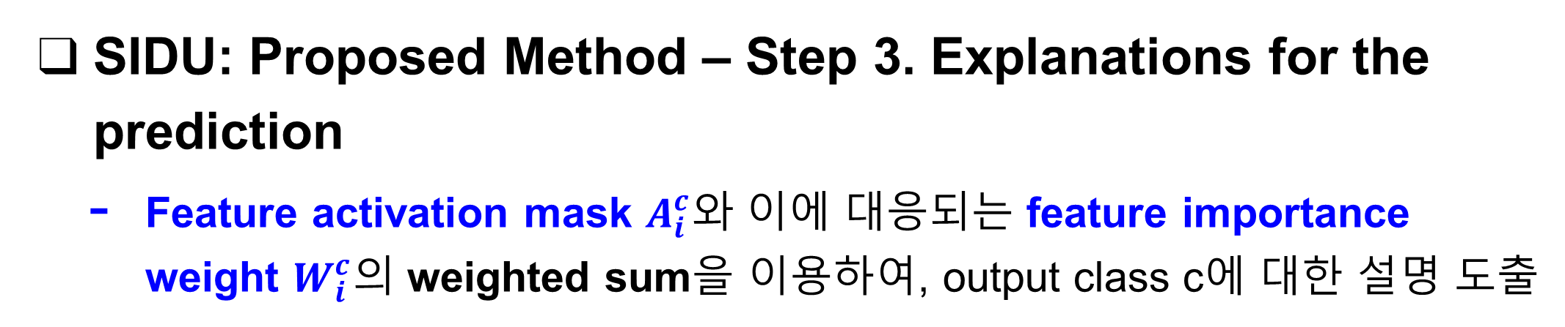
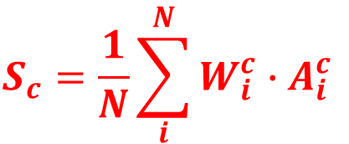
Paper: Introducing and assessing the explainable AI (XAI) method: SIDU
SIDU: Proposed Method – Step 3. Explanations for the prediction
Feature activation mask $A_{i}^{c}와$ 이에 대응되는 feature importance weight $W_{i}^{c}의$ weighted sum을 이용하여, output class c에 대한 설명 도출
$$S_{c}=\frac{1}{N}\sum_{i}^{N}{W_{i}^{c}∙A_{i}^{c}}$$

Slide 11
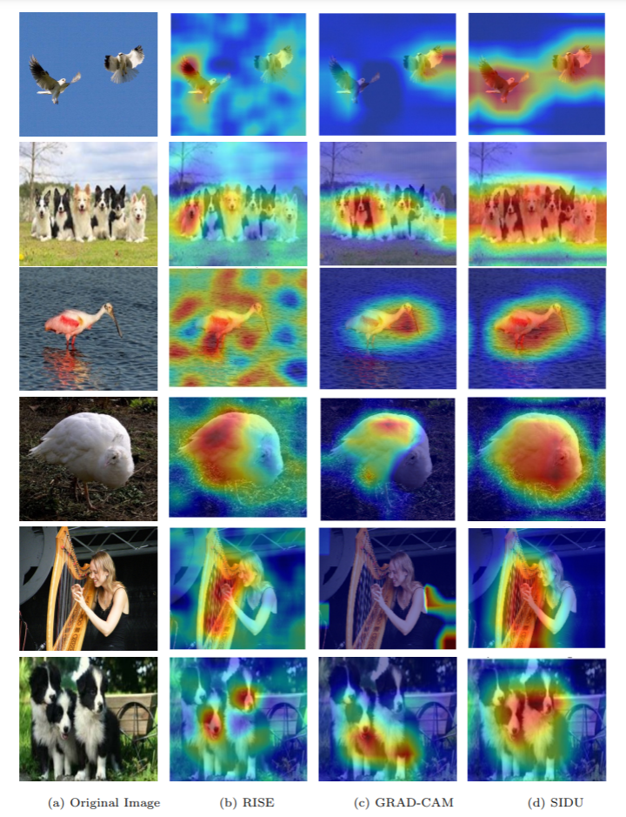
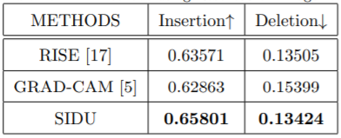
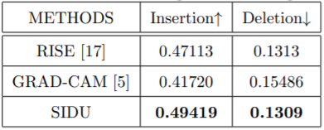
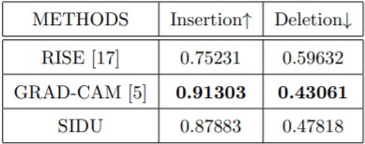
Paper: Introducing and assessing the explainable AI (XAI) method: SIDU
Evaluation
Dataset / Model | Result
ImageNet Validation set / ResNet-50
ImageNet Validation set / VGG-16
RFIQA / ResNet-50

Slide 12
Github
https://github.com/WannaBeSuperteur/2020/tree/master/

