Slide 1
Weekly Report
2021.05.14
Hongsik Kim
Mobile & Network Intelligence Laboratory

Slide 2
AI Explanable AI
Kaggle Competition
Patent Idea (not public)

Slide 3
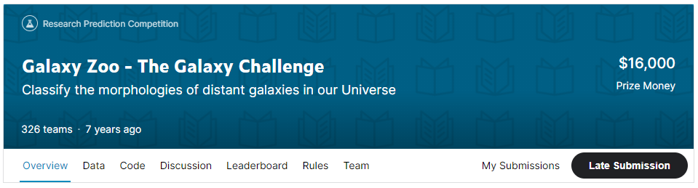
Kaggle Competition
Galaxy Zoo - The Galaxy Challenge
https://www.kaggle.com/c/galaxy-zoo-the-galaxy-challenge

Slide 4
Kaggle Competition
Galaxy Zoo - The Galaxy Challenge
Training input : 61,578개의 은하 이미지
Training output : 각 training 은하에 대한 probability distribution
Test input : 79,975개의 은하 이미지
Test output : 각 test 은하에 대한 probability distribution
Metric : Root Mean Squared Error

Slide 5
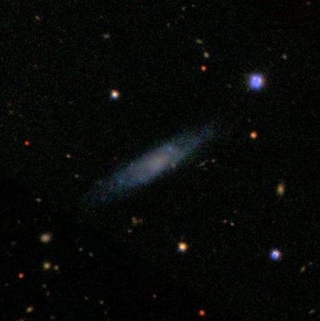
Kaggle Competition
Galaxy Zoo - The Galaxy Challenge
CNN (Convolutional Neural Network) 을 이용한 접근
이미지의 가운데 부분을 crop한 후, 크기를 변환하여 사용

Slide 6
Github
https://github.com/WannaBeSuperteur/2020/tree/master/

