Slide 1
Weekly Report
2021.06.30
Hongsik Kim
Mobile & Network Intelligence Laboratory

Slide 2
WPCN: Paper
Paper: Robust Beamforming Design and Time Allocation for IRS-assisted Wireless Powered Communication Networks

Slide 3
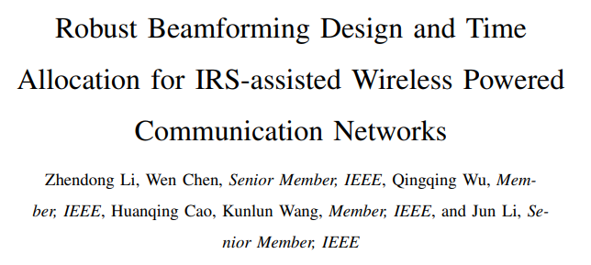
Current Status
Paper: Robust Beamforming Design and Time Allocation for IRS-assisted Wireless Powered Communication Networks
https://arxiv.org/pdf/2105.06226.pdf

Slide 4
Current Status
Paper: Robust Beamforming Design and Time Allocation for IRS-assisted Wireless Powered Communication Networks
System Model
N개의 antenna가 있는 HAP (Hybrid Access Point)
건물에 배치된 M개의 reflection element가 있는 IRS
1개의 antenna가 있는 K명의 사용자 또는 K개의 IoT device

Slide 5
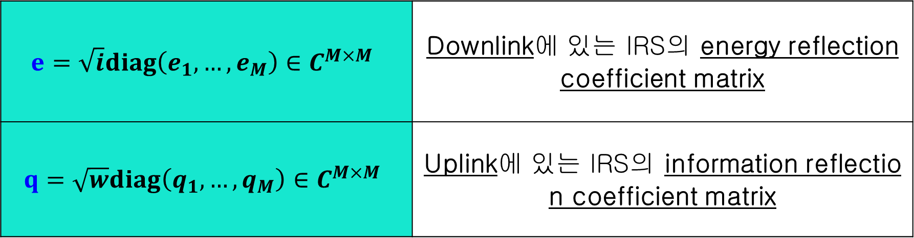
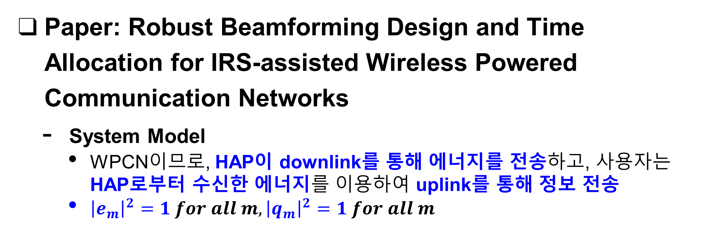
Current Status
Paper: Robust Beamforming Design and Time Allocation for IRS-assisted Wireless Powered Communication Networks
System Model
WPCN이므로, HAP이 downlink를 통해 에너지를 전송하고, 사용자는 HAP로부터 수신한 에너지를 이용하여 uplink를 통해 정보 전송
${\left|e_{m}\right|}^{2}=1 for all m, {\left|q_{m}\right|}^{2}=1 for all m$
$$e=\sqrt{i}diag\left(e_{1},…, e_{M}\right)∈C^{M×M}$$ | Downlink에 있는 IRS의 energy reflection coefficient matrix
$$q=\sqrt{w}diag\left(q_{1},…, q_{M}\right)∈C^{M×M}$$ | Uplink에 있는 IRS의 information reflection coefficient matrix

Slide 6
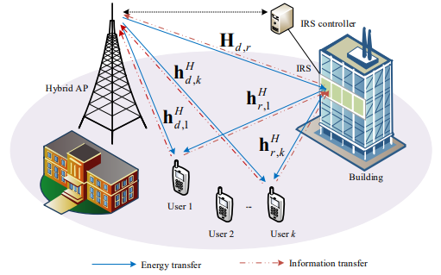
Current Status
Paper: Robust Beamforming Design and Time Allocation for IRS-assisted Wireless Powered Communication Networks
System Model

Slide 7
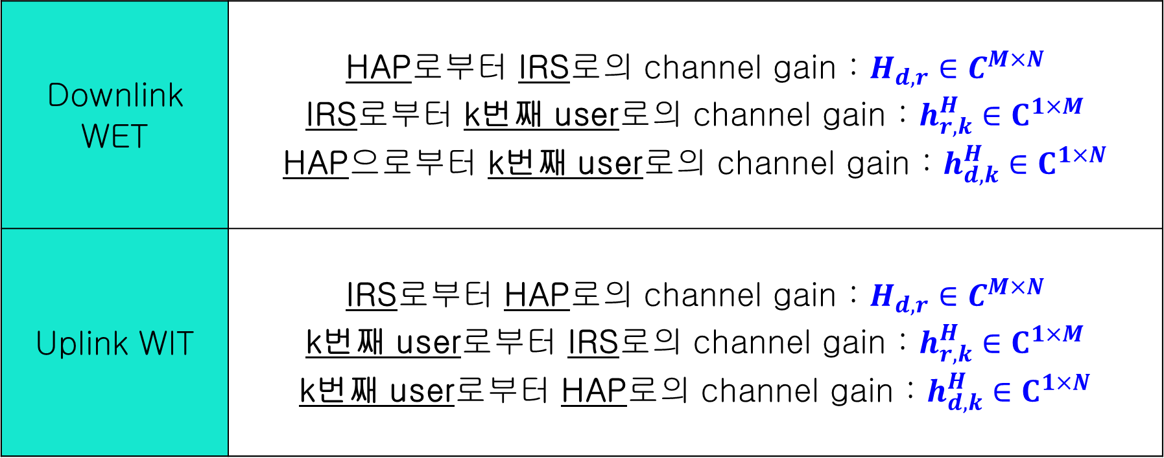
Current Status
Paper: Robust Beamforming Design and Time Allocation for IRS-assisted Wireless Powered Communication Networks
System Model
Downlink WET | HAP로부터 IRS로의 channel gain : $H_{d,r}∈C^{M×N}$ IRS로부터 k번째 user로의 channel gain : $h_{r,k}^{H}∈C^{1×M}$ HAP으로부터 k번째 user로의 channel gain : $h_{d,k}^{H}∈C^{1×N}$
Uplink WIT | IRS로부터 HAP로의 channel gain : $H_{d,r}∈C^{M×N}$ k번째 user로부터 IRS로의 channel gain : $h_{r,k}^{H}∈C^{1×M}$ k번째 user로부터 HAP로의 channel gain : $h_{d,k}^{H}∈C^{1×N}$

Slide 8
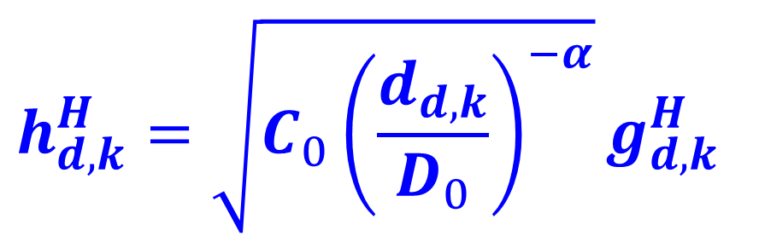
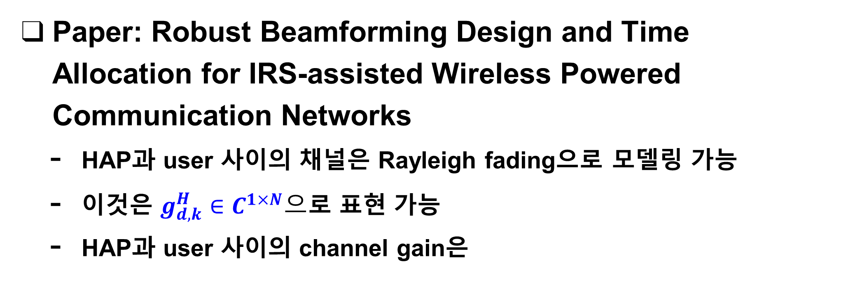
Current Status
Paper: Robust Beamforming Design and Time Allocation for IRS-assisted Wireless Powered Communication Networks
HAP과 user 사이의 채널은 Rayleigh fading으로 모델링 가능
이것은 $g_{d,k}^{H}∈C^{1×N}으$로 표현 가능
HAP과 user 사이의 channel gain은
$$h_{d,k}^{H}=\sqrt{C_{0}{\left(\frac{d_{d,k}}{D_{0}}\right)}^{−α}}g_{d,k}^{H}$$

Slide 9
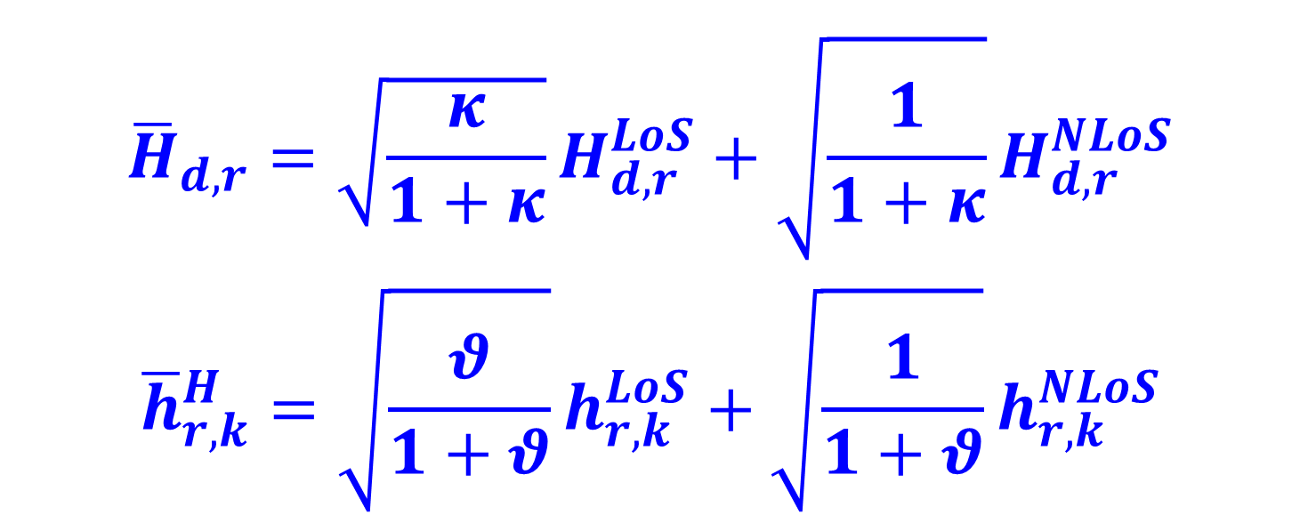
Current Status
Paper: Robust Beamforming Design and Time Allocation for IRS-assisted Wireless Powered Communication Networks
HAP과 IRS 사이의 채널과 IRS와 user 사이의 채널은 line-of-sight (LoS) component를 가지며, 다음과 같이 나타낼 수 있음
$${\overline{H}}_{d,r}=\sqrt{\frac{κ}{1+κ}}H_{d,r}^{LoS}+\sqrt{\frac{1}{1+κ}}H_{d,r}^{NLoS}$$
$${\overline{h}}_{r,k}^{H}=\sqrt{\frac{θ}{1+θ}}h_{r,k}^{LoS}+\sqrt{\frac{1}{1+θ}}h_{r,k}^{NLoS}$$

Slide 10
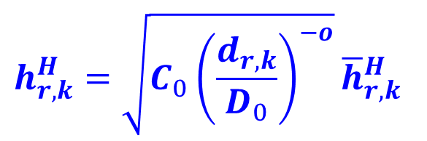
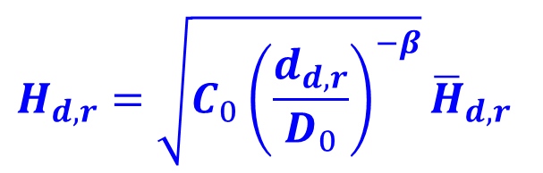
Current Status
Paper: Robust Beamforming Design and Time Allocation for IRS-assisted Wireless Powered Communication Networks
HAP와 IRS 사이의 channel gain은
IRS와 k번째 user 사이의 channel gain은
$$H_{d,r}=\sqrt{C_{0}{\left(\frac{d_{d,r}}{D_{0}}\right)}^{−β}}{\overline{H}}_{d,r}$$
$$h_{r,k}^{H}=\sqrt{C_{0}{\left(\frac{d_{r,k}}{D_{0}}\right)}^{−o}}{\overline{h}}_{r,k}^{H}$$

Slide 11
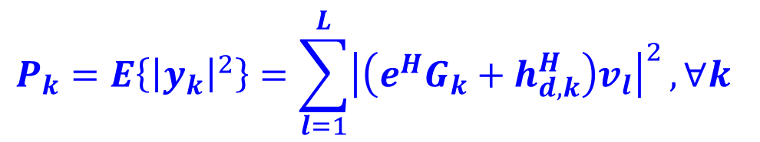


Current Status
Paper: Robust Beamforming Design and Time Allocation for IRS-assisted Wireless Powered Communication Networks
K번째 user가 얻을 수 있는 에너지는
여기서
$$E_{k}=τΞ\left(P_{k}\right), ∀k$$
$$P_{k}=E\left\{{\left|y_{k}\right|}^{2}\right\}=\sum_{l=1}^{L}{{\left|\left(e^{H}G_{k}+h_{d,k}^{H}\right)v_{l}\right|}^{2}}, ∀k$$
$$Ξ\left(P_{k}\right)=\left(\frac{ξ_{k}}{X_{k}\left(1+\exp\left(−a_{k}\left(P_{k}−b_{k}\right)\right)\right)}−Y_{k}\right), ∀k$$

Slide 12
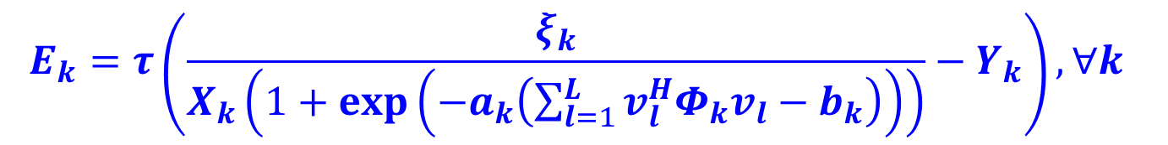
Current Status
Paper: Robust Beamforming Design and Time Allocation for IRS-assisted Wireless Powered Communication Networks
K번째 user의 DL channel covariance matrix를
이때 다음과 같이 나타낼 수 있음
$$Φ_{k}=E\left\{{\left(e^{H}G_{k}+h_{d,k}^{H}\right)}^{H}\left(e^{H}G_{k}+h_{d,k}^{H}\right)\right\}∈C^{N×N}$$
$$E_{k}=τ\left(\frac{ξ_{k}}{X_{k}\left(1+\exp\left(−a_{k}\left(\sum_{l=1}^{L}{v_{l}^{H}Φ_{k}v_{l}}−b_{k}\right)\right)\right)}−Y_{k}\right), ∀k$$

Slide 13
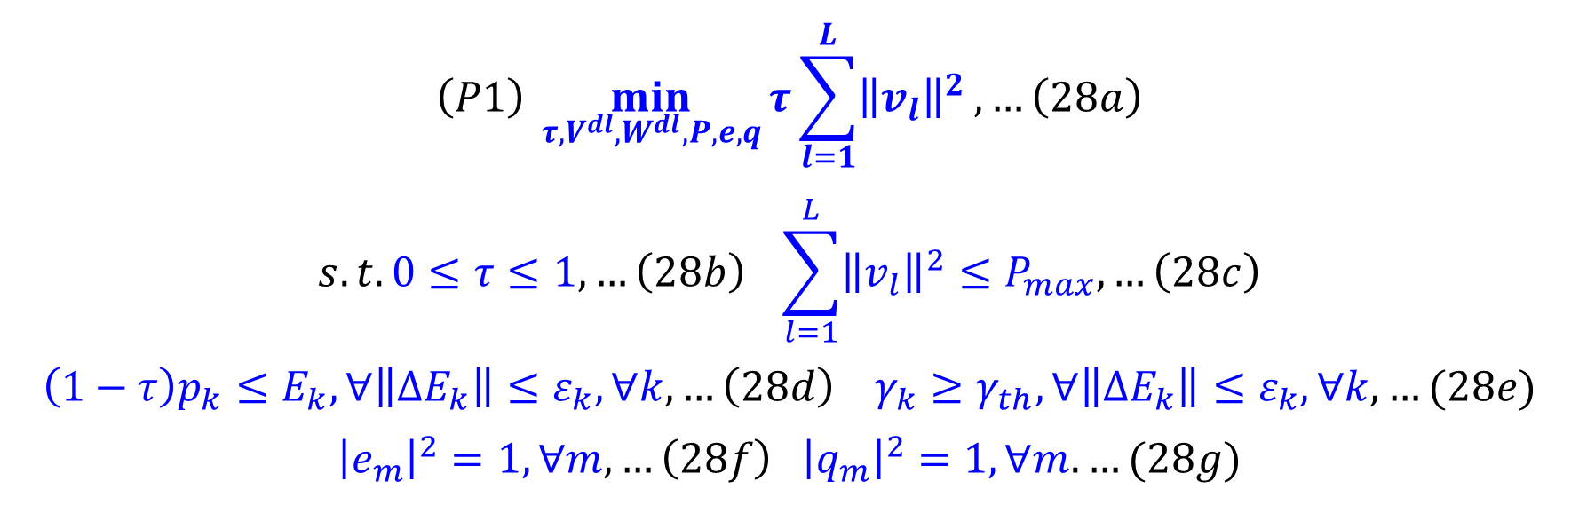
Current Status
Paper: Robust Beamforming Design and Time Allocation for IRS-assisted Wireless Powered Communication Networks
Problem 1: Minimize the transmission energy of the HAP
$$\left(P1\right) \min_{τ,V^{dl},W^{dl}, P,e,q}{τ\sum_{l=1}^{L}{{\left\|v_{l}\right\|}^{2}}, …\left(28a\right)}$$
$$s.t. 0≤τ≤1, …\left(28b\right) \sum_{l=1}^{L}{{\left\|v_{l}\right\|}^{2}}≤P_{max},…\left(28c\right)$$
$$\left(1−τ\right)p_{k}≤E_{k}, ∀\left\|ΔE_{k}\right\|≤ε_{k}, ∀k, …\left(28d\right) γ_{k}≥γ_{th}, ∀\left\|ΔE_{k}\right\|≤ε_{k}, ∀k,…(28e)$$
$${\left|e_{m}\right|}^{2}=1, ∀m, …\left(28f\right) {\left|q_{m}\right|}^{2}=1,∀m. …(28g)$$

Slide 14
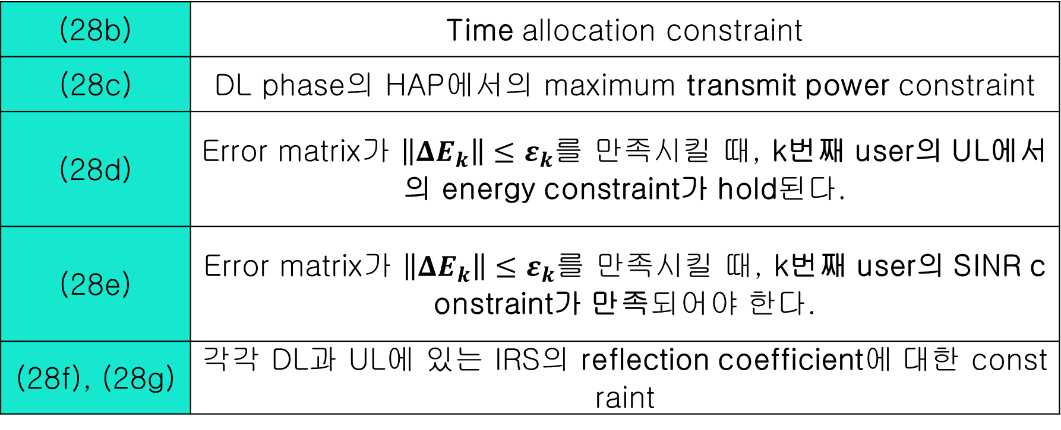
Current Status
Paper: Robust Beamforming Design and Time Allocation for IRS-assisted Wireless Powered Communication Networks
여기서 각각이 의미하는 바는 다음과 같음
(28b) | Time allocation constraint
(28c) | DL phase의 HAP에서의 maximum transmit power constraint
(28d) | Error matrix가 $\left\|ΔE_{k}\right\|≤ε_{k}$를 만족시킬 때, k번째 user의 UL에서의 energy constraint가 hold된다.
(28e) | Error matrix가 $\left\|ΔE_{k}\right\|≤ε_{k}$를 만족시킬 때, k번째 user의 SINR constraint가 만족되어야 한다.
(28f), (28g) | 각각 DL과 UL에 있는 IRS의 reflection coefficient에 대한 constraint

Slide 15
Github
https://github.com/WannaBeSuperteur/2020/tree/master/WPCN

