Slide 1
Weekly Report
2021.08.13
Hongsik Kim
Mobile & Network Intelligence Laboratory

Slide 2
AI Explanable AI
Paper Submission : IEEE Transactions on Neural Networks and Learning System
Kaggle Competition
Paper: An XAI Approach to Deep Learning Models in the Detection of Ductal Carcinoma in Situ

Slide 3
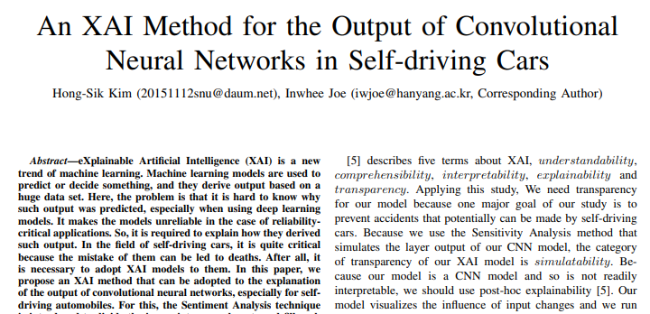
Kaggle Competition
Paper Submission : IEEE Transactions on Neural Networks and Learning Systems

Slide 4
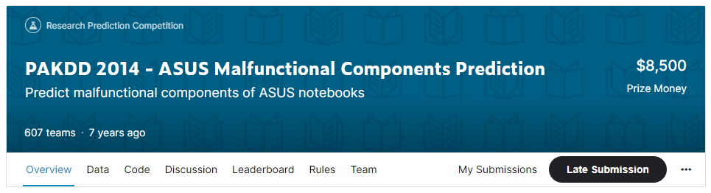
Kaggle Competition
1. PAKDD 2014 – ASUS Malfunctional Components Prediction
https://www.kaggle.com/c/pakdd-cup-2014

Slide 5
Kaggle Competition
1. PAKDD 2014 – ASUS Malfunctional Components Prediction
kNN (k-Nearest Neighbors) 방법 이용
(Module, Component, Year*12+Month, Month Only)

Slide 6
Kaggle Competition
1. PAKDD 2014 – ASUS Malfunctional Components Prediction
kNN (k-Nearest Neighbors) 방법 이용
For Module Type (M1~M9) and Component Type (P1~P31)
연도별, 월별 repair count를 이용하여 Mx, My 또는 Px, Py 간 correlation coefficient (CORR)를 계산
Distance = 1.0 - CORR
For Year*12+month
Distance = (absolute distance) / 24
For Month (1~12)
Using Circle Distance (in Slide 7)

Slide 7

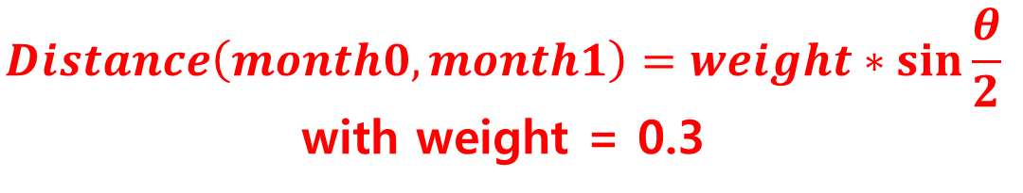
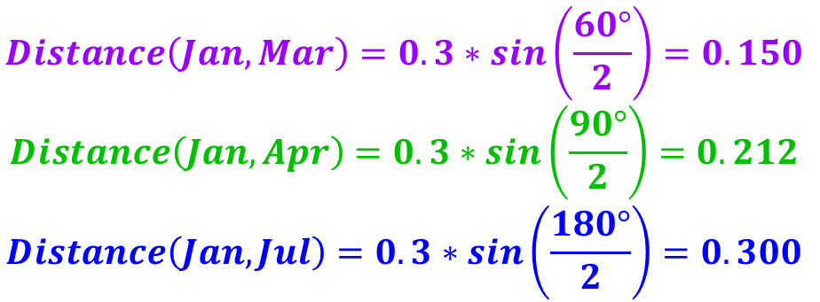
Kaggle Competition
1. PAKDD 2014 – ASUS Malfunctional Components Prediction
kNN (k-Nearest Neighbors) 방법 이용
Circle Distance for Month (1~12)
Dec
Jan
$$Distance\left(month0, month1\right)=weight∗\sin{\frac{θ}{2}}$$
with weight = 0.3
Feb
…
$$θ$$
Mar
$$Distance\left(Jan,Mar\right)=0.3∗sin\left(\frac{60°}{2}\right)=0.150$$
$$Distance\left(Jan,Apr\right)=0.3∗sin\left(\frac{90°}{2}\right)=0.212$$
$$Distance\left(Jan,Jul\right)=0.3∗sin\left(\frac{180°}{2}\right)=0.300$$
Apr
…
…
…
Jul

Slide 8
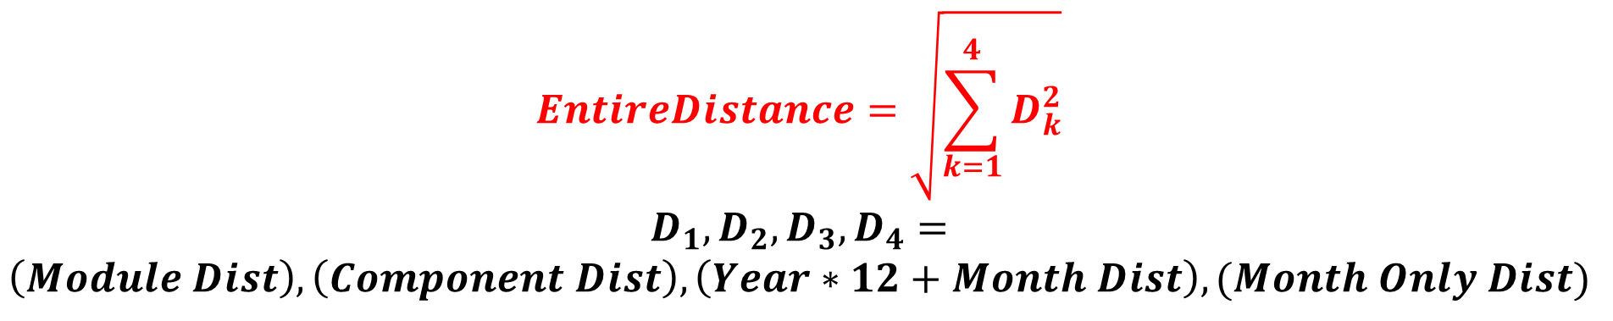
Kaggle Competition
1. PAKDD 2014 – ASUS Malfunctional Components Prediction
kNN (k-Nearest Neighbors) 방법 이용
Entire Distance:
$$EntireDistance=\sqrt{\sum_{k=1}^{4}{D_{k}^{2}}}$$
$$D_{1}, D_{2}, D_{3}, D_{4}=$$
$$\left(Module Dist\right), \left(Component Dist\right), \left(Year∗12+Month Dist\right), (Month Only Dist)$$

Slide 9
Kaggle Competition
1. PAKDD 2014 – ASUS Malfunctional Components Prediction
kNN (k-Nearest Neighbors) 방법 이용
K개의 이웃에 대해서 (1/distance * repair count)를 이용하여 거리에 반비례한 가중치를 적용하여 repair count를 예측
N | kNN에서의 k의 값 (고려할 이웃 item의 개수) 정수가 아닌 경우에도 처리 가능
Limit | 예측한 repair count를 [0, Limit]의 범위 내로 조정 Limit=3인 경우 [0, 1, 2, 3, 4, 5] -> [0, 1, 2, 3, 3, 3]

Slide 10
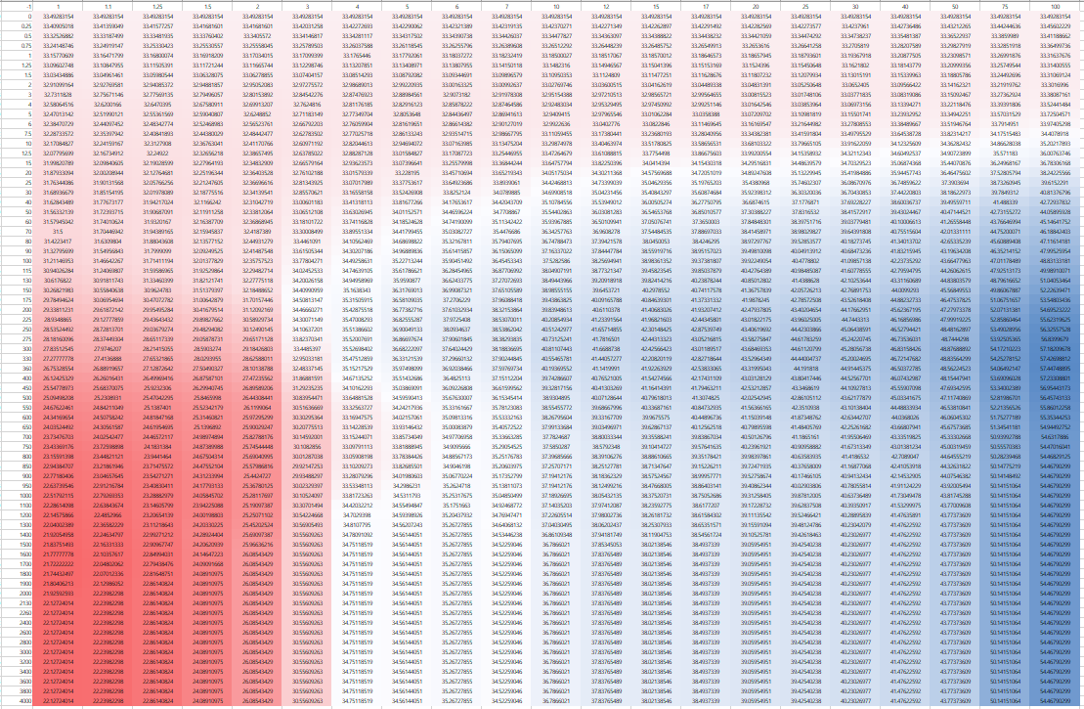
Kaggle Competition
1. PAKDD 2014 – ASUS Malfunctional Components Prediction
Validation Result
Train: Feb 2005 ~ Dec 2008, Valid: Jan 2009 ~ Dec 2009
(대체적으로 N이 커질수록
error 증가)
(가로축 : N, 세로축 : Limit)
(error가 최소)

Slide 11

Paper: An XAI Approach to Deep Learning Models in the Detection of Ductal Carcinoma in Situ
An XAI Approach to Deep Learning Models in the Detection of Ductal Carcinoma in Situ
https://arxiv.org/pdf/2106.14186.pdf

Slide 12
Github
https://github.com/WannaBeSuperteur/2020/tree/master/

