Slide 1
Weekly Report
2021.09.24
Hongsik Kim
Mobile & Network Intelligence Laboratory

Slide 2
AI Explanable AI
Kaggle Competition
SOTA method for Paper Revision : Explainable CNN

Slide 3
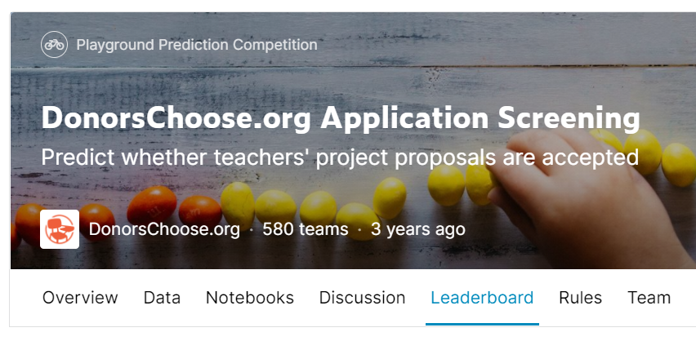
Kaggle Competition
1. DonorsChoose.org Application Screening
https://www.kaggle.com/c/donorschoose-application-screening

Slide 4
Kaggle Competition
DistilBert 모델 적용 시도
Bert Model 1 | BERT : (정보) + title
Bert Model 2 | BERT : (정보) + essay1
Bert Model 3 | BERT : (정보) + essay2
DistilBert Model | Title, essay1, …, essay4, summary를 조합 다양한 경우의 수 존재
LGBM Model 1 | LGBM Model with learning rate = 0.15
LGBM Model 2 | LGBM Model with learning rate = 0.10
LGBM Model 3 | LGBM Model with learning rate = 0.05
xgBoost Model | xgBoost Model

Slide 5
Kaggle Competition
DistilBert 모델 적용 시도
데이터 변환 방법 (using tokenizer)
title | essay1 | essay2 | essay3 | essay4 | summary
(encode using tokenizer)
0 0 0 1 | 0 0 1 7 | 0 6 12 | 13 12 10 9 | 0 5 6 5 | 0 19 2 6
0 2 3 9 | 0 13 1 2 | 0 10 11 | 0 0 0 4 | 0 0 12 7 | 20 8 13 4

Slide 6
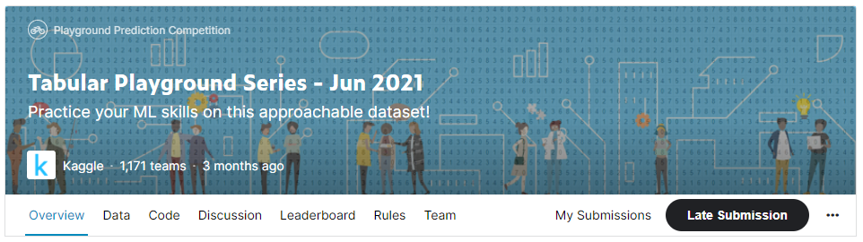
Kaggle Competition
2. Tabular Playground Series – Jun 2021
https://www.kaggle.com/c/tabular-playground-series-jun-2021

Slide 7
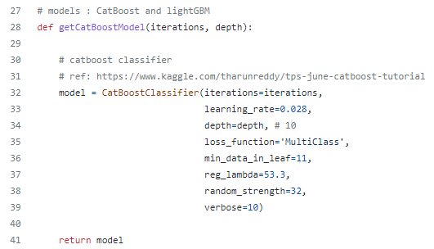
Kaggle Competition
2. Tabular Playground Series – Jun 2021
Using ensemble of CatBoost and lightGBM
실제로는 LightGBM을 사용하면 오류 발생, 따라서 CatBoost 모델만으로 시도 중

Slide 8
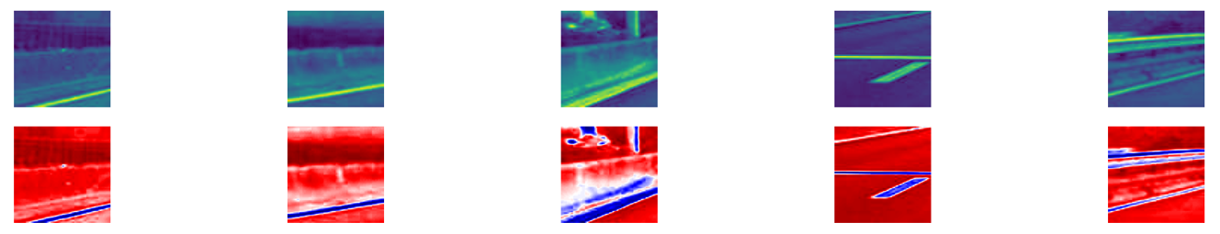
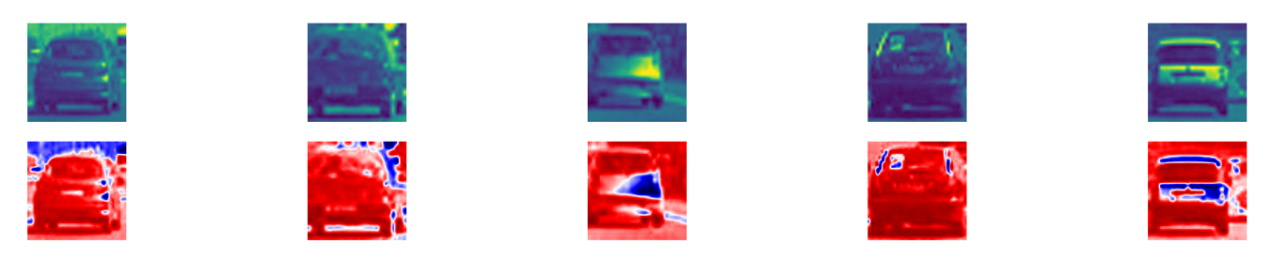
SOTA method for Paper Revision : Explainable CNN
Explainable CNN
Car vs. Non-car dataset에 적용 성공

Slide 9
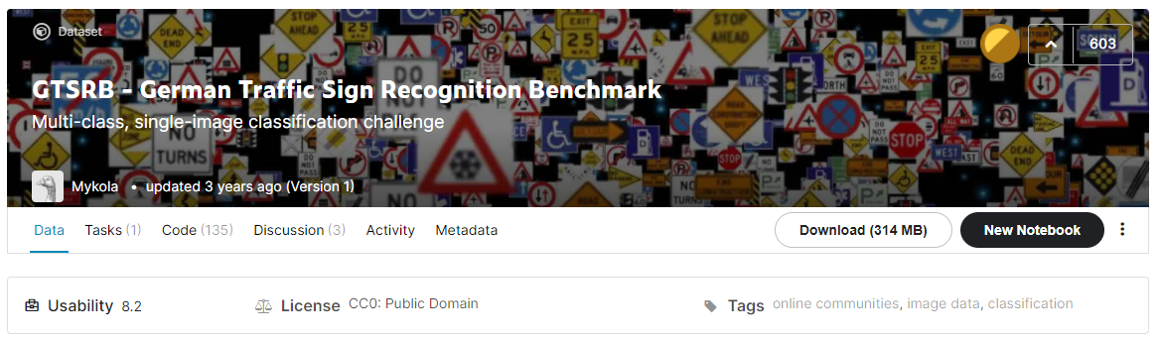
SOTA method for Paper Revision : Explainable CNN
Explainable CNN
German Traffic Sign Recognition Benchmark dataset
https://www.kaggle.com/meowmeowmeowmeowmeow/gtsrb-german-traffic-sign

Slide 10
Github
https://github.com/WannaBeSuperteur/2020/tree/master/

