Slide 1
Weekly Report
2021.06.04
Hongsik Kim
Mobile & Network Intelligence Laboratory

Slide 2
AI Explanable AI
Paper for the patent (Self-driving car) (not public)
Patent Idea (2021/05) (not public)
Kaggle Competition
Paper: Explaining black-box classifiers using post-hoc explanations-by-example: The effect of explanations and error-rates in XAI user studies

Slide 3
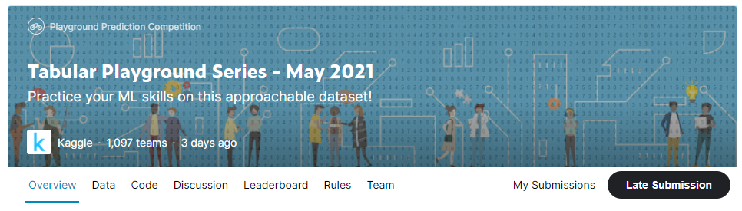
Kaggle Competition
Tabular Playground Series – May 2021
https://www.kaggle.com/c/tabular-playground-series-may-2021
Maximum Team Size : 3

Slide 4
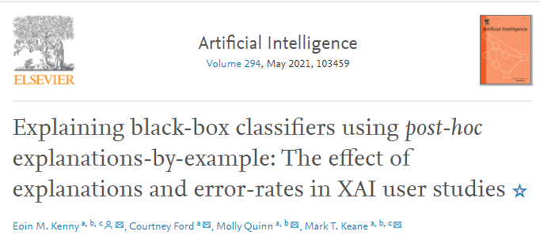
Paper: Explaining black-box classifiers using post-hoc explanations-by-example: The effect of explanations and error-rates in XAI user studies
https://www.sciencedirect.com/science/article/pii/S0004370221000102

Slide 5
Github
https://github.com/WannaBeSuperteur/2020/tree/master/

