Slide 1
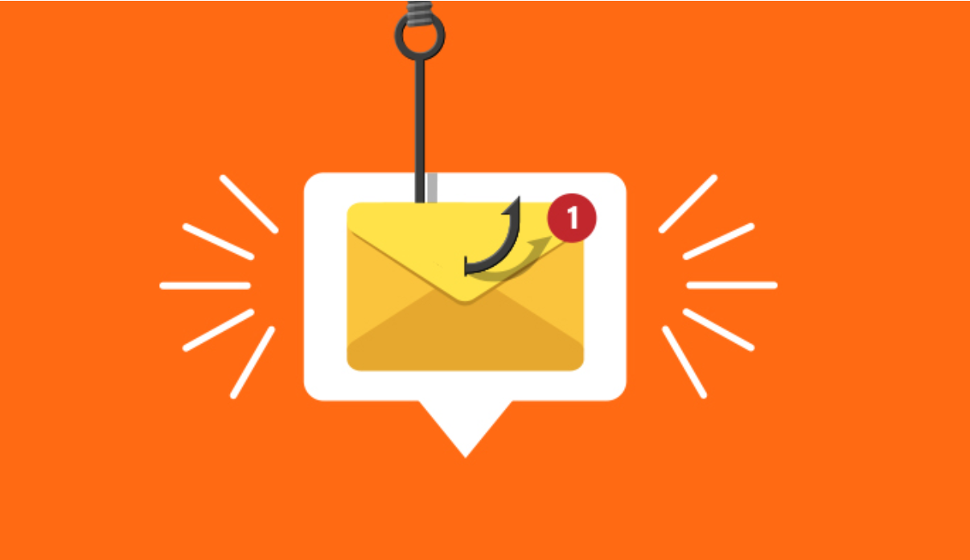
Phishing Awareness: Spot the Bait Before You’re Hooked!
Protect yourself and your organization from digital scams.

Slide 2
What is Phishing?
Phishing is a cyberattack that tricks you into revealing sensitive information by pretending to be a trustworthy source.
Common targets: usernames, passwords, credit card details.
Over 3.4 billion phishing emails are sent daily (APWG).

Slide 3
Types of Phishing
Email phishing — fake messages that look legitimate.
Spear phishing — personalized attacks targeting specific individuals.
Smishing — phishing via SMS text messages.
Vishing — voice phishing via phone calls.
Clone phishing — recreating real emails with malicious attachments/links.

Slide 4
Recognizing a Phishing Email
Urgent or threatening language (e.g., 'Your account will be suspended in 24 hours!').
Unusual sender address (e.g., support@micros0ft.com).
Generic greetings instead of your name.
Unexpected attachments or suspicious links.
Poor grammar, misspellings, or odd formatting.

Slide 5
Spotting Fake Websites
Check the URL for misspellings (e.g., paypol.com instead of paypal.com).
Wrong domain endings (.net instead of .com).
Look for HTTPS — but even phishing sites can use it.
Watch for lookalike designs copying real branding.

Slide 6
Social Engineering Tactics
Pretending to be someone you trust (IT support, boss, bank, government).
Creating urgency or fear (e.g., 'Security breach detected — click here').
Offering rewards (e.g., 'You’ve won a gift card!').
Impersonating coworkers (business email compromise).

Slide 7
Best Practices to Avoid Phishing
Verify sender identity before clicking links.
Hover over links to check their destination.
Avoid downloading attachments from unknown sources.
Enable multi-factor authentication (MFA).
Report suspicious messages to IT/security team.

Slide 8
Real-World Examples
2016 US election spear-phishing attack.
2020 COVID-19 relief scams.
Major brand impersonations: Microsoft, Google, Amazon.

Slide 9
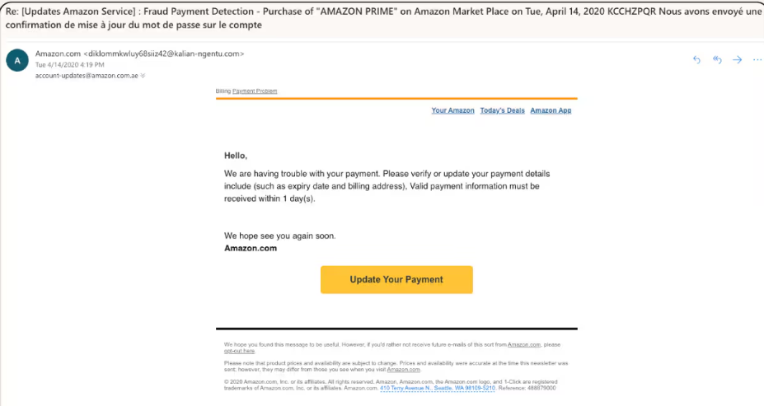
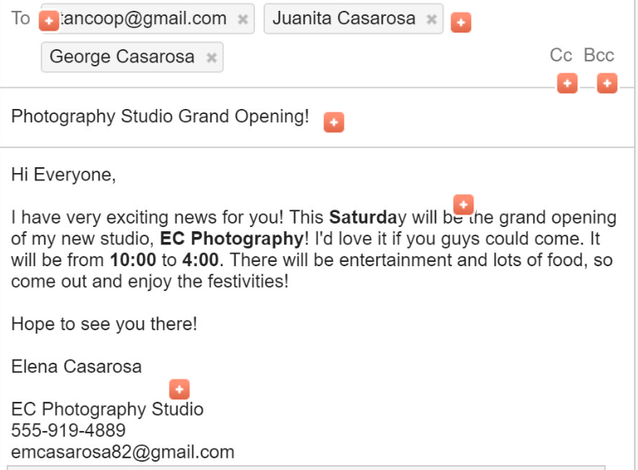
Interactive Quiz
Q1: Which of these is a phishing email?
A) B)
Q2: The link 'https://security-paypal.com' is:
A) Safe B) Suspicious
Q3: First step when receiving a suspicious message?
A) Click link B) Delete C) Report

Slide 10
Final Takeaways
Stay alert — phishing works because it exploits human trust.
Think before you click.
Report, don’t ignore.

Slide 11
Resources
https://www.antiphishing.org
https://staysafeonline.org
Your company-specific reporting email.

