Slide 1
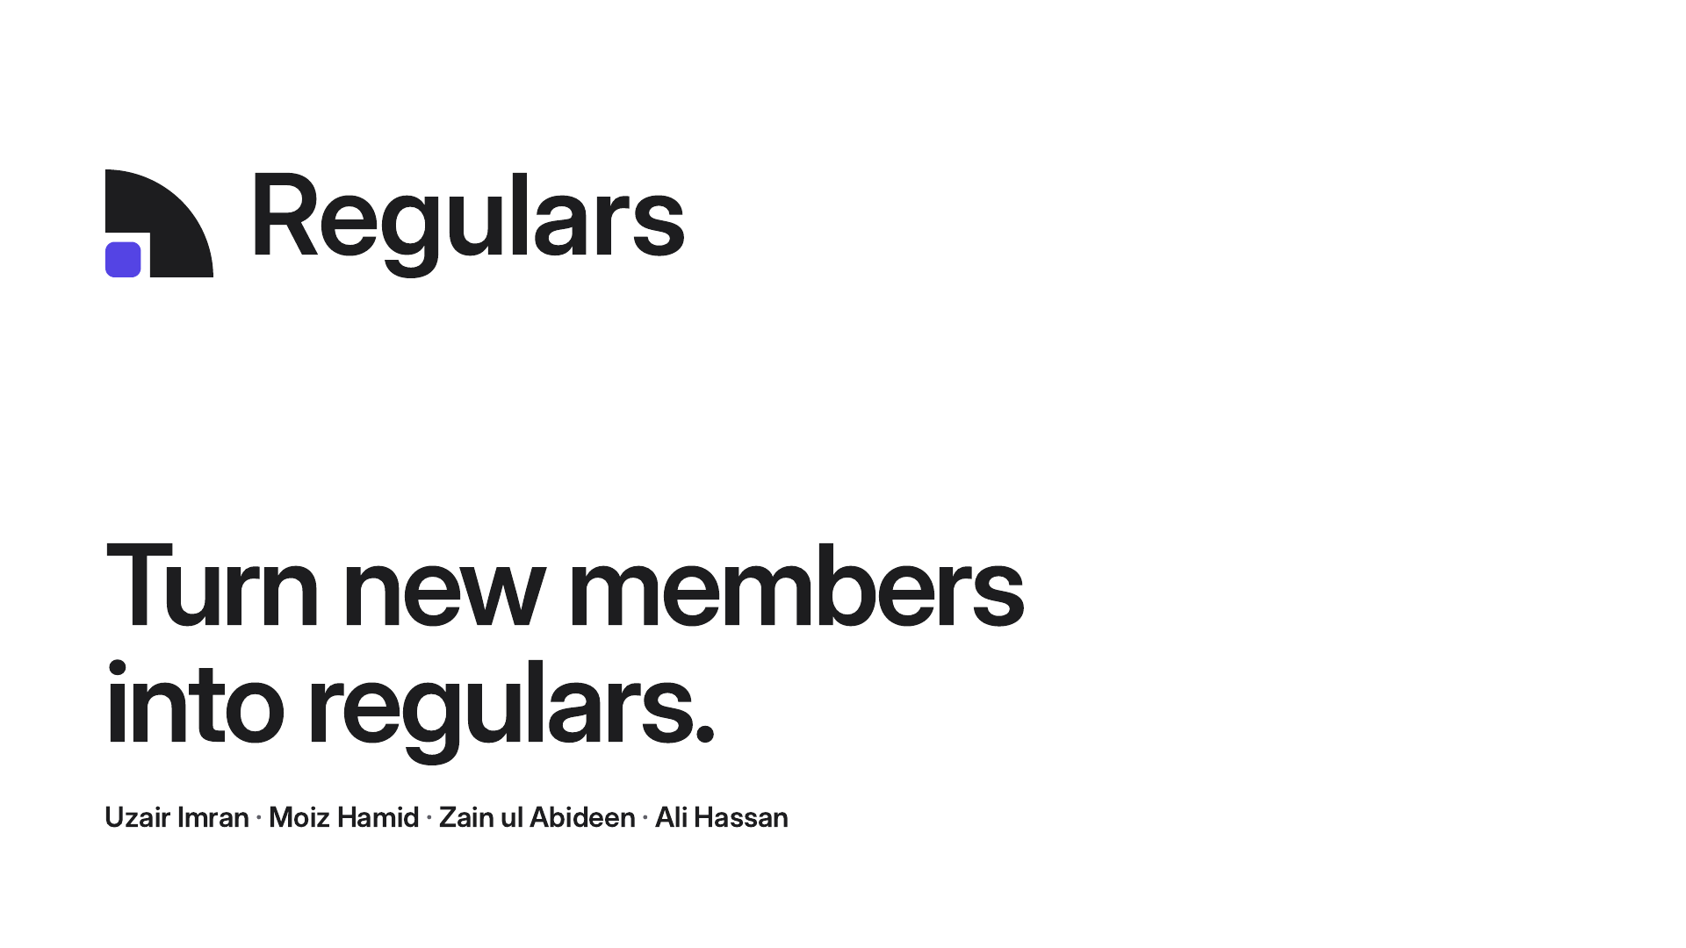
Notes:
We're the team behind Regulars. I'm Uzair, and with me are Moiz, Zain and Ali. We built Regulars, a member-retention dashboard for independent gyms in the US, around one goal: turn new members into regulars. In the next 3 minutes: why the first 90 days matter, what the app does, and the price we'd test.

Slide 2
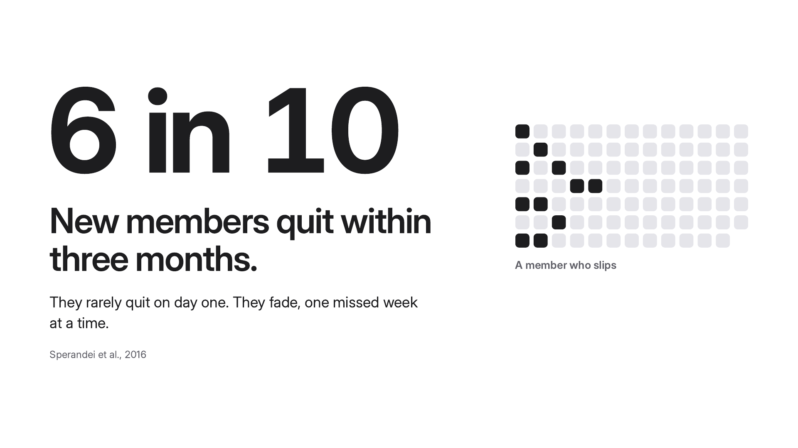
Notes:
Here's the problem. 6 in 10 new members quit within three months. That's from Sperandei and colleagues, 2016. And they rarely quit on day one. They fade, one missed week at a time. You can see it in this grid. Each square is a day, and this member's visits thin out, then stop.

Slide 3
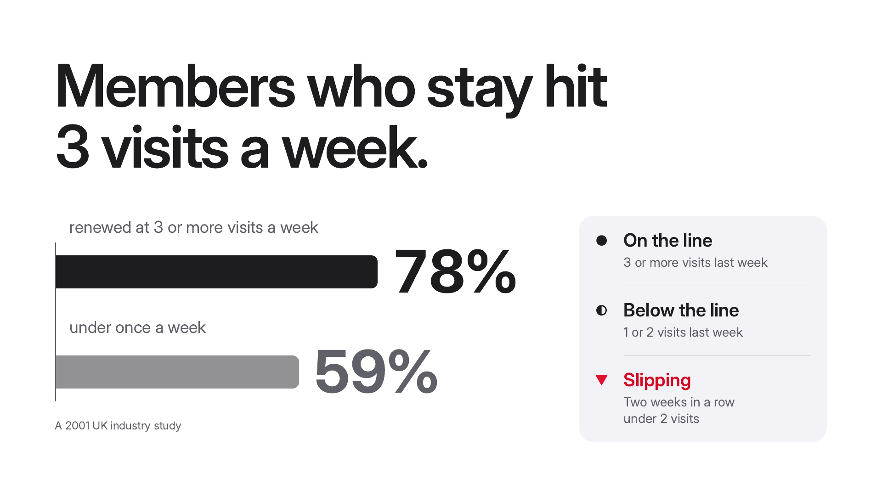
Notes:
Here is who stays. Members who stay hit 3 visits a week. In a 2001 UK industry study, members who came 3 or more times a week in their first month renewed 78% of the time. Under once a week, it was 59%. We built the app on that gap. 3 visits a week is the line: 3 or more last week is on the line, 1 or 2 is below it, and two weeks in a row under 2 visits is slipping.

Slide 4
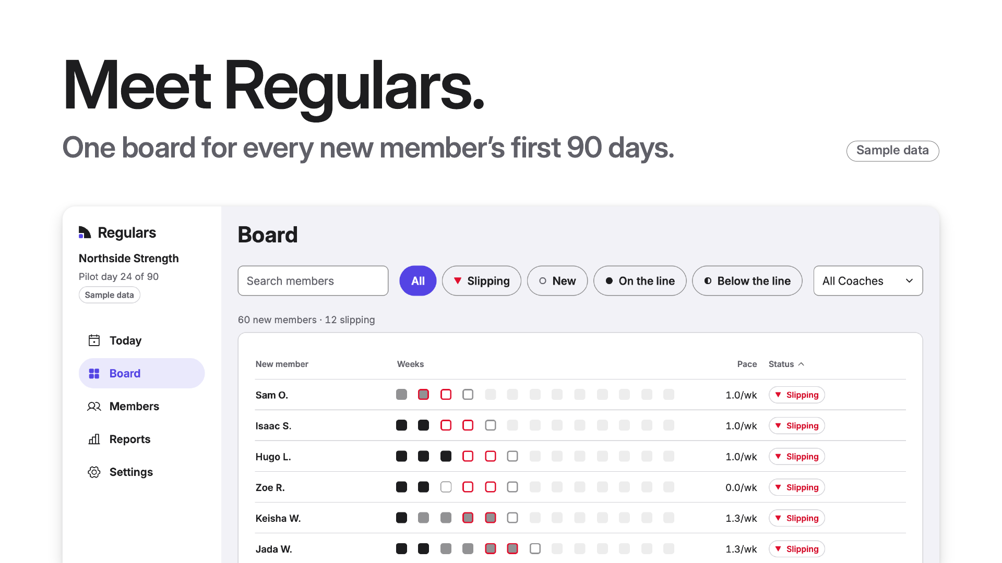
Notes:
Meet Regulars: one board for every new member's first 90 days. This is the real app, with sample data. Each row is a new member, and each square is a week. Dark is 3 or more visits, grey is one or two, and a red edge is slipping. With Regulars, you see every new member's first 90 days, spot anyone who is slipping, and nudge them back with a personal text.

Slide 5
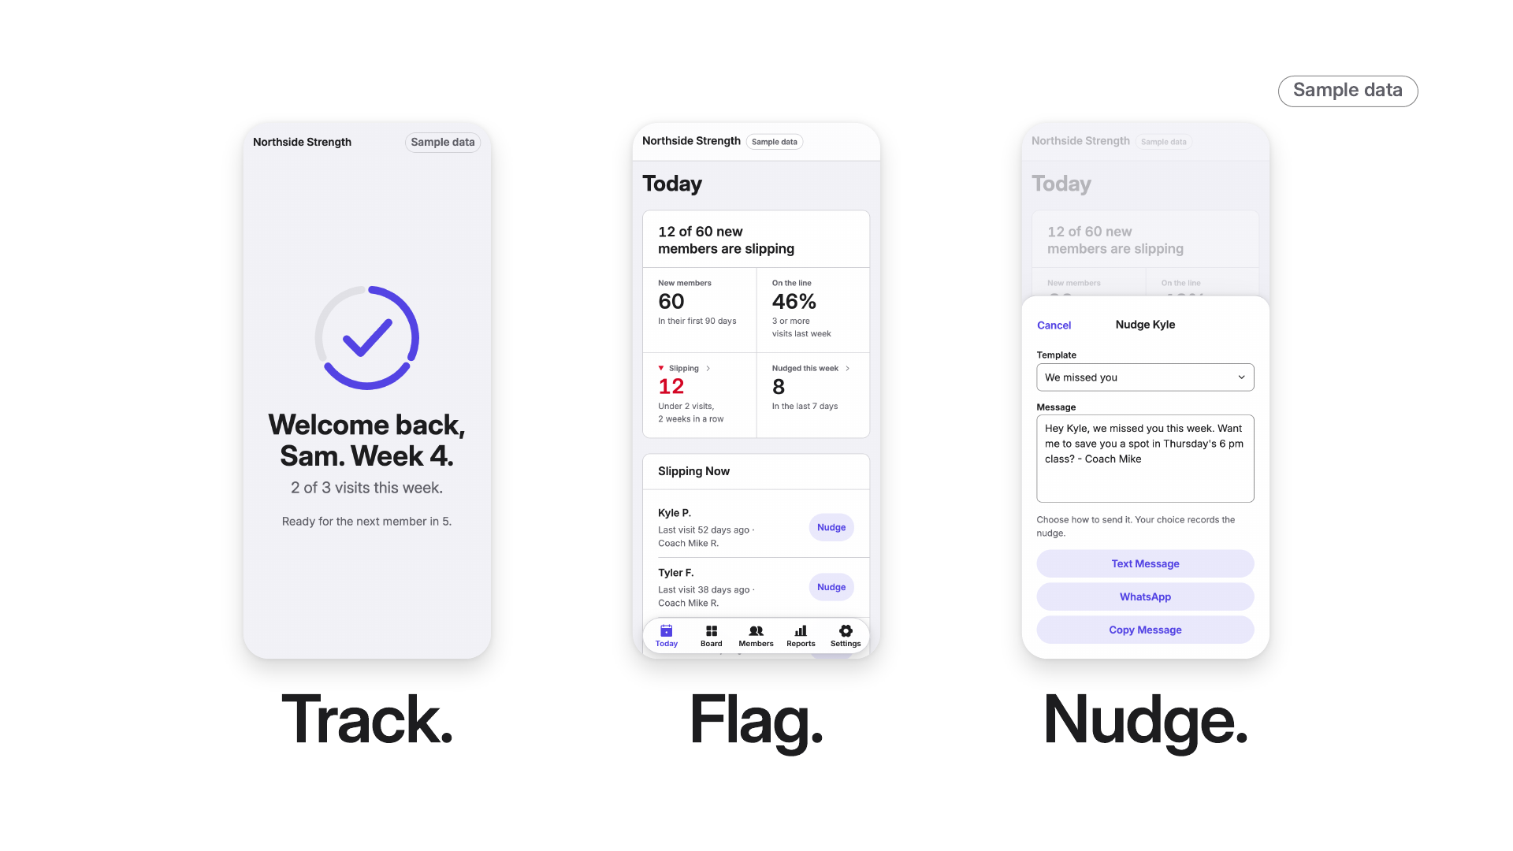
Notes:
It works in three steps. Press once for each; the screens come in one at a time.
Track. A member checks in at the front-desk kiosk with their phone number, and the welcome shows their week. Every new member's check-ins land on one board, for 90 days. (Press.)
Flag. Two weeks in a row under 2 visits and they're flagged as slipping, right on Today, while there is still time. (Press.)
Nudge. One tap opens a personal text from you or their coach, ready to send. The app never sends anything itself: the coach sends it from their own phone.

Slide 6
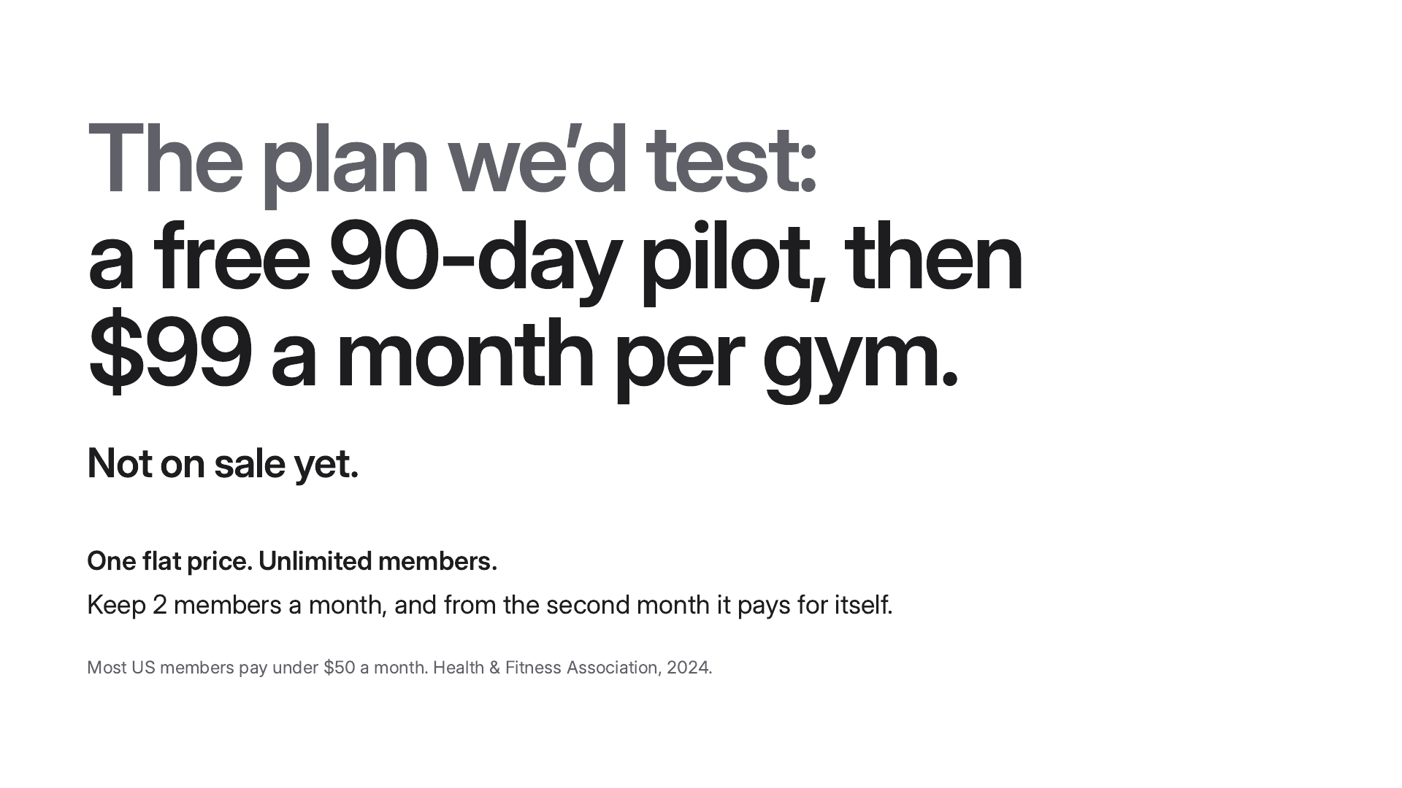
Notes:
Here's the plan we'd test: a free 90-day pilot, then $99 a month per gym. It's not on sale yet. One flat price, with unlimited members. Most US members pay under $50 a month, according to the Health and Fitness Association. So keep 2 members a month, and from the second month it pays for itself.

Slide 7
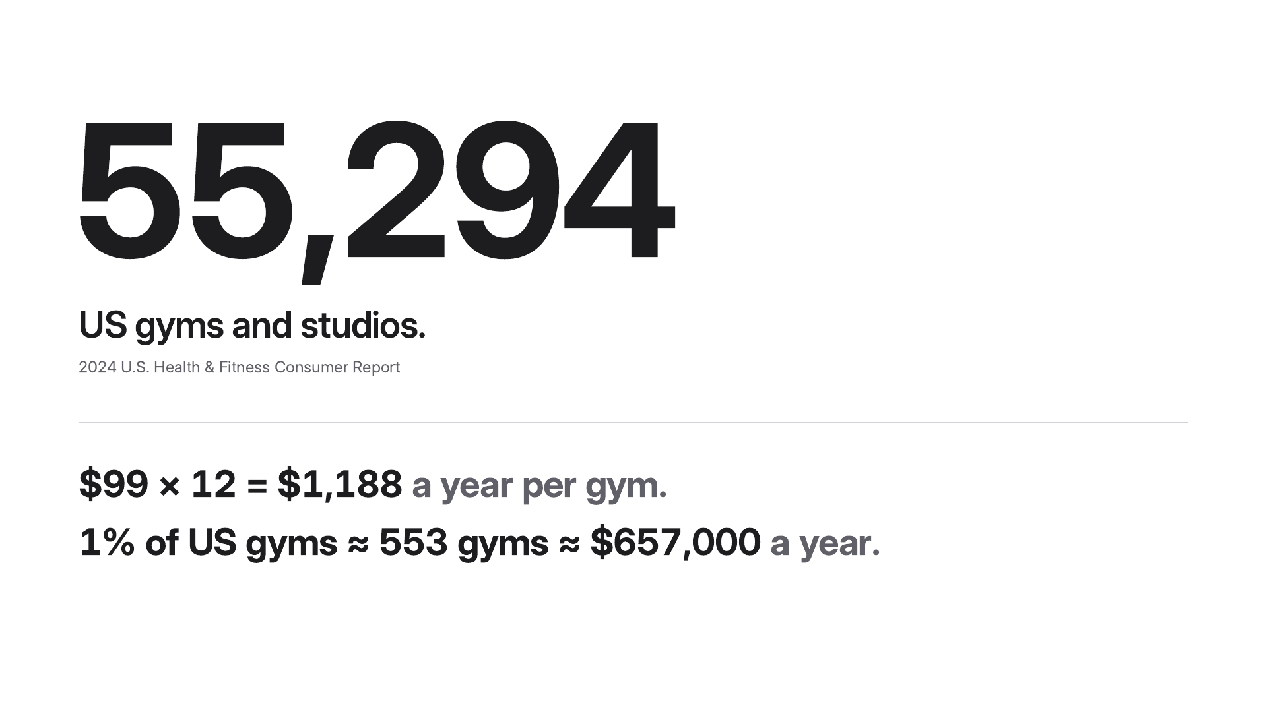
Notes:
Now the market. There are 55,294 gyms and studios in the US, from the 2024 U.S. Health and Fitness Consumer Report. At $99 a month, that's $1,188 a year per gym. One percent of US gyms is about 553 gyms, or about $657,000 a year. And here's where we fit. Some gym systems do flag members at risk, often on their bigger plans. Ours is the narrow version: only a new member's first 90 days, one rule anyone can check, and messages from the coach's own phone.

Slide 8
Notes:
That's Regulars: one board for the first 90 days, so you can see who's slipping while there's still time. Turn new members into regulars. We're Uzair Imran, Moiz Hamid, Zain ul Abideen and Ali Hassan. Thank you. We'll take your questions.

