Slide 1
黑龙江
浅谈
2020上半年人均GDP
许万鹏 信息安全19-01班

Slide 2
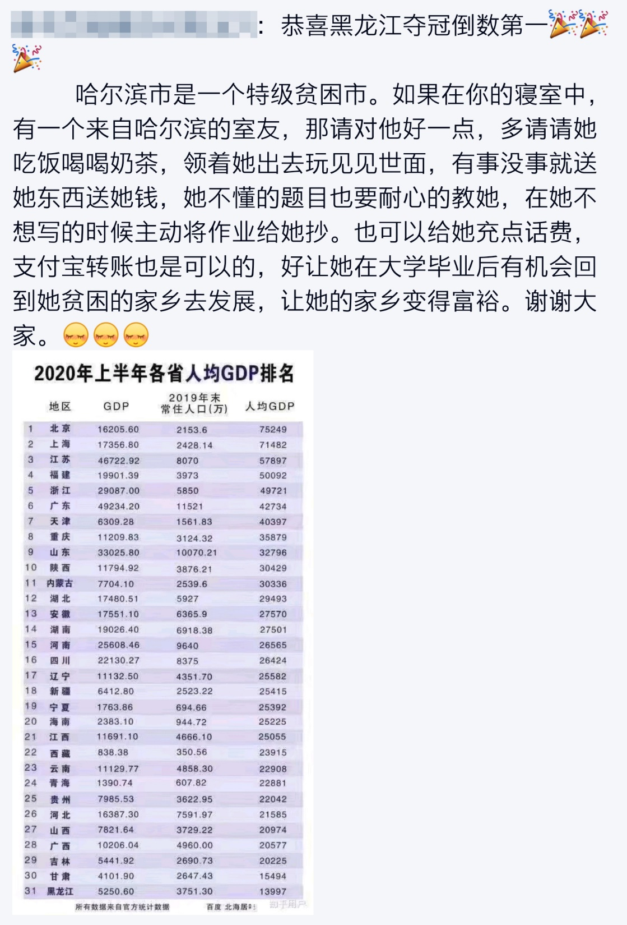

Slide 3
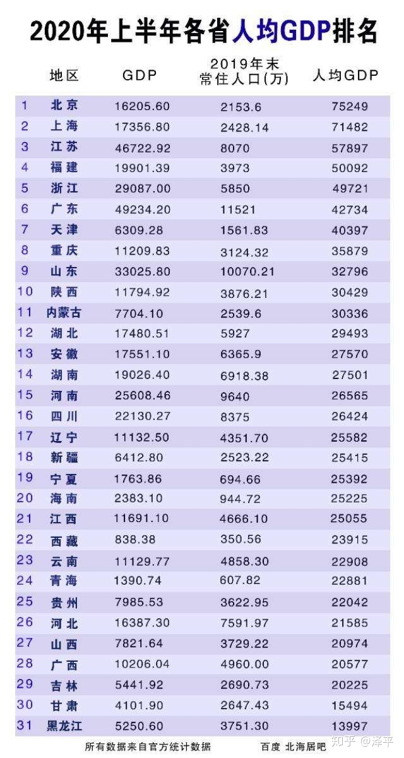

Slide 4
为什么？

Slide 5
1.疫情

Slide 6

Real GDP per capita=$\frac{\begin{aligned}\text{Gross} \text{Domestic} \text{Product} \\ \end{aligned}}{\begin{aligned} \\ \text{population} \text{base}\end{aligned}}$

Slide 7
2.人口流出

Slide 8
Real GDP per capita=$\frac{\begin{aligned}\text{Gross} \text{Domestic} \text{Product} \\ \end{aligned}}{\begin{aligned} \\ \text{population} \text{base}\end{aligned}}$

Slide 9
3.响应当时号召

Slide 10
Real GDP per capita=$\frac{\begin{aligned}\text{Gross} \text{Domestic} \text{Product} \\ \end{aligned}}{\begin{aligned} \\ \text{population} \text{base}\end{aligned}}$

Slide 11
展望

Slide 12
谢谢大家！

