Slide 1
Transferable Sparse Adversarial Attack against Deep Learning Models
Wanpeng Xu

Slide 2
Contents
Seminal Work
Research Status of Adversarial Attacks
Research Status of Adversarial Training
Our Work — Transferable Sparse Adversarial Attack

Slide 3
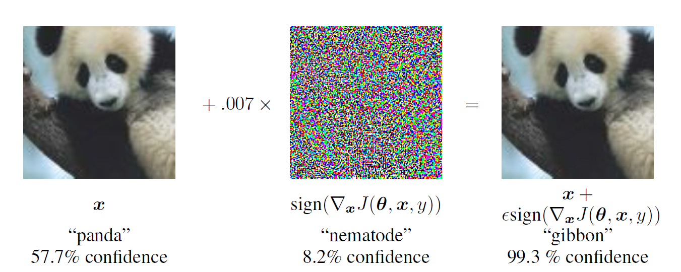
Seminal Work

Slide 4
Research Status of Adversarial Attacks
White-box Attack
FGSM
DeepFool
C&W
PGD / PGD₀
JSMA
SparseFool
…
Black-box Attack
ZOO
Boundary Attack
UAP
One Pixel Attack
Pointwise Attack
CornerSearch
…
Notes:
White-box / Black-box Attack
Targeted / Untargeted Attack
Gradient / Optimization / GAN -based Attack
ℓ₀ / ℓ₂ / ℓ∞ Attack
…
FGSM：Fast Gradient Sign Method
DeepFool：DeepFool Attack
C&W：Carlini and Wagner Attack
PGD / PGD0：Projected Gradient Descent 投影梯度下降
JSMA：Jacobian-based Saliency Map Attack
SparseFool：SparseFool Attack
ZOO：Zeroth Order Optimization 零阶优化
UAP：Universal Adversarial Perturbation

Slide 5
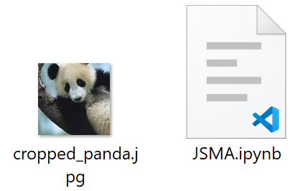
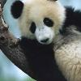
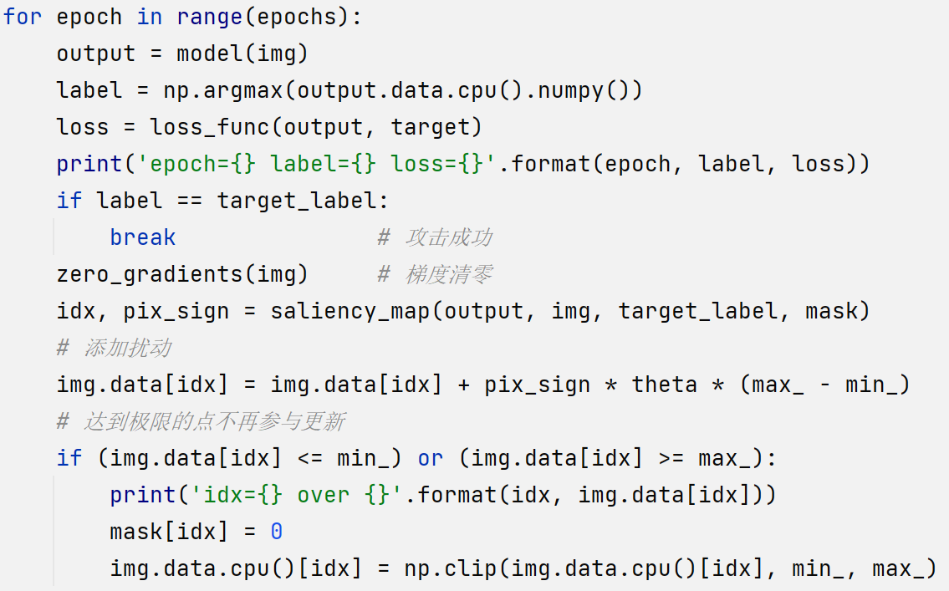
JUST TRY IT! JSMA!
GPU: 5 seconds or less
CPU: 1 minute or less
Notes:
Jacobian-based Saliency Map Attack

Slide 6
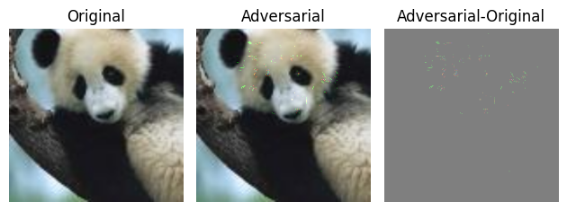
Attack Result
Notes:
Jacobian-based Saliency Map Attack

Slide 7
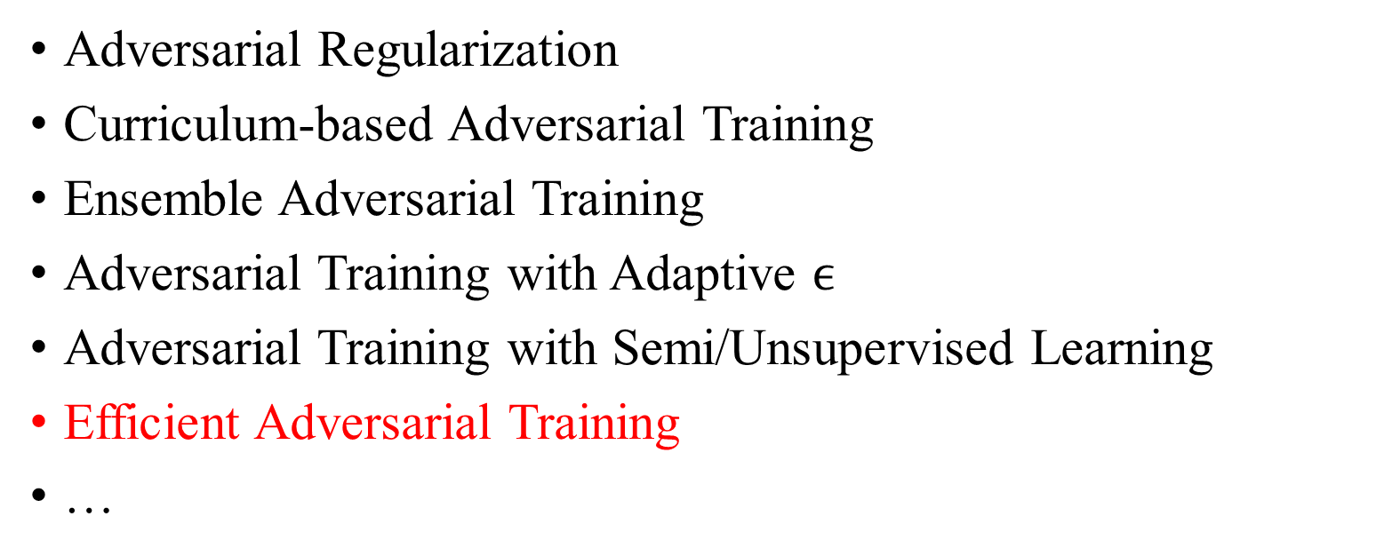
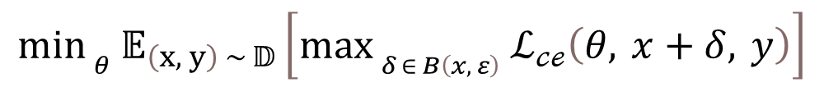
Research Status of Adversarial Training
$$\min_{ _{θ}} 𝔼_{\left(x, y\right) ∼ 𝔻}\left[\max_{ _{δ ∈ B\left(x, ε\right)} }ℒ_{𝒸ℯ}\left(θ, x+δ, y\right)\right]$$
Adversarial Regularization
Curriculum-based Adversarial Training
Ensemble Adversarial Training
Adversarial Training with Adaptive $ϵ$
Adversarial Training with Semi/Unsupervised Learning
Efficient Adversarial Training
…
Notes:
对抗正则化（Adversarial Regularization）
基于课程的对抗训练（Curriculum-based Adversarial Training）
集成对抗训练（Ensemble Adversarial Training）
自适应$ε$对抗训练（Adversarial Training with Adaptive $ϵ$）
自监督/无监督对抗训练（Adversarial Training with Semi/Unsupervised Learning）
高效对抗训练（Efficient Adversarial Training）
…

Slide 8
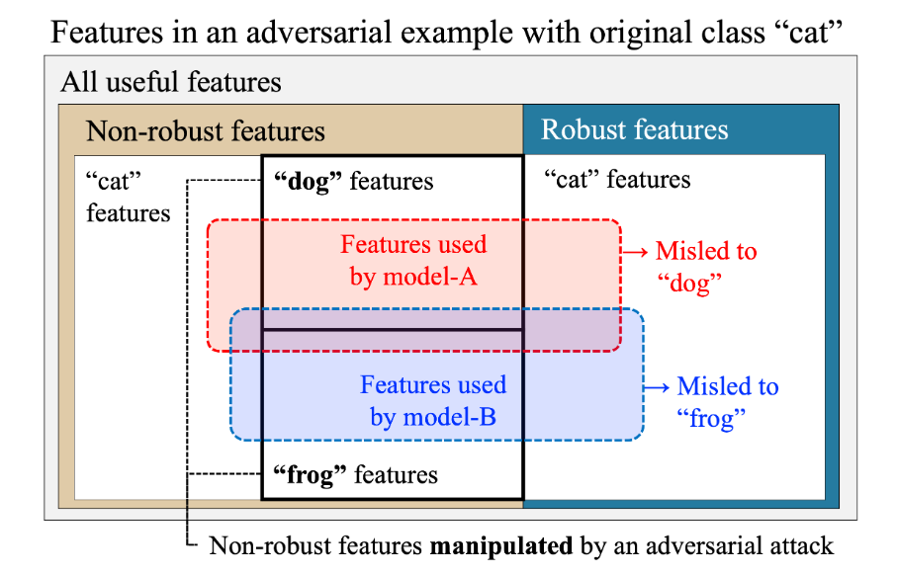
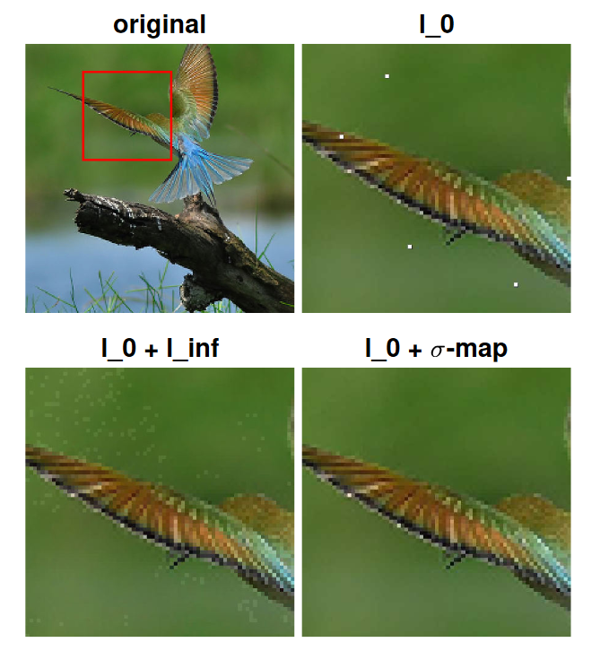
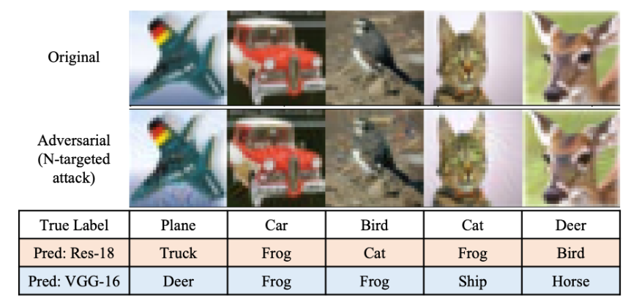
Our Work — Transferable Sparse Adversarial Attack
Transferability
Sparsity
Notes:
对抗正则化（Adversarial Regularization）
基于课程的对抗训练（Curriculum-based Adversarial Training）
集成对抗训练（Ensemble Adversarial Training）
自适应$ε$对抗训练（Adversarial Training with Adaptive $ϵ$）
自监督/无监督对抗训练（Adversarial Training with Semi/Unsupervised Learning）
高效对抗训练（Efficient Adversarial Training）
…

Slide 9
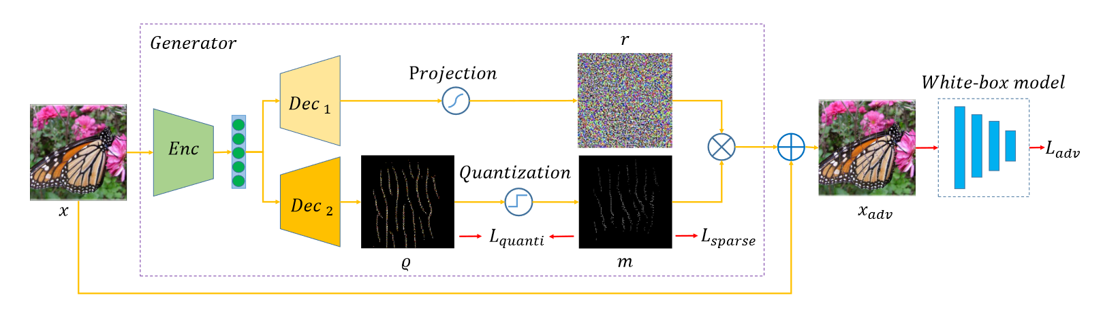

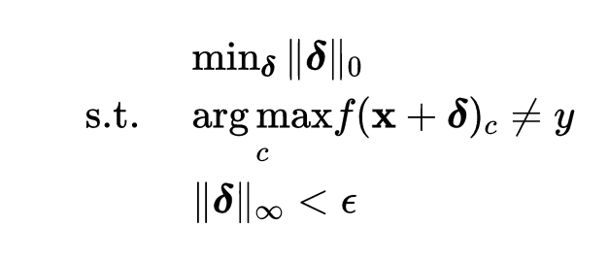
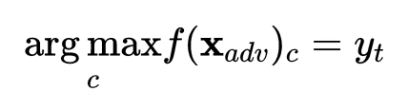



Trainable Generator Architecture

Slide 10
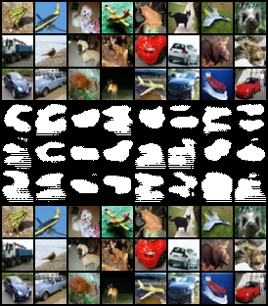
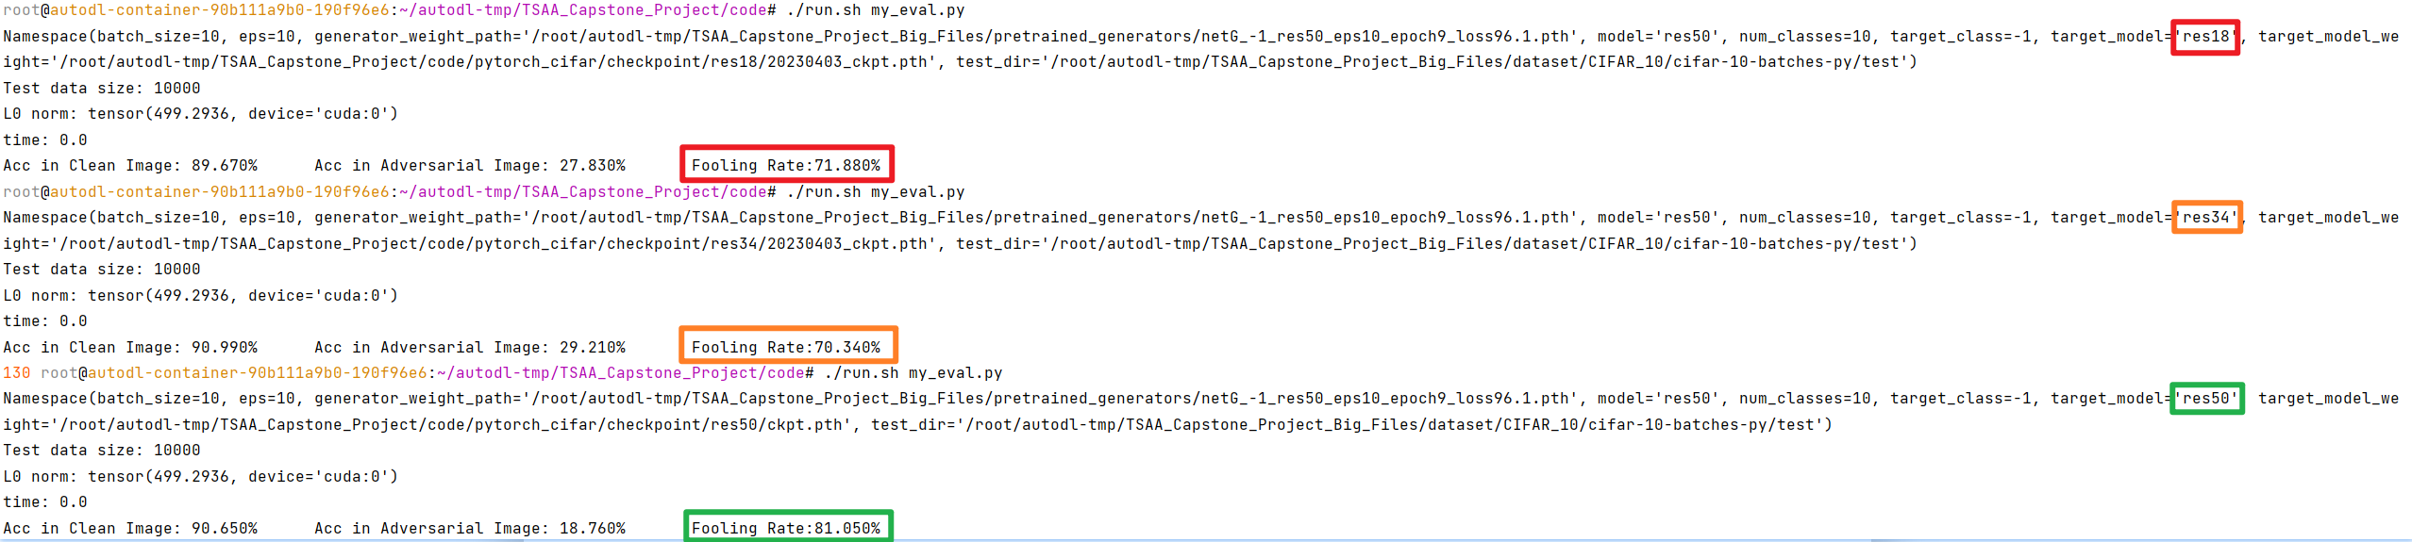
Attack Result
Original image
Mask image
Adversarial image
Notes:
Jacobian-based Saliency Map Attack

Slide 11
Thanks for Listening!

