Slide 1


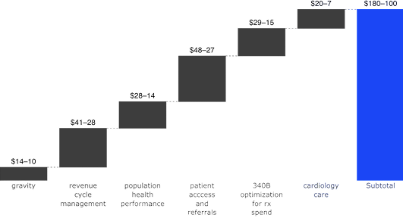
health_care_name
Impact
$5M - $8M
Top Value Pool
Note: Chart shows gross revenue and cost impact (preliminary estimate using Innovaccer + industry benchmarks). To be refined with system data.

Slide 2

Gravity — Data Platform
AI-enabled IT ops optimization & consolidation
Lever Breakdown
Value Lever
Impact
Value Area
Calculation
Infrastructure Rationalization
$M - $M
Operating Expense - Reduced Avoidable ED Utilization
10-15% reduction in preventable ED visits (28% of ED visits) x Avg. cost per ED visit
Note: Chart shows gross revenue and cost impact (preliminary estimate using Innovaccer + industry benchmarks). To be refined with system data.

Slide 3
Cross suite priorities
Delivers measurable impact across cost, risk, and quality — enabling systems to thrive in value-based care. By unifying data, analytics, and AI across the enterprise, it transforms disconnected workflows into coordinated, intelligent operations.
Innovaccer helps health systems achieve measurable, repeatable, and scalable impact—improving clinical outcomes, enhancing operational efficiency, and accelerating their journey toward data-driven, AI-enabled value-based care.
Key Assumptions
Delivers measurable impact across cost, risk, and quality — enabling systems to thrive in value-based care. By unifying data, analytics, and AI across the enterprise, it transforms disconnected workflows into coordinated, intelligent operations.
Innovaccer helps health systems achieve measurable, repeatable, and scalable impact—improving clinical outcomes, enhancing operational efficiency, and accelerating their journey toward data-driven, AI-enabled value-based care.

Slide 4
Assumptions
PARAMETER
MODEL ESTIMATE
USER INPUT (Overrite)
Net Patient Service Revenue
Impact
Value Area
Impact
Total Physicians
Impact
Value Area
Impact
Total Patients Treated
Impact
Value Area
Impact
FFS Patients Treated
Impact
Value Area
Impact
VBC Lives Attributed
Impact
Value Area
Impact
Share of Medicare in payer mix
Impact
Value Area
Impact
Number of Care Managers
Impact
Value Area
Impact
MSSP ACO
Impact
Value Area
Impact

