Slide 1
How to Establish a New Business
--Wanting Miao

Slide 2
PROBLEM & BACKGROUND
Toronto is one of the most famous places in the world. We want to explore how to establish a new business from a market point of view regarding food, accommodation, beautiful places, and many more.
When it comes to a new business, it is important to explore the competition in the area, especially for a busy area. As we all known, establishing a good business idea is one of the pillars of the success and the people most often fails if there is not enough researches from a market prospective, like friendly environment. Every city is unique in their own way and give something new. And now the information is so common regarding location of every place around the world on your fingertips which make it easier to explore.
Therefore, this project designed to explore the existed business around the Toronto on the basis of available information, which will generate the new business ideas based on the research.

Slide 3
DATA DESCRIPTION
For this problem, we will get the services of Foursquare API to explore the data, in terms of their neighborhoods. The data also include the information about the places around each neighborhood like restaurants, hotels, coffee shops, parks. We selected one Borough from each city to analyze their neighborhoods.
Data source: 'https://en.wikipedia.org/wiki/List_of_postal_codes_of_Canada:_M'

Slide 4
METHODOLOGY
We will use machine learning technique, “Clustering”, K-means to segment the neighborhoods with similar objects on the basis of each neighborhood data and explore more about these clusters based on the model. This will help to locate the target business’s areas and hubs, and then we can judge the best location to start a new business.
k-means clustering is rather easy to apply to even large data sets, particularly when using heuristics such as Lloyd's algorithm. It has been successfully used in market segmentation, computer vision, and astronomy among many other domains. It often is used as a preprocessing step for other algorithms, for example to find a starting configuration.

Slide 5
EXPLORATION
For our target country: Toronto, we first have to clean and tidy our dirty data, including extracting table from Wikipedia page by beautifulsoup method.
Then we plan to explore the data according to our requirements. In the processing phase, which applied multiple steps, eliminating “Not assigned” values, combine neighborhoods. For data verification and further exploration, we use Foursquare API to get the coordinates of Toronto and explore its neighborhoods. The neighborhoods are further characterized as venues and venue categories.We cluster our locations based on their characters and explore each cluster after our kmeans methodology.
This appoarch will help us to generate the whole picture of the business existed in Toronto place and help us to decide our ultimate business location and type.

Slide 6
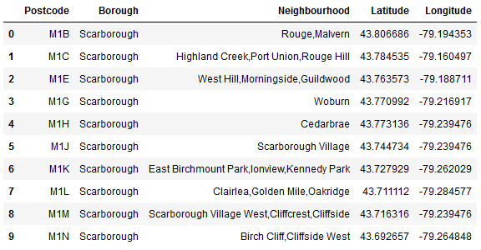
Clean dataset

Slide 7
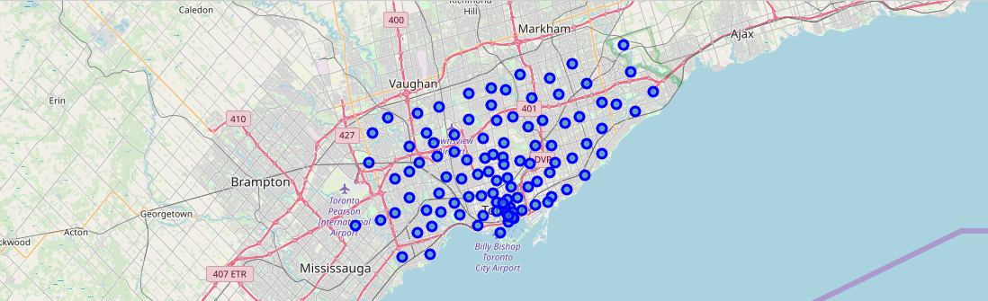
locatons density
Ideal location which is a busy area.

Slide 8
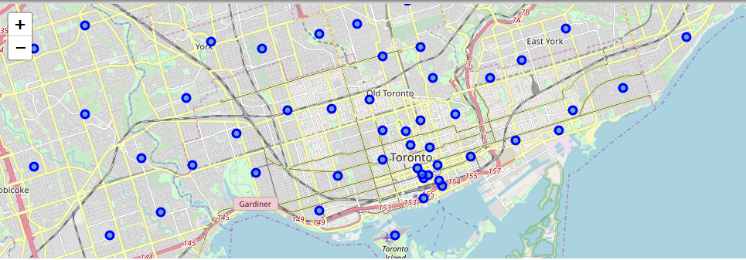
Zoom in
Ideal location which is a busy area.

Slide 9
Top 50 venues
Top 50 venues that are in Studio District within a radius of 200 meters. We can figure out the environment here to better decide our business according to the environment:
'headerLocation': 'Leslieville',
'headerFullLocation': 'Leslieville, Toronto',
'headerLocationGranularity': 'neighborhood',
'totalResults': 15,
'suggestedBounds': {'ne': {'lat': 43.6613255018, 'lng': -79.33843958229481},
'sw': {'lat': 43.6577254982, 'lng': -79.3434064177052}},
'groups': [{'type': 'Recommended Places',
'name': 'recommended',
'items': [{'reasons': {'count': 0,
'items': [{'summary': 'This spot is popular',
'type': 'general',
'reasonName': 'globalInteractionReason'}]},
'venue': {'id': '4ad7e958f964a520001021e3',
'name': "Ed's Real Scoop",
......

Slide 10
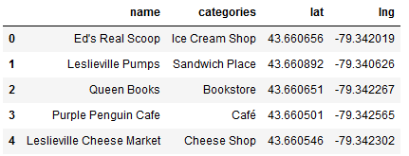
Category of the venue
We can identify that the categories are: Ice Cream Shop, Sandwich Place, Bookstore, Cafe and Cheese shop. Four of the five are related to the food and one of them is related to the education area. Three of the food area are related to the fast food, including ice cream, cafe and sandwich. We can generate that most people will tend to get fast food in the revenue. We considered that fast food industry is one of our top choice when it come to a new business in Toronoto.

Slide 11
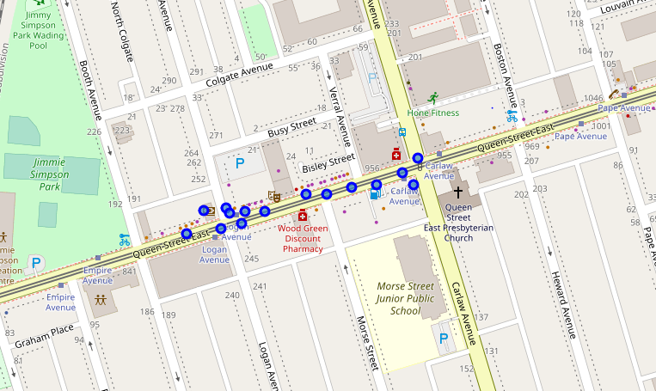
Studio District neighborhood

Slide 12
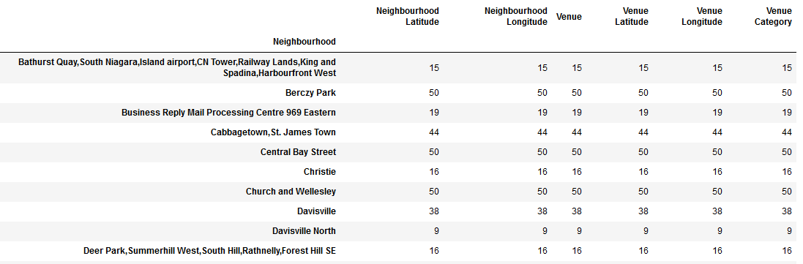
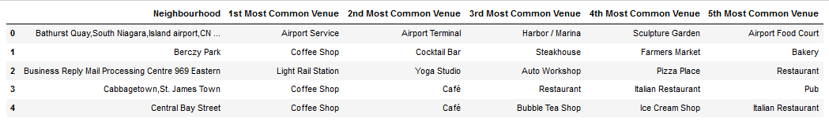
Top 5 most commen venue
We can identify that the most common renue are as picture above. We can consider cafe or other fast food around airport or other street listed above.

Slide 13
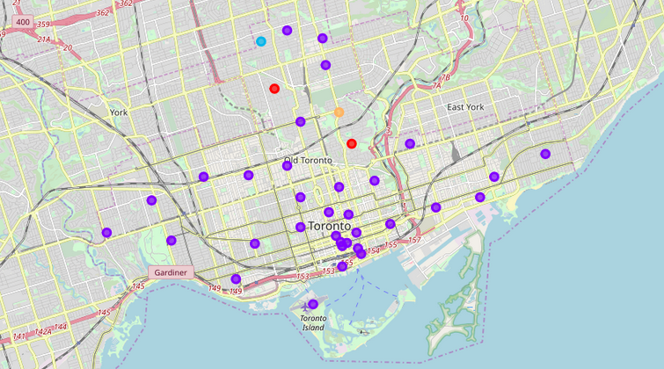
5 Clusters overview

Slide 14
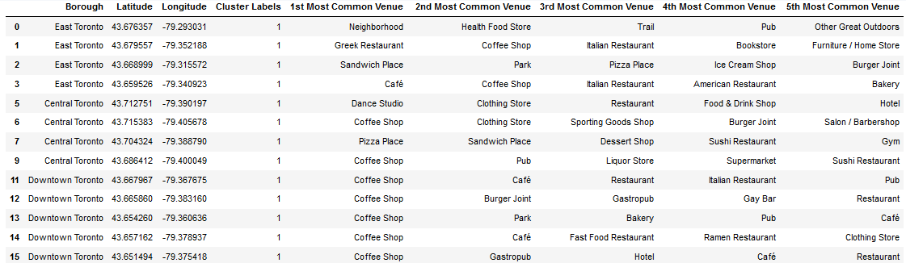
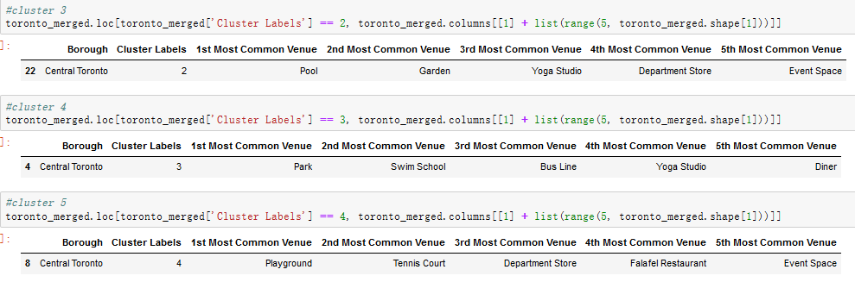
Detail for the clusters
We can see that downtown Toronto and central Toronto are in Borough for cluster1. Park is the most common revenue, then is trail, playground and restaurant. We consider that for this cluster, entertainment is the main function. If we have located this area, we can consider to build an entertainment business.
For our second cluster listed above, we can consider to run a coffee shop. While at the same time we should brand ourselves, because too many cafe here will lead to a intensive competition. If we want less competition, then we can try restuarant or gym nearby.
For the rest of clusters, we can find that the entertainment is the focus in these area. Therefore, we can develop some better entertainment activities in this area, or we can start some fast food business around which lead to less competiton in this area. To decide which locations and business type to choose, we should futher discuss the business strategy and type. Then combine the specific business type and mission of our new business, we can choose a suitable location.

Slide 15
Conclusion
We decide to establish our business in a location near the busy street, around the airport. We divided our choosed locations into 5 clusters and figure out the top 5 most common venue in the locations. We find most of them are related to entertainment. We can try to establish a fastfood resturant based on the current situation, which will reduce the competition and people tend to get food during the activity. While the entertainment business can also be established only if we have a blue ocean strategy which can attract more people for our the business.

