Slide 1
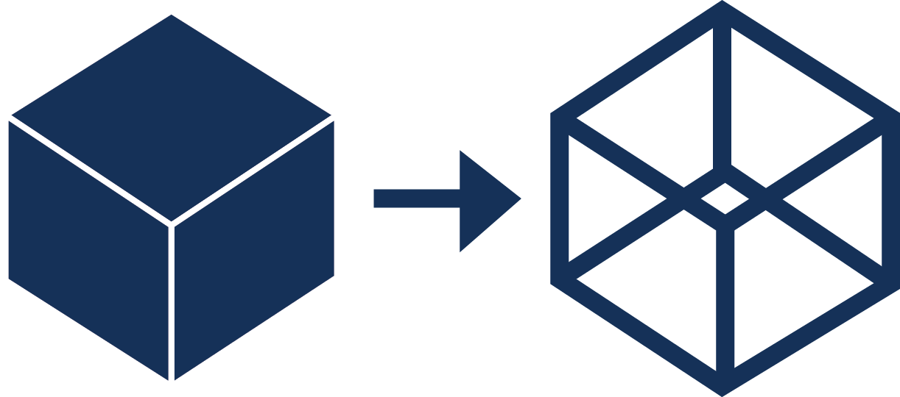
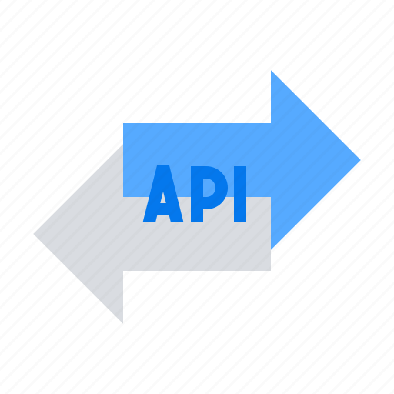

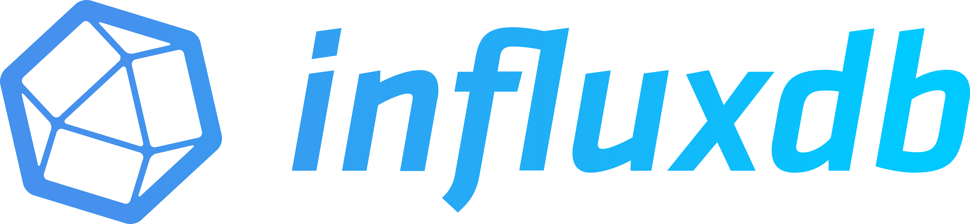
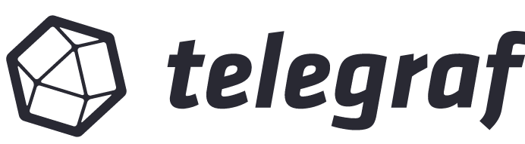
Digital Twin
Network-level AI/ML
AI Engine Platform
Centralized Database and Applications
Task Specification
AI Model Composition Training/Retraining
AI Deployment
and Inference
Monitoring and Virtualization
Data Ingestion and Pre-processing
Centralized Time Series Database
SDN controller
Telemetry Streaming
Local Time Series Database
…
Local AI/ML
Distributed Databases
Tx
Telemetry
Telemetry
Rx
Telemetry
Telemetry

Slide 2
Digital Twin
Network-level AI/ML
AI Engine Platform
Centralized Database and Applications
Task Specification
AI Model Composition Training/Retraining
AI Deployment
and Inference
Monitoring and Virtualization
Data Ingestion and Pre-processing
Centralized Time Series Database
SDN controller
Telemetry Streaming
Local Time Series Database
…
Telemetry
Local AI/ML
Telemetry
Distributed Databases
Telemetry
Telemetry
Tx
Rx

Slide 3
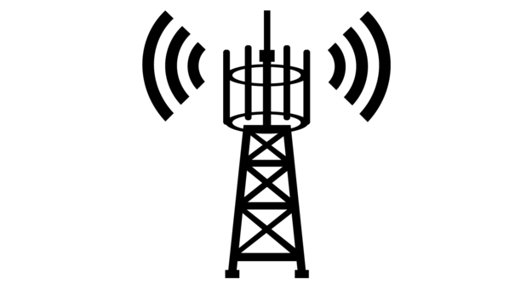
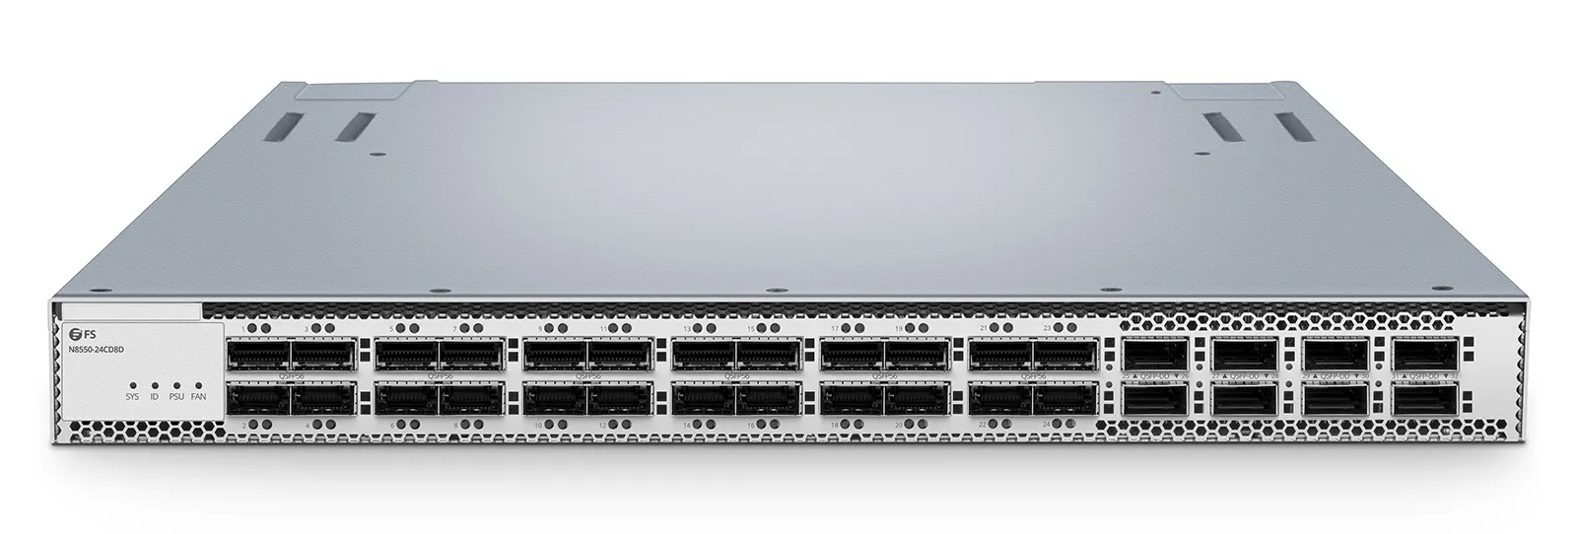
Telemetry
Telemetry

Slide 4
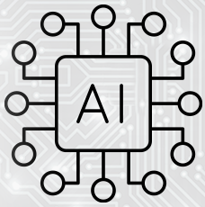
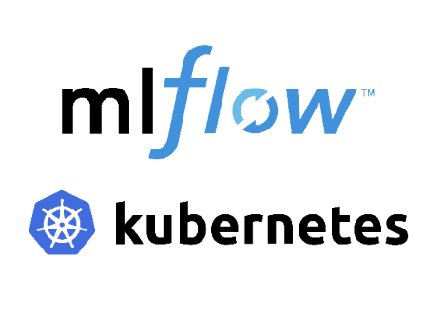
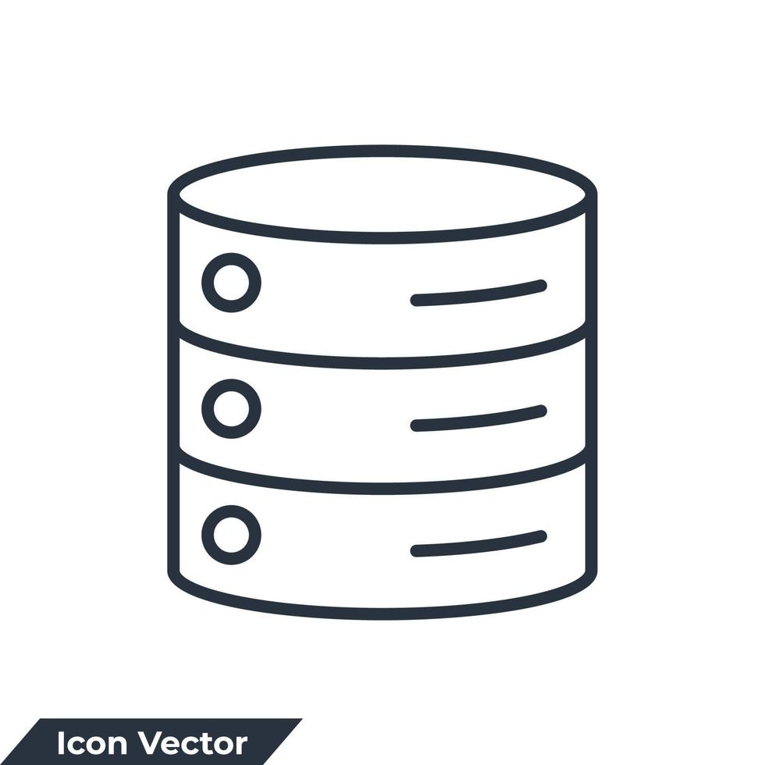
Telemetry
Telemetry
Telemetry

Slide 5
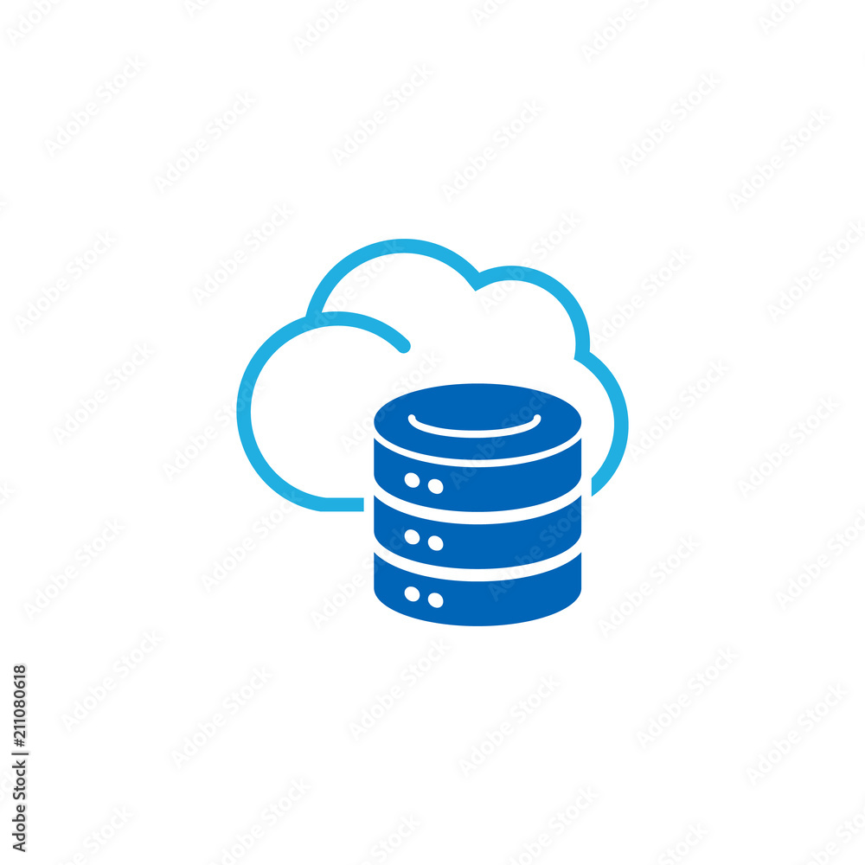
Centralized Database
Telemetry
Telemetry
Telemetry

Slide 6



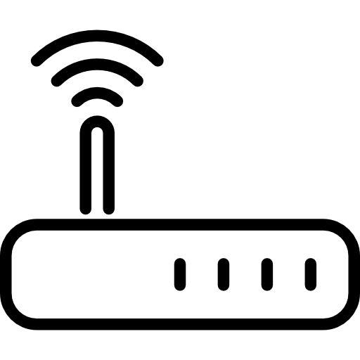

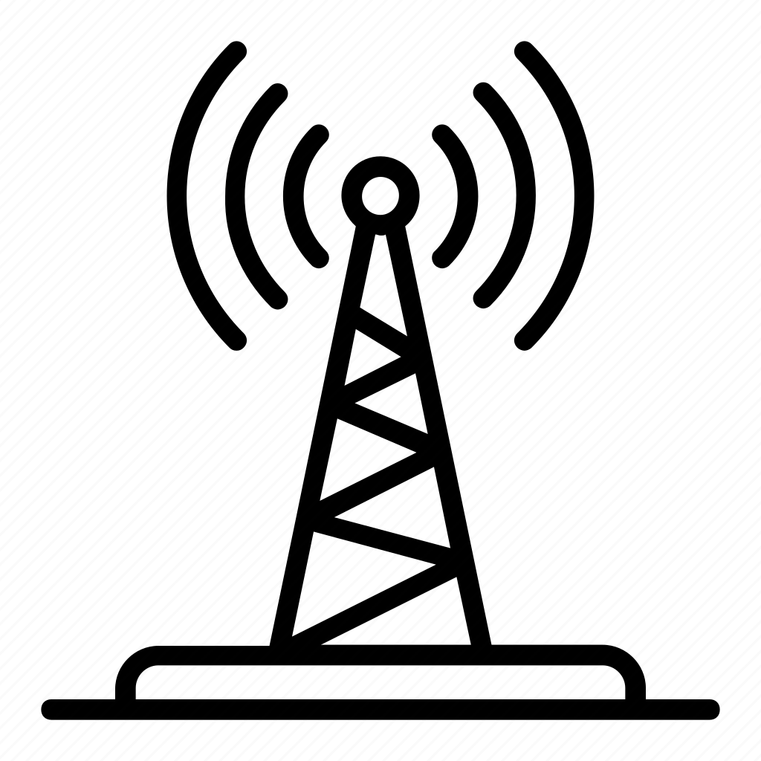

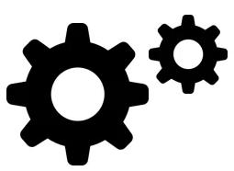
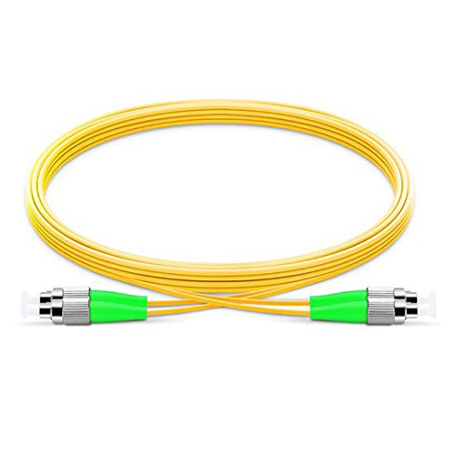
Centralized Database and Applications
SDN Controller
Network Digital Twin
Network-Level AI/ML
AI Engine Platform
Radio Access Network 1
Telemetry
Task Specification
AI Model Composition Training/Retraining
AI Deployment
and Inference
Monitoring and Virtualization
Radio Access Network 2
Telemetry
Data Ingestion and Pre-processing
RAN Two
AI Deployment
and Inference
Local AI/ML
Local Database
Centralized Time Series Database
Local Database
Local AI/ML
......
......
Kafka-based Telemetry Pipeline
Telemetry
Local AI/ML
Telemetry
Local AI/ML
Telemetry
Local AI/ML
Telemetry
Local AI/ML
Aggregation Node 1
Optical Transport Network
Aggregation Node 2

Slide 7


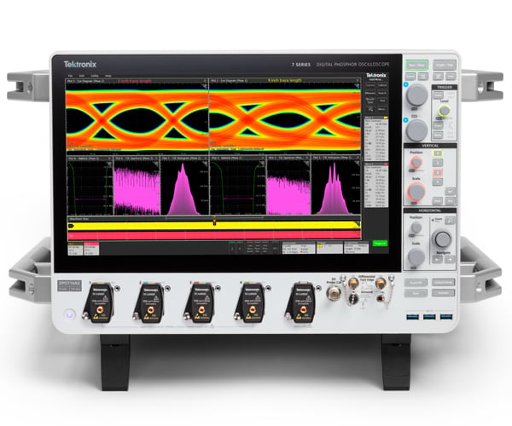
Radio Access Network 1
Network Digital Twin
Centralized Database and Applications
SDN Controller
Network Digital Twin
Radio Access Network 2
Network Digital Twin
Network-Level AI/ML
AI Engine Platform
Telemetry
Task Specification
AI Model Composition Training/Retraining
AI Deployment
and Inference
Monitoring and Virtualization
SDN Controller
Data Ingestion and Pre-processing
RAN Two
SDN Controller
Telemetry
AI Deployment
and Inference
Local AI/ML
Local Database
Centralized Time Series Database
Local Database
Local AI/ML
......
......
Kafka-based Telemetry Pipeline
Telemetry
Local AI/ML
Telemetry
Local AI/ML
Telemetry
Local AI/ML
Telemetry
Local AI/ML
Tx/Rx
Tx/Rx
Polarization Sensing
Polarization Sensing
Aggregation Node 1
Optical Transport Network
Aggregation Node 2

Slide 8
Wireless Access Network 1
RAN Controller
Centralized Database and Applications
SDN Controller
RAN Controller
Wireless Access Network 2
Network Digital Twin
Network-Level AI/ML
AI Engine Platform
Task Specification
AI Model Composition Training/Retraining
AI Deployment
and Inference
Monitoring and Virtualization
Telemetry
Access Network Digital Twin
Data Ingestion and Pre-processing
RAN Two
Access Network Digital Twin
Telemetry
AI Deployment
and Inference
Centralized Time Series Database
Local AI/ML
Local Database
Local Database
Local AI/ML
......
Kafka-based Telemetry Pipeline
......
Telemetry
Local AI/ML
Telemetry
Local AI/ML
Telemetry
Local AI/ML
Telemetry
Local AI/ML
Tx/Rx
Tx/Rx
Polarization Sensing
Polarization Sensing
Aggregation Node 1
Optical Transport Network
Aggregation Node 2

Slide 9


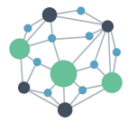
Access Network Digital Twin
Centralized Database and Applications
Access Network Digital Twin
OTN
Digital Twin
Network-Level AI/ML
AI Engine Platform
SDN Controller
Local AI/ML
Local Database
Task Specification
AI Model Composition Training/Retraining
AI Deployment
and Inference
Monitoring and Virtualization
Local Database
Local AI/ML
Sensing
Telemetry
Data Ingestion and Pre-processing
RAN Two
Telemetry
Sensing
RAN Controller
Wireless Access Network 2
Wireless Access Network 1
v
AI Deployment
and Inference
RAN Controller
Centralized Time Series Database
Kafka-based Telemetry Pipeline
Node 1 DB
Node 2 DB
…
Node 5 DB
Node 6 DB
Semantic Interface
RAN-OTN Semantic Channel
Local AI/ML
Local AI/ML
Local AI/ML
Local AI/ML
Semantic Interface
RAN-OTN Semantic Channel
Telemetry Data: Performance Monitoring
Device Configurations
Telemetry
Telemetry
Sensing Platform
SOP, CD, PMD, Temperature, Backscatter Trace
Aggregation Node 1
Intermediate Node 2
Optical Transport Network Physical Layer
Intermediate Node 5
Aggregation Node 6

Slide 10
Access Network Digital Twin
Centralized Database and Applications
Access Network Digital Twin
OTN
Digital Twin
Network-Level AI/ML
AI Engine Platform
SDN Controller
Local AI/ML
Local Database
Task Specification
AI Model Composition Training/Retraining
AI Deployment
and Inference
Monitoring and Virtualization
Local Database
Local AI/ML
Sensing
Telemetry
Data Ingestion and Pre-processing
RAN Two
Telemetry
Sensing
RAN Controller
Wireless Access Network 2
Wireless Access Network 1
v
AI Deployment
and Inference
RAN Controller
Centralized Time Series Database
Kafka-based Telemetry Pipeline
Node 1 DB
Node 2 DB
…
Node 5 DB
Node 6 DB
Local AI/ML
Local AI/ML
Local AI/ML
Local AI/ML
Telemetry
Telemetry
Performance Monitoring
Device Configurations/Parameters
Sensing Data
SOP, CD, PMD, Temperature, Backscatter Trace
Aggregation Node 1
Intermediate Node 2
Optical Transport Network Physical Layer
Intermediate Node 5
Aggregation Node 6

Slide 11
Access Network Digital Twin
Centralized Database and Applications
Access Network Digital Twin
OTN
Digital Twin
Network-Level AI/ML
AI Engine Platform
SDN Controller
Local AI/ML
Local Database
Task Specification
AI Model Composition Training/Retraining
AI Deployment
and Inference
Monitoring and Virtualization
Local Database
Local AI/ML
Sensing
Telemetry
Data Ingestion and Pre-processing
RAN Two
Telemetry
Sensing
RAN Controller
Wireless Access Network 2
Wireless Access Network 1
v
AI Deployment
and Inference
RAN Controller
Centralized Time Series Database
Kafka-based Telemetry Pipeline
Node 1 DB
Node 2 DB
…
Node 5 DB
Node 6 DB
Local AI/ML
Local AI/ML
Local AI/ML
Local AI/ML
Telemetry
Telemetry
Performance Monitoring
Device Configurations/Parameters
Sensing Data
SOP, CD, PMD, Temperature, Backscatter Trace
Aggregation Node 1
Intermediate Node 2
Optical Transport Network Physical Layer
Intermediate Node 5
Aggregation Node 6

Slide 12
Access Network Digital Twin
Centralized Database and Applications
Access Network Digital Twin
OTN
Digital Twin
Network-Level AI/ML
AI Engine Platform
SDN Controller
Local AI/ML
Local Database
Task Specification
AI Model Composition Training/Retraining
AI Deployment
and Inference
Monitoring and Virtualization
Semantic
Encoder
Local Database
Local AI/ML
Sensing
Telemetry
Data Ingestion and Pre-processing
RAN Two
Telemetry
Sensing
RAN Controller
Wireless Access Network 2
Wireless Access Network 1
v
AI Deployment
and Inference
RAN Controller
Centralized Time Series Database
Kafka-based Telemetry Pipeline
Node 1 DB
Node 2 DB
…
Node 5 DB
Node 6 DB
Local AI/ML
Local AI/ML
Local AI/ML
Local AI/ML
Telemetry
Telemetry
Performance Monitoring
Device Configurations/Parameters
Sensing Data
SOP, CD, PMD, Temperature, Backscatter Trace
Aggregation Node 1
Intermediate Node 2
Optical Transport Network Physical Layer
Intermediate Node 5
Aggregation Node 6

Slide 13
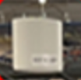

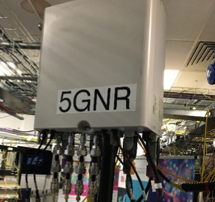




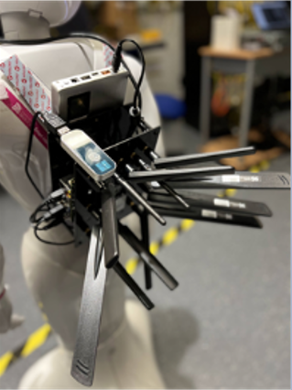
Tx
Rx
WiFi6 AP
LiFi AP
5G RU
MPTCP
Multi-access CPE

Slide 14




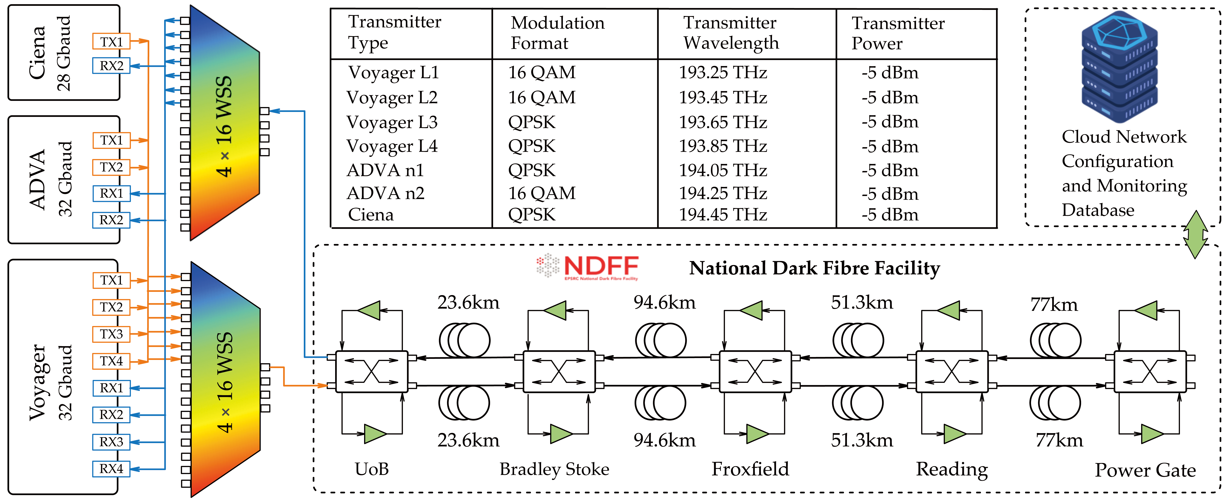
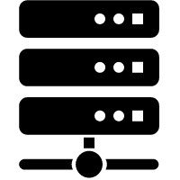


MPTCP
Proxy
VPN
NAT
DNS
Datacentre
with GPU
Robot VNFs
RADIUS
DHCP
Etc.
Switches
5G Network Management
Edge Cluster
5G Core
WiFi Controller
LiFi Controller
5G CU+DU
WiFi6 AP
LiFi AP
5G RU
MPTCP
Multi-access
CPE
Lab Testing Area
Robot

Slide 15
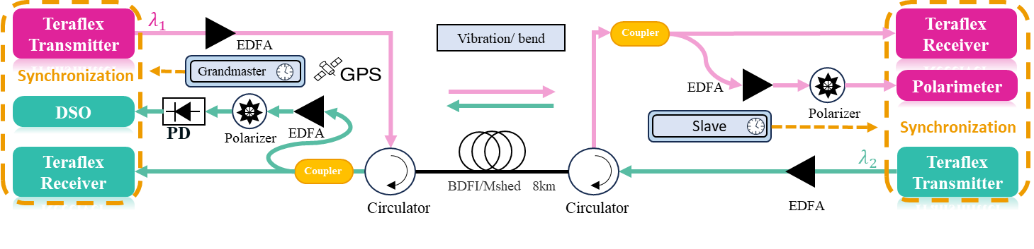
(a)
MPTCP
Proxy
VPN
NAT
DNS
Datacentre
with GPU
VNFs
RADIUS
DHCP
Etc.
Switches
5G Network Management
Edge Cluster
5G Core
WiFi Controller
LiFi Controller
5G CU+DU
WiFi6 AP
LiFi AP
5G RU
MPTCP
···
MPTCP
(b)
Multi-Access CPE 1
Multi-Access CPE 4
(c)

Slide 16
Wireless Access Network 1
RAN Controller
Centralized Database and Applications
SDN Controller
RAN Controller
Wireless Access Network 2
Network Digital Twin
Network-Level AI/ML
AI Engine Platform
Task Specification
AI Model Composition Training/Retraining
AI Deployment
and Inference
Monitoring and Virtualization
Telemetry
Access Network Digital Twin
Data Ingestion and Pre-processing
RAN Two
Access Network Digital Twin
Telemetry
AI Deployment
and Inference
Centralized Time Series Database
Local AI/ML
Local Database
Local Database
Local AI/ML
......
Kafka-based Telemetry Pipeline
......
Telemetry
Local AI/ML
Telemetry
Local AI/ML
Telemetry
Local AI/ML
Telemetry
Local AI/ML
Tx/Rx
Tx/Rx
Polarization Sensing
Polarization Sensing
Aggregation Node 1
Optical Transport Network
Aggregation Node 2

Slide 17
Access Network Digital Twin
Centralized Database and Applications
Access Network Digital Twin
OTN
Digital Twin
Network-Level AI/ML
AI Engine Platform
SDN Controller
Local AI/ML
Local Database
Task Specification
AI Model Composition Training/Retraining
AI Deployment
and Inference
Monitoring and Virtualization
Local Database
Local AI/ML
Sensing
Telemetry
Data Ingestion and Pre-processing
RAN Two
Telemetry
Sensing
RAN Controller
Wireless Access Network 2
Wireless Access Network 1
v
AI Deployment
and Inference
RAN Controller
Centralized Time Series Database
Kafka-based Telemetry Pipeline
Node 1 DB
Node 2 DB
…
Node 5 DB
Node 6 DB
Semantic Interface
RAN-OTN Semantic Channel
Local AI/ML
Local AI/ML
Local AI/ML
Local AI/ML
Semantic Interface
RAN-OTN Semantic Channel
Telemetry Data: Performance Monitoring
Device Configurations
Telemetry
Telemetry
Sensing Platform
SOP, CD, PMD, Temperature, Backscatter Trace
Aggregation Node 1
Intermediate Node 2
Optical Transport Network Physical Layer
Intermediate Node 5
Aggregation Node 6

Slide 18
Access Network Digital Twin
Centralized Database and Applications
Access Network Digital Twin
OTN
Digital Twin
Network-Level AI/ML
AI Engine Platform
SDN Controller
Local AI/ML
Local Database
Task Specification
AI Model Composition Training/Retraining
AI Deployment
and Inference
Monitoring and Virtualization
Local Database
Local AI/ML
Sensing
Telemetry
Data Ingestion and Pre-processing
RAN Two
Telemetry
Sensing
RAN Controller
Wireless Access Network 2
Wireless Access Network 1
v
AI Deployment
and Inference
RAN Controller
Centralized Time Series Database
Kafka-based Telemetry Pipeline
Node 1 DB
Node 2 DB
…
Node 5 DB
Node 6 DB
Local AI/ML
Local AI/ML
Local AI/ML
Local AI/ML
Telemetry
Telemetry
Performance Monitoring
Device Configurations/Parameters
Sensing Data
SOP, CD, PMD, Temperature, Backscatter Trace
Aggregation Node 1
Intermediate Node 2
Optical Transport Network Physical Layer
Intermediate Node 5
Aggregation Node 6

Slide 19
Access Network Digital Twin
Centralized Database and Applications
Access Network Digital Twin
OTN
Digital Twin
Network-Level AI/ML
AI Engine Platform
SDN Controller
Local AI/ML
Local Database
Task Specification
AI Model Composition Training/Retraining
AI Deployment
and Inference
Monitoring and Virtualization
Local Database
Local AI/ML
Sensing
Telemetry
Data Ingestion and Pre-processing
RAN Two
Telemetry
Sensing
RAN Controller
Wireless Access Network 2
Wireless Access Network 1
v
AI Deployment
and Inference
RAN Controller
Centralized Time Series Database
Kafka-based Telemetry Pipeline
Node 1 DB
Node 2 DB
…
Node 5 DB
Node 6 DB
Local AI/ML
Local AI/ML
Local AI/ML
Local AI/ML
Telemetry
Telemetry
Performance Monitoring
Device Configurations/Parameters
Sensing Data
SOP, CD, PMD, Temperature, Backscatter Trace
Aggregation Node 1
Intermediate Node 2
Optical Transport Network Physical Layer
Intermediate Node 5
Aggregation Node 6

Slide 20

Wireless Network Digital Twin
Centralized Database and Applications
Wireless Network Digital Twin
Optical Network
Digital Twin
Network-Level AI/ML
AI Engine Platform
Network Controller
Local AI/ML
Local Database
Task Specification
AI Model Composition Training/Retraining
AI Deployment
and Inference
Monitoring and Virtualization
Local Database
Local AI/ML
Monitoring
Sensing
Data Ingestion and Pre-processing
RAN Two
Sensing
Monitoring
Network Controller
Wireless Access Network 1
Time-series Database
AI Deployment
and Inference
Relational Database
Wireless Access Network 2
Network Controller
Centralized Cross-Domain Data Repository
Kafka-based Telemetry Pipeline
Semantic Encoder
Node 1 DB
Node 2 DB
…
Node 5 DB
Node 6 DB
Semantic Encoder
Local AI/ML
Local AI/ML
Local AI/ML
Local AI/ML
Telemetry
Telemetry
Semantic Decoder
Performance Monitoring
Device Configurations/Parameters
Sensing Data
SOP, CD, PMD, Temperature, Backscatter Trace
Semantic Decoder
Aggregation Node 1
Intermediate Node 2
Optical Transport Network Physical Layer
Intermediate Node 5
Aggregation Node 6

Slide 21
Access Network Digital Twin
Centralized Database and Applications
Access Network Digital Twin
Semantic
Decoder
OTN
Digital Twin
Network-Level AI/ML
AI Engine Platform
SDN Controller
Semantic
Decoder
Local AI/ML
Local Database
Semantic
Encoder
Task Specification
AI Model Composition Training/Retraining
AI Deployment
and Inference
Monitoring and Virtualization
Semantic
Encoder
Local Database
Local AI/ML
Sensing
Telemetry
Data Ingestion and Pre-processing
RAN Two
Telemetry
Sensing
RAN Controller
Wireless Access Network 2
Wireless Access Network 1
v
AI Deployment
and Inference
RAN Controller
Centralized Time Series Database
Kafka-based Telemetry Pipeline
Node 1 DB
Node 2 DB
…
Node 7 DB
Node 8 DB
Local AI/ML
Local AI/ML
Local AI/ML
Local AI/ML
Telemetry
Telemetry
Performance Monitoring
Device Configurations/Parameters
Sensing Data
SOP, CD, PMD, Temperature, Backscatter Trace
Aggregation Node 1
Intermediate Node 2
…
Optical Transport Network Physical Layer
…
Intermediate Node 7
Aggregation Node 8

Slide 22
Tx
Rx
WiFi6 AP
LiFi AP
5G RU
MPTCP
Multi-access CPE

Slide 23
MPTCP
Proxy
VPN
NAT
DNS
Datacentre
with GPU
Robot VNFs
RADIUS
DHCP
Etc.
Switches
5G Network Management
Edge Cluster
5G Core
WiFi Controller
LiFi Controller
5G CU+DU
WiFi6 AP
LiFi AP
5G RU
MPTCP
Multi-access
CPE
Lab Testing Area
Robot

Slide 24
(a)
MPTCP
Proxy
VPN
NAT
DNS
Datacentre
with GPU
VNFs
RADIUS
DHCP
Etc.
Switches
5G Network Management
Edge Cluster
5G Core
WiFi Controller
LiFi Controller
5G CU+DU
WiFi6 AP
LiFi AP
5G RU
MPTCP
···
MPTCP
(b)
Multi-Access CPE 1
Multi-Access CPE 4
(c)

Slide 26
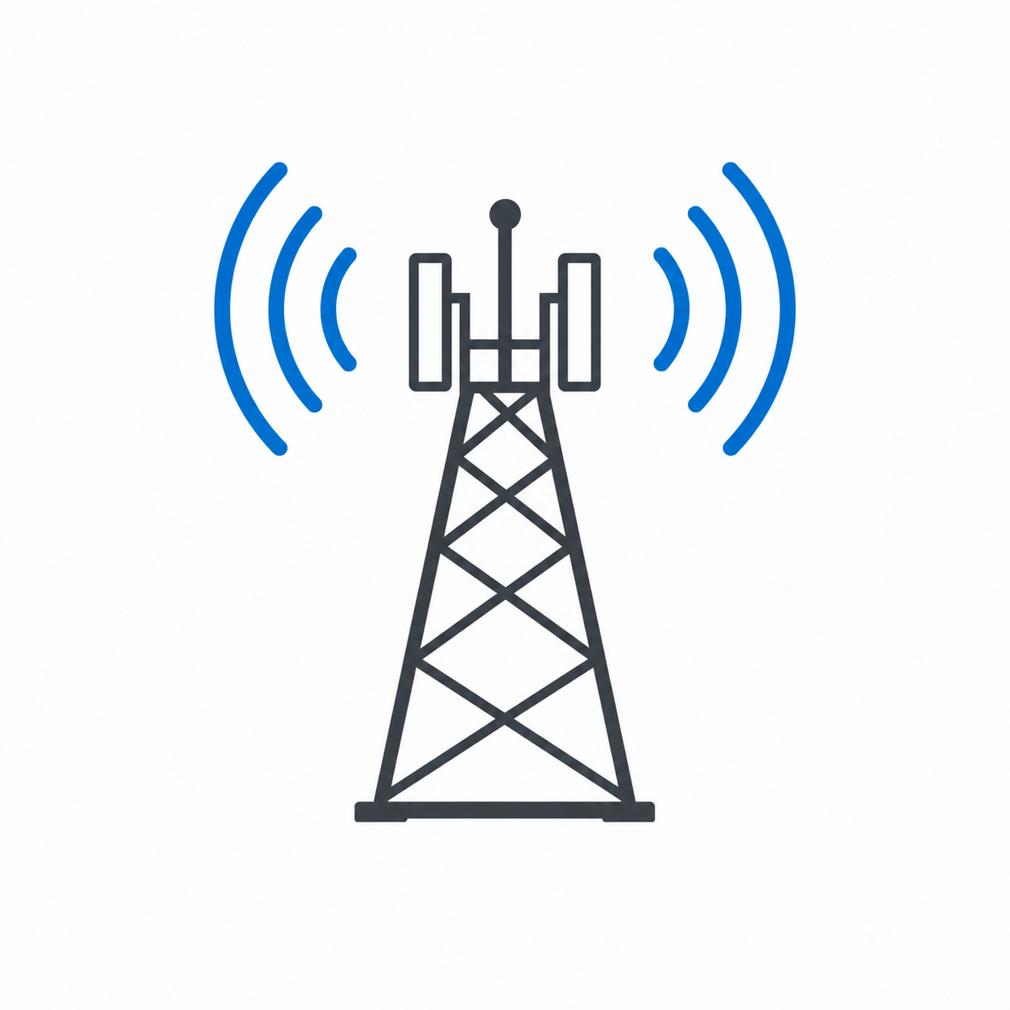
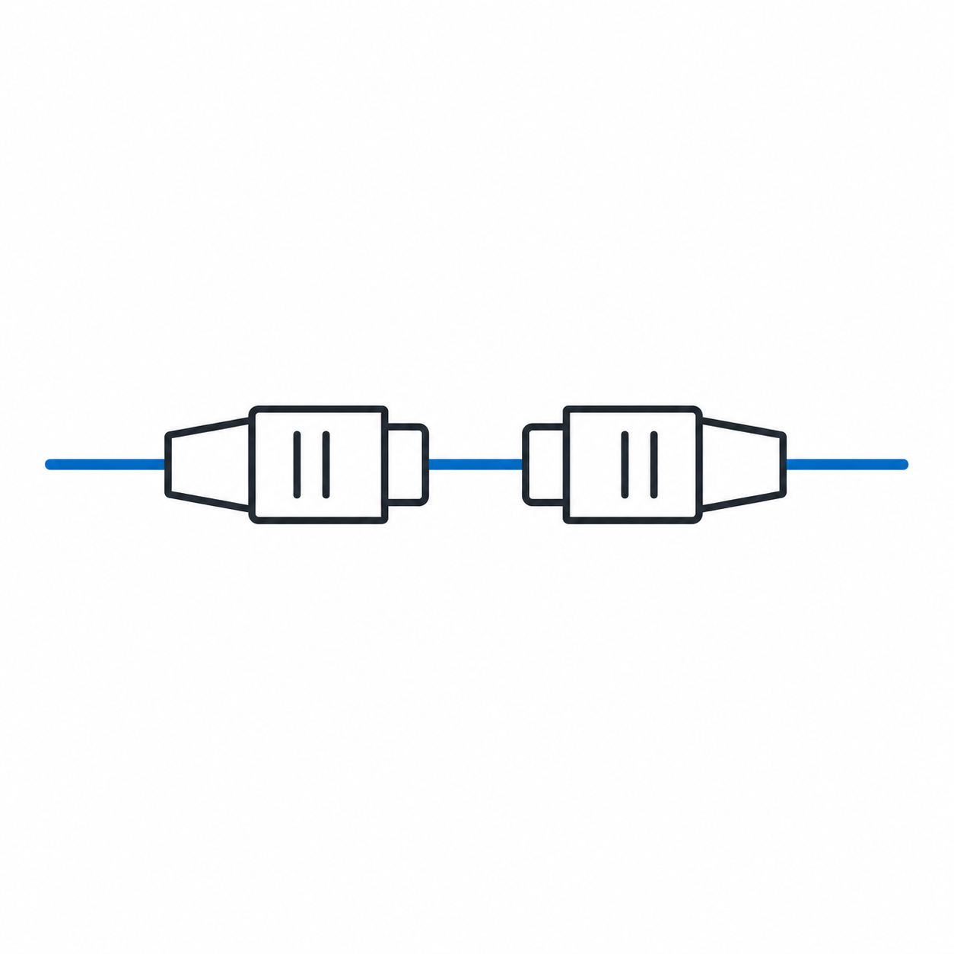
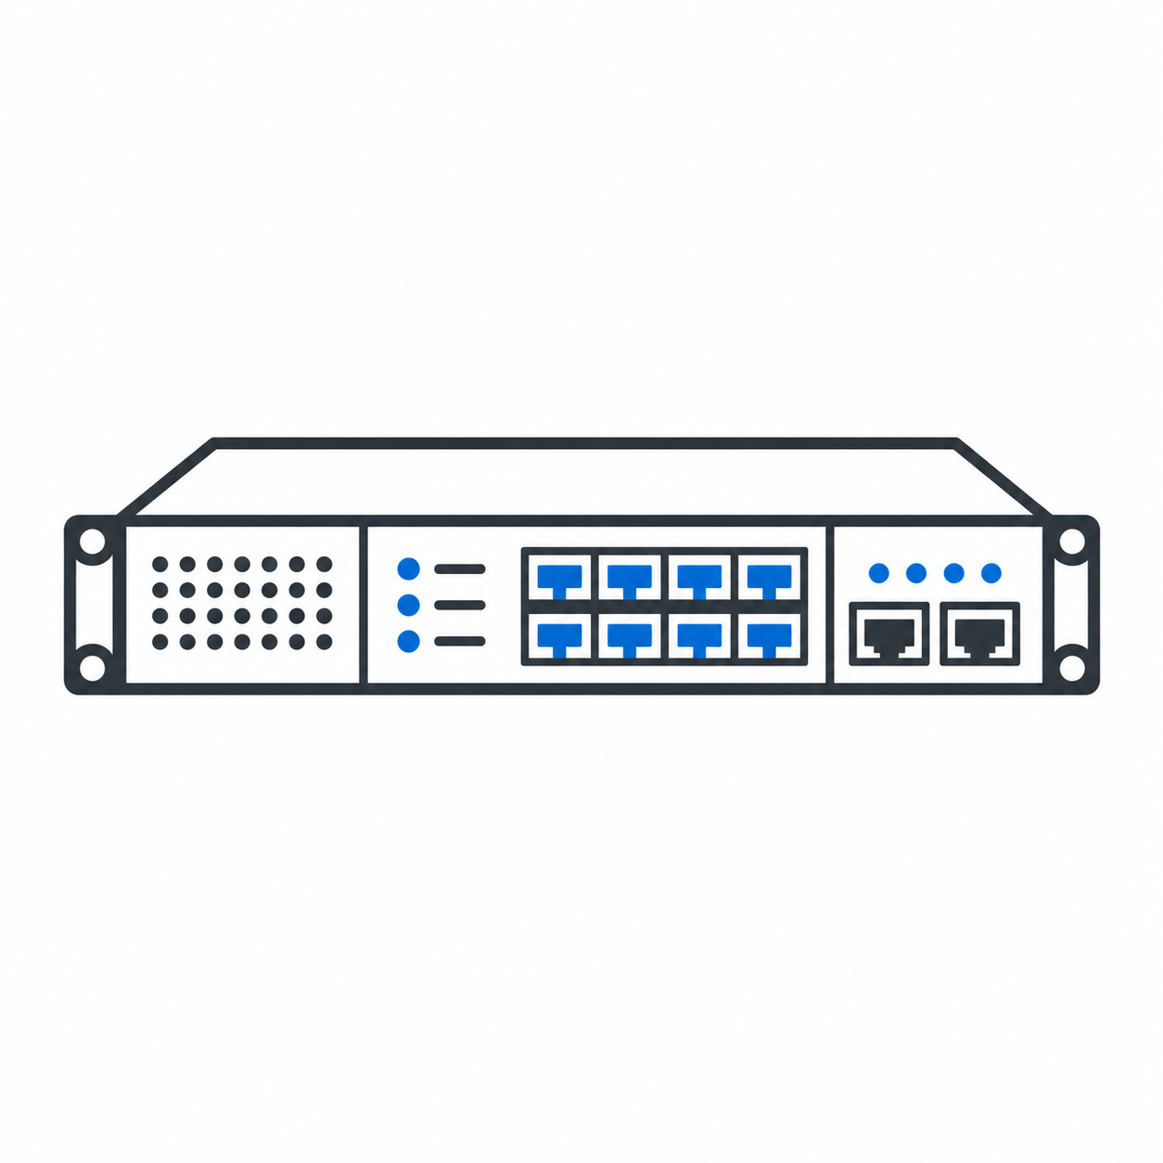

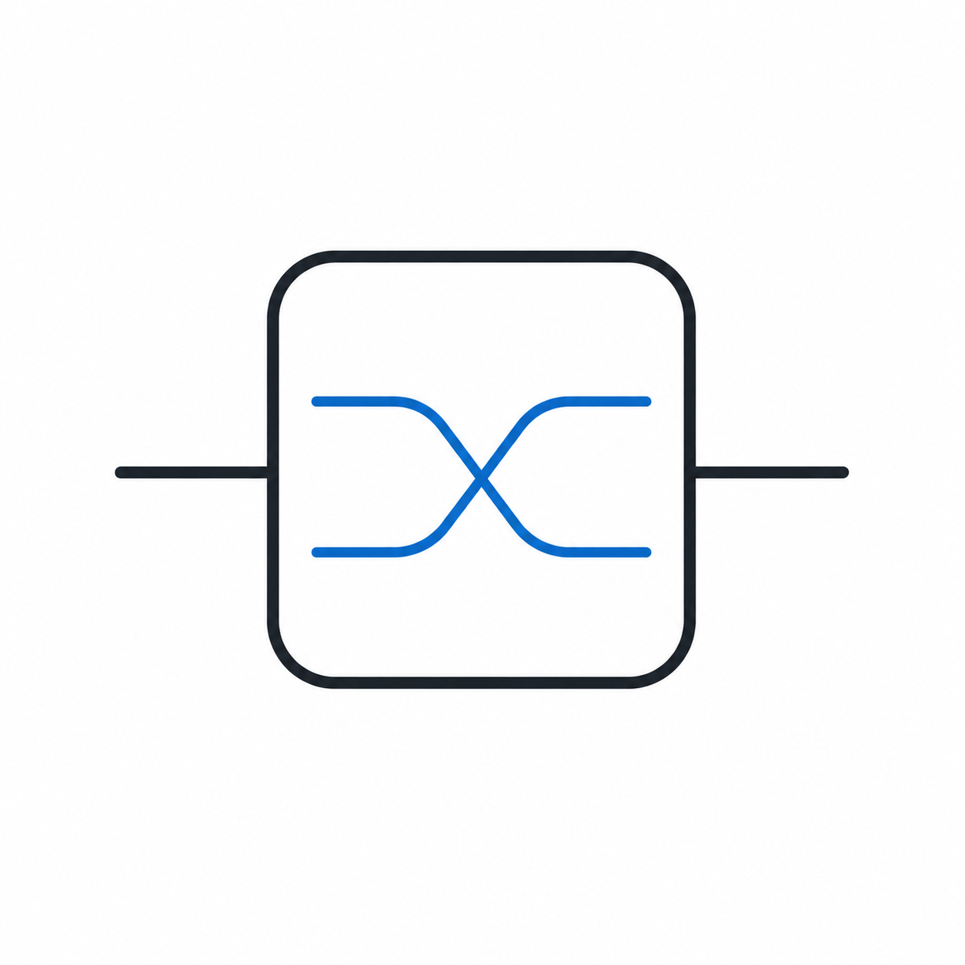

Slide 27


User Input
Generate a raw QoT dataset for all NDFF paths starting from Bristol using 8 Voyager transmitters only. Use 8 channel slots and enumerate all binary on/off channel patterns across the 8 slots. Simulate only QPSK and 16QAM.
Natural language task
Policy_update.json/ constraints.json
report.md / figures
Agentic AI Layer
Planner Agent (LLM)
Scenario Expander Agent (LLM)
Results Analysis Agent (LLM)
1. KPI history;
2. Simulation logs.
analysis.json
Reflection Agent (LLM)
Report Agent (LLM)
1. Parsing user input and define research tasks;
2. Generating research scenarios (Scenario Id, simulation case, simulation tool, KPIs).
plan.json
1. Validate every simulation case against orchestrator contracts;
2. Script Generation.
Validate → aggregate KPIs → compliance → sensitivity → summary
Gap analysis → attribution → policy updates (search space, constraints, optimizer)
Evaluation results
Response user requests. Create detailed report.
Telemetry / Config / Policy Access
scripts.py / config.json
simulation_results.json
Agent Invocation/ Execution Policies
Execution Status/ Intermediate KPIs/ Agent logs
Network Knowledge Base
Digital Twin
Orchestrator
Optical Performance Monitoring Data
Network Configuration & Topology Info
Physics-based Models
1. Task Graph construction
2. KPI catalogues, Optimisation Strategies
3. Agent coordination
4. State tracking
5. Execution lifecycle management
DT/Simulation Artifacts & Results
Policies / Constraints / Action Logs
Data-driven ML Models
Telemetry
Decision & Optimization Models
Transceiver Side
Optical Network Physical Layer
Receiver Side

Slide 28
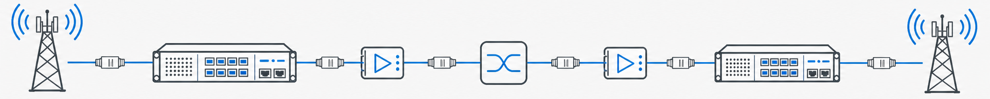
LLM-Driven Multi Agents
Data flow
User
Request
Planner
Agent
Scenario Expander Agent
Result Analysis Agent
Reflection
Agent
Report
Agent
Actions
Digital Twins
AI Engines
Orchestrator
Network Controllers
Physical Models
Traditional ML Models
1. Task Graph construction
2. KPI catalogues
3. Optimisation Strategies
4. Agent coordination
5. State tracking
Path Computation & Provisioning
Data-Driven ML Models
Deep Learning Models
……
Cross-Domain Orchestration
Analytical Models
AI Deployment
and Inference
Decision & Optimization AI
Policy-based Closed-loop Control
Time-series Database
Centralized Cross-Domain Data Repository
Relational Database
……
……
Kafka-based Telemetry Pipeline
……
……
Wireless Domain Database 1
……
Optical Domain Database 1
……
Optical Domain Database M
……
Wireless Domain Database N
Network Configuration Info
Telemetry Protocols
Performance Monitoring | Sensing

Slide 29
LLM-Driven Multi Agents (Agentic AI)
Data flow
User
Request
Planner
Agent
Scenario Expansion Agent
Results Analysis Agent
Reflection
Agent
Report
Agent
Actions
Digital Twins
AI Engines
Orchestrator
Network Controllers
Physical Models
Traditional ML Models
1. Task Graph construction
2. KPI catalogues
3. Optimisation Strategies
4. Agent coordination
5. State tracking
6. Execution Control
Path Computation & Provisioning
Data-Driven ML Models
Deep Learning Models
Cross-Domain Orchestration
Analytical Models
AI Deployment
and Inference
Decision & Optimization AI
Policy-based Closed-loop Control
Time-series Database
Centralized Cross-Domain Data Repository
Relational Database
……
……
Kafka-based Telemetry Pipeline
……
……
Wireless Domain Database 1
……
Optical Domain Database 1
……
Optical Domain Database M
……
Wireless Domain Database N
Network Configuration Info
Telemetry Protocols
Performance Monitoring | Sensing

