Slide 1
TEA
©Wikipedia

Slide 2
TEA & HEALTH EFFECTS
Tea is an aromatic beverage.
Here are some of the potential health benefits of tea;
Immunity against intestinal disorders.
Prevention of dental carries.

Slide 3
STATISTICS
Country | Percentage
China | 48%
India | 39%
Sri Lanka | 13%

Slide 4
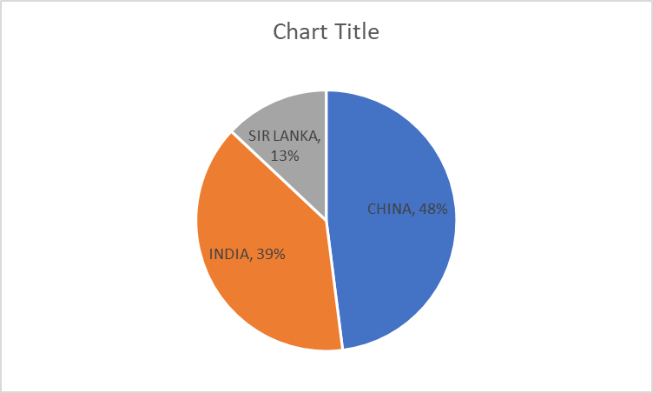
PRODUCTION AS A CHART

