Slide 1
Semantic Specification of Program for Development
Supervised by
Dr. Muhammad Masroor Ali
Professor
Dept. of CSE, BUET
Presented by
Sourav Saha Dip (1505003)
MD. Al Imran (1505100)
Waqar Hassan Khan (1505107)

Slide 2
Overview
For developing a software a requirement list is given.
A software developer designs the software using various classes, functions etc.
From this software we can obtain an ontology.

Slide 3
Overview
The ontology is then matched with the requirement list and a mapping between these two is created.
We determine quality measurements such as consistency, completeness, correctness, unambiguity.
The aim of this research is to improve these measurement values using semantic analysis.

Slide 4
Software Requirements
Codeontology
A parser to make rdf triples from java src code and jar files.
Protégé
A software to build and visualize ontology.

Slide 5
Current Approach
Stakeholder provides the software developer with his software requirements
This requirements are incrementally changed throughout the development cycle
The finished product is then evaluated by a series of software testing

Slide 6
Problem in Current Approach
Matching between requirement list and finished software is not automated
Testing a large scale software requires a lot of time and manpower
No universal standard for mapping requirement list to the software

Slide 7
Proposed Approach
Build an ontology from the software using a parser
Mapping the ontology with the given requirement list
Measuring quality parameters such as:
Consistency
Completeness
Correctness

Slide 8
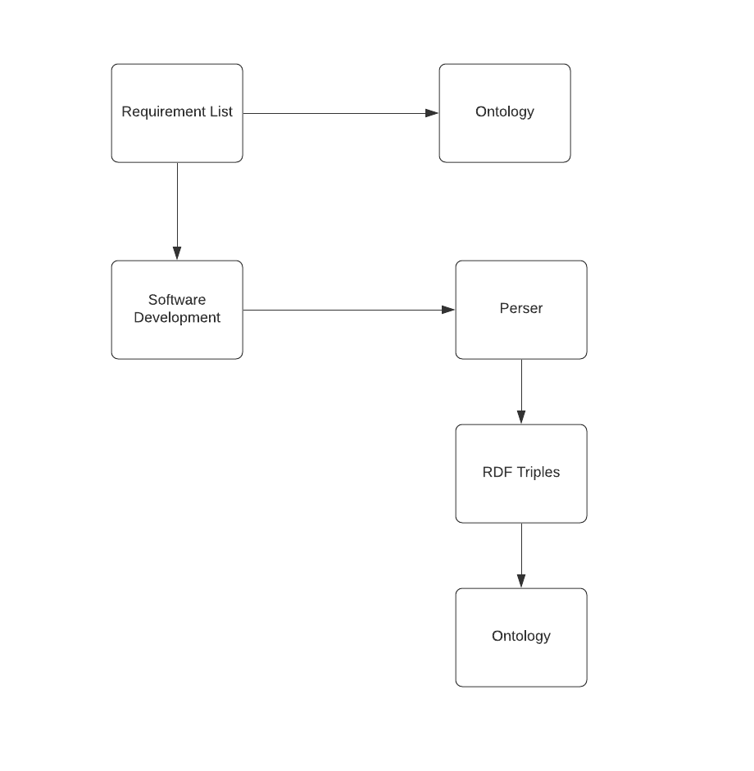
Proposed Approach(contd.)

Slide 9
Proposed Approach(contd.)
Ontology
A formal representation of an object oriented programming language
Classification of the existing concepts
Helps to visualize concepts and relations of a software

Slide 10
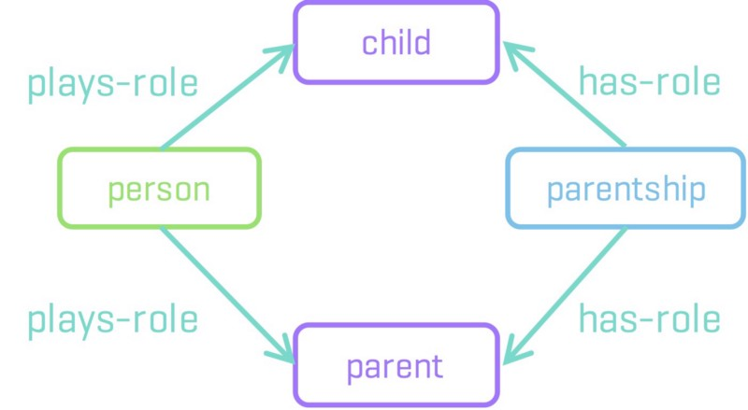
Proposed Approach(contd.)
Fig: Example of Ontology¹

Slide 11
Proposed Approach(contd.)
Requirement list
A list of itemized sentences written in natural language
Each sentence represents a customers requirement to a software system to be developed
a relationship between a concept from the requirement list and a concept from the ontology

Slide 12
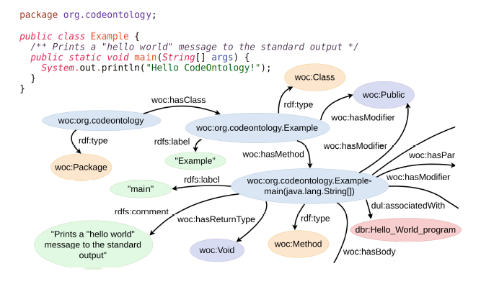
Proposed Approach(contd.)
Creating RDF triples

Slide 13
Related Theories
Concepts:
Function
Object
Constraint
quality
Relationships:
synonym,
antonym,
contradict,
apply

Slide 14
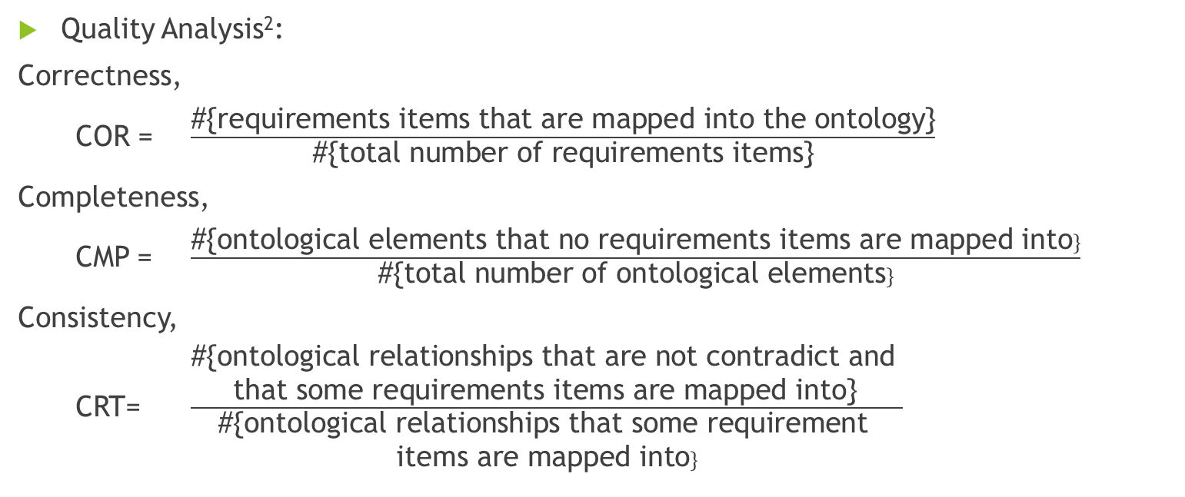
Related Theories
Quality Analysis²:
Correctness,
COR = $\frac{\text{\#\{}\text{requirements} \text{items} \text{that} \text{are} \text{mapped} \text{into} \text{the} \text{ontology}\text{\}}}{\text{\#\{}\text{total} \text{number} \text{of} \text{requirements} \text{items}\text{\}}}$
Completeness,
CMP = $\frac{\text{\#\{}\text{ontological} \text{elements} \text{that} \text{no} \text{requirements} \text{items} \text{are} \text{mapped} \text{into}\}}{\text{\#\{}\text{total} \text{number} \text{of} \text{ontological} \text{elements}\}}$
Consistency,
CRT= $\frac{\begin{aligned}\text{\#\{}\text{ontological} \text{relationships} \text{that} \text{are} \text{not} \text{contradict} \text{and} \\ \text{that} \text{some} \text{requirements} \text{items} \text{are} \text{mapped} \text{into}\text{\}} \end{aligned}}{\begin{aligned}\text{\#\{}\text{ontological} \text{relationships} \text{that} \text{some} \text{requirement} \\ \text{items} \text{are} \text{mapped} \text{into}\}\end{aligned}}$

Slide 15
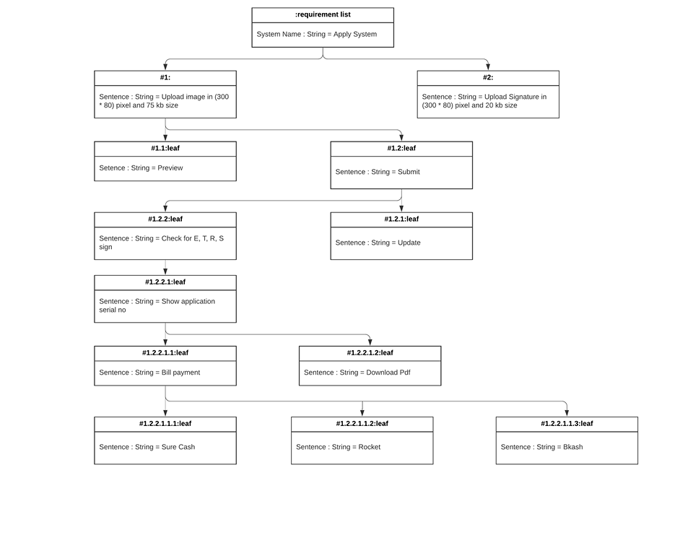
Implementation

Slide 16
Implementation

Slide 17

Implementation
Quality measurement:
Correctness,
COR = $\frac{\text{\#\{}\text{requirements} \text{items} \text{that} \text{are} \text{mapped} \text{into} \text{the} \text{ontology}\text{\}}}{\text{\#\{}\text{total} \text{number} \text{of} \text{requirements} \text{items}\text{\}}}$
= $\frac{9}{12}$
=75%

Slide 18
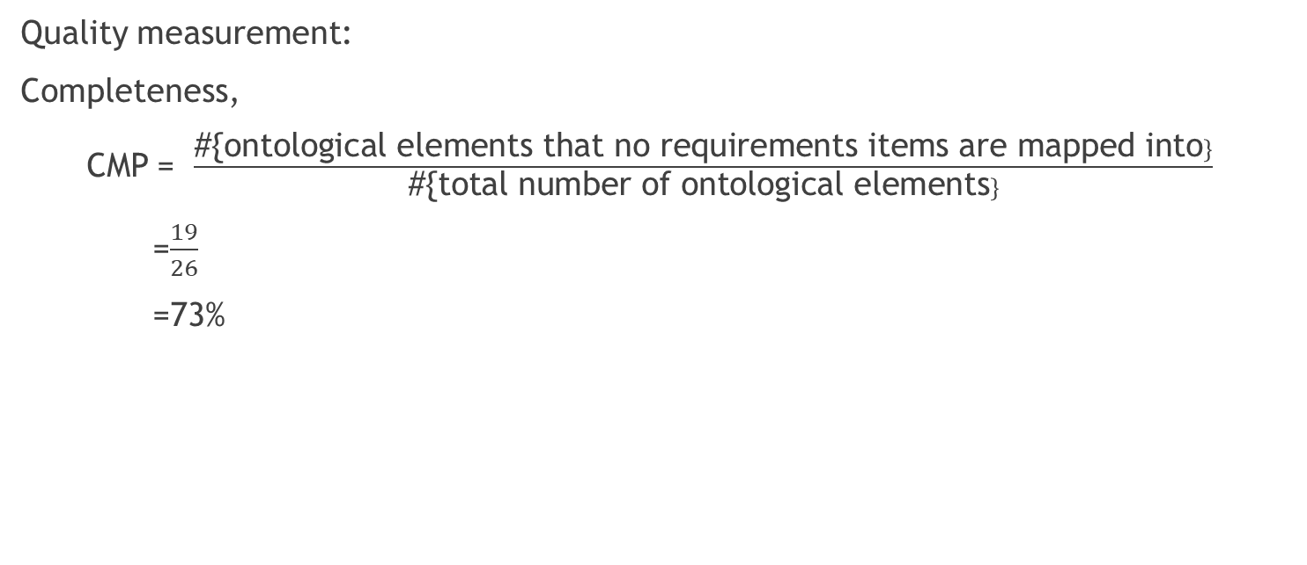
Implementation
Quality measurement:
Completeness,
CMP = $\frac{\text{\#\{}\text{ontological} \text{elements} \text{that} \text{no} \text{requirements} \text{items} \text{are} \text{mapped} \text{into}\}}{\text{\#\{}\text{total} \text{number} \text{of} \text{ontological} \text{elements}\}}$
=$\frac{19}{26}$
=73%

Slide 19
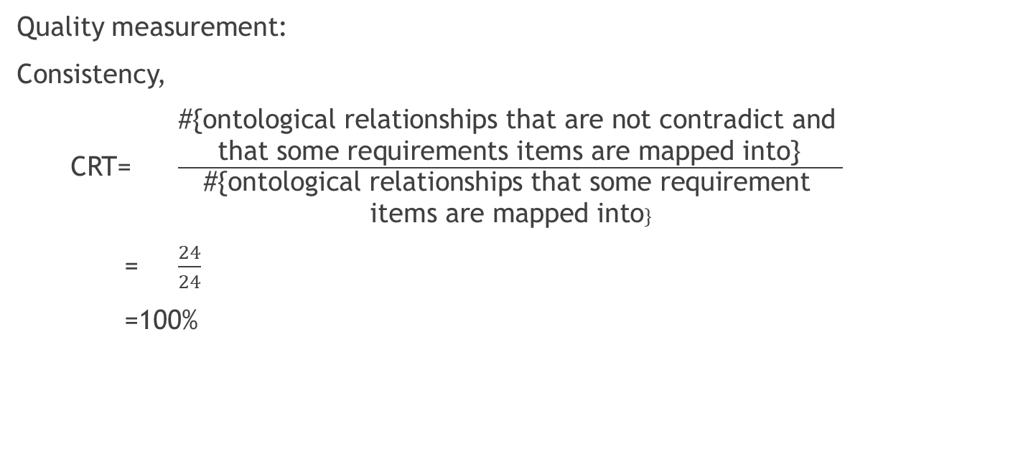
Implementation
Quality measurement:
Consistency,
CRT= $\frac{\begin{aligned}\text{\#\{}\text{ontological} \text{relationships} \text{that} \text{are} \text{not} \text{contradict} \text{and} \\ \text{that} \text{some} \text{requirements} \text{items} \text{are} \text{mapped} \text{into}\text{\}} \end{aligned}}{\begin{aligned}\text{\#\{}\text{ontological} \text{relationships} \text{that} \text{some} \text{requirement} \\ \text{items} \text{are} \text{mapped} \text{into}\}\end{aligned}}$
= $\frac{24}{24}$
=100%

Slide 20
References
1) https://www.kdnuggets.com/2017/05/ontology-simplest-definition.html
2) Ontology Based Requirements Analysis: Lightweight Semantic Processing Approach- by Haruhiko Kaiya and Motoshi Saeki

