Slide 1
TITANS_Sukkur
Introduction to
MongoDB
Data • Information • Databases • NoSQL
Instructor: Sir Yasir Ali Lashari
Institution: TITANS Sukkur
Notes:
Welcome slide. TITANS_Sukkur is the group name. Sir Yasir Ali Lashari is the instructor for this MongoDB course. This presentation covers: Data, Information, Database vs FMS, MongoDB intro, NoSQL vs SQL, Features, Use Cases, Installation, and MongoDB Compass.

Slide 2
TITANS_Sukkur | Sir Yasir Ali Lashari
📊 What is Data?
Data = Raw, unprocessed facts and figures without context or meaning.
📱
42
🌡️
38.5
A number on your phone screen
Temperature reading (°C)
📍
27.7172° N
🔢
PK-123
GPS coordinate
Flight code string
🏥 Real Life: A hospital collects: patient age (25), weight (70), temperature (38.5). These raw numbers alone = DATA.
Notes:
Data is the most basic form of input. Examples: 'Rahul', '25', 'Sukkur', '9898989898'. Without context, data is meaningless. A hospital records temperature=38.5 — just a number without meaning. Data types: numbers, text, images, audio, video.

Slide 3
TITANS_Sukkur | Sir Yasir Ali Lashari
💡 What is Information?
Information = Processed, organized data that has context and meaning — enabling decisions.
RAW DATA
INFORMATION
PROCESS
+
CONTEXT
• 25
• Sukkur
• M
• 9800000000
Ali Khan, 25 years old, Male,
lives in Sukkur, Sindh.
Contact: 9800000000
🔑 Key: Data + Context + Meaning = Information
🏪 Real Life: Amazon's "Customers who bought this also bought..." — sales data → useful shopping information!
Notes:
Information is data that has been processed and given meaning. Formula: Data + Processing + Context = Information. Example: Raw data 38.5 becomes 'Patient Ali has high fever (38.5°C)' — that's information! Google Maps turns GPS coordinates into 'Turn left in 200m'. Weather apps turn temperature data into 'It will rain today'.

Slide 4

What Is a Database?
A database is an organized collection of related data, designed for easy storage, retrieval, and management.
🏫 School DB
👤 Employee DB
Stores student records, grades, and courses
Tracks staff info, salaries, and departments
📚 Student DB
Manages enrollments, attendance, and results

Slide 5
TITANS_Sukkur | Sir Yasir Ali Lashari
🗄️ Database vs File Management System
📁 File Management System
🗃️ Database System (DBMS)
✗ Data stored in separate files
✗ Data redundancy (duplication)
✗ No data integrity check
✗ Difficult to search/query
✗ No multi-user support
✗ Security is very limited
📋 Example: Excel sheets folder
✓ Centralized data storage
✓ Minimal data redundancy
✓ Data integrity enforced
✓ Powerful query language (SQL)
✓ Multi-user access supported
✓ Role-based security control
🗃️ Example: MySQL, MongoDB
VS
🏦 Real Life: A bank uses DBMS not Excel files — millions of transactions, multi-branch access, security rules.
Notes:
File Management System (FMS): Traditional way — data in separate files. Problems: data duplication, inconsistency, difficult to share. Database Management System (DBMS): Organized, efficient data management. Real-world: Airlines use DBMS to manage millions of bookings. Without DBMS, booking the same seat twice would be common!

Slide 6
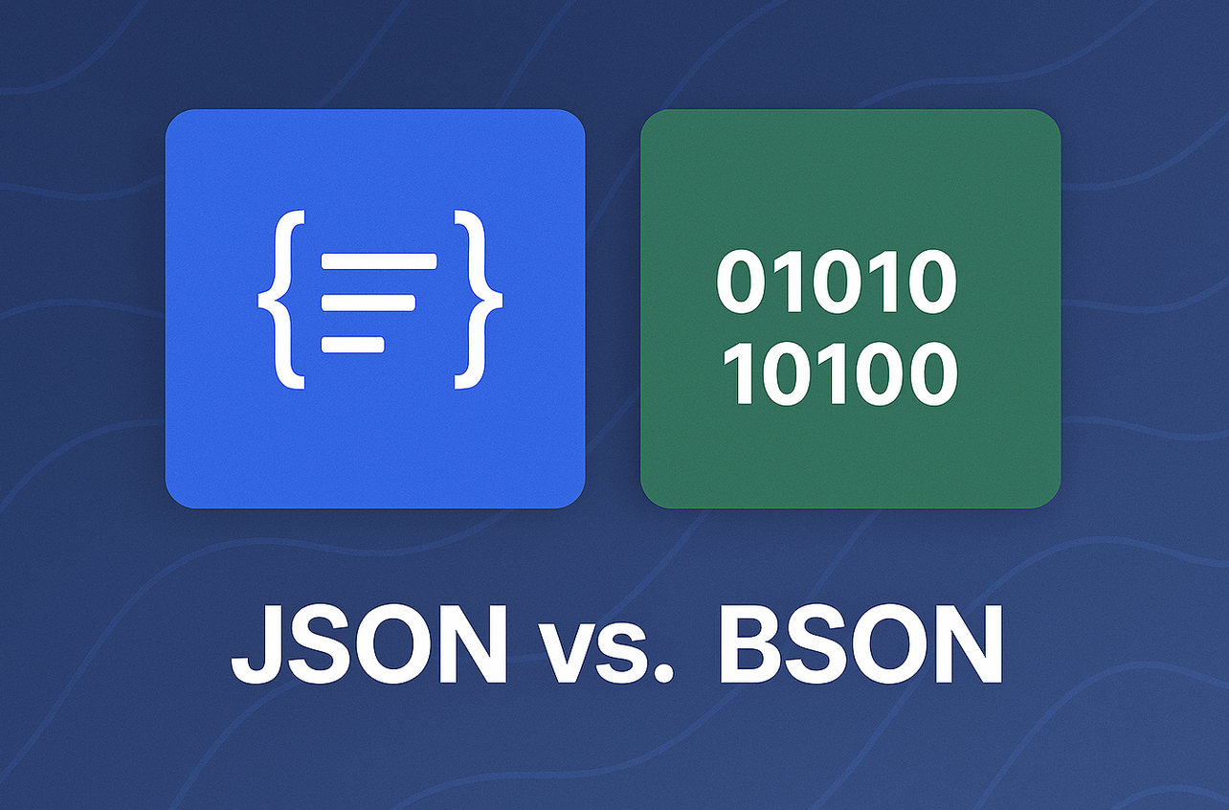
TITANS_Sukkur | Sir Yasir Ali Lashari
⚡ NoSQL vs SQL
Feature
SQL (Relational)
NoSQL (MongoDB)
Data Structure
Tables with rows & columns
Documents (JSON/BSON)
Schema
Fixed, predefined schema
Flexible, dynamic schema
Scalability
Vertical (bigger server)
Horizontal (more servers)
Query Language
SQL (SELECT, JOIN...)
MongoDB Query Language
Relationships
Foreign keys & JOINs
Embedded documents
Best For
Banking, ERP systems
Real-time apps, Big Data
Examples
MySQL, PostgreSQL, Oracle
MongoDB, Cassandra, Redis
🚀 Real Life: Twitter uses NoSQL (Cassandra) for 500M tweets/day; banks use SQL for ACID transactions.
Notes:
SQL = Structured Query Language databases (relational). NoSQL = 'Not Only SQL' — more flexible. Think of SQL as an organized wardrobe with fixed compartments. NoSQL is like a flexible bag where you can fit anything! Real-life: Instagram uses both — SQL for user accounts, NoSQL for posts/photos/stories.

Slide 7
TITANS_Sukkur | Sir Yasir Ali Lashari
MongoDB
🍃 What is MongoDB?
MongoDB is an open-source, document-oriented NoSQL database that stores data in flexible, JSON-like documents called BSON (Binary JSON). It was built for speed, scale, and agility.
Founded
Type
Language
License
2009
NoSQL
C++
SSPL
by MongoDB Inc.
(formerly 10gen)
Document-oriented
database
Core written in C++
& JavaScript shell
Server Side Public
License (Open Source)
MongoDB Document Example:
🌍 Used By:
{
"name": "Ali Khan",
"city": "Sukkur",
"age": 25,
"skills": ["MongoDB", "Python"]
}
• Forbes • eBay • LinkedIn
• Toyota • Adobe • Uber
• Bosch • EA Games
Notes:
MongoDB = 'Humongous' data. It's the most popular NoSQL database in the world. Unlike SQL, you don't need a fixed schema. Real-life: Imagine storing a student record — in SQL you need strict columns. In MongoDB, one student can have 3 subjects, another can have 5, and you don't need to restructure anything!

Slide 8
TITANS_Sukkur | Sir Yasir Ali Lashari
✨ Features of MongoDB
📄 Document-Oriented
🔧 Schema-less (Flexible)
📈 Horizontal Scaling
Data stored as BSON documents. Each document can have different fields — like a dynamic form!
No rigid structure. Add or remove fields anytime without breaking the database.
Sharding distributes data across servers. Handle billions of records effortlessly!
🔁 Replication
⚡ High Performance
🔍 Rich Query Language
Replica sets keep multiple data copies. If one server fails, another takes over instantly.
Indexed queries run in milliseconds. In-memory processing for blazing fast reads.
Filter, sort, aggregate, and join data using MongoDB's powerful query operators.
Notes:
Key MongoDB features: 1) Document-Oriented — stores JSON-like docs. 2) Schema-less — flexible structure. 3) Horizontal scaling — add more machines. 4) Replication — data backup. 5) High Performance — fast queries. 6) Rich queries — aggregate, filter, sort. Real-life: Airbnb uses MongoDB's flexibility to store different property types — hotels have different fields than apartments!

Slide 9
TITANS_Sukkur | Sir Yasir Ali Lashari
🌐 Use Cases of MongoDB
🛒 E-Commerce
🌍 Social Media
🏥 Healthcare
Used by: Amazon, Daraz
Used by: Facebook, Twitter
Used by: Hospitals, Clinics
Product catalogs with varying attributes per category. Dynamic pricing and inventory management.
User profiles, posts, comments, likes — unstructured data at massive scale.
Patient records with different fields per specialty. Store medical images & reports together.
🎮 Gaming
🚗 IoT & Mobility
📊 Analytics & BI
Used by: EA, Zynga
Used by: Uber, Tesla
Used by: Forbes, Tableau
Player profiles, leaderboards, game states, real-time multiplayer data storage.
Millions of sensor readings per second. Real-time location, telemetry, event streaming.
Log analysis, behavior tracking, real-time dashboards and reporting.
Notes:
MongoDB powers some of the world's biggest apps. Uber processes billions of location updates daily in MongoDB. Pokémon GO used MongoDB to handle 65 million players at launch. Airbnb stores all listings — each with completely different attributes — in MongoDB. In Pakistan, many fintech startups use MongoDB for flexibility.

Slide 10
TITANS_Sukkur | Sir Yasir Ali Lashari
⚙️ Installing MongoDB
1
Download MongoDB Community Server
2
Run the Installer
Go to mongodb.com/try/download/community
Select your OS: Windows / macOS / Linux
Windows: Run .msi file → Choose 'Complete' install
macOS: Use Homebrew: brew install mongodb-community
3
Start MongoDB Service
4
Verify Installation
Windows: net start MongoDB
Linux/Mac: mongod --dbpath /data/db
Open terminal → type: mongosh
You should see: > (MongoDB shell prompt)
💡 Tip: MongoDB Atlas (cloud version) — no installation needed! Sign up at cloud.mongodb.com and use free tier.
Notes:
Installation steps: 1. Download from mongodb.com. 2. Install (Windows MSI or Homebrew on Mac). 3. Start the mongod service. 4. Test with mongosh command. Alternative: MongoDB Atlas is a cloud-hosted version — perfect for beginners, no server setup required. Free tier available with 512MB storage!

Slide 11
TITANS_Sukkur | Sir Yasir Ali Lashari
🧭 MongoDB Compass
MongoDB Compass is the official FREE GUI (Graphical User Interface) tool for MongoDB. It lets you visually explore your data, run queries, and manage databases — no command line needed!
👁️
🔍
📊
⚡
Visual Explorer
Query Builder
Aggregation Pipeline
Performance Insights
Browse collections and documents with a clean tree view — like a file explorer for your data!
Build MongoDB queries visually with auto-complete. No memorizing syntax!
Visual pipeline editor for complex data processing. Drag and arrange stages!
See slow queries, analyze indexes, and optimize database performance easily.
📥 How to Install MongoDB Compass:
Step 1: Visit mongodb.com/products/compass Step 2: Download for Windows/Mac/Linux Step 3: Connect with: mongodb://localhost:27017
🎯 Think of Compass like: phpMyAdmin for MySQL, but much more powerful and beautiful!
Notes:
MongoDB Compass is to MongoDB what phpMyAdmin is to MySQL. It's a GUI tool that makes it easy to: view and edit documents, build queries visually, create and manage indexes, and see real-time performance stats. Perfect for beginners who aren't comfortable with the command line yet. Download free from mongodb.com/products/compass

Slide 12
🎓 Session Summary
TITANS_Sukkur · Sir Yasir Ali Lashari
📊 Data
💡 Information
Raw, unprocessed facts — numbers, text, images
Processed data with context and meaning
🗄️ Database vs FMS
🍃 MongoDB
DBMS is organized, secure & multi-user; FMS is basic
NoSQL, document-oriented, flexible & scalable database
⚡ NoSQL vs SQL
✨ Features
NoSQL = flexible schema, horizontal scale, JSON docs
Schema-less, replication, sharding, high performance
🌐 Use Cases
🧭 Compass
E-commerce, Social Media, Healthcare, Gaming, IoT
Free GUI tool to visually manage MongoDB databases
Next Session: Hands-on MongoDB CRUD Operations 🚀 | TITANS_Sukkur | Sir Yasir Ali Lashari
Notes:
Summary slide for recap. This session covered: Data vs Information, Database vs File Management System, Introduction to MongoDB, NoSQL vs SQL comparison, Features, Use Cases, Installation steps, and MongoDB Compass GUI. Next class will cover CRUD operations: Create, Read, Update, Delete in MongoDB with hands-on practice.

