Slide 1


DEPARTMENT OF CARDIOLOGY · PIC, BAHAWALPUR
Clinicopathological
Conference
A case-based clinical discussion
Dr Mubashir Aziz PGR Cardiology · PIC, BWP
Clinicopathological Conference
01

Slide 2





PATIENT PROFILE
Biodata
AGE
GENDER
46 years
Female
RESIDENCE
PROFESSION
Shazia Bibi
Bahawalpur
Nurse
w/o Nicholan George
Clinicopathological Conference
02

Slide 3
CHIEF COMPLAINT
Palpitations
for 4 hours
Sudden onset · sensation of racing heart
Clinicopathological Conference
03

Slide 4



HISTORY OF PRESENT ILLNESS
The Story So Far
A 46-year-old female, previously in her usual state of health, developed sudden-onset palpitations 4 hours ago with a sensation that her heart was racing.
ASSOCIATED SYMPTOMS
Dizziness
Fatigue
Two prior identical episodes required admission to the cardiac emergency and settled after IV medication. She was told her heart rhythm is irregular.
NO PERTINENT NEGATIVES
✕ Chest pain
✕ Shortness of breath
✕ Syncope
✕ Weight loss
✕ Tremor
Clinicopathological Conference
04

Slide 5


BACKGROUND HISTORY
Drug History
Tab Vadil
Rate / rhythm control
Tab Rivaroxaban
Oral anticoagulation
Medications
Purpose Symptom control with stroke-risk protection
Clinicopathological Conference
05

Slide 6


BACKGROUND HISTORY
Medical History
KNOWN COMORBIDITY
Hypertension
On oral antihypertensive medication
Medical
HTN
Clinicopathological Conference
06

Slide 7


BACKGROUND HISTORY
Past Surgical History
FINDING
Not significant
No prior operative history
Surgical
NONE REPORTED
Clinicopathological Conference
07

Slide 8




SOCIAL & FAMILY HISTORY
Life Context
Socioeconomic History
OCCUPATION
MARITAL STATUS
Nurse by profession
Married
Family History
CLASS
RESIDENCE
Not significant
Lower middle class
Bahawalpur
Clinicopathological Conference
08

Slide 9
CLINICAL ASSESSMENT
Examination
General physical & systemic examination findings
General Physical
Cardiovascular
Respiratory
CNS
Gastrointestinal
Clinicopathological Conference
09

Slide 10


GENERAL PHYSICAL EXAMINATION
On Presentation
HEART RATE
RADIAL PULSE
BLOOD PRESSURE
TEMPERATURE
RESP. RATE
136
96
110/70
98
14
bpm
bpm
mmHg
°F
/min
Apex–radial pulse deficit ≈ 40 bpm (heart rate 136 vs radial pulse 96) — a hallmark of atrial fibrillation.
General
Pulse Character
Blood Pressure
Thin, lean, middle-aged female; comfortable in bed
Irregularly irregular
110/70 mmHg — right arm, lying
Normal volume & character
IV cannula in situ (right hand)
Vessel wall not palpable
No significant inter-arm difference
Alert & oriented — time, place, person
No radio-radial / femoral delay
No postural drop
Pulse deficit present
Clinicopathological Conference
10

Slide 11


SYSTEMIC EXAMINATION
Cardiovascular System
INSPECTION
Shape of the precordium — normal
Remainder of the inspection limited by exposure
PALPATION
Apex beat: 5th intercostal space, medial to the midclavicular line — normal character
No thrill; no other palpable sounds
No left parasternal heave
AUSCULTATION
1st heart sound & both components of 2nd heart sound audible at their respective areas
1st heart sound: variable intensity; 2nd heart sound: both components normal intensity
No added sounds audible
Clinicopathological Conference
11

Slide 12


SYSTEMIC EXAMINATION
Respiratory System
FINDING
Air entry equal & adequate bilaterally
Bilateral chest examination unremarkable
Respiratory
NORMAL
Clinicopathological Conference
12

Slide 13


SYSTEMIC EXAMINATION
Central Nervous System
FINDING
Not significant
Neurological examination unremarkable
CNS
UNREMARKABLE
Clinicopathological Conference
13

Slide 14

SYSTEMIC EXAMINATION
Gastrointestinal System
FINDING
Not significant
Abdominal examination unremarkable
GIT
UNREMARKABLE
Clinicopathological Conference
14

Slide 15
DIAGNOSTIC WORK-UP
Investigations
Bedside, laboratory & imaging findings
12-Lead ECG
Blood counts
Biochemistry
Endocrine screen
Echocardiography
Clinicopathological Conference
15

Slide 16
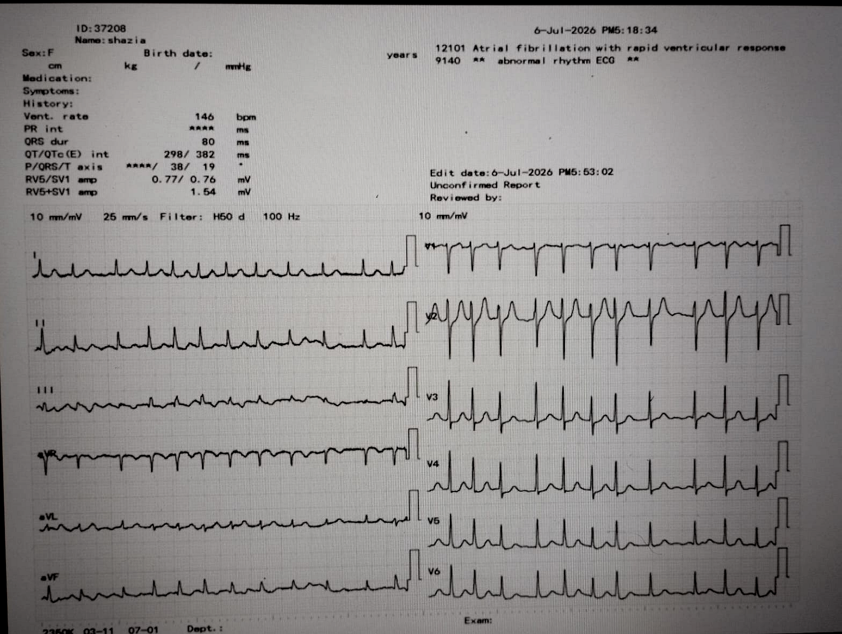


INVESTIGATIONS · ELECTROCARDIOGRAM
12-Lead ECG
Atrial Fibrillation with Rapid Ventricular Response
Abnormal rhythm ECG · 06-Jul-2026
VENTRICULAR RATE
146 bpm
RAPID
RHYTHM
P WAVES
Atrial fibrillation
Absent
PR · QRS
QT / QTC · AXIS
– · 80 ms
298 / 382 ms · 38°
Clinicopathological Conference
16

Slide 17

INVESTIGATIONS · HAEMATOLOGY
Complete Blood Count
Sample date: 10-Jun-2022
TEST
RESULT
REFERENCE RANGE
UNITS
TEST
RESULT
REFERENCE RANGE
UNITS
Haemoglobin
10.6 LOW
11.5–16.5
g/dL
Platelets
296
150–400
×10³/µL
WBC
6.94
4.0–11.0
×10³/µL
RBC
3.53 LOW
3.6–5.8
×10⁶/µL
Neutrophils
61
40–75
%
MCV
85.7
80–100
fL
Lymphocytes
28
20–45
%
MCH
30.0
27–34
pg
Monocytes
4
2–10
%
MCHC
35.0
30–35
g/dL
Eosinophils
7 HIGH
1–6
%
HCT
30.3 LOW
35–47
%
IMPRESSION Mild normocytic anaemia (low Hb, RBC & HCT) with mild eosinophilia.
Clinicopathological Conference
17

Slide 18


INVESTIGATIONS · ROUTINE CHEMISTRY
Renal, Electrolytes & Viral Screen
Sample date: 06-Jul-2026
RENAL FUNCTION
SERUM ELECTROLYTES
VIRAL SCREEN
Urea
Sodium
HBsAg
Negative
28 mg/dL
141 mmol/L
Reference 16.6–48.6 mg/dL
Reference 135–155 mmol/L
HIV Ag/Ab
Negative
Creatinine
Potassium
0.8 mg/dL
3.9 mmol/L
HCV (ICT)
Reference 0.6–1.2 mg/dL
Reference 3.5–5.5 mmol/L
Negative
IMPRESSION Normal renal function and electrolytes; viral screen negative.
Clinicopathological Conference
18

Slide 19
INVESTIGATIONS · BIOCHEMISTRY & ENDOCRINE
Additional Investigations
Chughtai Lab · 18-Dec-2025
Test
Result
Reference range
Status
Serum Magnesium
2.2 mg/dL
1.6 – 2.6
Normal
Vitamin B12
188 pg/mL
187 – 883
Normal
Serum Potassium
4.0 mmol/L
3.5 – 5.1
Normal
Serum Total T3
73.85 ng/dL
70 – 204
Normal
Serum Total T4
7.99 µg/dL
4.6 – 11
Normal
HbA1c (Glycated Hb)
5.1 %
< 5.7
Normal
Impression Normal thyroid function, electrolytes, magnesium, B12 and HbA1c — no thyrotoxic or metabolic trigger for AF.
Clinicopathological Conference
19

Slide 20

INVESTIGATIONS · ECHOCARDIOGRAPHY
Echocardiography
27-Jan-2023 · Dr Ussama Munir
EJECTION FRACTION
MEASUREMENTS
FINDINGS
LVEF 65%
LVEF
65
57–73
%
Normal LV size & good systolic function
LVIDD
45
35–56
mm
No regional wall-motion abnormality
(Normal 57–73%)
IVS
7
6–11
mm
LVPW
8
6–11
mm
No clot in LA or LV
RELEVANT TO AF
LAD
29
19–40
mm
No clot in LA / LV
Normal chambers, valves, IAS & IVS
E/A
0.8
—
PASP
15
—
mmHg
Normal pericardium
CONCLUSION Normal biventricular size and systolic function.
Clinicopathological Conference
20

Slide 21


CASE DISCUSSION
Differential Diagnosis
Causes of an irregular tachycardia — each excluded on ECG grounds
Atrial flutter
No sawtooth flutter waves; R–R interval is irregular
Multifocal atrial tachycardia
No ≥ 3 differing P-wave morphologies present
Frequent atrial ectopics
No discrete P waves preceding each QRS complex
AVNRT / AVRT (SVT)
Paroxysmal SVT is regular — here the rhythm is irregular
Sinus tachycardia + ectopics
P waves absent; rhythm is irregularly irregular
Clinicopathological Conference
21

Slide 22
FINAL DIAGNOSIS
Atrial Fibrillation with Rapid Ventricular Response
Confirmed on 12-lead ECG
Structurally normal heart
146 bpm · irregularly irregular · no P waves
LVEF 65% · no clot in LA or LV
Background hypertension
Mild normocytic anaemia
Established comorbidity
Incidental haematology finding
Clinicopathological Conference
22

Slide 23


HOSPITAL COURSE & OUTCOME
Clinically Improved
From cardiac emergency to safe discharge
Admitted
Treated
Improved
Discharged
Cardiac emergency
IV medication
Rhythm & symptoms settled
Home for follow-up
Thank you
Clinicopathological Conference
23

