Slide 1

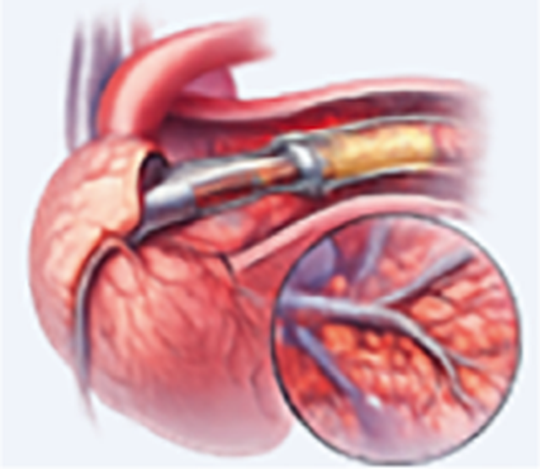
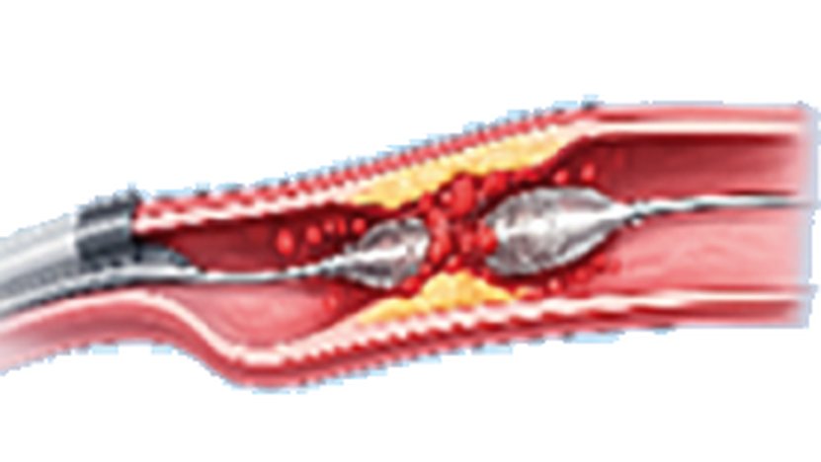

JOURNAL CLUB PRESENTATION
Rapid Inflation-Deflation vs Pressure-Optimized Stenting During Primary PCI
The RAPID-POP Trial
Hakeem A, et al. JACC Cardiovasc Interv. 2026;19(16):2234–2246
PRESENTED BY
Dr Hassan
PGR Cardiology
Cardiac Center, BVH Bahawalpur

Slide 2



BACKGROUND
Why Microvascular Reperfusion Still Fails
40%
Previous anti–no-reflow strategies
Thrombus aspiration
Inconsistent benefit in trials
of STEMI patients fail to achieve tissue-level reperfusion despite a patent epicardial artery
Adjunct pharmacotherapy
Neutral or inconsistent results
2–4×
Deferred stenting
No convincing outcome gain
higher 30-day mortality, with adverse LV remodeling and heart failure
Need: a preventive approach that stops embolization at its source — during stent deployment.
RAPID-POP Trial | JACC Cardiovasc Interv 2026
2

Slide 3




RATIONALE
Stent Deployment: A Modifiable Culprit
Rapid inflation–deflation
Transient expansion
“Toothpaste effect”
Slow-flow / no-reflow
Brief, nominal-pressure balloon inflation
No sustained strut embedment into thrombus
Thrombus & plaque debris extruded distally
Microvascular obstruction, larger infarct
The POP hypothesis
The key determinant may not be pressure alone, but achieving a stable stent–vessel interface before deflation. Pressure Optimization Protocol (Uretsky et al) operationalizes this in real time; OCT and observational data suggest better expansion, less malapposition and lower target-vessel failure.
RAPID-POP Trial | JACC Cardiovasc Interv 2026
3

Slide 4



PROCEDURAL PROTOCOLS
POP Algorithm vs Conventional Deployment
Pressure Optimization Protocol (POP)
Drop ≥0.3 atm?
Inflate stent to ≥14 atm
Watch gauge over 30-second window
NO
30 s stable → Deflate
YES
Reinflate to target & reassess
Conventional strategy
↻ repeat cycle
Single inflation at nominal or near-nominal pressure
Held ≤20 seconds, then full deflation
Based on pretrial audit: median 12 s at 12 atm
Median inflation: 90 s at 14.0 atm
Postdilation at operator’s discretion
All: aspirin 300 mg + ticagrelor 180 mg or clopidogrel 600 mg; heparin 5,000 U; second-generation DES
RAPID-POP Trial | JACC Cardiovasc Interv 2026
4

Slide 5






METHODS
Study Design at a Glance
PROBE design
3 NICVD network centers
Sep 2024 – Nov 2025
Prospective, randomized, open-label, blinded endpoint; investigator initiated
NICVD Karachi, SICVD Lyari, SICVD Hyderabad (Sindh, Pakistan)
931 screened; 660 randomized; 607 in mITT cohort
1:1 randomization
Independent oversight
Blinded core labs
Central web system, permuted blocks, on arrival in the cath lab
DSMB; blinded 3-physician Clinical Events Committee
ECG (ST resolution) and angiography (TIMI flow) read blind
RAPID-POP Trial | JACC Cardiovasc Interv 2026
5
Notes:
Registered NCT06430892; IRB approval NICVD (IRB-23/2024).

Slide 6


PATIENT POPULATION
Who Was Enrolled?
Inclusion
Key exclusions
Adults aged ≥18 years
STEMI: ischemic symptoms + guideline-defined ST elevation
Undergoing primary PCI
Killip class III–IV
Prior CABG to target vessel
Unprotected left main culprit
Reference vessel <2.5 or >4.5 mm
Bifurcation needing 2-stent technique
PCI of target vessel within 12 months
Prehospital thrombolysis
RAPID-POP Trial | JACC Cardiovasc Interv 2026
6

Slide 7
ENDPOINTS
Hierarchical Reperfusion Endpoint
1
ST-segment resolution ≥70% at 90 min
Win ratio (Finkelstein–Schoenfeld)
Principal marker of tissue-level reperfusion (blinded ECG core lab)
Every POP patient compared with every conventional patient (92,100 pairs). Move to the next tier only if tied.
2
Final TIMI grade 3 flow
Angiographic reperfusion, blinded panel of 6 interventionalists
3
No slow-flow / no-reflow
Slow flow = TIMI 2; no-reflow = TIMI 0–1 without mechanical obstruction
Secondary endpoint
30-day MACE: all-cause death, MI, definite stent thrombosis, or stroke
Sample size: ~290 per arm for STR (50% → 62%, 80% power); target 330 per arm
RAPID-POP Trial | JACC Cardiovasc Interv 2026
7

Slide 8
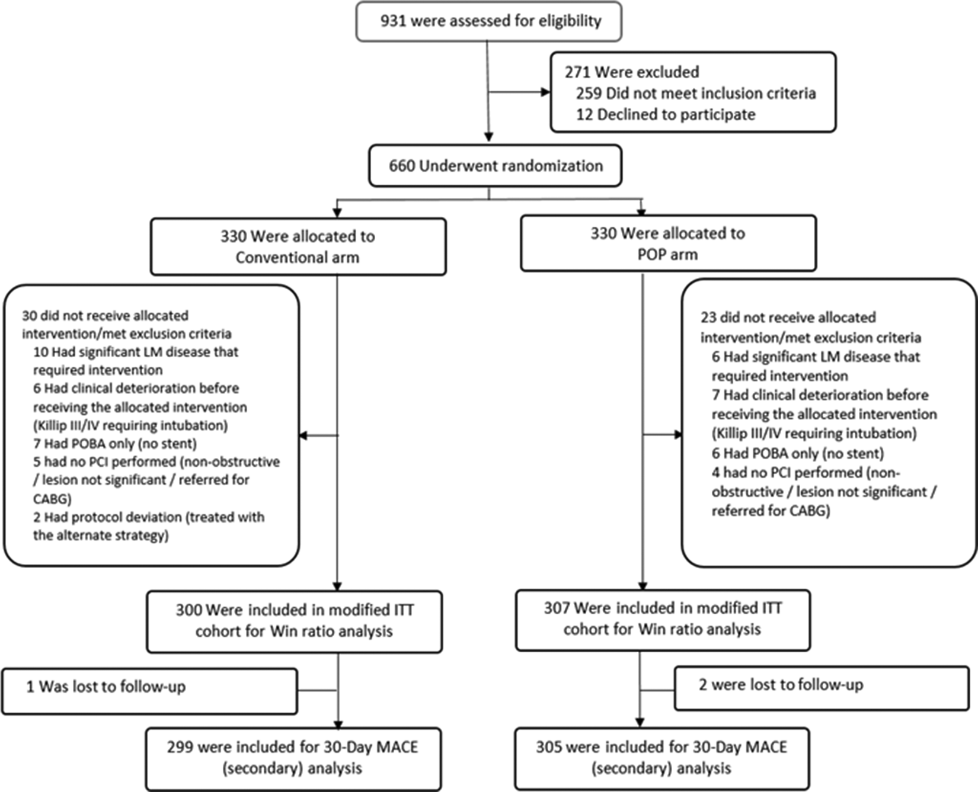
RESULTS
Patient Flow (CONSORT)
931
screened
660
randomized
307 vs 300
mITT: POP vs conventional
99.5%
30-day follow-up complete
RAPID-POP Trial | JACC Cardiovasc Interv 2026
8

Slide 9
RESULTS
Baseline Characteristics — Well Balanced
Clinical
55.0 y
77.1%
54.5%
31.5%
Mean age
Male
Hypertension
Diabetes
Angiographic
50.9%
52.6%
52.9%
44.0%
LAD culprit
Multivessel disease
Pre-PCI TIMI 0
Thrombus grade V
Door-to-balloon 90 min • Total ischemic time 305 min • Mean LVEF 39.6% • Killip I 93.6%
RAPID-POP Trial | JACC Cardiovasc Interv 2026
9

Slide 10
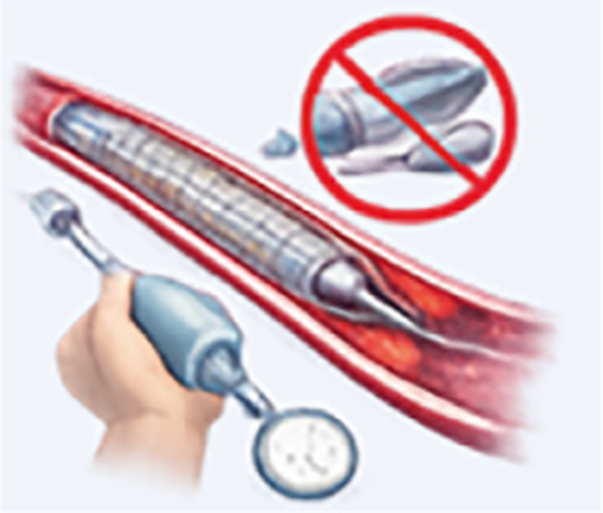
RESULTS
Procedural Differences Between Arms
POP
Conventional
Inflation pressure
14.0 atm
10.7 atm
Inflation time (median)
90 sec
20 sec
Postdilation (per stent)
65.3 %
91.0 %
POP protocol completed in 97.7% • NC balloon pressure identical: 17.8 atm
Postdilation avoided in >1 in 4 stents with POP (P < 0.001)
RAPID-POP Trial | JACC Cardiovasc Interv 2026
10

Slide 11
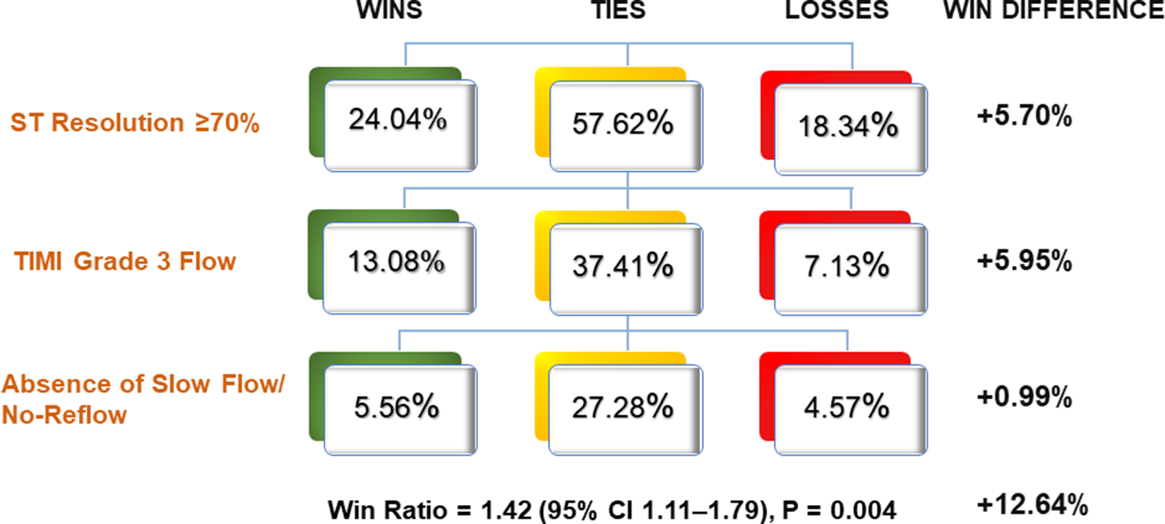

PRIMARY ENDPOINT
POP Wins on Hierarchical Reperfusion
WIN RATIO
1.42
95% CI 1.11–1.79 • P = 0.004
+12.64%
Benefit driven by the first two tiers: ST resolution (+5.70%) and TIMI 3 flow (+5.95%)
net win difference
Figure 2: hierarchical win-ratio decomposition, mITT population (Hakeem et al, 2026)
RAPID-POP Trial | JACC Cardiovasc Interv 2026
11

Slide 12
PRIMARY ENDPOINT COMPONENTS
Reperfusion Components: POP vs Conventional
TIMI 3 flow
P = 0.012
ST resolution
P = 0.18
No SF / NR
P = 0.17
RAPID-POP Trial | JACC Cardiovasc Interv 2026
12

Slide 13
SECONDARY ENDPOINT
30-Day Clinical Outcomes
MACE HAZARD RATIO
0.49
95% CI 0.18–1.31 • P = 0.15
6 / 307 vs 12 / 300 events
Numerically halved, not significant. Trial powered for reperfusion, not clinical events — hypothesis generating.
RAPID-POP Trial | JACC Cardiovasc Interv 2026
13

Slide 14
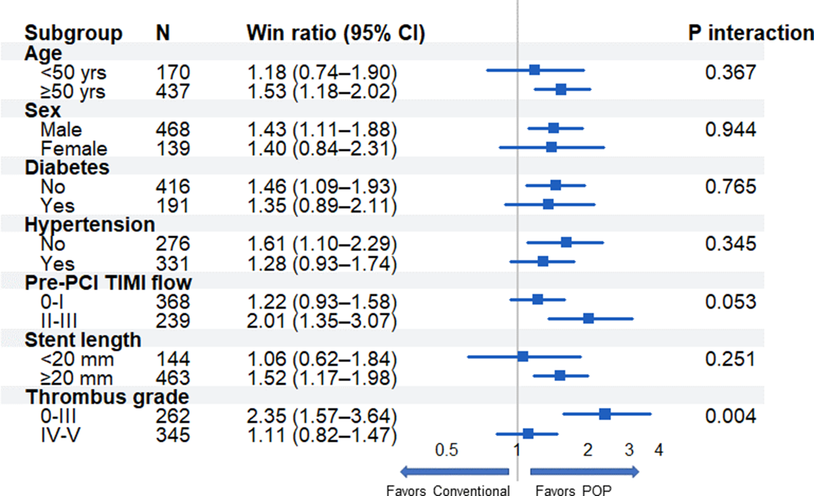
EXPLORATORY ANALYSES
Subgroups: Effect Consistent in Direction
Thrombus grade
0–III: 2.35 vs IV–V: 1.11
P-interaction = 0.004
Pre-PCI TIMI flow
II–III: 2.01 vs 0–I: 1.22
P-interaction = 0.053
Stent length
≥20 mm: 1.52 vs <20 mm: 1.06
P-interaction = 0.251
Largest benefit with lower thrombus burden and preserved flow (exploratory)
RAPID-POP Trial | JACC Cardiovasc Interv 2026
14

Slide 15
ROBUSTNESS
Sensitivity Analyses Confirm the Signal
1.42
1.32
+4.93%
5.9%
All 660 randomized
Center-stratified
Worst case
Missing STR
95% CI 1.11–1.80, P = 0.003
95% CI 1.04–1.72, P = 0.024
All 23 non-evaluable POP patients counted as failures
Balanced between arms (P = 0.36); imputation consistent
Reversing the hierarchy and stratifying by pre-/postdilation status gave directionally consistent results.
RAPID-POP Trial | JACC Cardiovasc Interv 2026
15

Slide 16

DISCUSSION
How Might POP Work?
Sustained pressure
Key interpretive points
90 s inflation delivers radial force along the full 26 mm segment
91% postdilation in the conventional arm suggests 20-s nominal inflation is systematically insufficient
Identical NC pressure (17.8 atm) excludes more aggressive postdilation as an explanation
STR ranked first: best reflects myocardial reperfusion and prognosis
Simple, cost-neutral, device-independent — immediately implementable
Strut embedment
Progressive, homogeneous expansion; stent–vessel interface sealed
Less embolization
Debris trapped before deflation — fewer distal emboli
Better reperfusion
Higher STR and TIMI 3 flow; less postdilation needed
RAPID-POP Trial | JACC Cardiovasc Interv 2026
16

Slide 17





CRITICAL APPRAISAL
Limitations
Open-label
Bundled intervention
Operators aware of allocation; may affect lesion preparation
Pressure, duration, repeat cycles — effects not separable
Predilation imbalance
Generalizability
68.4% vs 80.0%; modest stent-size differences
3 NICVD campuses in Pakistan; local low-pressure practice
Powered for reperfusion
No routine imaging
30-day MACE finding is hypothesis generating
No IVUS/OCT or CMR — mechanism is inferred
RAPID-POP Trial | JACC Cardiovasc Interv 2026
17

Slide 18
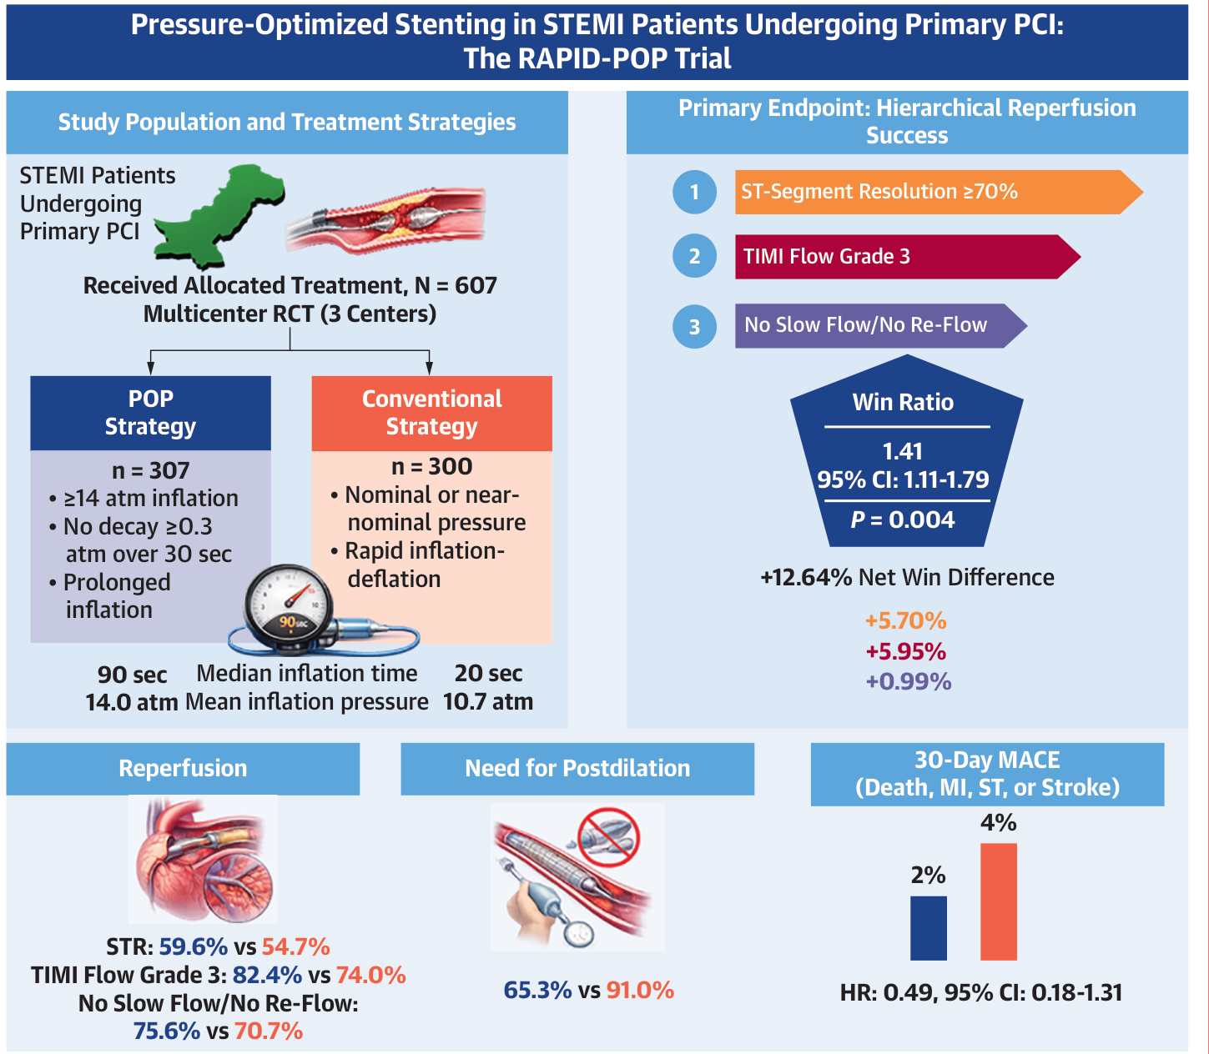

SUMMARY
Central Illustration & Take-Home Messages
Better reperfusion
Win ratio 1.42 with POP in primary PCI
Less postdilation
65.3% vs 91.0% of stents
Fewer MACE — trend
2.0% vs 4.1%, not significant
Practical
Simple, cost-neutral, 97.7% feasible
RAPID-POP Trial | JACC Cardiovasc Interv 2026
18

Slide 19

Thank You
Questions & Discussion
Dr Hassan • PGR Cardiology • Cardiac Center, BVH Bahawalpur

