Slide 1

JOURNAL CLUB
NATURE Trial
Mechanical thrombectomy with enVast in STEMI with large thrombus burden — a randomised superiority trial (ESC Congress 2026)
Presented by
Dr M. Waqas Saleem
PGR Cardiology
Cardiac Centre, BVH Bahawalpur
Notes:
Journal club presentation of the NATURE trial, presented as a late-breaking clinical trial at ESC Congress 2026 in Munich by Prof. Marco Valgimigli.

Slide 2

Background: why a large thrombus matters
Large thrombus
Distal embolisation
Microvascular obstruction
Larger infarct
What we already know
TASTE (n = 7,244): routine aspiration did not reduce mortality
TOTAL (n = 10,732): no clinical benefit, and more strokes at 30 days
ESC guidelines: routine thrombus aspiration is not recommended (Class III)
Question: can a stent-retriever remove clot better and more safely?
NATURE Trial · Journal Club · Cardiac Centre, BVH Bahawalpur
2
Notes:
In STEMI with a large thrombus, balloon and stent can fragment clot and push it downstream (distal embolisation), causing microvascular obstruction and larger infarcts. Routine manual aspiration was tested in TASTE and TOTAL without clinical benefit, and TOTAL showed more strokes, so current ESC guidance does not recommend routine aspiration.

Slide 3
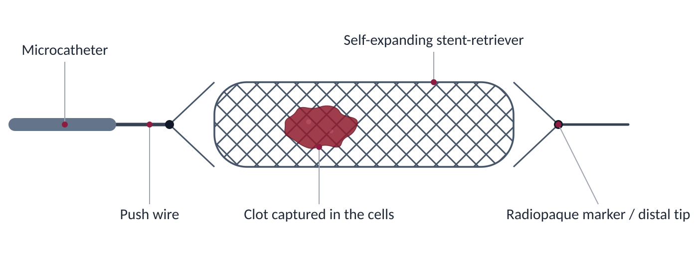
The enVast device
Schematic illustration (not to scale). Coronary stent-retriever by Vesalio, derived from the NeVa neurovascular thrombectomy platform.
NATURE Trial · Journal Club · Cardiac Centre, BVH Bahawalpur
3
Notes:
enVast is Vesalio's coronary clot retriever, derived from its NeVa neurovascular thrombectomy platform. It is delivered through a microcatheter, self-expands inside the clot, holds the clot in its cells and is then pulled back. The picture is a schematic illustration, not a photograph.

Slide 4
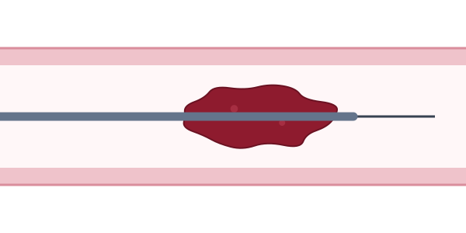
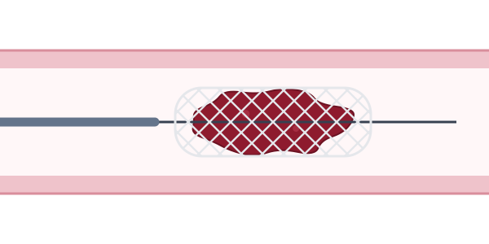
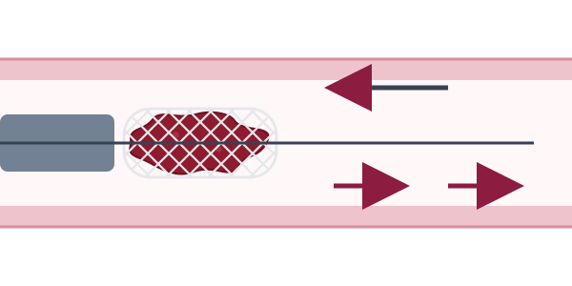
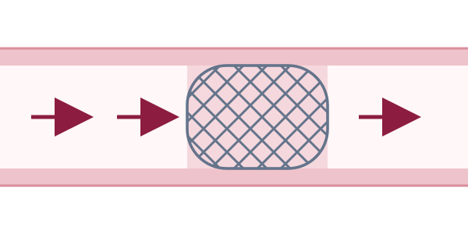
The procedure step by step
1
Cross
2
Deploy
Wire and microcatheter pass through the clot
Retriever opens inside the clot and holds it
3
Retrieve
4
Stent
Device and clot pulled back into the guide
Conventional PCI; flow restored
Schematic illustrations (not to scale).
NATURE Trial · Journal Club · Cardiac Centre, BVH Bahawalpur
4
Notes:
Step 1: the wire and microcatheter cross the thrombus. Step 2: the microcatheter is pulled back and the retriever expands inside the clot. Step 3: the retriever and the captured clot are withdrawn into the guide catheter, restoring flow. Step 4: conventional PCI with stent implantation completes the procedure.

Slide 5

Trial design
154 STEMI patients with large thrombus · 11 centres
Type
Prospective, multicentre, randomised
Hypothesis
Superiority on infarct size
Randomised 1 : 1
PI
Prof. Marco Valgimigli, Lugano
enVast thrombectomy
then conventional PCI
Standard PCI
standard of care
Sponsor
Vesalio
Registry
NCT04969471
NATURE Trial · Journal Club · Cardiac Centre, BVH Bahawalpur
5
Notes:
154 patients at 11 centres were randomised 1:1 to enVast-assisted thrombectomy followed by conventional PCI, or to standard primary PCI. The hypothesis was superiority of enVast on infarct size. Design paper: Landi et al., Cardiovascular Revascularization Medicine, 2026.

Slide 6


Inclusion criteria
Age ≥ 18 years
Key point
Chest pain > 20 min with ST elevation ≥ 1 mm in ≥ 2 contiguous leads, or infero-lateral MI with ST depression ≥ 1 mm in ≥ 2 of V1–V3 and a positive terminal T wave
TIMI thrombus grade ≥ 3
A definite clot longer than half the vessel diameter. These patients are the most likely to embolise clot during PCI, so they have the most to gain from thrombectomy.
TIMI thrombus grade ≥ 3 in the infarct-related artery (re-confirmed after wiring if TIMI 0 flow)
Intervention started within 8 hours of symptom onset
Informed consent before the procedure
NATURE Trial · Journal Club · Cardiac Centre, BVH Bahawalpur
6
Notes:
Inclusion criteria as listed on ClinicalTrials.gov (NCT04969471). The key criterion is TIMI thrombus grade 3 or more, re-confirmed after wiring if the artery is occluded.

Slide 7

Exclusion criteria
Unconscious patient
Why these exclusions?
Infarct-related artery < 2.5 mm (visual estimate)
Small, calcified or tortuous vessels: hard to deliver a retriever safely
Stent thrombosis and prior MI in the same territory would confound infarct size
Severe calcification or extreme tortuosity at or proximal to the culprit lesion
Stent thrombosis as the culprit lesion
Previous MI in the same territory
Women of child-bearing potential
Participation in another interventional trial
NATURE Trial · Journal Club · Cardiac Centre, BVH Bahawalpur
7
Notes:
Exclusion criteria as listed on ClinicalTrials.gov (NCT04969471). Most exclude anatomy where a retriever is hard to deliver safely, or situations that would confound the infarct-size endpoint.

Slide 8



Endpoints
Primary
Secondary
Safety
Infarct size by CK-MB area under the curve
Infarct size on cardiac MRI (% of LV mass) at day 3
Death, stroke and MACE at 30 days
NATURE Trial · Journal Club · Cardiac Centre, BVH Bahawalpur
8
Notes:
The primary endpoint is enzymatic infarct size (CK-MB area under the curve). The key secondary endpoint is infarct size on cardiac MRI at day 3. Safety was assessed at 30 days.

Slide 9
Primary endpoint: met
26%
relative reduction in infarct size (CK-MB AUC) with enVast versus standard PCI
P = 0.001
NATURE Trial · Journal Club · Cardiac Centre, BVH Bahawalpur
9
Notes:
Enzymatic infarct size by CK-MB AUC was about 26% lower with enVast (P = 0.001). The chart shows the relative effect with control set to 100; absolute values are in the primary presentation.

Slide 10
Secondary endpoint: cardiac MRI
CK-MB AUC (primary)
26% smaller
Standard PCI
enVast + PCI
Significant, P = 0.001
Cardiac MRI at day 3 (secondary)
25% smaller
Standard PCI
enVast + PCI
Trend in the same direction
Two different measures, a blood test and imaging, point the same way.
NATURE Trial · Journal Club · Cardiac Centre, BVH Bahawalpur
10
Notes:
Cardiac MRI at day 3 showed about a 25% relative reduction in infarct size as a percentage of LV mass. It was a positive trend rather than a formally significant result, but it agrees with the CK-MB finding.

Slide 11
Safety at 30 days
No strokes and no deaths with enVast
Important because aspiration in TOTAL increased stroke
Very few events overall
The trial was not powered for clinical outcomes
NATURE Trial · Journal Club · Cardiac Centre, BVH Bahawalpur
11
Notes:
At 30 days: stroke 0% vs 1.3%, death 0% vs 2.6%, MACE 1.3% vs 3.8% (enVast vs control). Reassuring given the stroke signal with aspiration in TOTAL, but the event numbers are very small.

Slide 12
Strengths
Randomised, multicentre
Right population
11 centres, 1:1 allocation
Only patients with a large thrombus
Consistent results
Safe early course
CK-MB and cardiac MRI agree
No stroke or death with enVast at 30 days
NATURE Trial · Journal Club · Cardiac Centre, BVH Bahawalpur
12
Notes:
Randomised multicentre design, a population chosen where benefit is plausible, agreement between biomarker and MRI, and no early safety signal.

Slide 13
Limitations
1
Small trial
2
Surrogate endpoint
Only 154 patients
Infarct size, not death or heart failure
3
Operators not blinded
4
MRI only a trend
Device use cannot be hidden
Industry-funded; needs independent confirmation
NATURE Trial · Journal Club · Cardiac Centre, BVH Bahawalpur
13
Notes:
Small sample, surrogate primary endpoint, operators unavoidably aware of device use, the MRI result only a trend, and industry sponsorship.

Slide 14
Conclusion
In STEMI with a large thrombus, enVast thrombectomy before PCI was superior to standard PCI in reducing infarct size, with no early safety concern.
Today
Next
Promising for selected large-thrombus cases, but not yet routine. Guidelines are unchanged.
A larger trial with hard outcomes: death, heart failure and stroke.
NATURE Trial · Journal Club · Cardiac Centre, BVH Bahawalpur
14
Notes:
NATURE met its superiority hypothesis on infarct size, with reassuring 30-day safety. Because it is small and uses a surrogate endpoint, it should not yet change routine practice; an outcomes trial is the next step.

Slide 15
Take-home for our cath lab
01
Grade the thrombus (TIMI thrombus grade) in every STEMI
02
Routine manual aspiration is still not recommended
03
Stent-retriever thrombectomy is promising for large thrombus, but awaits outcome data
NATURE Trial · Journal Club · Cardiac Centre, BVH Bahawalpur
15
Notes:
Practical messages for discussion: grade thrombus burden, do not use routine aspiration, and follow the evidence as outcome trials report.

Slide 16
References
Valgimigli M. NATURE trial. Late-Breaking Clinical Trial, ESC Congress 2026, Munich.
Landi A, et al. Mechanical thrombectomy in STEMI with large thrombus burden: design and rationale of the NATURE trial. Cardiovasc Revasc Med. 2026.
ClinicalTrials.gov NCT04969471: NATURE (enVast as an adjunct to PPCI in STEMI).
Fröbert O, et al. Thrombus aspiration during STEMI (TASTE). N Engl J Med. 2013.
Jolly SS, et al. Primary PCI with or without routine manual thrombectomy (TOTAL). N Engl J Med. 2015.
Byrne RA, et al. 2023 ESC Guidelines for the management of acute coronary syndromes. Eur Heart J. 2023.
NATURE Trial · Journal Club · Cardiac Centre, BVH Bahawalpur
16
Notes:
NATURE figures are from the ESC 2026 late-breaking presentation and press reports; check the peer-reviewed publication for final values.

Slide 17
Thank you
Questions and discussion
Dr M. Waqas Saleem · PGR Cardiology · Cardiac Centre, BVH Bahawalpur

