Slide 1
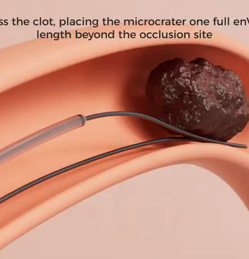
NATURE Trial
JOURNAL CLUB · ESC CONGRESS 2026
Mechanical thrombectomy with enVast in STEMI with large thrombus burden: a randomised superiority trial
PRESENTED BY
Dr M. Waqas Saleem
PGR Cardiology · Cardiac Centre, BVH Bahawalpur
Notes:
Journal club presentation of the NATURE trial, presented as a late-breaking clinical trial at ESC Congress 2026 in Munich by Prof. Marco Valgimigli.

Slide 2

Why a large thrombus matters
BACKGROUND
01
02
03
04
Large thrombus
Distal embolisation
Microvascular obstruction
Larger infarct
Heavy clot burden in the infarct artery
Balloon and stent push clot downstream
Debris plugs the microcirculation
Less myocardium salvaged
Removing the clot before stenting aims to break this chain.
NATURE Trial · Journal Club
02
Notes:
In STEMI with a large thrombus, balloon and stent can fragment clot and push it downstream (distal embolisation), causing microvascular obstruction and larger infarcts.

Slide 3

What we already know
BACKGROUND
TASTE · N = 7,244
TOTAL · N = 10,732
ESC GUIDELINES
No mortality benefit
More strokes
Class III
Routine aspiration did not reduce death
No clinical benefit, and more strokes at 30 days
Routine thrombus aspiration is not recommended
The question: can a stent-retriever remove clot better, and more safely?
NATURE Trial · Journal Club
03
Notes:
Routine manual aspiration was tested in TASTE and TOTAL without clinical benefit, and TOTAL showed more strokes, so current ESC guidance does not recommend routine aspiration.

Slide 4
TAPAS vs TASTE vs TOTAL vs NATURE
IN CONTEXT
 | TAPAS · NEJM 2008 | TASTE · NEJM 2013 | TOTAL · NEJM 2015 | NATURE · ESC 2026
Patients | 1,071 · 1 centre | 7,244 · Sweden | 10,732 · 20 countries | 154 · 11 centres
Who | All-comer STEMI | All-comer STEMI | All-comer STEMI | Thrombus grade ≥ 3 only
Device | Manual aspiration | Manual aspiration | Manual aspiration | enVast stent-retriever
Endpoint | Myocardial blush 0–1 | Death at 30 days | CV death/MI/shock/HF | Infarct size, CK-MB AUC
Result | 17% vs 26%, P < 0.001 | 2.8% vs 3.0%, P = 0.63 | 6.9% vs 7.0%, P = 0.86 | 26% smaller, P = 0.001
Stroke | Not reported | 0.5% vs 0.5% | 0.7% vs 0.3% (↑) | 0% vs 1.3%
Verdict | Positive, surrogate | Neutral | Neutral, stroke signal | Positive, surrogate
RIGHT PATIENTS
BETTER TOOL
THE LESSON OF TAPAS
Only large thrombus, where embolisation risk is highest
A retriever captures the whole clot instead of fragmenting it
A positive surrogate needs an outcomes trial to confirm it
TAPAS was positive on a surrogate too, but TASTE and TOTAL then showed no hard-outcome benefit.
04
Notes:
TAPAS (Svilaas, NEJM 2008) was a single-centre trial in Groningen of 1,071 all-comer STEMI patients. Manual aspiration improved myocardial blush (grade 0 or 1 in 17.1% vs 26.3%, P under 0.001), and a 1-year follow-up (Vlaar, Lancet 2008) suggested lower cardiac death (3.6% vs 6.7%). That led to wide adoption, but the much larger TASTE (Fröbert, NEJM 2013) and TOTAL (Jolly, NEJM 2015) trials found no reduction in hard outcomes: TASTE 30-day death 2.8% vs 3.0% (P = 0.63); TOTAL CV death, recurrent MI, cardiogenic shock or class IV heart failure at 180 days 6.9% vs 7.0% (P = 0.86), with more strokes at 30 days (0.7% vs 0.3%, P = 0.02). NATURE differs in three ways: only patients with large thrombus (TIMI thrombus grade 3 or more), a stent-retriever that traps the clot rather than aspirating fragments, and infarct size as the endpoint. Like TAPAS, it is positive on a surrogate endpoint, so the history of aspiration is the reason it needs an outcomes trial before it changes practice.

Slide 5



Trial design
METHODS
154 STEMI patients with large thrombus · 11 centres
TYPE
Prospective, multicentre, randomised
HYPOTHESIS
Randomised 1 : 1
Superiority on infarct size
PI
Prof. Marco Valgimigli, Lugano
enVast thrombectomy
Standard PCI
SPONSOR
then conventional PCI
standard of care
Vesalio
REGISTRY
NCT04969471
NATURE Trial · Journal Club
05
Notes:
154 patients at 11 centres were randomised 1:1 to enVast-assisted thrombectomy followed by conventional PCI, or to standard primary PCI. The hypothesis was superiority of enVast on infarct size. Design paper: Landi et al., Cardiovascular Revascularization Medicine, 2026.

Slide 6



Inclusion criteria
METHODS
Age ≥ 18 years
Chest pain > 20 min with ST elevation ≥ 1 mm in ≥ 2 contiguous leads, or infero-lateral MI with ST depression ≥ 1 mm in ≥ 2 of V1–V3 and a positive terminal T wave
KEY POINT
TIMI thrombus grade ≥ 3
TIMI thrombus grade ≥ 3 in the infarct-related artery (re-confirmed after wiring if TIMI 0 flow)
A definite clot longer than half the vessel diameter. These patients are the most likely to embolise clot during PCI, so they have the most to gain from thrombectomy.
Intervention started within 8 hours of symptom onset
Informed consent before the procedure
Source: ClinicalTrials.gov NCT04969471
06
Notes:
Inclusion criteria as listed on ClinicalTrials.gov (NCT04969471). The key criterion is TIMI thrombus grade 3 or more, re-confirmed after wiring if the artery is occluded.

Slide 7


TIMI thrombus grading
METHODS
Eligible for NATURE: grade ≥ 3
G0
G1
G2
G3
G4
G5
No angiographic thrombus
Possible thrombus: haziness, reduced contrast density
Definite thrombus ≤ ½ vessel diameter
Definite thrombus > ½ but < 2 vessel diameters
Definite thrombus ≥ 2 vessel diameters
Total occlusion; thrombus size cannot be assessed
Large thrombus burden is usually defined as grade ≥ 4
Grade 5: re-grade after wiring or a small balloon restores flow
Gibson CM, et al. Circulation 2001 · Sianos G, et al. J Am Coll Cardiol 2007
07
Notes:
TIMI thrombus grade (Gibson et al., Circulation 2001): G0 no thrombus; G1 possible thrombus (reduced contrast density, haziness, irregular lesion contour); G2 definite thrombus up to half the vessel diameter; G3 definite thrombus more than half but less than two vessel diameters; G4 definite thrombus two or more vessel diameters; G5 total occlusion, so the thrombus cannot be sized. Sianos et al. (JACC 2007) defined large thrombus burden as grade 4 or more and proposed re-grading grade 5 lesions after flow is restored with a wire or small balloon. NATURE enrolled grade 3 or more, re-confirmed after wiring when the artery was occluded.

Slide 8

Exclusion criteria
METHODS
−
Unconscious patient
−
Infarct-related artery < 2.5 mm (visual estimate)
WHY THESE EXCLUSIONS?
−
Severe calcification or extreme tortuosity at or proximal to the culprit lesion
Small, calcified or tortuous vessels: hard to deliver a retriever safely.
−
Stent thrombosis as the culprit lesion
−
Previous MI in the same territory
Stent thrombosis and prior MI in the same territory would confound infarct size.
−
Women of child-bearing potential
−
Participation in another interventional trial
Source: ClinicalTrials.gov NCT04969471
08
Notes:
Exclusion criteria as listed on ClinicalTrials.gov (NCT04969471). Most exclude anatomy where a retriever is hard to deliver safely, or situations that would confound the infarct-size endpoint.

Slide 9



Endpoints
METHODS
PRIMARY
SECONDARY
SAFETY
Infarct size by CK-MB area under the curve
Infarct size on cardiac MRI (% of LV mass) at day 3
Death, stroke and MACE at 30 days
NATURE Trial · Journal Club
09
Notes:
The primary endpoint is enzymatic infarct size (CK-MB area under the curve). The key secondary endpoint is infarct size on cardiac MRI at day 3. Safety was assessed at 30 days.

Slide 10
Primary endpoint: met
RESULTS
Relative infarct size, CK-MB AUC (standard PCI = 100)
26%
100
74
relative reduction in infarct size (CK-MB AUC) with enVast versus standard PCI
P = 0.001
Standard PCI
enVast + PCI
NATURE Trial · Journal Club
10
Notes:
Enzymatic infarct size by CK-MB AUC was about 26% lower with enVast (P = 0.001). The chart shows the relative effect with control set to 100; absolute values are in the primary presentation.

Slide 11
Secondary endpoint: cardiac MRI
RESULTS
Cardiac MRI at day 3 (secondary)
25% smaller · trend
Standard PCI
100
enVast + PCI
75
WHAT WAS MEASURED
WHEN
RESULT
Infarct size, % of LV mass
Day 3 after PCI
About 25% smaller with enVast (trend)
Imaging points the same way as the primary endpoint, but on its own it is a trend, not proof.
Relative values, standard PCI = 100
11
Notes:
Cardiac MRI at day 3 showed about a 25% relative reduction in infarct size as a percentage of LV mass. It was a positive trend rather than a formally significant result, but it agrees with the CK-MB finding.

Slide 12

Safety at 30 days
RESULTS
enVast + PCI
Standard PCI
Event rate, %
No strokes and no deaths with enVast
3.8%
Important, because aspiration in TOTAL increased stroke.
2.6%
1.3%
1.3%
Very few events overall; the trial was not powered for clinical outcomes.
0%
0%
Stroke
Death
MACE
NATURE Trial · Journal Club
12
Notes:
At 30 days: stroke 0% vs 1.3%, death 0% vs 2.6%, MACE 1.3% vs 3.8% (enVast vs control). Reassuring given the stroke signal with aspiration in TOTAL, but the event numbers are very small.

Slide 13
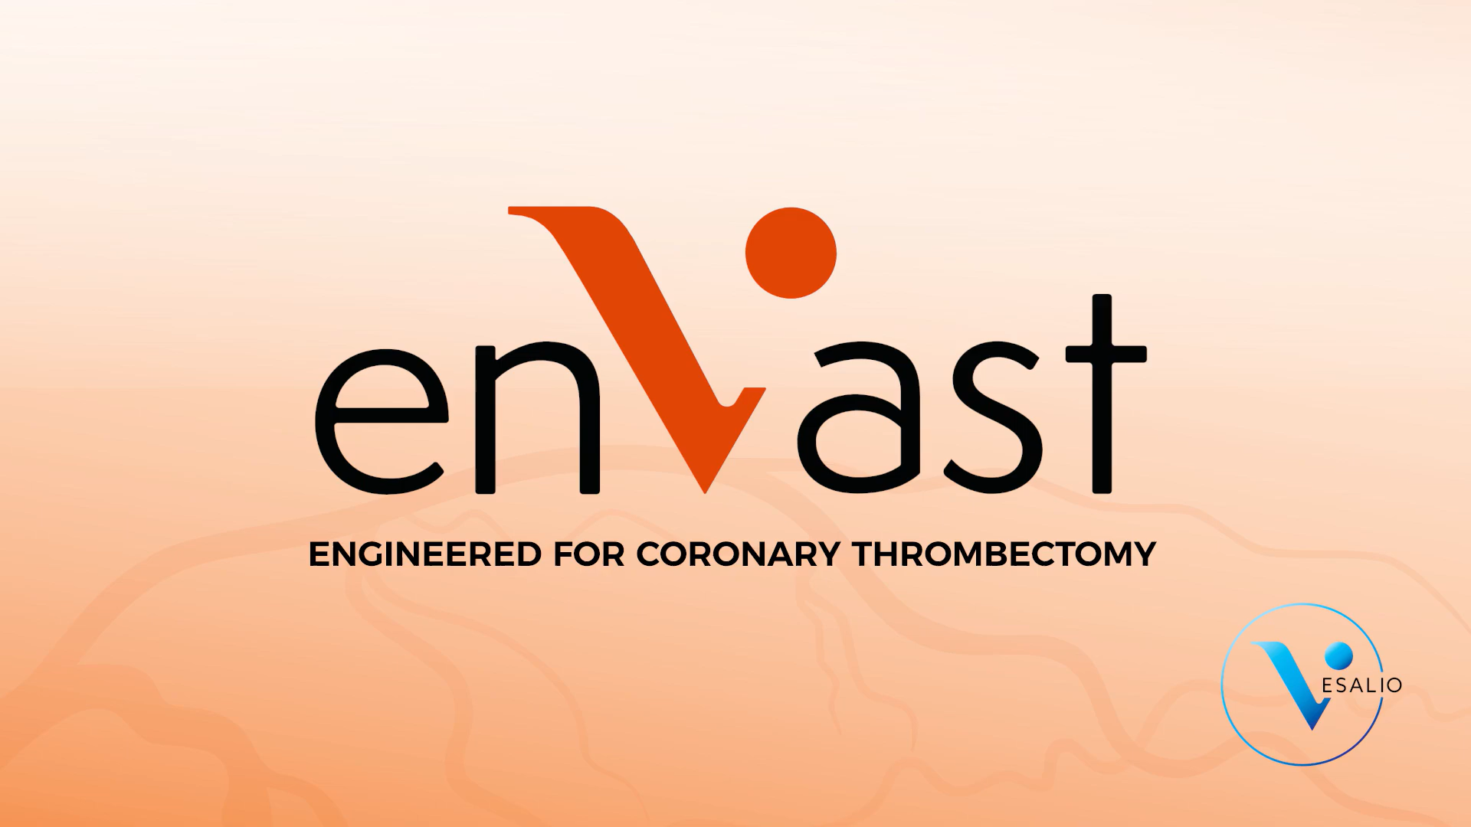
See it in action
THE DEVICE
PROCEDURE ANIMATION
Cross, deploy, retrieve, stent
Click the video to play or pause. It is embedded in the deck, so no internet is needed.
Source: Vesalio. enVast Coronary Thrombectomy System procedure animation.
Watch with narration on YouTube
NATURE Trial · Journal Club
13
Notes:
Official Vesalio animation of the enVast coronary thrombectomy procedure. Click the video to play it; it is embedded, so it plays offline (silently, with on-screen captions). For narration, use the YouTube link.

Slide 14




Strengths
APPRAISAL
Randomised, multicentre
Right population
11 centres, 1:1 allocation
Only patients with a large thrombus
Consistent results
Safe early course
CK-MB and cardiac MRI agree
No stroke or death with enVast at 30 days
NATURE Trial · Journal Club
14
Notes:
Randomised multicentre design, a population chosen where benefit is plausible, agreement between biomarker and MRI, and no early safety signal.

Slide 15
Limitations
APPRAISAL
1
Small trial
2
Surrogate endpoint
Only 154 patients
Infarct size, not death or heart failure
3
Operators not blinded
4
MRI only a trend
Device use cannot be hidden
Industry-funded; needs independent confirmation
NATURE Trial · Journal Club
15
Notes:
Small sample, surrogate primary endpoint, operators unavoidably aware of device use, the MRI result only a trend, and industry sponsorship.

Slide 16
CONCLUSION
In STEMI with a large thrombus, enVast thrombectomy before PCI was superior to standard PCI in reducing infarct size, with no early safety concern.
TODAY
NEXT
Promising for selected large-thrombus cases, but not yet routine. Guidelines are unchanged.
A larger trial with hard outcomes: death, heart failure and stroke.
NATURE Trial · Journal Club
16
Notes:
NATURE met its superiority hypothesis on infarct size, with reassuring 30-day safety. Because it is small and uses a surrogate endpoint, it should not yet change routine practice; an outcomes trial is the next step.

Slide 17
For our cath lab
TAKE-HOME
01
Grade the thrombus (TIMI thrombus grade) in every STEMI
02
Routine manual aspiration is still not recommended
03
Stent-retriever thrombectomy is promising for large thrombus, but awaits outcome data
NATURE Trial · Journal Club
17
Notes:
Practical messages for discussion: grade thrombus burden, do not use routine aspiration, and follow the evidence as outcome trials report.

Slide 18
Thank you
Questions and discussion
Dr M. Waqas Saleem · Cardiac Centre, BVH Bahawalpur

