Slide 1
Design patterns

Slide 2
Design patterns
“A pattern describes a problem which occurs over and over again in our environment, and then describes the core of the solution to that problem, in such a way that you can use this solution a million times over, without ever doing it the same way twice.”

Slide 3
Patterns solve software structural problems
like:
Abstraction,
Encapsulation
Information hiding
Separation of concerns
Coupling and cohesion
Separation of interface and implementation
Single point of reference
Divide and conquer

Slide 4
Benefits of Design Patterns
Design patterns enable large-scale reuse of software architectures and also help document systems
Patterns explicitly capture expert knowledge and design tradeoffs and make it more widely available
Patterns help improve developer communication
Pattern names form a common vocabulary

Slide 5
The “gang of four” (GoF)
Erich Gamma, Richard Helm, Ralph Johnson & John Vlissides (Addison-Wesley, 1995)
Design Patterns book catalogs 23 different patterns as solutions to different classes of problems, in C++ & Smalltalk
The problems and solutions are broadly applicable, used by many people over many years
What design pattern did we discover with the Undo problem?
Why is it useful to learn about this pattern?
Patterns suggest opportunities for reuse in analysis, design and programming
GOF presents each pattern in a structured format
What do you think of this format? Pros and cons?

Slide 6
Types of Pattern
There are 3 types of pattern …
Creational: address problems of creating an object in a flexible way. Separate creation, from operation/use.
Structural: address problems of using O-O constructs like inheritance to organize classes and objects
Behavioral: address problems of assigning responsibilities to classes. Suggest both static relationships and patterns of communication
(use cases)

Slide 7
Gang of Four (GoF) patterns
Creational Patterns (abstracting the object-instantiation process)
Factory Method Abstract Factory Singleton
Builder Prototype
Structural Patterns (how objects/classes can be combined to form larger structures)
Adapter Bridge Composite
Decorator Facade Flyweight
Proxy
Behavioral Patterns (communication between objects)
Command Interpreter Iterator
Mediator Observer State
Strategy Chain of Responsibility Visitor
Template Method

Slide 8
Elements of Design Patterns
Design patterns have 4 essential elements:
Pattern name: increases vocabulary of designers
Problem: intent, context, when to apply
Solution: UML-like structure, abstract code
Consequences: results and tradeoffs

Slide 9
Creational Patterns
Abstract Factory:
Factory for building related objects
Builder:
Factory for building complex objects incrementally (multi course dinner- separate object construction- easy to understand)
Factory Method:
Method in a derived class creates associates (person, male, female- additional types)
Prototype:
Factory for cloning new instances from a prototype (chess game-initial setup)
Singleton:
Factory for a singular (sole) instance (president of country-easy to write)

Slide 10
Structural Patterns
Adapter:
Translator adapts a server interface for a client (iphone power adapter)
Bridge:
Abstraction for binding one of many implementations (household switch)
Composite:
Structure for building recursive aggregations (group messaging)
Decorator:
Decorator extends an object transparently (add responsibility to object, inheritance, 10 pizza with 3 topping, discount, complex)
Facade:
Simplifies the interface for a subsystem (event manager, online book, reduce coupling, reduce network calls, single interface represent entire subsystems)
Flyweight:
Many fine-grained objects shared efficiently.

Slide 11
Behavioral Patterns
Chain of Responsibility:
Request delegated to the responsible service provider
Command:
Request or Action is first-class object, hence re-storable
Iterator:
Aggregate and access elements sequentially
Interpreter:
Language interpreter for a small grammar
Mediator:
Coordinates interactions between its associates
Memento:
Snapshot captures and restores object states privately
Which ones do you think you have seen somewhere?

Slide 12
Facade (Non software example)
Provide a unified
interface to a set
of interfaces in a
subsystem.

Slide 13
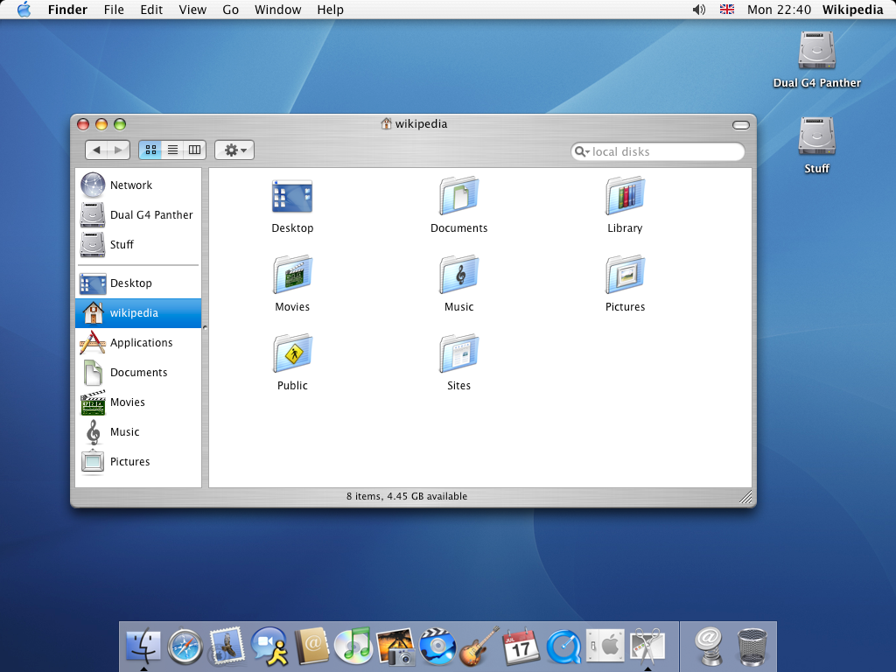

Facade (Software counterpart)

Slide 14
Flyweight (Non software example)
Use sharing to
support large
numbers of fine-
grained objects
efficiently

Slide 15
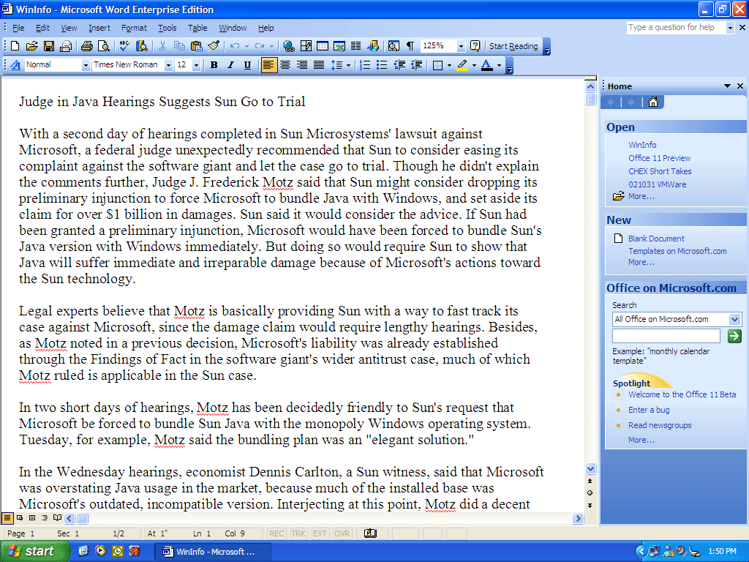
Flyweight (Software counterpart)
Memory

Slide 16
Chain of Responsibility (Non software example)
Chain the
receiving objects
and pass the
request along the
chain until an
object handles it.

Slide 17
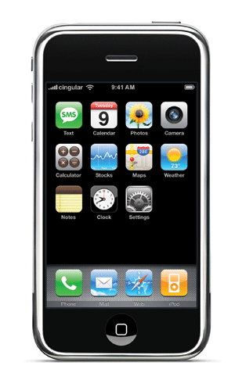
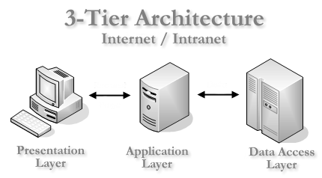
Chain of Responsibility (Software counterpart)
Internet
Login page
Password checking
Balance statement

Slide 18
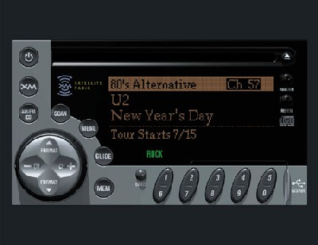
Memento (Non software example)
Externalize
object’s state so
that object can be
restored to this
state later.

Slide 19
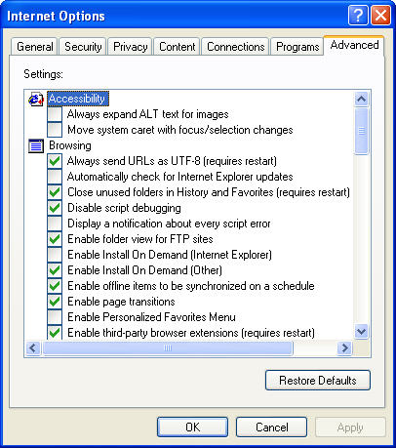
Memento (Software counterpart)

Slide 20
Observer (Non software example)
When an object
changes its state,
all its dependants
are notified.

Slide 21

Observer (Software counterpart)
Internet
Cricinfo Server

Slide 22
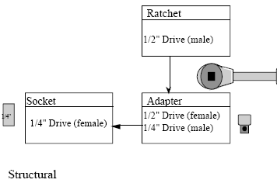
Adapter (Non software example)
Convert the
interface of a
class into another
Interface clients
expect.

Slide 23
Adapter (Software counterpart)
Java module
Java Native
Interface (JNI)
C++ module

Slide 24
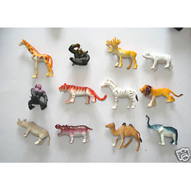
Builder (Non software example)
Separate the construction
process of a complex object
from its representation so
that the same construction
Process can create different
representations.

Slide 25
Builder (Software counterpart)
Compiler process
Lexical
analysis
Syntax
analysis
Semantic
analysis
Intermediate code
Interpretation
Java Compiler
Java Lexer
Java Parser
Semantic
analysis
Java byte code
JVM
Python Compiler
Python Lexer
Python Parser
Semantic
analysis
Python byte code
PVM

Slide 26
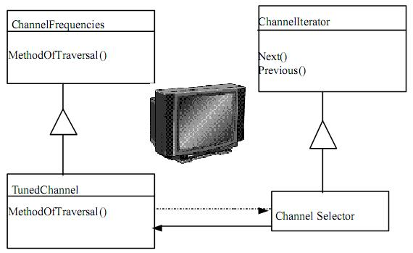
Iterator (Non software example)
Provide a way to
access the
elements of a set
sequentially.

Slide 27
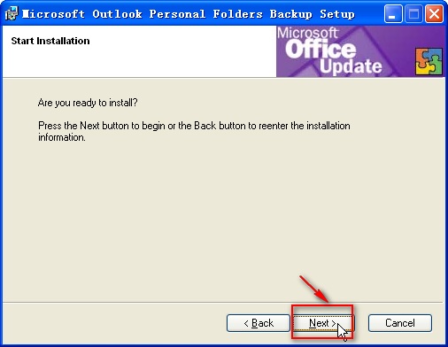
Iterator (Software counterpart)

Slide 28
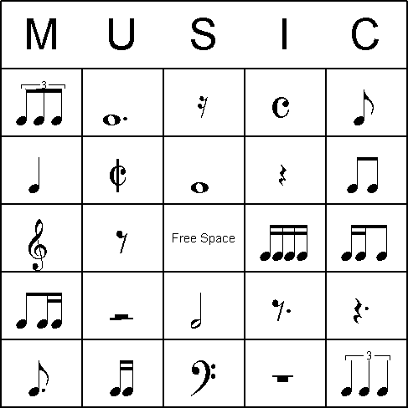
Interpreter (Non software example)
Interpreter interprets
the sentences in a
language based
on its grammar.

Slide 29
Interpreter (Software counterpart)
In Gtalk/Yahoo messengers
:-) is interpreted as ☺
:-( is interpreted as ☹

Slide 30
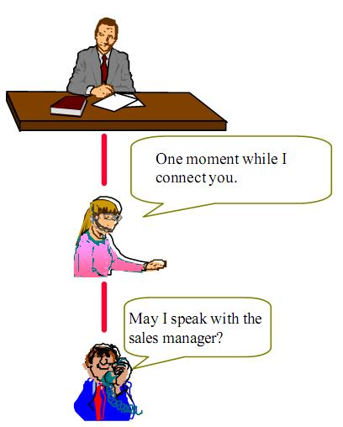
Proxy (Non software example)
Provide a surrogate or
placeholder for
another object to
control access to it.

Slide 31
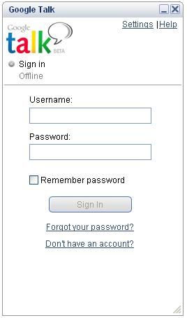
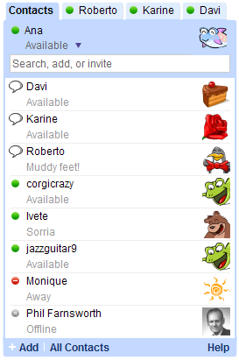

Proxy (Software counterpart)

Slide 32
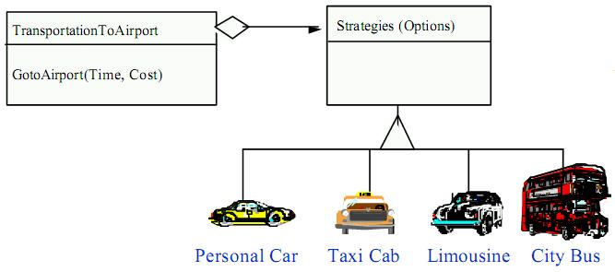
Strategy (Non software example)
A Strategy defines a set of algorithms that can be
used interchangeably.

Slide 33

Strategy (Software counterpart)
Multiple
interchangeable
weapons available to
attack an enemy.

Slide 34
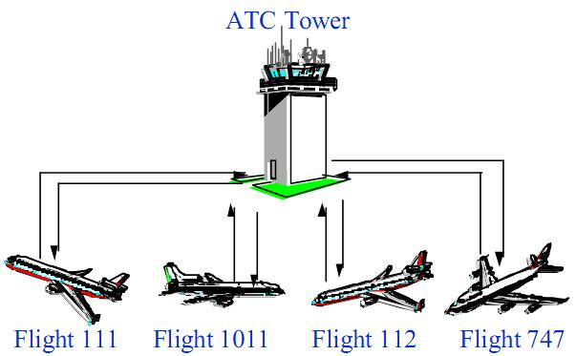
Mediator (Non software example)
Loose coupling
between colleague
objects is achieved by
having colleagues
communicate with the
Mediator, rather than
one another.

Slide 35
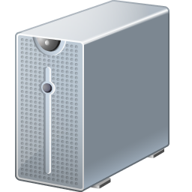
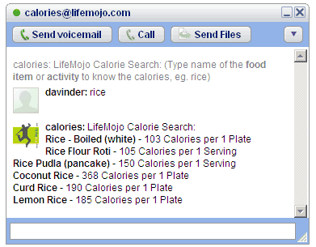
Mediator (Software counterpart)
Gtalk Server

Slide 36
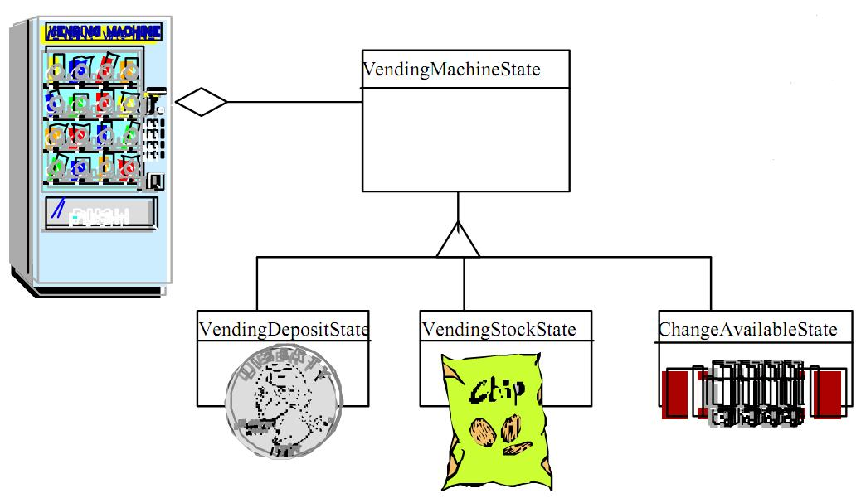
State (Software example)
An object alters its
behavior when its
internal state
changes.

Slide 37
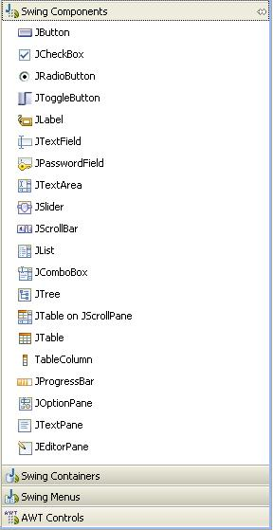
Template Method (Software example)
Event handling in Java GUI
components is unimplemented.
Define the skeleton of an
algorithm in an operation,
deferring some steps to
subclasses.

