Slide 1





STUDENT
MANAGMENT
SIR SUALEH
@SMIT

Slide 2
PROJECT INTRO
This project is a user-based platform where individuals can sign up and log in to access their dashboard. After logging in, users will see all posts available on the platform. The dashboard includes features for managing content, allowing users to view their own posts, save posts for later, and add new posts. The My Posts section displays all posts uploaded by the user, while the Saved Posts section keeps track of bookmarked content. The Add Post feature enables users to create and share new posts. This system provides a smooth and interactive experience for content management.

Slide 3
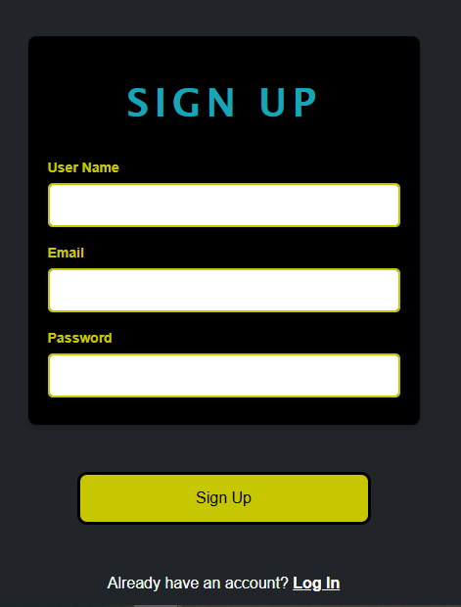
VERIFICATION CODE GO TO YOUR MAIL
1
SIGNUP

Slide 4
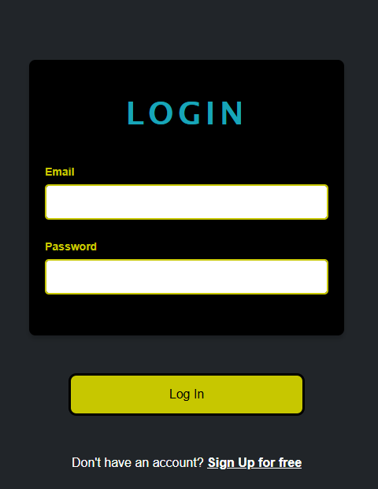
REDIRECT TO DASHBOARD
2
LOGIN

Slide 5
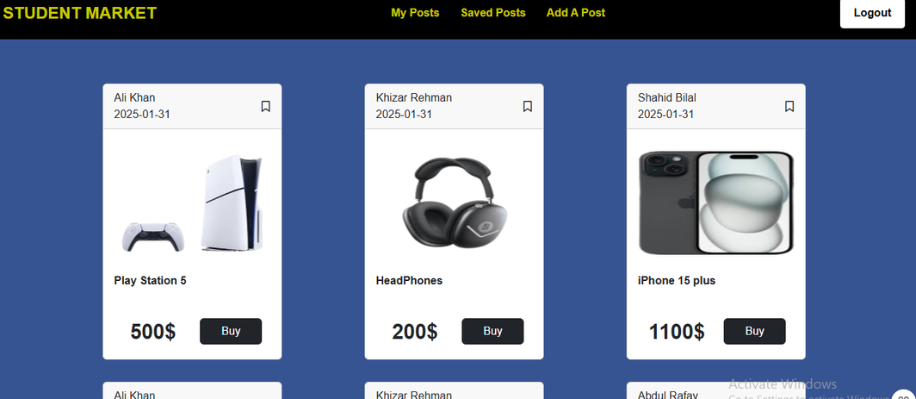
DASHBOARD
MY POST
SAVED POST
ADD POST
YOUR POSTS
YOUR SAVED POSTS
ADD POST/PREVIEW

Slide 6
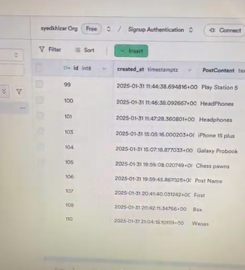
CHALLENGE
SUPABASE
The main challenge was connecting the project with Supabase, handling authentication, and managing data smoothly.

Slide 7
THANK YOU
SIR SUALEH
KHALID -KHIZAR-WAQAS-IMRAN

