Slide 1

Cuboid
MITIGATA CYBERFORGE · PROBLEM 02
Store 42
A key opens one slice, and nothing else
An aggregation layer between the database and the dashboards: fast, fresh and exact for every store, and sealed off from every other.
status
10M
100
1,000
1
time
stores
orders
stores
dashboards
laptop
Team iiitdards · Aditya Rai, Bhuvan Raju
Notes:
We are team iiitdards: Aditya Rai and Bhuvan Raju. Open with the problem, not the name. A cuboid is one view of a data cube: stores by time by status. Every dashboard number is a sum over part of that cube, and the blue slab is the whole isolation story in one picture: a key opens one store's slice and nothing else. Everything in this deck was measured on one laptop, with both databases, Cuboid, the store app and the load generator sharing it.

Slide 2
We reproduced the problem before solving it
PRD §1 · THE PROBLEM
Is slow
Hurts everyone
Forces bad shortcuts
“it scans lots of data, so the dashboard takes seconds or minutes to load”
“one big store’s report makes the app slow for all stores”
“a nightly job is cheap but shows yesterday’s numbers; querying live is fresh but expensive”
5.4 s
105×
24 h
Dashboard p99 at 10M orders with 1,000 dashboards querying directly, on properly indexed tables.
The store app’s own p95 went from 0.99 ms to 104 ms. Its throughput fell from 188 to 54 operations a second.
That is the choice: numbers up to a day old, or the slowdown beside this. We wanted neither.
So Cuboid never asks the main database for a dashboard number at all.
Evidence: artifacts/safety/main.json · Direct phase, 1,000 dashboards on the main database, 10M orders
Notes:
Before building anything fast, we built the slow version properly and measured it: the direct baseline has real indexes and connection pooling, so it is a fair comparison. The numbers on this slide are that baseline at the PRD's main size. 105 times is 104 ms over 0.99 ms on the app's own queries. The 24 hours is simply what a nightly job means, not a measurement. This is the bar the rest of the deck has to clear.

Slide 3
Five goals met; one query misses the sixth
PRD §2 GOALS · §4 TARGETS
PRD goal | How the PRD measures it | Good | Great | Measured at 10M orders | Verdict
Fast | Time for each dashboard query | Under 1 s | Under 200 ms | 1,000 dashboards: p99 3 ms. Slowest uncached query: 230 ms | Good
Fresh | Adding an order to seeing it in the numbers | Under 5 min | Under 30 s | p99 1.1 s, for inserts and updates | Great
Safe | Normal app query time, with and without dashboard load | Under 25% | Under 10% | +17.5%: p95 0.99 ms to 1.16 ms | Good
Separate | A tenant only ever sees its own data | No band | No band | 0 of 1,000,000 requests crossed stores. 0 leaked in drills | Met
Correct | Compare with a direct database query | Most queries | All queries | 2,500 of 2,500 exact, 500 while writes ran | Great
Scales | Query speed at 1M vs 10M records | Under 5x | Under 2x | 7 of 8 queries at 3.2x or less. Top customers: 13.7x | Not met
Read it fairly: seven of eight queries beat Great on speed; viewers get even the eighth from cache in under 2 ms. Against Cuboid stopped entirely, safety is +28.4%, a quarter of a millisecond on one shared laptop.
Evidence: docs/TARGETS.md · artifacts/ · measured at 10M orders on one laptop, 12 logical CPUs, 15.6 GB of RAM
Notes:
Say the weak rows before anyone asks. Fast is Good rather than Great because of one query: top customers, 230 ms uncached on the largest store. Safe is Good: the PRD compares with and without dashboard load, and that is +17.5%. Compared with Cuboid not running at all it is +28.4%, which we state too. Scales is not met because of that same query, which has about 130,000 groups to sort. Separate has no Good or Great band in the PRD; it is a yes or no, so we tested it hard. Correctness was measured just before the last refresh fix, and later checks on the final build also came back exact. The 1M growth figures come from an earlier build.

Slide 4
Dashboards read a copy built from the stream
PRD §1 · “AN AGGREGATION LAYER THAT SITS BETWEEN THE DATABASE AND THE DASHBOARDS”
Store app
normal reads, writes
Write path: rollup deltas, mirror and position commit in one transaction
Stream reader
logical replication
Engine
retract old, add new
Flush
one transaction, 1 s
Aggregate store
rollups, mirror, position
Main database
PostgreSQL, WAL
row security
Read path: every request, every time
Key, path
who may ask
Planner
smallest rollup
Cache, limit
per store
Guard
checks the reply
Dashboards
API key
Check a number
budgeted, read-only
The only read on the main database: compared at the same WAL position
WHAT THE PRD SAID WE WOULD LEARN
Indexing
Pre-computing
Caching
Streams
Measuring
Cells keyed by store, rollup, grain and bucket
Exact rollups that retract under updates and deletes
One partition per store, valid by time range
Logical replication with a one-second flush
Every number written to a file in artifacts/
Evidence: docs/ARCHITECTURE.md · docs/adr/ · Go, PostgreSQL 16, React · no polling and no triggers on the main database
Notes:
Two paths. The write path reads the main database's write-ahead log. An insert adds to a rollup, a delete retracts, and an update does both, which is why placed to cancelled moves exactly. Rollup deltas, mirror rows and the applied log position commit in one transaction, so a crash resumes exactly. The read path holds no connection to the main database at all. The only read on main is the budgeted check at the bottom, which exists to prove the numbers. The five techniques at the bottom are the ones the PRD says this problem teaches.

Slide 5
Every must-have, through one simple API
PRD §3 · FR-1 TO FR-7 · MUST HAVE
ID | The PRD’s example | The real GET, largest store | Result at 10M
FR-1 | Orders and total sales, last 7 days | /tenants/42/orders/summary?range=last_7d | 5.7 ms
FR-2 | Orders per day, last 30 days | /tenants/42/orders/trend?interval=day&range=last_30d | 8.8 ms
FR-3 | Top 10 products by sales this week | /tenants/42/products/top?n=10&by=sales&range=this_week | 38.6 ms
FR-4 | Orders by status | /tenants/42/orders/breakdown?by=status&range=last_7d | 6.9 ms
FR-5 | Store A can never see Store B’s numbers | Store 42’s key on /tenants/43/orders/count | 404, same as a missing store
FR-6 | Add an order and see the count go up; placed to cancelled | POST an order, PATCH it to cancelled, GET the breakdown | About 1.0 s, both ways
FR-7 | Simple API, short README of the endpoints | /tenants/42/orders/count?from=...&to=... | README, OpenAPI, Postman
Company owners get the same calls under /companies/{id}, across their stores. Data: 10M orders across 100 stores, the largest with 19.3%, from our generator, since the organisers’ script had not arrived.
Evidence: artifacts/speed/main.json (p99, uncached, largest store) · artifacts/demo-check/main.json: 23 of 23 pass at 10M
Notes:
These are the PRD's own examples, as real calls. Times are p99 and uncached on the largest store: the cache is off, so this is the engine, not the cache. Top customers is not on this page because the PRD's FR-3 example is products; it is on the scorecard and the last slide. For FR-5, another store's id and a store that does not exist return byte-identical 404s, so a key cannot even learn which stores exist. Timing differences on that 404 are not fully closed, and we say so. The 23 acceptance checks ran at 10M on the final build's query path.

Slide 6
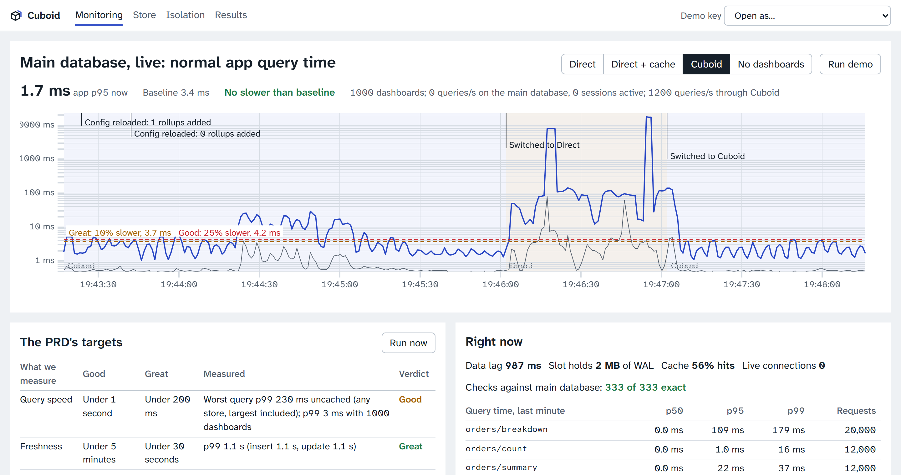
Same load, same database: 104 ms to 1.16 ms
PRD §2 GOALS 1, 3 · §4 QUERY SPEED, DATABASE SAFETY
5.7 ms
dashboard p99 through Cuboid. Direct: 5.4 s
184 /s
app operations with 1,000 dashboards. Direct: 54. None: 188
Measuring found a real bug. The first full run at this size showed dashboards at p99 1.4 s and the app 412% slower: every one-second flush was recomputing every moving range. Refreshes now back off under load, and viewers get the last exact answer labelled with its true age. Result: p99 3 ms, and +17.5%.
Evidence: artifacts/safety/main.json, 120-second phases · artifacts/speed/main.json · screenshot from this stack under real load
Notes:
This is the moment to switch to the live monitoring page: press Direct, then Cuboid. The chart's numbers come from two-minute phases, and the direct baseline has proper indexes and pooling. The app slows a little through Cuboid because everything shares one laptop's cores and disk, and no dashboard query reaches the main database. The trade-off of the fix: under heavy load, a moving range such as last 7 days refreshes about every 5 seconds, and every answer states its true age. Fixed ranges still see new orders in about a second.

Slide 7
Fresh in a second, exact at any timestamp
PRD §2 GOALS 2, 5 · FR-6 · §4 FRESHNESS, CORRECTNESS
14 August 09:17:03 to 3 October 18:41:59, read as:
Edge
Hours
Days
Month
Days
Hours
Edge
raw rows
14 Aug
15 to 31 Aug
September
1 to 2 Oct
3 Oct
raw rows
How a number is proved
1.1 s
The check found what unit tests could not
1
Fence
Write a marker into the WAL, and wait for Cuboid to reach it.
p99, new order to visible, and updates too. None of 400 probes timed out.
Two orders in three minutes went missing. A commit right after a heartbeat shares its log position, so it looked already applied.
2
Compare
Read Cuboid’s answer, and run direct SQL on main at that point.
2,500 / 2,500
3
Reconcile
Fixed, with a test. Only comparing with the live database could show it.
exact against direct SQL, with arbitrary timestamps. 500 ran during writes.
Account for transactions still in flight, so a match means exact.
Evidence: artifacts/freshness/main.json · artifacts/correctness/main.json · internal/pipeline/position_test.go
Notes:
Press Check against main database on any number: this is the part to show live. The strip is how a range is read: whole hours, days and months come from rollups, and the two thin edges read raw rows from a narrow mirror with no personal data. So any timestamp is exact, not just whole days. The bug story is the honest proof that the check works: it failed before it passed. Freshness and correctness were measured just before the final refresh fix, which changed when answers are refreshed, not how they are computed.

Slide 8
We inject INC-02 and count what leaks
PRD §2 GOAL 4 · FR-5 · “STORE A CAN NEVER SEE STORE B’S NUMBERS”
Key scope
hashed, one scope
Path check
other ids: 404
Cache partition
one per store
Row security
tenant setting
Result check
every row asserted
Response guard
last look
Drill A: shared cache key. 538,506 faults
stopped at the guard
Drill B: connection mix-up, the INC-02 mechanism. 20,452 faults
stopped at the result check
Drill C: missing tenant setting. 21,514 faults
stopped at row security
0 leaked
0 of 1,000,000
20 kills
in all three drills at 10M orders, while requests were cancelled mid-flight
randomized requests crossed stores, 57,153 of them cancelled by the client
kill -9 under writes: back within 3.1 s, and 500 of 500 checks exact
Six checks, each assuming the others failed. 30 of 30 red-team checks also pass: bad keys, injection, row security, recategorising, order moves.
Evidence: artifacts/{demo-check,isolation,chaos,redteam}/main.json · docs/ISOLATION.md
Notes:
INC-02 is the cache bug in the problem deck. OpenAI published that mechanism: a request cancelled at the wrong moment left a pooled connection out of step, so the next request received someone else's answer. So we built that bug into our own code, behind a labelled drill that runs only in demo mode on this local stack. Run one live from the Isolation page: the row shows which check stopped the fault. Blocked answers can outnumber faults, because viewers share a computation. The red-team run is from an earlier build; the drills are on the final query path, and the 1,000,000 requests and 20 kills predate the last refresh fix.

Slide 9
All five bonuses, each shown live
PRD §3 · B-1 TO B-5 · BONUS, “PICK ANY”
B-1
How fresh
config/metrics.yaml: one line, B-4
Every response states its age and log position, and stale answers say so.
status_payment: {source: orders,
dims: [status, payment_method],
grains: {hour: 35d, day: all, month: all}}
B-2
Rebuild from scratch
From the mirror and from main at 10M: 5,395 queries answered during them, 0 failed.
every response: B-1
B-3
Limit heavy queries
"freshness": {"lsn": "3/6EFAE260",
"lag_ms": 1107, "stale": false,
"updated": "updated 1 second ago"}
The biggest store floods: 3,560 limited. Other stores’ p99 stayed under 3 ms.
B-4
Metric by config
Beyond the brief
One line of YAML: live in 44 s at 10M, with no restart and no main-database load.
Same engine, Mitigata’s data: SOC alerts through config alone
Run now: re-measures speed, freshness, correctness live
Autopilot: the demo, through real APIs, 3 clean runs
Company view: all an owner’s stores, and each one
B-5
Monitoring page
Query time, data lag, target lines, limiter, and every control in one place.
Evidence: artifacts/demo-check/main.json D11 to D15, on the 10M tier · config/metrics.yaml · web/src/views/Monitor.tsx
Notes:
The PRD says pick any; we built all five. Pick one to show live, ideally the flood or the YAML metric. On a rebuild from the main database the stream pauses, so answers keep coming with their true age; the online two-consumer cut-over was not built. A new metric at 10M took between 44 and 62 seconds across our runs, and it builds from the mirror without touching the main database. SOC alerts are synthetic data, one client organisation per store, to show the same engine serving the kind of data Mitigata works with.

Slide 10
Where it falls short, said before you ask
PRD §2 GOAL 6 · §4 GROWTH · “MUST RUN EASILY”
Top customers is the limit.
Its cost grows with the customers in the range. The designed fix, running window totals, touches the exactly-once path, so we did not rush it.
Docker is written, not run.
Docker Desktop broke on our machine. All numbers come from the native path, with the same Postgres version, settings and ports.
The organisers’ script never arrived.
We built a generator to the PRD’s shape. Switching is documented, not proven.
One laptop, 100 tenants.
The path to 1,000 tenants is a design, not yet built.
Fast for every store. Exact to the paisa. Never in the wrong store’s hands.
github.com/WarHawkADI/cuboid
Evidence: artifacts/growth/latest.json, largest store, uncached p99; 1M figures are from an earlier build · docs/FINAL_REPORT.md
Notes:
End on the honest list, then the line. Growth is the one PRD goal not met, and it is one query. We would rather show you the limit than hide the query. Docker: if you want to run it yourself today, the native path in the README is what we measured; the Compose files exist but have not been run. Most of this code was written with Claude Code under our direction, as docs/DISCLOSURE.md states, and we can walk through any file. Then take questions. docs/PITCH_QA.md has the 15 hardest.

