Slide 1
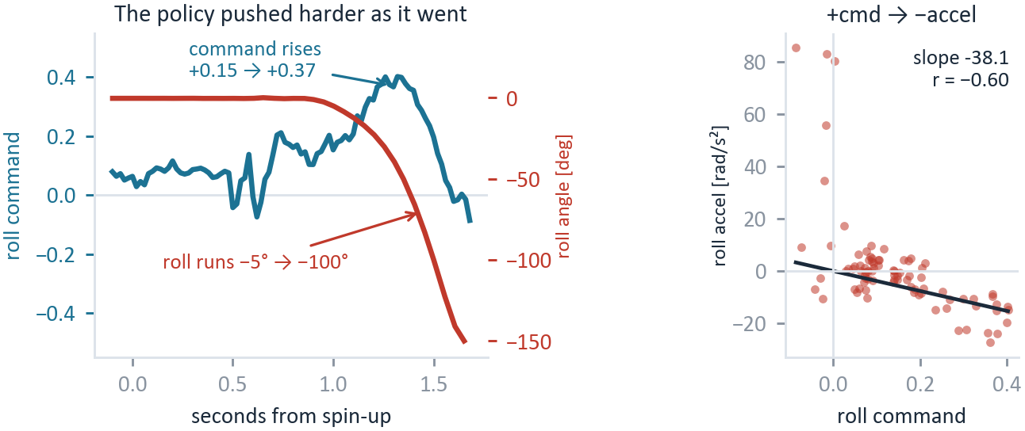
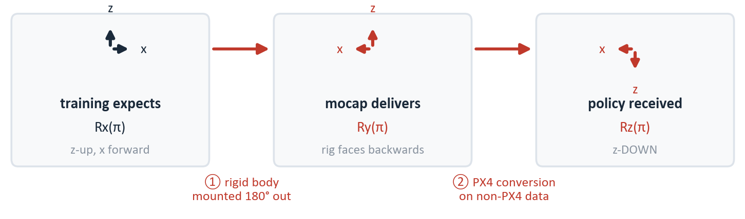
Two Frame Errors Flipped the Axes — Not the Mixer
ATMO 2026-08-18 flight 3 (log_417) · measured from the bags and the deployed runtime
1 The roll loop was positive feedback
What was wrong
The mocap rig faces backwards. The rigid body and the flight controller point opposite ways on the vehicle, and nothing downstream removes it.
The PX4 conversion ran on non-PX4 data. update_px4_state applied NED→ENU and FRD→FLU to bridge odometry that was already z-up world with body-frame twist — right conversion, wrong caller.
What each axis did
axis | mount | conv. | result
roll | flip | — | INVERTED — crashed
pitch | flip | flip | correct, by accident
yaw | — | flip | INVERTED (413 runaway)
2 Two wrong frames, one on top of the other
Fix both together. Each fix alone still leaves two axes inverted.
analysis/frame_proof.py · frame_figs.py · ANALYSIS_HANDOFF §13
Notes:
The crash was attributed to the mixer. It was not the mixer -- the mixer is correct for a standard-X, innie airframe. Two frame errors are, and they hit different axes, which is exactly why the axes disagreed with each other. The mount: the Motive rigid body and the flight controller face opposite ways on the vehicle. You can see it on the robot -- it needs no proof. If asked: measured against the FC's own attitude on three flights it is 179.9 / 179.1 / 178.6 deg, residual 1.0-3.2 deg, and since Motive is z-up and the bridge's to_z_up is a no-op, no code touches the pose, so it can only be the rigid body. The conversion: update_px4_state applies PX4's NED->ENU and FRD->FLU to the mocap bridge's odometry, which is already z-up world with body-frame twist. Right conversion, wrong caller. It also swaps x with y and negates height -- the policy was told a climb was a descent. Composition: training expects Rx(pi); the mount delivers Ry(pi); the conversion adds Rx(pi); the policy received Rz(pi) -- roll and yaw inverted, pitch clean. Roll is flipped by the mount and the conversion never touches roll, so it survived to the rotors and crashed 417: the policy's own roll command climbs +0.15 to +0.37 while roll runs -5 to -100 deg, plant slope -38.1 rad/s^2 per unit. Pitch is flipped by the mount and back by the conversion, which is why every mixer-side test called pitch the clean axis. Yaw is flipped by the conversion alone -- the 413 runaway -- and the 8/18 column flip cancelled it rather than fixing the mixer. So: fix the mount, remove the conversion, and revert the 8/18 yaw column, all in one change. Do NOT deploy the designed roll negation -- fixing the mount already fixes roll. Restrained single-axis bench tests gate the next flight.

