Slide 1
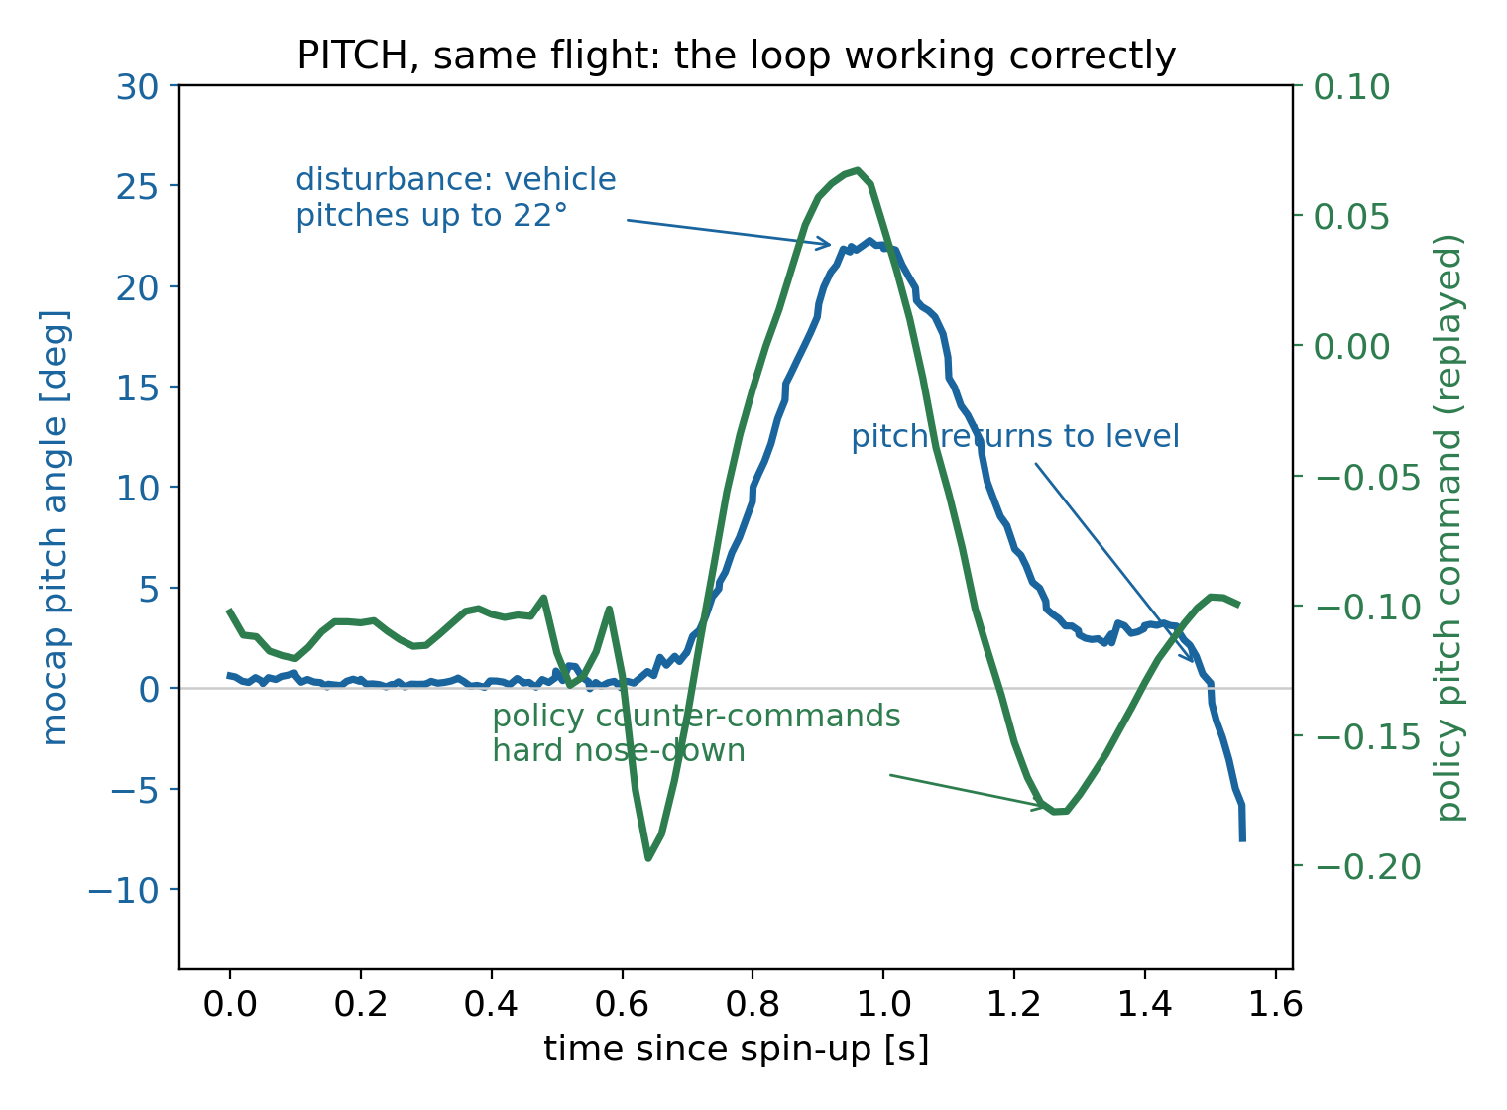
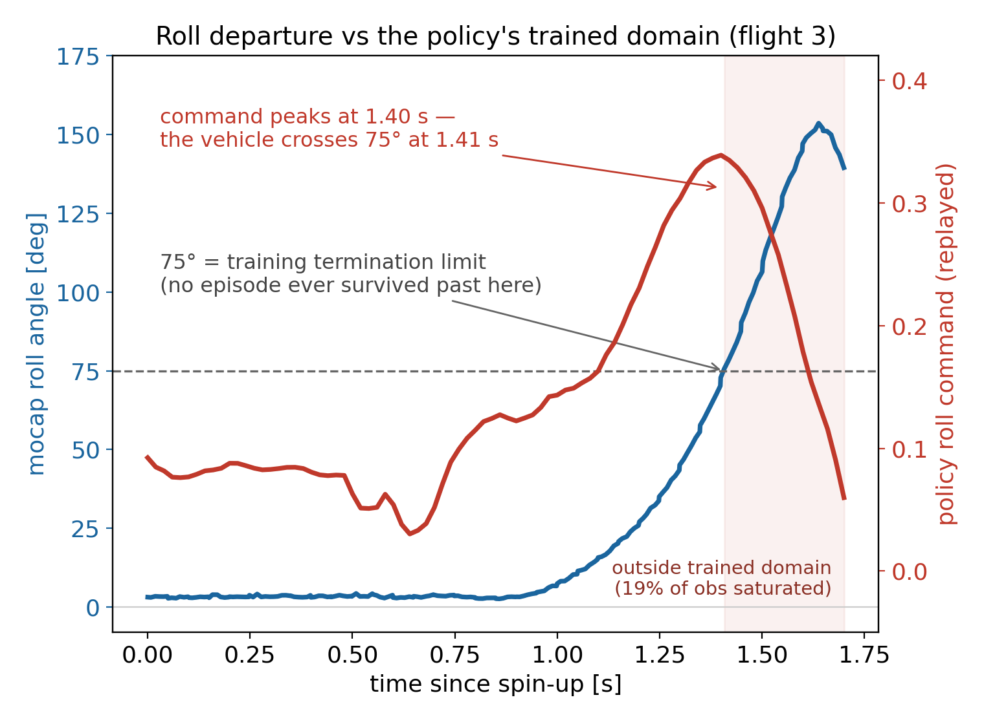
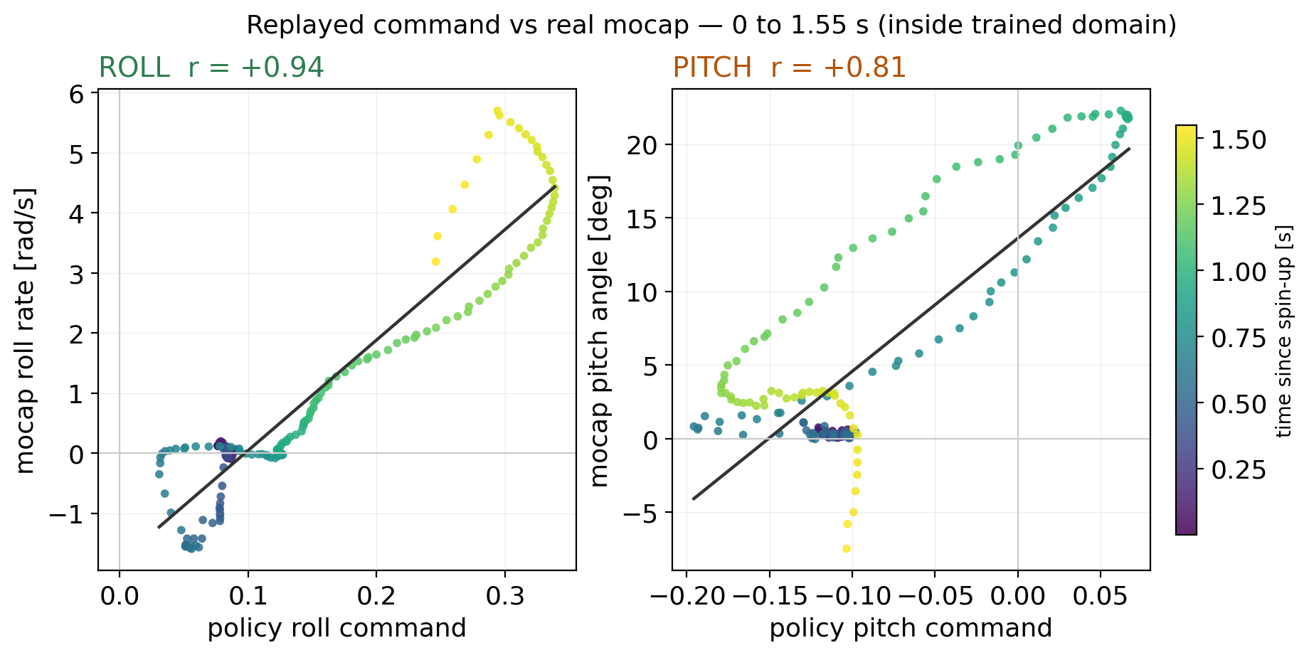
Why it rolled: the policy's roll axis was inverted
DROP FLIGHT-3 VIDEO HERE
roll departure, ~1.7 s from spin-up to kill
Command vs real mocap (in-domain window): the loop is coherent in the frame the policy saw — the sign fault sits between that frame and the airframe (mixer + obs ingestion, fixed together).
Command peaks at 1.40 s — the 75° training termination limit is crossed at 1.41 s. Liftoff at tilt ≈ 29°; tilt rests at the measured 17.6° through the departure.
Notes:
KEY BEAT: the roll command peaks at 1.40 s and the vehicle crosses 75 deg at 1.41 s -- 75 deg is exactly the training attitude-termination limit. The policy fought (through an inverted mixer) right up to the edge of every state it had ever seen, and past that edge its inputs saturate (19% of channels at the normalizer rail) and the output stops being a controller. The video shows the roll departure. The scatters are the replayed network against real mocap: roll r=+0.94 with the command leading by ~100 ms -- policy and vehicle agreed perfectly about what was happening in the frame the policy saw; they disagreed with reality about which direction it was. Root cause: roll+yaw mixer columns inverted sim->hardware, plus the mocap ingestion frame (obs roll = -0.95x FC truth, pitch +1.01x). Yaw was fixed between flights 1 and 2 and the data shows its verdict flip; roll reads inverted in all flights. Mixer flip and obs-frame fix must deploy TOGETHER (each alone leaves an odd inversion count); restrained single-axis tests gate the next flight.

