Slide 1
Coursera Capstone Project
Clustering neighborhood of Toronto

Slide 2
1. Introduction
Toronto is a global city filled with vast opportunity and is home to an array of distinctive and dynamic neighborhoods that reflect the diversity of its population. The city is known for its vibrant arts and entertainment scene, incredible cultural festivals, delicious food, thriving sports culture, excellent shopping, beautiful parks and beaches, and much more.
But, in order to open the business in Toronto and become success the owner need the understand the market and their competitor properly.

Slide 3
2. Problem
Our problem is simple question.
"if someone is looking to open a restaurant, where would we recommend that they open it?

Slide 4
3. Data
The data for this project has been collected from multiple sources.
3.1. Neighborhood
The data of neighborhood in city of Toronto is obtained by web scraping using BeatifulSoup library in Python. The data is scaped from Wikipedia website.

Slide 5
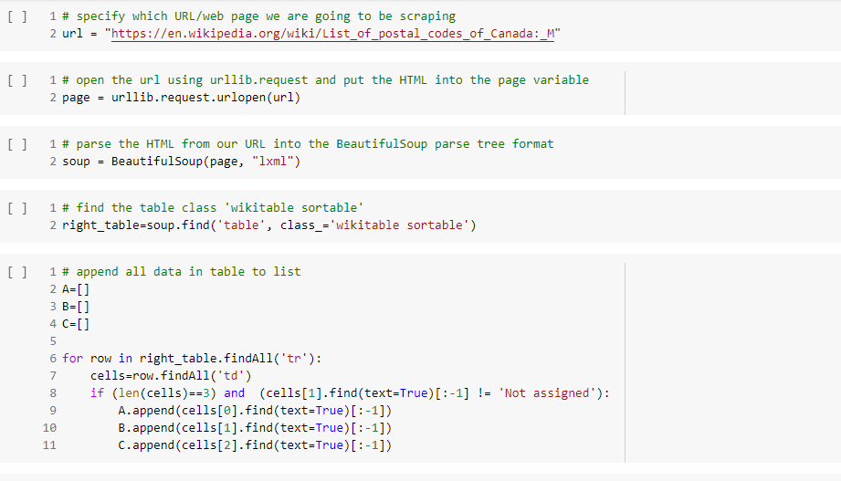

Slide 6
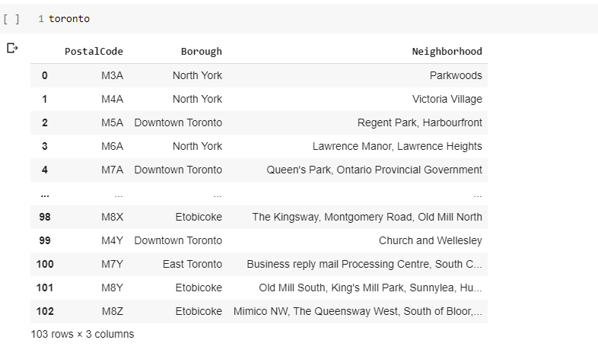

Slide 7
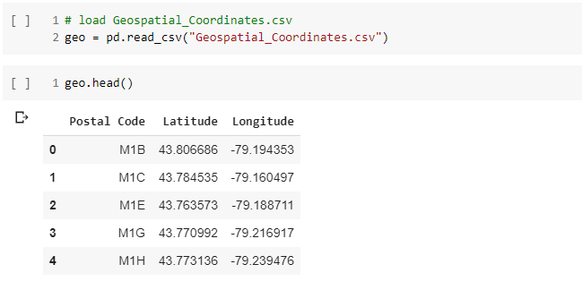
3.2. Geospatial data
The geospatial data of Toronto is provided by Coursera in form of csv file which contained latitude and longitude data in Toronto.

Slide 8
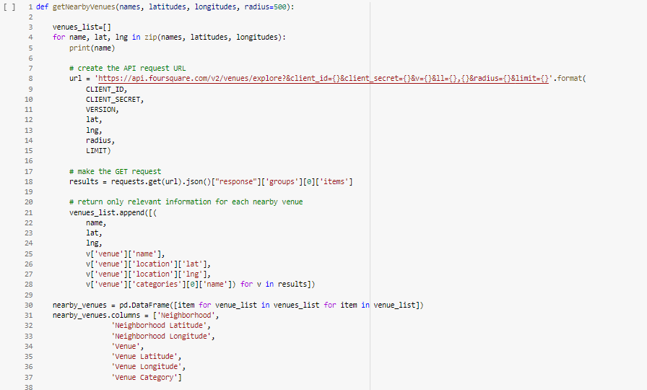
3.3. Venue category data
The venue category data is collected by using FourSquare API and new data frame is created with the respective neighborhood.

Slide 9
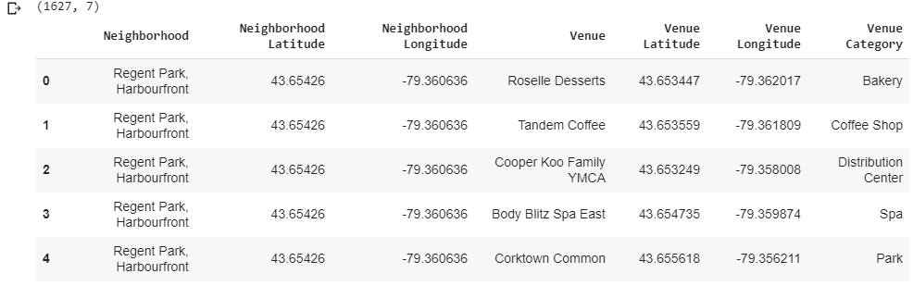

Slide 10
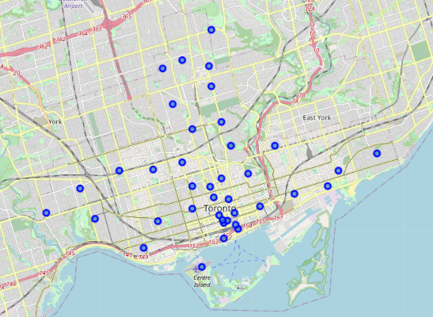
4. Methodology
4.1. Folium
folium builds on the data wrangling strengths of the Python ecosystem and the mapping strengths of the leaflet.js library. Manipulate your data in Python, then visualize it in on a Leaflet map via folium.
The cluster visualizations are created by Folium to generates the leaflet map with marker on the map.

Slide 11
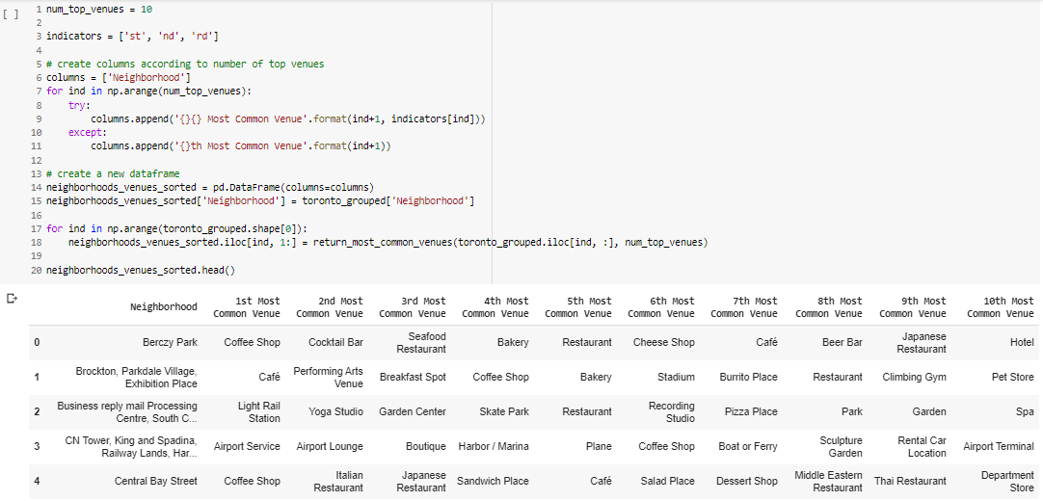
4.2. Top 10 most common venue
Because of high variety in venues. We selected only top 10 common category in each neighborhood to train K-means Clustering Algorithm.

Slide 12
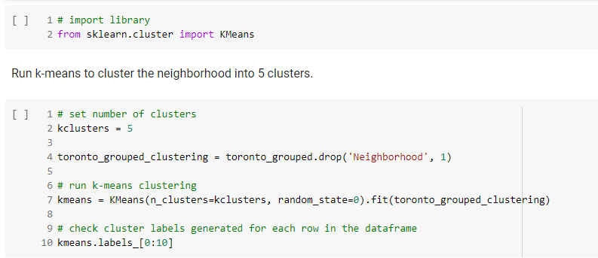
4.3. K-means clustering
We used sklearn library to generates K-means Clustering with hyperparameter n_clusters = 5

Slide 13
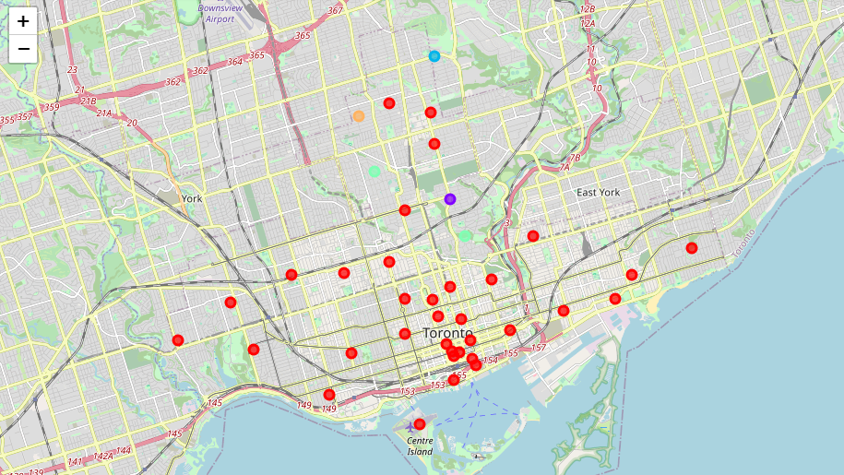
5. Result
The neighborhoods are divided in 5 clusters and visualized on the leaflet map. Each clusters are shown in different color on the map.
The most common

Slide 14
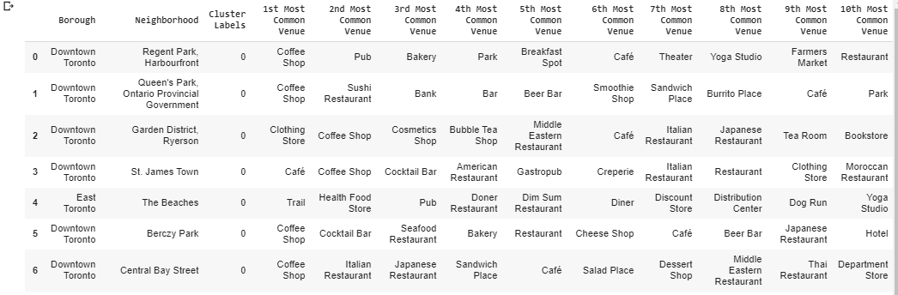
5. Result
The result from clustering shows that the most common venue category in city of Toronto is cluster 0 as shown in the map as red marker. The result in cluster 0 shows that the most common venues in the cluster are coffee shop and café. Inaddition, the next categories of common venue in the cluster 0 are many types of restaurant and food store as shown below.

Slide 15
5. Conclusion
From the result, we can suggest that if someone is looking to open a restaurant in city of Toronto, they should open their restaurant in cluster 1,2,3 or 4 neighborhoods because in cluster 0 there are too many restaurants in neighborhood.

