Slide 1
Data Analysis
IBM Employees Dataset
Warat Chokulket

Slide 2

Introduction
Option
Text Here
Add Text
Add Contents Title

Slide 3
Introduction
An employee is the power of the company like an engine in a car. High potential employees mean high company capability. In order to obtain high potential employees, company need to invest a lot of time and money. If an employee you have invested so much time and money leaves, this would mean that you would have to spend even more time and money to hire somebody else.

Slide 4
Problem
I’m out
I’m satisfied
The problem that we are looking to solve is …
01
What is the factor that lead to employee attrition?
Our target is …
Attrition
02
How can we keep employees happy and satisfied to company?

Slide 5
Exploratory Data Analysis
Option
Text Here
Add Text
Add Contents Title

Slide 6
Exploratory Data Analysis
Dataset contained 1470 samples and 35 columns
84%
16%
1233
Attrition No
237
Attrition Yes
To find insight, we use KDE plot to show distribution of each features and display some interesting features.

Slide 7
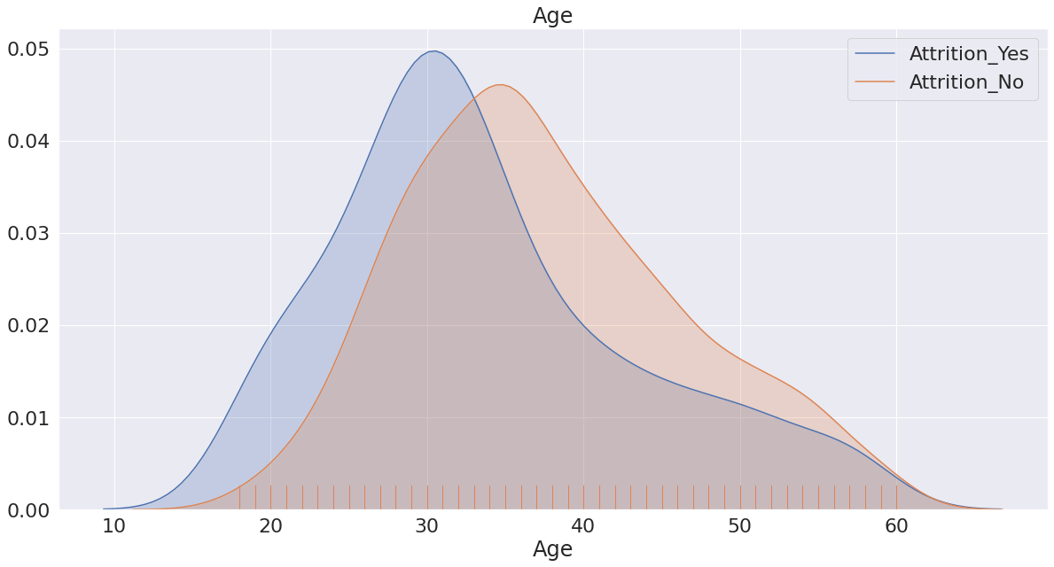
KDE Plot
Age
Age distribution is nearly the same for our target but the left blue area shows that younger people are more likely to quit.
Add Contents Title
You can simply impress your audience and add a unique zing and appeal to your Presentations. Easy to change colors, photos and Text.
Add Contents Title
You can simply impress your audience and add a unique zing and appeal to your Presentations. Easy to change colors, photos and Text.

Slide 8
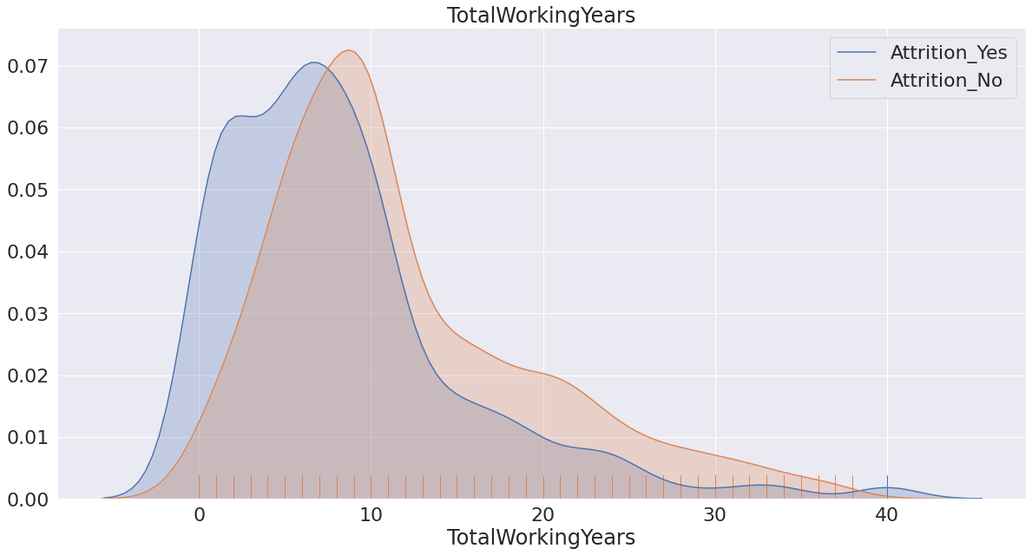
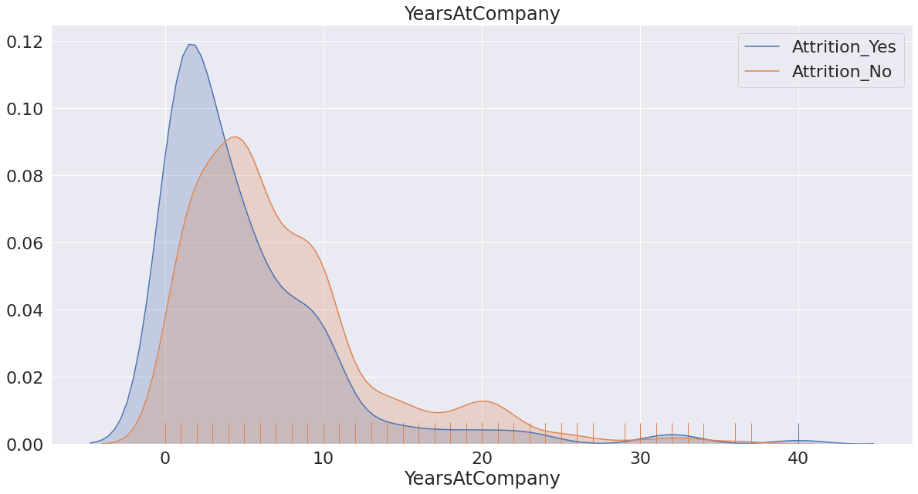
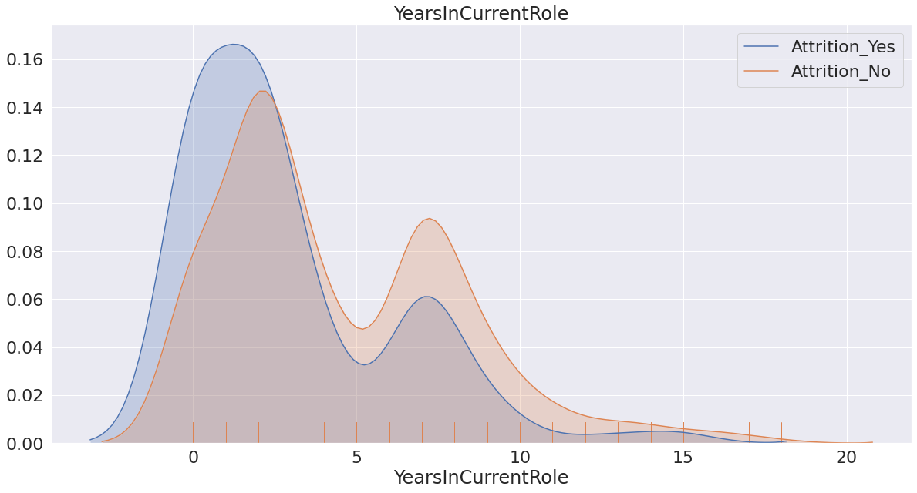
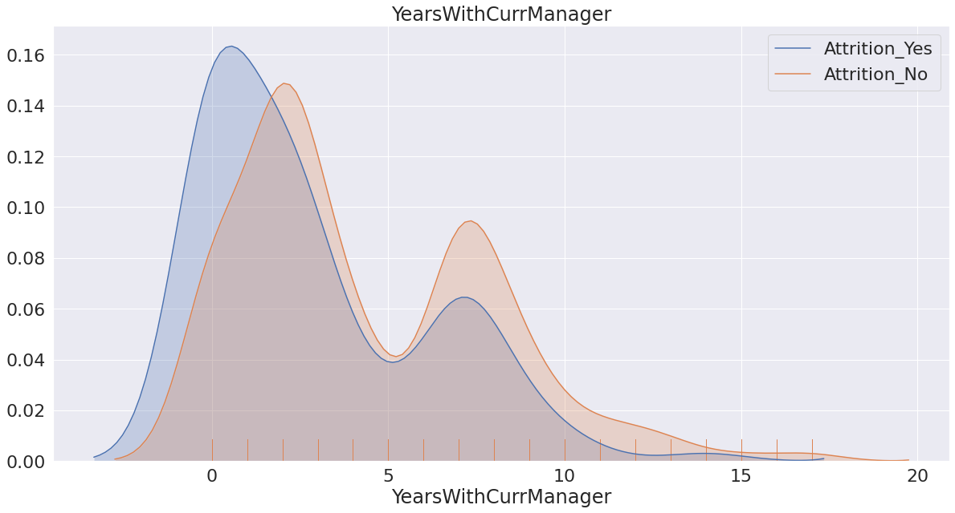
KDE Plot
This 4 features are related to one another and related to Age feature too.
Total working years
Years at company
Years in current role
Years with current manager

Slide 9
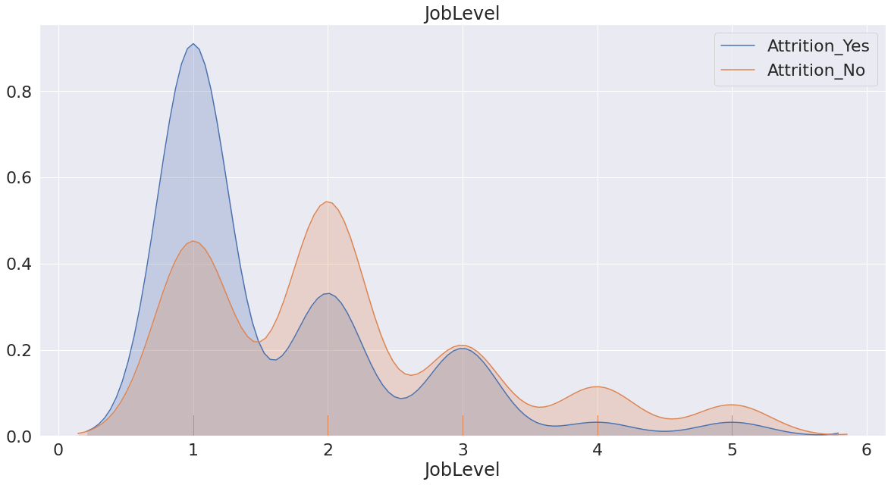
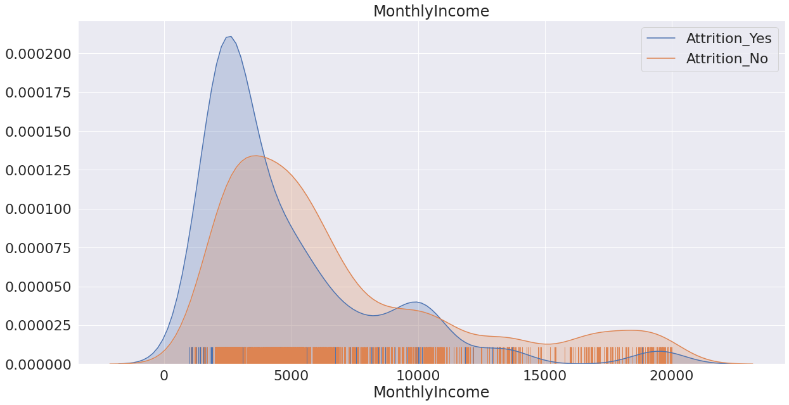
KDE Plot
Job level and monthly income features seem interesting too.
With low job level and low monthly income, people are more likely to quit.

Slide 10
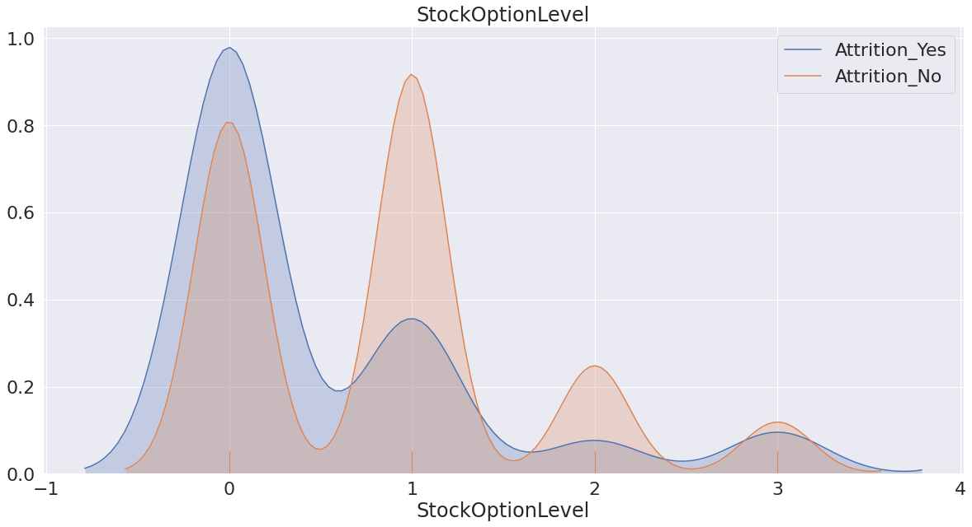
KDE Plot
Stock option level is the most interesting feature.
From blue area, we can presume that people are more likely to quit with zero stock option level.
Moreover, stock option level 1 in orange area supports our hypothesis

Slide 11
Exploratory Data Analysis
84%
16%
1233
Attrition No
237
Attrition Yes
For categorical features, we use bar plot with percentage of attrition_yes / total_attrition to find insight.

Slide 12
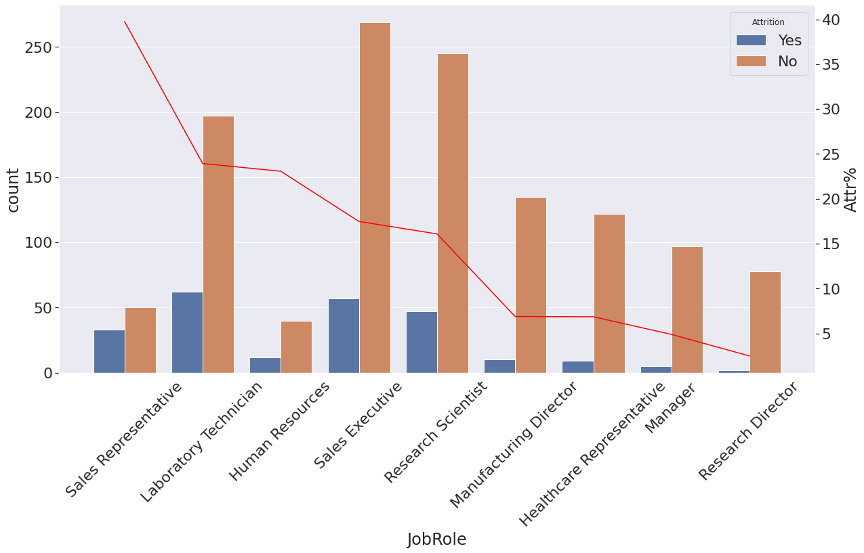
Bar Plot
Job role
Sales representative is the highest attrition percentage at 40% that higher than Laboratory technician by 15%

Slide 13
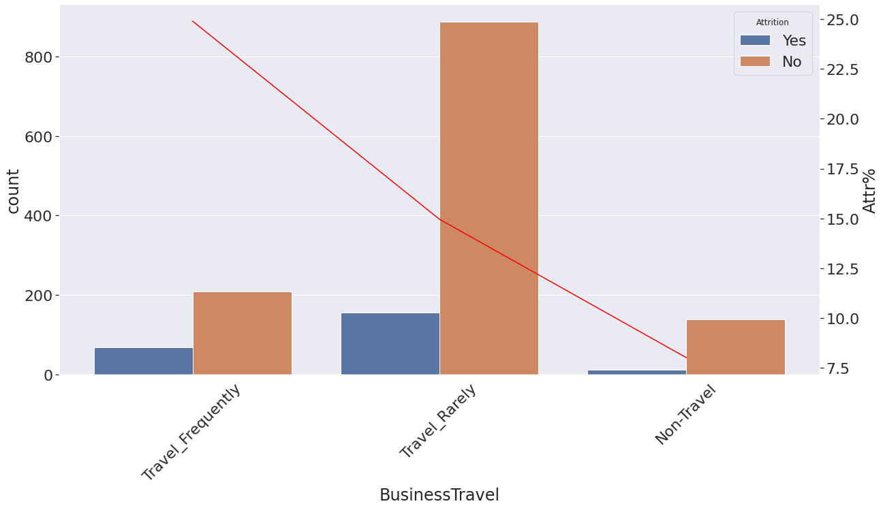
Bar Plot
Business travel
People who travel frequently are higher attrition percentage around 10%.
They may relate to sales representative role.

Slide 14
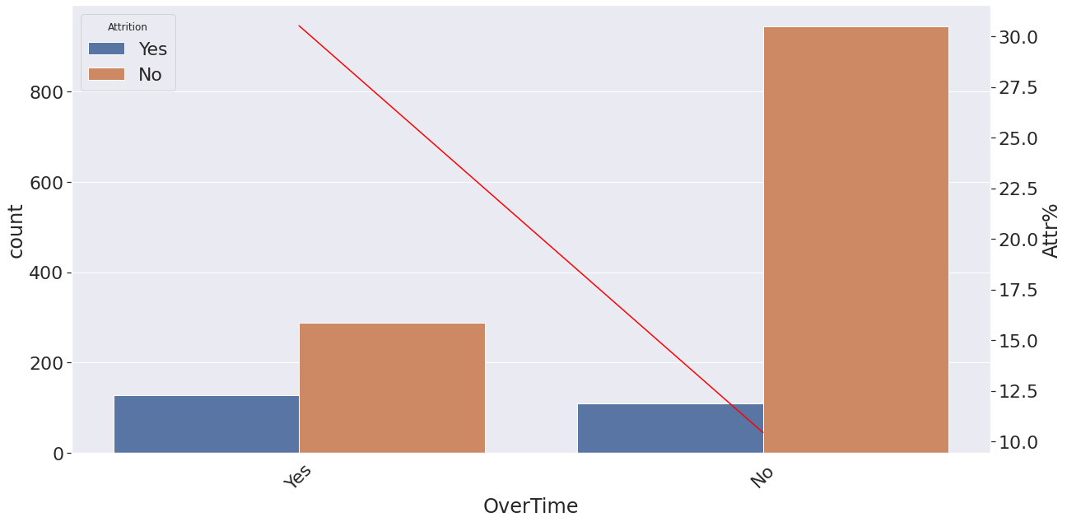
Bar Plot
Overtime
Attrition percentage for overtime is higher than no-overtime by 20%.
Overtime may affect to other features such as work life balance or job satisfaction.

Slide 15
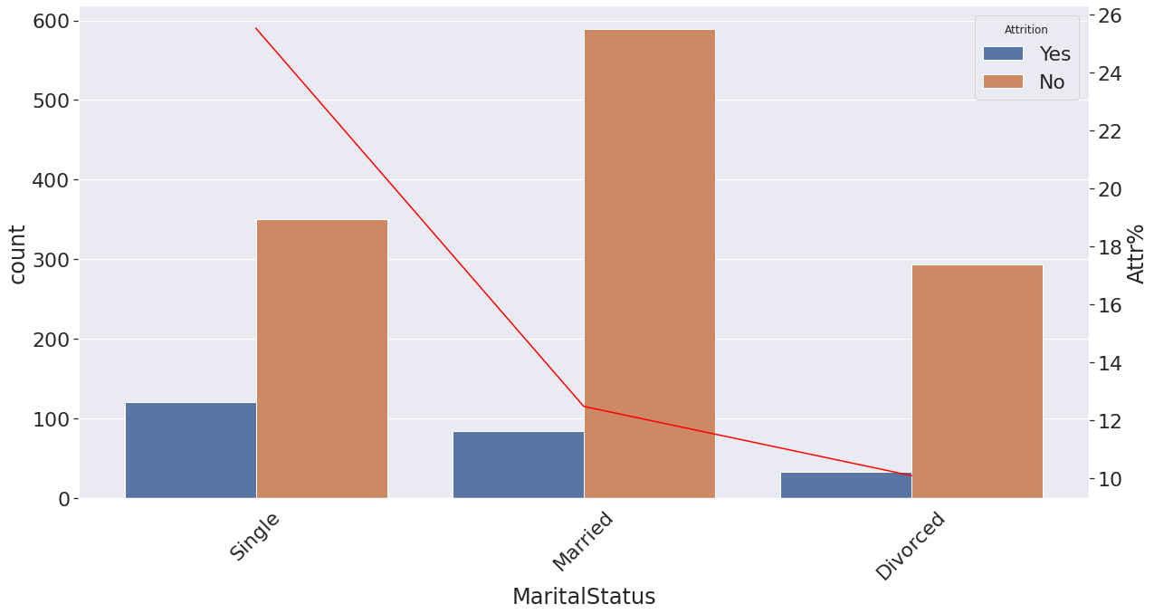
Bar Plot
Marital status
Single status is higher attrition percentage than married status by 14%.

Slide 16
Feature Engineering & Data Preprocessing
Option
Text Here
Add Text
Add Contents Title

Slide 17
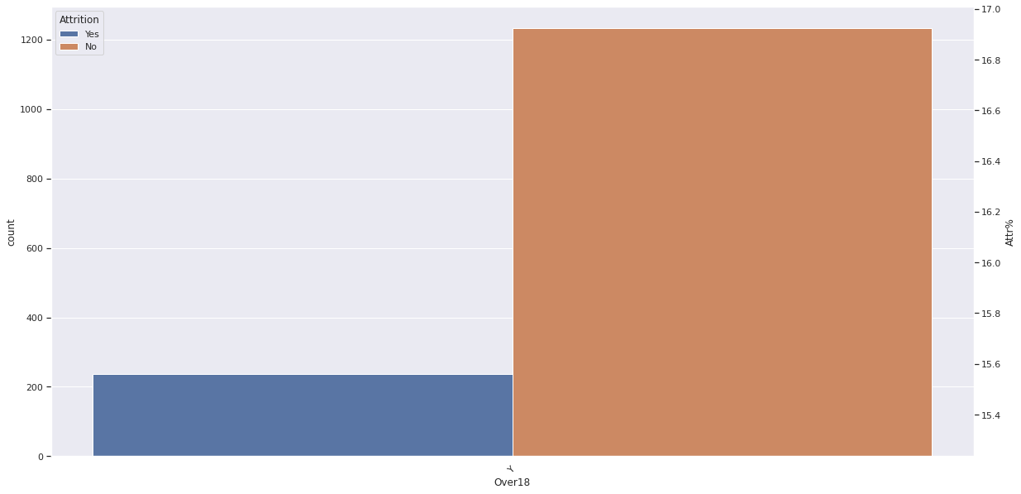
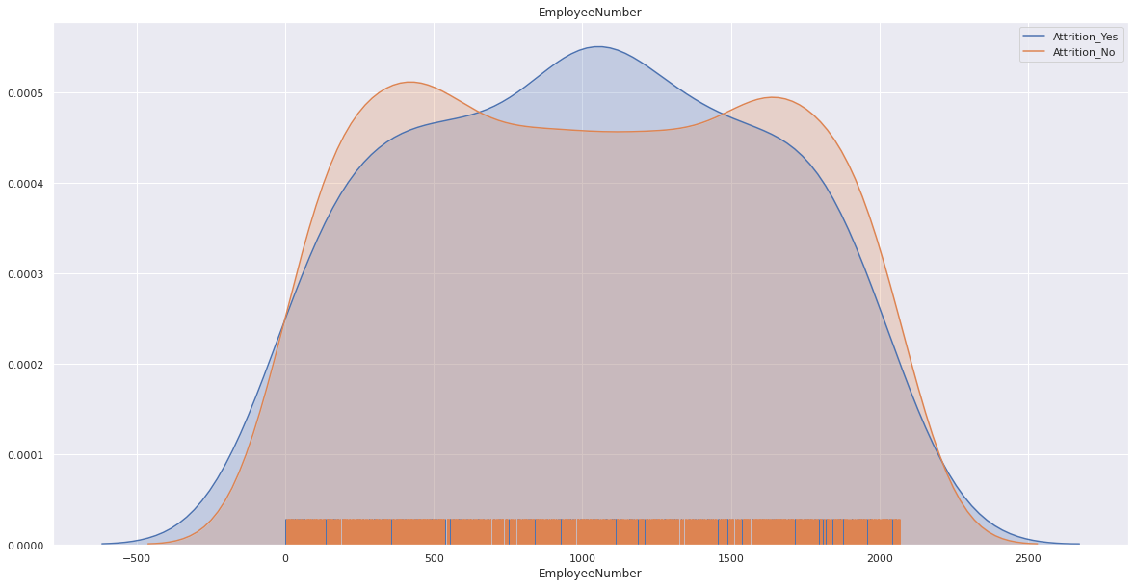
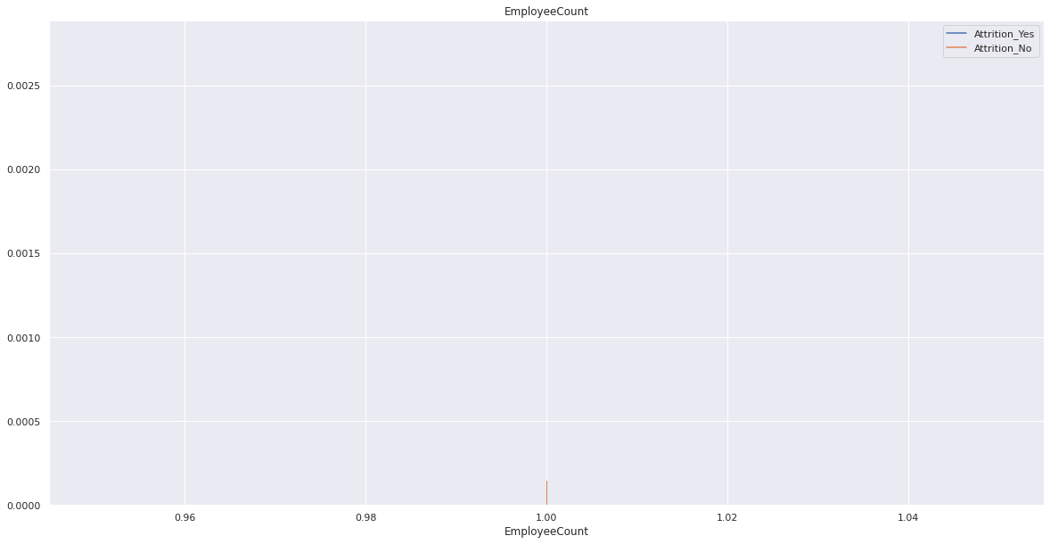
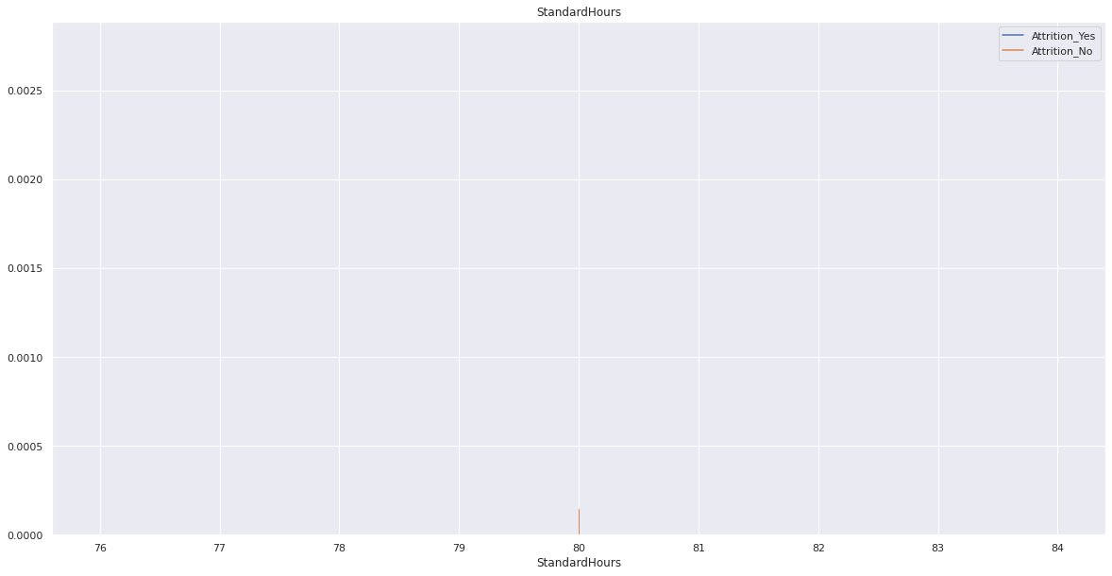
Feature Engineering
Drop some unnecessary features
From the KDE plot, we will see some features that all values are the same or not have meaning.
Standard Hours
Employee Count
Over18
Employee Number

Slide 18
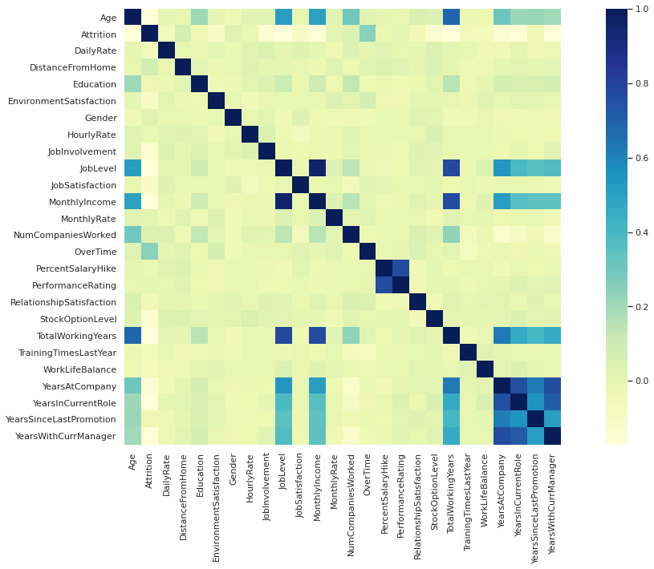
Feature Engineering
Drop colinear features
In order to accurate our machine learning model, we need to drop features that highly related to one another.
Job Level
Monthly Income
Performance Rating
Total Working Years
Years At Company
Years In Current Role
Years Since Last Promotion
Years With Current Manager

Slide 19
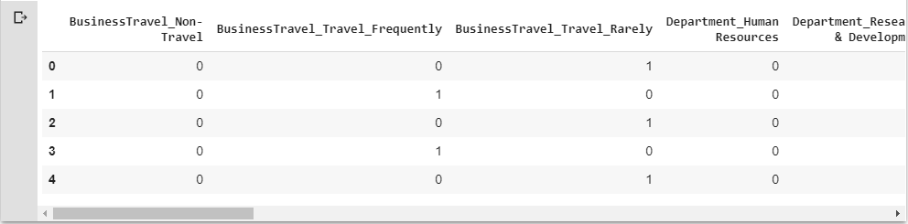
Data Preprocessing
Encode categorical features
In order to train machine learning model, we need to use numerical data. So, we numerically encode all categorical features.

Slide 20
Machine Learning
Option
Text Here
Add Text
Add Contents Title

Slide 21
Splitting Data
Split our dataset into training set and test set
Data set
100%
Training set
80%
Test set
20%

Slide 22
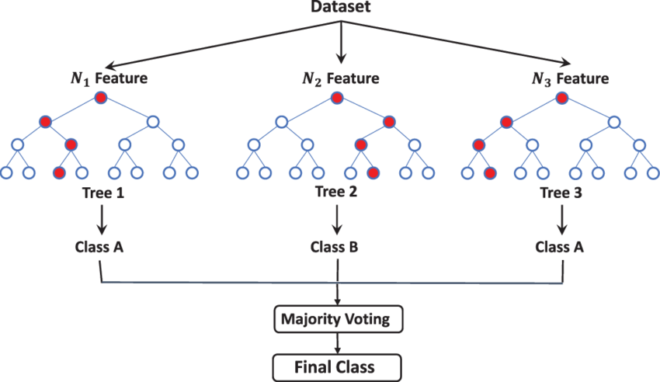
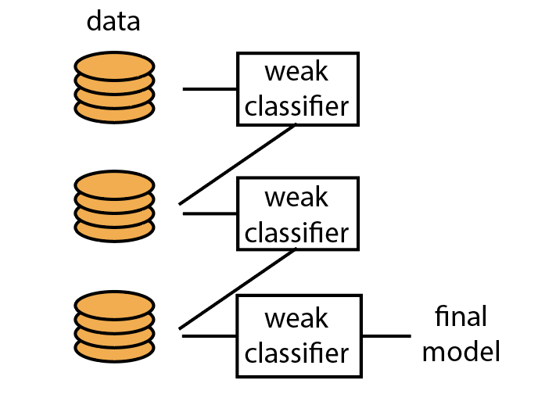
Model
In order to find the factor that lead to employee attrition, we can perform machine learning model and see “What features are importance for model?” and “It is the same as our hypothesis from data analysis or not? “.
Random Forest Model
Gradient Boosting Model

Slide 23
Resampling training data
In order to reduce imbalance target problem, we use over-sampling and under-sampling process. Over-sampling increases the weight of the minority class by replicating the minority class examples and Under-sampling decreases the weight of the majority class by cutting the majority class examples
84%
16%
1233
Attrition No
237
Attrition Yes

Slide 24
Result
Option
Text Here
Add Text
Add Contents Title

Slide 25
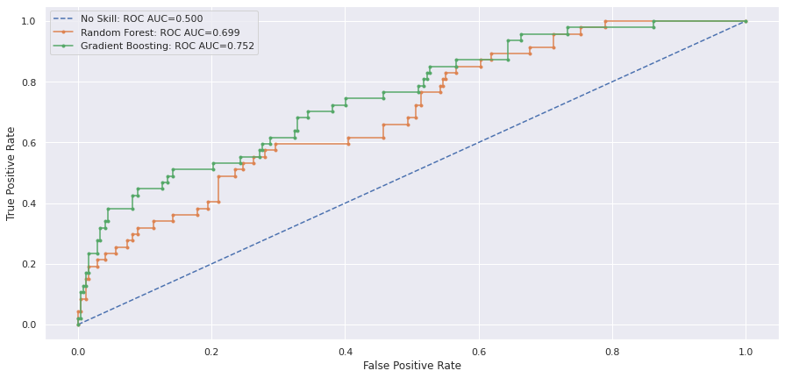
ROC Curve
ROC scores from Gradient Boosting model is higher than Random Forest model at 0.752

Slide 26
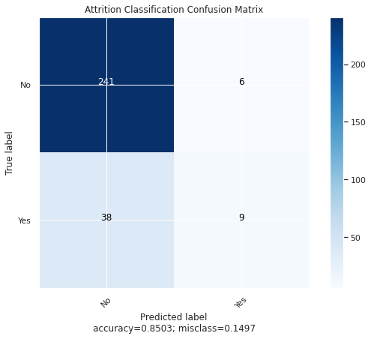
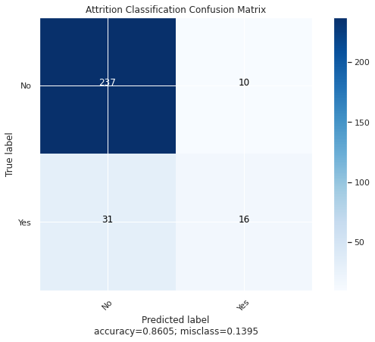
Confusion Matrix
Confusion Matrix
Create from test set data that we split before training
Random Forest Model
Gradient Boosting Model

Slide 27
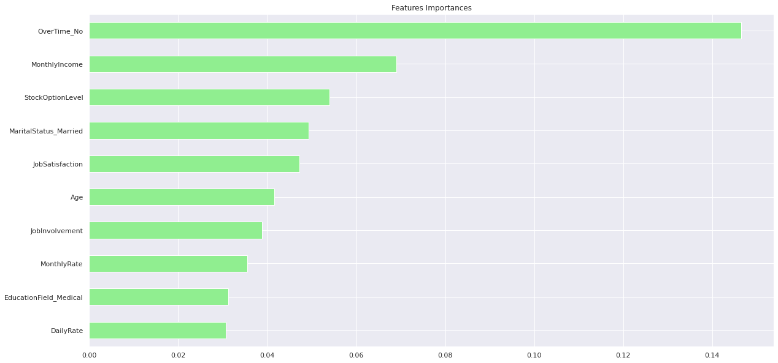
Importance Features
Random Forest Model

Slide 28
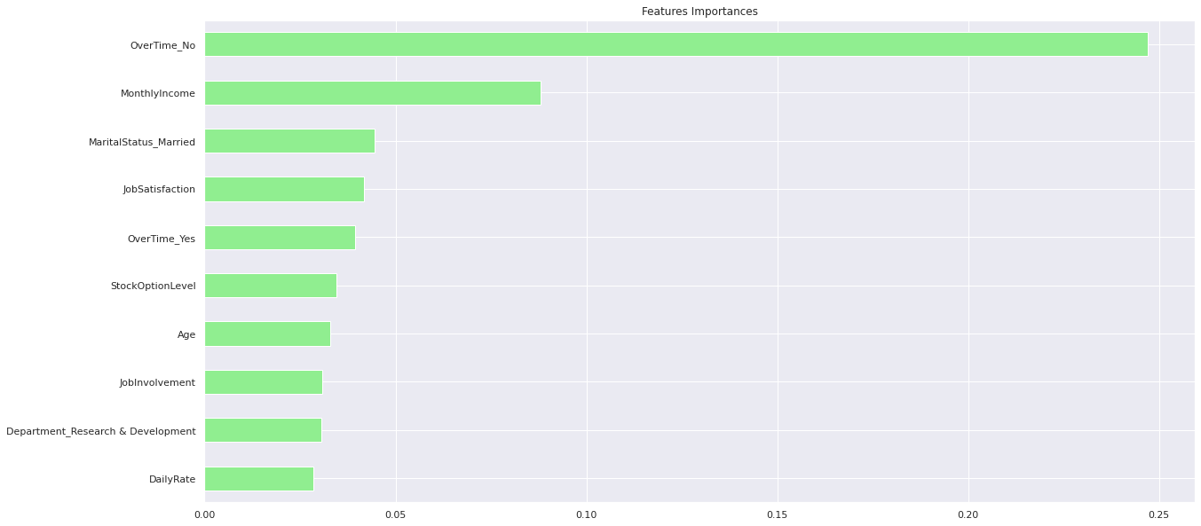
Importance Features
Gradient Boosting Model

Slide 29
Conclusion
Option
Text Here
Add Text
Add Contents Title

Slide 30
Conclusion
01
What is the factor that lead to employee attrition?
Our Problem..
02
How can we keep employees happy and satisfied to company?
EDA
From EDA, we have 7 importance features
Age and other that related to age
Job level
Monthly Income
Stock Option Level
Sales Representative job role
Overtime
Marital status

Slide 31
Conclusion
Machin Learning Model
From our two models, we have importance features that are the same from different model
Overtime = No
Monthly Income
Stock Option Level
Job Satisfaction
Married
Age
Job Involvement

Slide 32
Conclusion
01
What is the factor that lead to employee attrition?
02
How can we keep employees happy and satisfied to company?
Expected
The most importance factor is Overtime. To improve Monthly Income and Stock Option, we need to invest more money. But to reduce Overtime, we may just need to improve working process.
Overtime
Monthly Income
Stock Option Level
Marital status
Age
(Job level)
Surprised
Job Satisfaction and Job Involvement are interesting factor. This two factors seem not related to other factor. So, we need to dig deeper to know “What affect to this two factors”.
Job Satisfaction
Job Involvement
Sales Representative job role

Slide 33
THANK YOU

