Slide 1
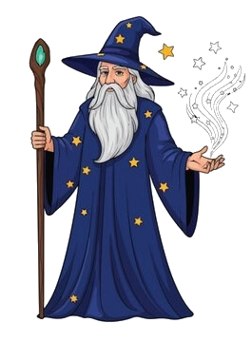
Hello human! Welcome to the castle grounds! In a moment, you will start your treasure hunt! Sadly enough, I will not be able to guide you. However, the castles are protected by my dragon Norbert. He will try to guide you to the treasure room.
Press space to continue

Slide 2
In a moment, you will be able to choose between 3 castles. Once you chose, you’ll enter that castle, and you’ll see a wall. In the wall, doors are hidden. I made sure you see where possible doors are with black rectangles.
Press space to continue
Notes:
There are hidden doors in the wall that you need to find. If you get through 20 walls without missing, you will reach the treasure room.

Slide 3
You have to guess where the doors are hidden. If you get 10 correct, you’ll find the treasure in that castle. You can choose a door with the mouse.
Press space to continue

Slide 4
After 45 minutes, you’ll go to the master castle, where I will see if you know the rules of all castles.
Press space to continue

Slide 5
If I see that you know the rules earlier than that, you can go to the master castle earlier and you’ll be done faster.
Press space to continue

Slide 6
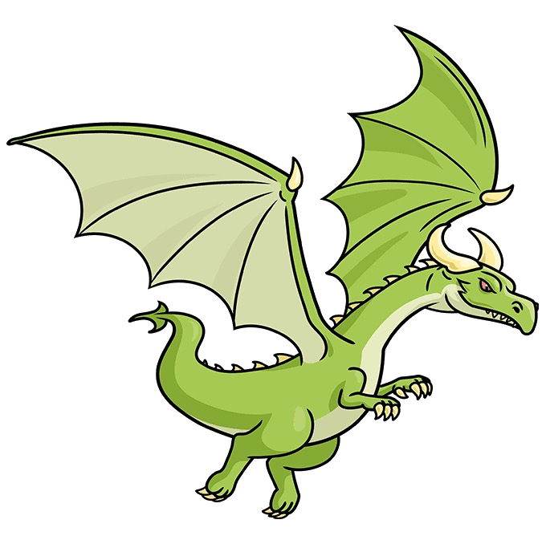
So, I will need to go now, but let me introduce you to my dragon Norbert who will try to guide you. Sadly enough, Norgert cannot talk yet. However, I was able to teach him how to communicate using figures. I was able to teach him about sizes of squares, colors and orientations. It is your job to figure out what the rules are!
Press space to continue

Slide 7
Here is an example of what I was able to learn him in short notice:
Press space to continue

Slide 8
Norbert is able to change the size of the square, the orientation of the line and the color of the figure
Press space to continue

Slide 9
With these features, Norbert will give you hints towards the location of the door.
As long as you are correct, you stay in a castle, once you’re wrong, you can choose a new (or the same) castle. Always use the mouse to decide.
Press space to continue

Slide 10
Try to figure out the rules of all castles as you’ll be tested on all of them in the test castle.
Good luck! Press space to continue

Slide 11

Press space to start the experiment

