Slide 1
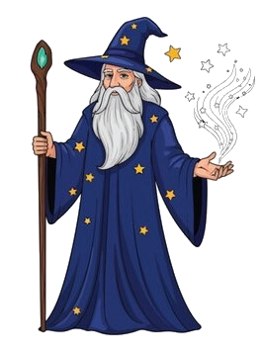
Hello human! Welcome to the castle grounds! In a moment, you will start your treasure hunt! Sadly enough, I will not be able to guide you . However, the castles are protected by my dragon Norbert. He will try to guide you to the treasure room.
Press space to continue

Slide 2
In a moment, you will be able to choose between 3 castles. Once you enter, you will walk through a corridor until you reach a wall.
Press space to continue
Notes:
There are hidden doors in the wall that you need to find. If you get through 20 walls without missing, you will reach the treasure room.

Slide 3
There are hidden doors in the wall that you need to find. If you get through 20 walls without missing, you will reach the treasure room.
Press space to continue

Slide 4
It was only in my power to provide you with some possible locations and I put squares on the wall there. You need to guess where the hidden door is. If you get 20 correct in a row, you will reach the treasure room.
Press space to continue

Slide 5
But be warned, after some time, you will go to the master castle, where all castles will be merged and the treasure in the room there will be huge! So it is in your best interest to learn all castles!
Press space to continue

Slide 6
It is very important to know that not all castles are equally difficult. You can see that because in some castles, there are more possible doors.
Press space to continue

Slide 7
But very important. To help you a bit, I made sure that what you learn in the easier castles, can be used in later castles. The rules you uncover will remain the same.
Press space to continue

Slide 8
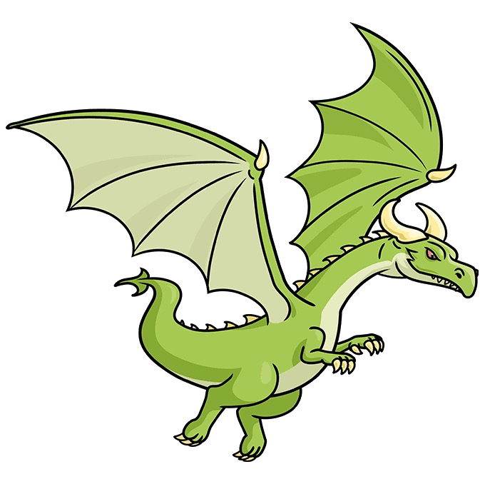
So, I will need to go to the order now, but let me introduce you to my dragon Norbert who will try to guide you. I was able to teach him about sizes of squares, colors and orientations and he will provide you with hints using these features. It is your job to figure out what the rules are!
Press space to continue

Slide 9
Here is an example of what I was able to learn him on such short notice:
Press space to continue

Slide 10
Norbert is able to change the color, the size of the square and the orientation of the line.
Press space to continue

Slide 11
With these features, Norbert will give you hints towards the location of the door using these three features.
And remember, what you learn in an easier castle, can be learned in the more difficult ones.
Press space to continue

Slide 12
If you guess a door correctly, you can stay in the castle and try to get to the treasure room, but if you’re wrong, you are thrown out of the castle, but you can try again. Click on the castles and doors with your mouse to choose.
Good luck! Press space to continue

Slide 13

Press space to start the experiment

