Slide 1

Breaking Rainbow takes a weekend on a Laptop
Ward Beullens IBM Research Europe Crypto 2022

Slide 2
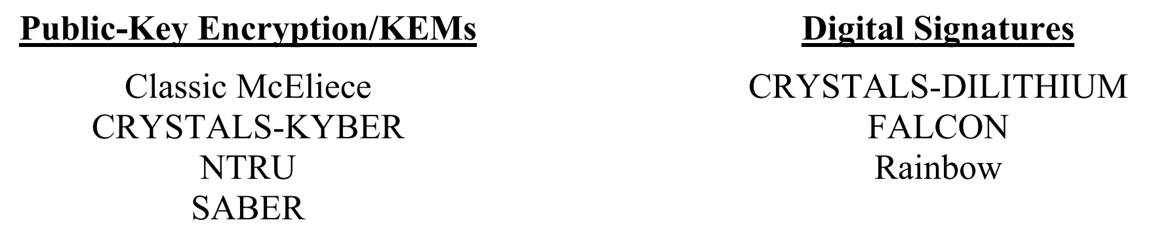



Rainbow signatures (2005)
Small signatures (66B), good performance.
But large Keys (59KB) and not secure.

Slide 3


History of Rainbow
1997 | Oil & Vinegar [Patarin]
2005 | Rainbow [Ding, Schmidt]
2008 | First wave of cryptanalysis dries up [KS98,BC05,BG06, DYCCC08,…]
2017 | NIST PQC
’20-’21 | Improved MinRank attacks, RBS [BBCGPSTV20,BBBGNRT20,BBCPSV21, PS20,NIWDR20]
2021 | Rainbow is one of signature finalists.
2021 | New description of Rainbow, new attacks [Beu21]
2022 | Practical break [this work]

Slide 4
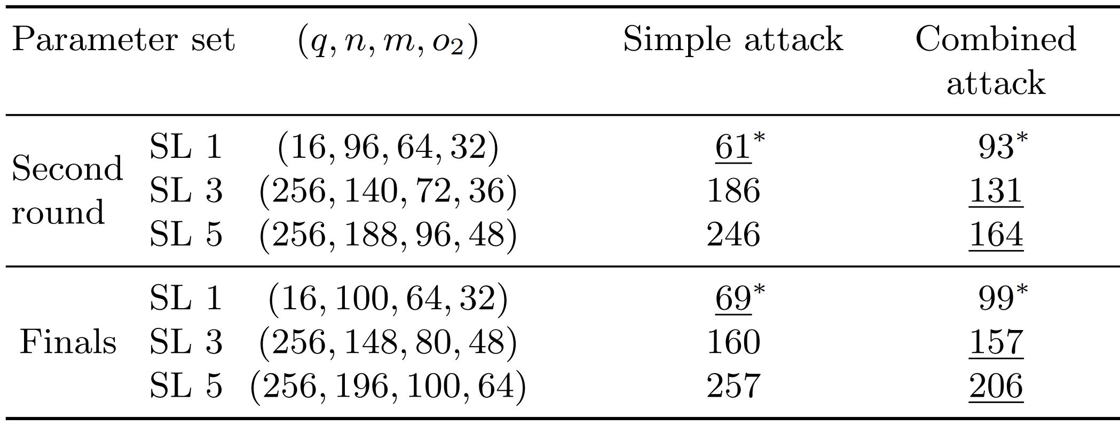

New attacks $\log_{2}{(}$bit cost$)$
*full key recovery attack (as opposed to universal forgery attack)

Slide 5
Overview
New attacks
Conclusion
Oil & vinegar
Rainbow

Slide 6
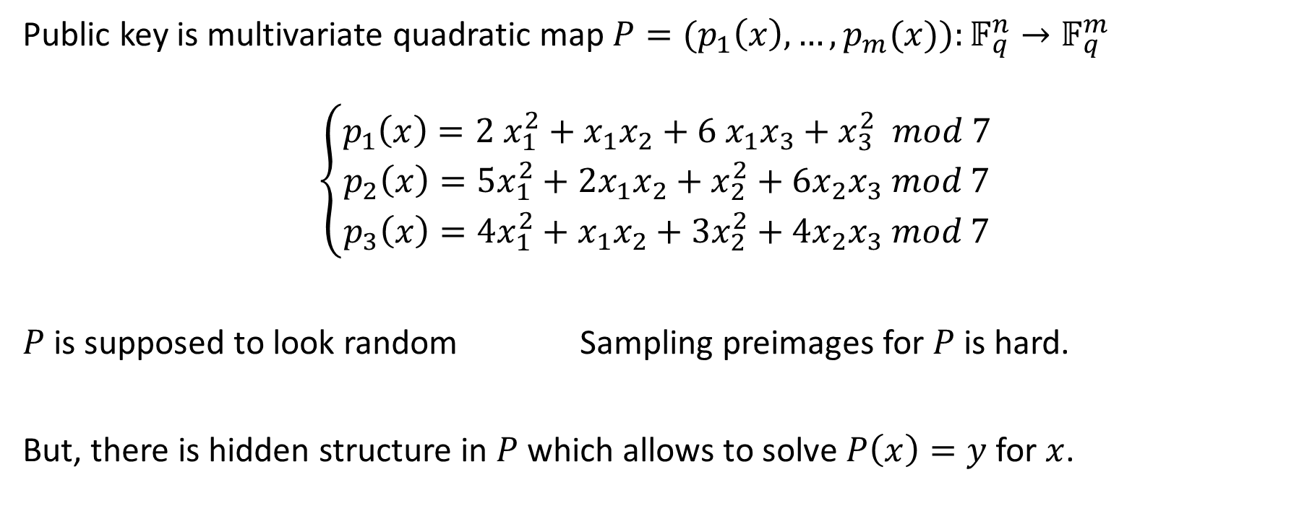
Multivariate Trapdoors
Public key is multivariate quadratic map $P=(p_{1}\left(x\right),…,p_{m}(x)):𝔽_{q}^{n}→𝔽_{q}^{m}$
$$\left\{\begin{aligned}p_{1}\left(x\right)={2 x}_{1}^{2}+{x_{1}x}_{2}+6 x_{1}x_{3}+x_{3}^{2} mod 7 \\ p_{2}\left(x\right)={5x}_{1}^{2}+{2x}_{1}x_{2}+x_{2}^{2}+{6x}_{2}x_{3} mod 7 \\ p_{3}\left(x\right)={4x}_{1}^{2}+x_{1}x_{2}+{3x}_{2}^{2}+{4x}_{2}x_{3} mod 7\end{aligned}\right.$$
$P$ is supposed to look random Sampling preimages for $P$ is hard.
But, there is hidden structure in $P$ which allows to solve $P\left(x\right)=y$ for $x$.

Slide 7
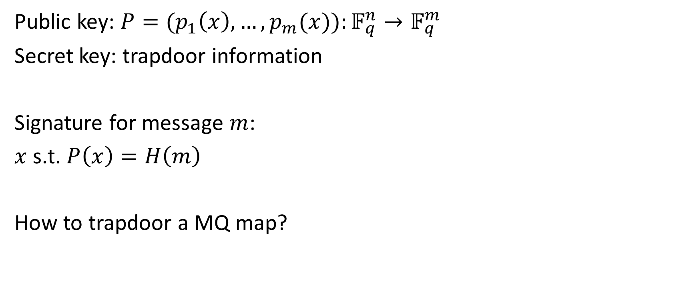
Trapdoor signatures
Public key: $P=(p_{1}\left(x\right),…,p_{m}(x)):𝔽_{q}^{n}→𝔽_{q}^{m}$
Secret key: trapdoor information
Signature for message $m$:
$x$ s.t. $P\left(x\right)=H\left(m\right)$
How to trapdoor a MQ map?

Slide 8


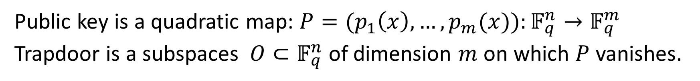



Oil & Vinegar Trapdoor as presented in [Beu21]
Public key is a quadratic map: $P=(p_{1}\left(x\right),…,p_{m}(x)):𝔽_{q}^{n}→𝔽_{q}^{m}$
Trapdoor is a subspaces $O⊂𝔽_{q}^{n}$ of dimension $m$ on which $P$ vanishes.
$$𝔽_{q}^{n}$$
$$𝔽_{q}^{m}$$
$$P$$
$$O$$
$$P$$
.
0

Slide 9
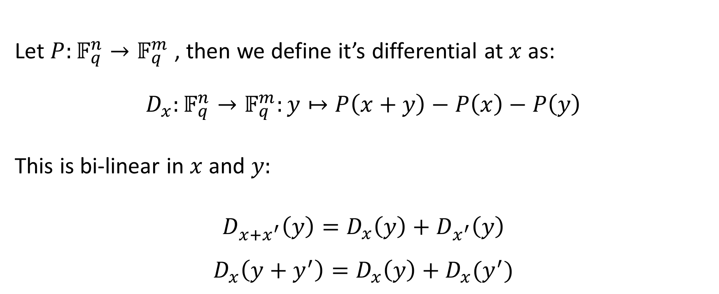
Definition of differential:
Let $P:𝔽_{q}^{n}→𝔽_{q}^{m}$, then we define it’s differential at $x$ as:
$$D_{x}:𝔽_{q}^{n}→𝔽_{q}^{m}:y↦P\left(x+y\right)−P\left(x\right)−P\left(y\right)$$ This is bi-linear in $x$ and $y:$
$$D_{x+x^{′}}\left(y\right)=D_{x}\left(y\right)+D_{x^{′}}\left(y\right)$$
$$D_{x}\left(y+y^{′}\right)=D_{x}\left(y\right)+D_{x}(y^{′})$$

Slide 10
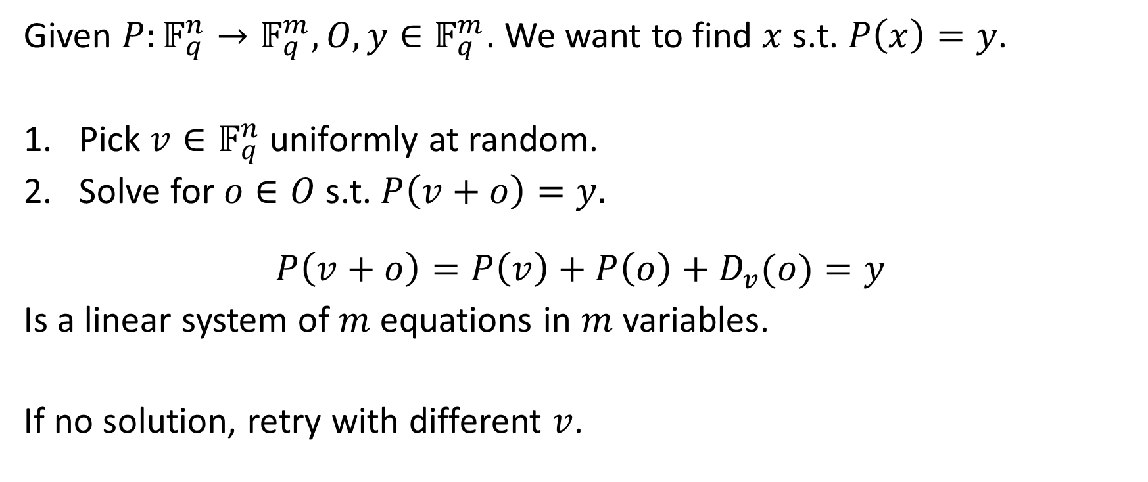
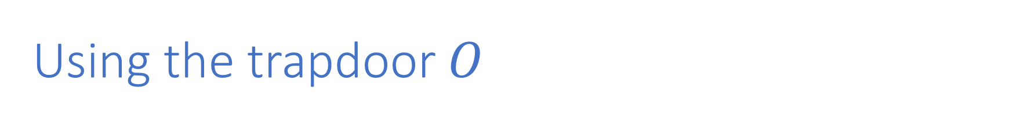
Using the trapdoor $O$
Given $P:𝔽_{q}^{n}→𝔽_{q}^{m}, O, y∈𝔽_{q}^{m}$. We want to find $x$ s.t. $P\left(x\right)=y$.
Pick $v∈𝔽_{q}^{n}$ uniformly at random.
Solve for $o∈O$ s.t. $P\left(v+o\right)=y.$
$$P\left(v+o\right)=P\left(v\right)+P\left(o\right)+D_{v}(o)=y$$
Is a linear system of $m$ equations in $m$ variables.
If no solution, retry with different $v$.

Slide 11
Overview
New attacks
Conclusion
Oil & vinegar
Rainbow

Slide 12


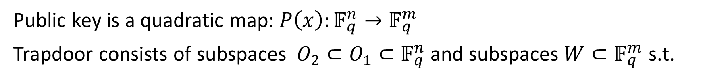





Rainbow Trapdoor as presented in [Beu21]
Public key is a quadratic map: $P\left(x\right):𝔽_{q}^{n}→𝔽_{q}^{m}$
Trapdoor consists of subspaces $O_{2}⊂O_{1}⊂𝔽_{q}^{n}$ and subspaces $W⊂𝔽_{q}^{m}$ s.t.
$$𝔽_{q}^{n}$$
$∀x∈𝔽_{q}^{n}$ $$D_{x}$$
$$𝔽_{q}^{m}$$
$$O_{1}$$
$$W$$
$$P_{|O_{1}}$$
$$O_{2}$$
$$P_{|O_{2}}$$
.
0

Slide 13



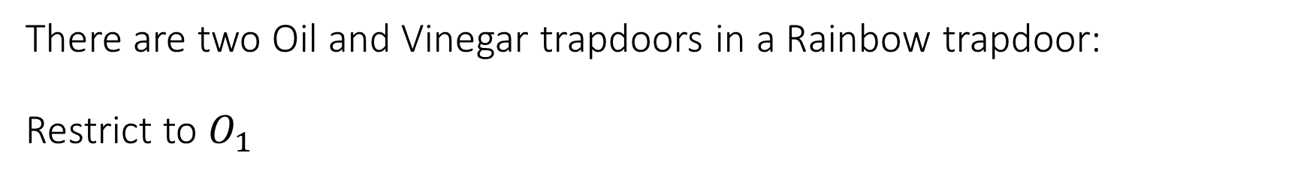
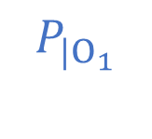



There are two Oil and Vinegar trapdoors in a Rainbow trapdoor: Restrict to $O_{1}$
$$𝔽_{q}^{n}$$
$$𝔽_{q}^{m}$$
$$O_{1}$$
$$W$$
$$P_{|O_{1}}$$
$$O_{2}$$
$$P_{|O_{2}}$$
.
0

Slide 14



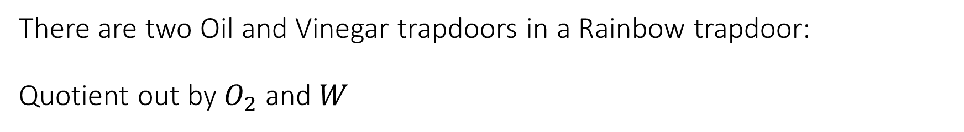



There are two Oil and Vinegar trapdoors in a Rainbow trapdoor: Quotient out by $O_{2}$ and $W$
$$𝔽_{q}^{n}/O_{2}$$
$$𝔽_{q}^{m}/W$$
$$O_{1}/O_{2}$$
$W$/$W$
$$P_{|O_{1}}$$
$$O_{2}/O_{2}$$
$$P_{|O_{2}}$$
.
0

Slide 15
Overview
New attacks
Conclusion
Oil & vinegar
Rainbow

Slide 16

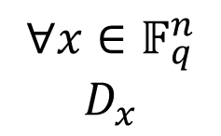
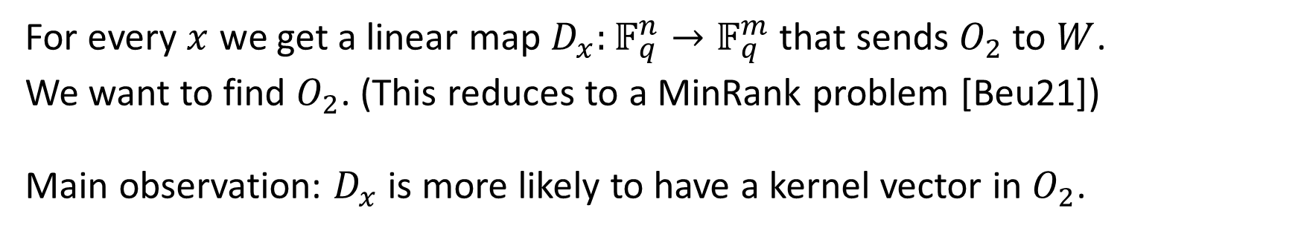



Main idea
$$𝔽_{q}^{n}$$
$$𝔽_{q}^{m}$$
$$W$$
$$O_{2}$$
$∀x∈𝔽_{q}^{n}$ $$D_{x}$$
For every $x$ we get a linear map $D_{x}:𝔽_{q}^{n}→𝔽_{q}^{m}$ that sends $O_{2}$ to $W$.
We want to find $O_{2}$. (This reduces to a MinRank problem [Beu21])
Main observation: $D_{x}$ is more likely to have a kernel vector in $O_{2}$.

Slide 17
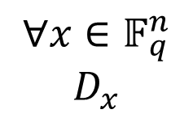
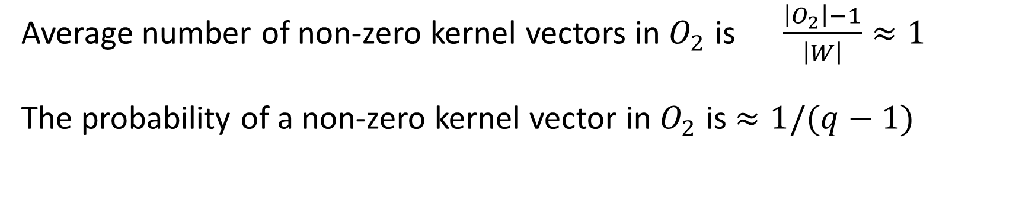
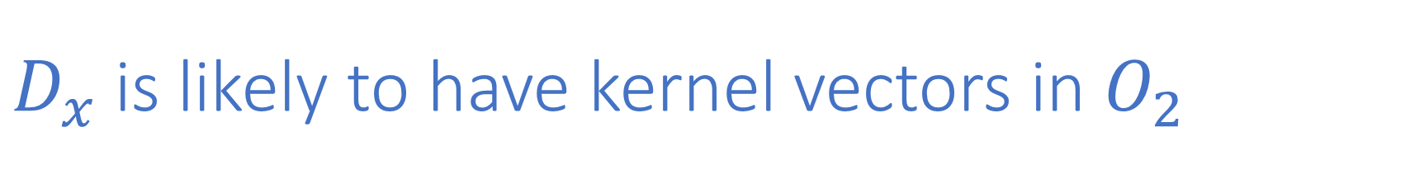


$D_{x}$ is likely to have kernel vectors in $O_{2}$
$$𝔽_{q}^{n}$$
$$𝔽_{q}^{m}$$
$$O_{2}$$
$∀x∈𝔽_{q}^{n}$ $$D_{x}$$
$$W$$
Average number of non-zero kernel vectors in $O_{2}$ is $\frac{\left|O_{2}\right|−1}{\left|W\right|}≈1$ The probability of a non-zero kernel vector in $O_{2}$ is $≈1/(q−1)$

Slide 18
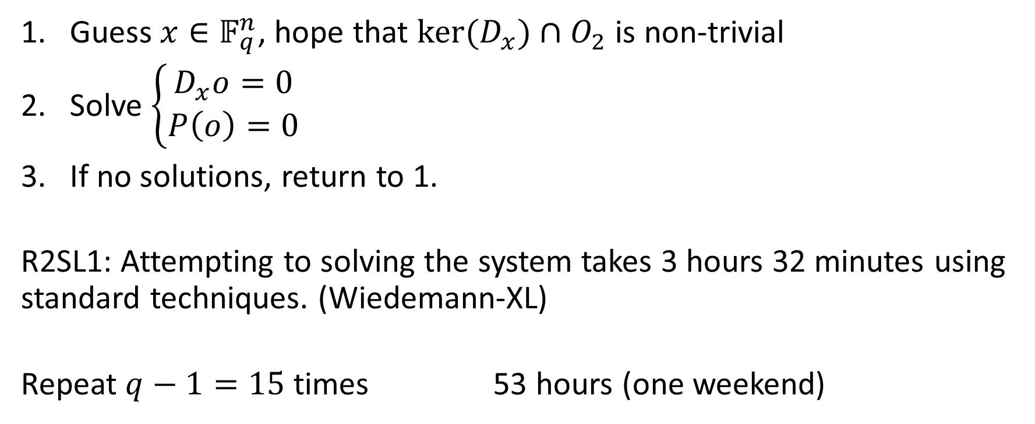
New Attack:
Guess $x∈𝔽_{q}^{n}$, hope that ${ker⁡(D}_{x})∩O_{2}$ is non-trivial
Solve $\left\{\begin{aligned}D_{x}o=0 \\ P\left(o\right)=0\end{aligned}\right.$
If no solutions, return to 1.
R2SL1: Attempting to solving the system takes 3 hours 32 minutes using standard techniques. (Wiedemann-XL)
Repeat $q−1=15$ times 53 hours (one weekend)

Slide 19



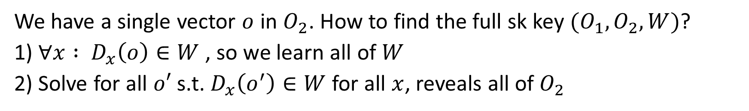





Finishing the attack
We have a single vector $o$ in $O_{2}$. How to find the full sk key $(O_{1},O_{2},W)$?
1) $∀x : D_{x}\left(o\right)∈W$ , so we learn all of $W$
2) Solve for all $o′$ s.t. $D_{x}\left(o^{′}\right)∈W$ for all $x$, reveals all of $O_{2}$
$$𝔽_{q}^{n}$$
$∀x∈𝔽_{q}^{n}$ $$D_{x}$$
$$𝔽_{q}^{m}$$
$$O_{1}$$
$$W$$
$$P_{|O_{1}}$$
$$O_{2}$$
$$P_{|O_{2}}$$
.
0

Slide 20

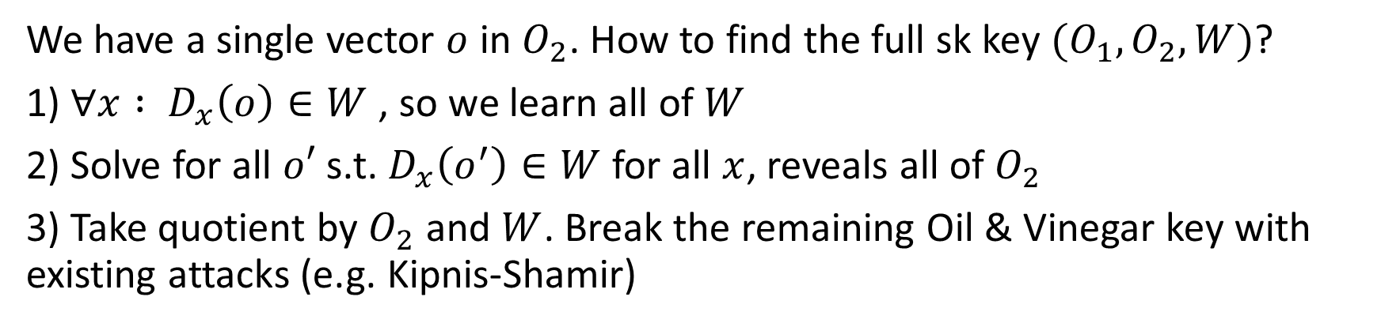



Finishing the attack
We have a single vector $o$ in $O_{2}$. How to find the full sk key $(O_{1},O_{2},W)$?
1) $∀x : D_{x}\left(o\right)∈W$ , so we learn all of $W$
2) Solve for all $o′$ s.t. $D_{x}\left(o^{′}\right)∈W$ for all $x$, reveals all of $O_{2}$
3) Take quotient by $O_{2}$ and $W$. Break the remaining Oil & Vinegar key with existing attacks (e.g. Kipnis-Shamir)
$$𝔽_{q}^{n}/O_{2}$$
$$O_{1}/O_{2}$$
$$𝔽_{q}^{m}/W$$
$$P$$
.
0

Slide 21
Overview
New attacks
Conclusion
Oil & vinegar
Rainbow

Slide 22
Wrapping up:
Rainbow is not secure. (R2SL1 is broken in practice.)
Increasing parameters would be expensive
4.4x larger PK
2.5xlarger signatures
5x slower
Oil & Vinegar is much simpler and now more efficient/compact.
Questions?

