Slide 1
Spectroscopy Lab Results
AE4899-25
FTIR · Raman · UV-Vis · XRD
Group 3 · Icy · Ward Depoorter· Pim van der Molen
Delft University of Technology | 13/03/2026

Slide 2

RESEARCH QUESTION
What is the required resolution of a future VNIR measurement system to detect organics on Enceladus’ surface?
Objective 1
Objective 2
Objective 3
What compounds occur in Enceladus' plumes and at what concentration?
How does the concentration of these compounds affect their footprint in VNIR measurement?
How does resolution (spatial, spectral & radiometric) affect the ability of instruments to detect organics on Enceladus?

Slide 3
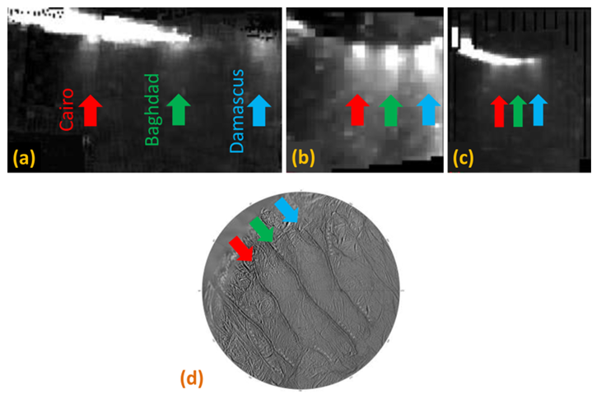
Enceladus
Plumes
Contents (sub-selection)
Features (VNIR)
Compound | Concentration (%)
Methane | 0.91 [1] ~ 1.68 [2]
Methanol | 0.015 [1]
Formaldehyde | 0.31 [1]
Feature / Wavelength (μm)
C-H stretch (3.3)
Band complex (3.4)
Electronic transitions (0.30~0.34)
Plumes ejecting material around the South Polar Region from the Tiger Stripes [3]
What do we observe?
Ice & water bands around 3 μm
Weak 3.5 μm feature
[1]: Waite, 2009
[2]: Waite, 2006
[3]: Dhingra, 2017
Notes:
We know there are organics, but we struggle to detect them using VIMS. Why? Relate to large amount of water, features falling outside measured spectrum. What features fall within spectrum?

Slide 4
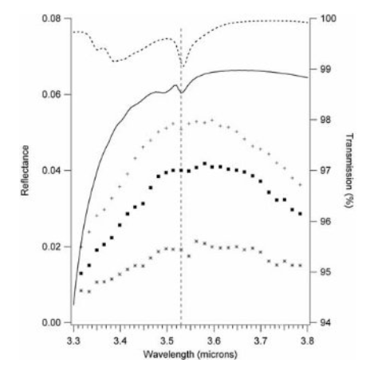
Effect of concentration on footprint
Comparing measurements to lab experiments
Dashed line: pure methanol at 100 K.
Solid line: 1% methanol in crystalline water at 140 K.
Crosses: global average on Enceladus.
Squares: Enceladus around tiger stripes.
Stars: Enceladus tiger stripes.
Presence
Higher concentration of organics near regions with plume activity.
Competing effects; raised temperatures reduce methanol trapping.
Reflectance & transmission spectra relating laboratory analogues to Enceladus’ surface [Hodyss, 2009]
Notes:
Methanol falls within spectrum. However, even if we know methanol is present, VIMS only contains faint features. Why? Low concentration, spectral resolution.

Slide 5
Formaldehyde
Comparing measurements to lab experiments
Laboratory transmission & VIMS reflectance data.
Dashed line: pure methanol at 100 K.
Solid line: 1% methanol in crystalline water at 140 K.
Crosses: global average on Enceladus.
Squares: Enceladus around tiger stripes.
Stars: Enceladus tiger stripes.
Presence
Higher concentration of organics near regions with plume activity.
However, close to craters, temperature is slightly higher, making it harder for ice to trap methanol.
Reflectance & transmission spectra relating laboratory to Enceladus surface [Hodyss, 2009]
Fourier Transform Infrared Spectroscopy | Range: 4000–600 cm⁻¹

Slide 6
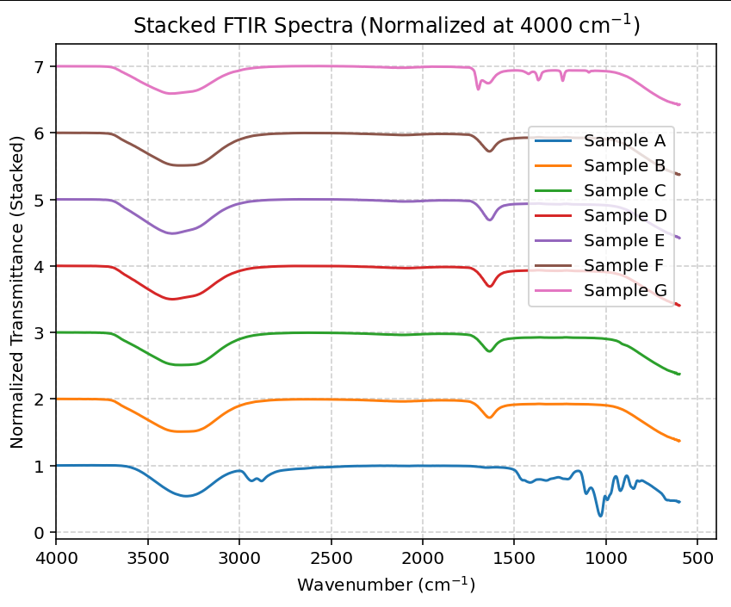
VIMS Limitations
VIMS: 0.3-5 μm ( 3.3e4 – 2000 [cm-1] )
C-H stretch visible
C=O invisible
Fingerprint region invisible: complex organics
Low spatial resolution: ~300m/pixel on closest flyby
Others in order of km/pixel
Issue: VIMS cannot explain plume composition
VIMS| Range: 3.3e4 – 2000 cm⁻¹
Notes:
Many discernible IR features fall outside VIMS range. Overlap of amorphous water features.

Slide 7
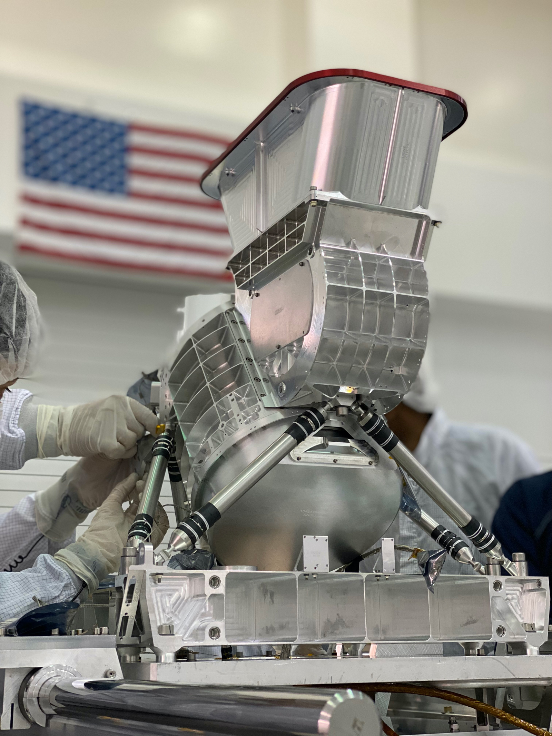
Recently flown VNIR Instruments
Source: NASA
Europa clipper MISE
(Mapping Imaging Spectrometer for Europa)
Same wavelength range
10 nm spectral resolution (Vims: 16nm)
Higher spatial resolution (25-300m/pixel)
Higher SnR in C-H absorption band!
Vims: global, large features
MISE: distinguish weak, local surface features from ice dominated surface
Enceladus orbiter with MISE equivalent: great results
Case study | MISE , Europa clipper|
Notes:
Explain spectral resolution, spatial resolution (flyby distance, pixel size), SNR

Slide 8
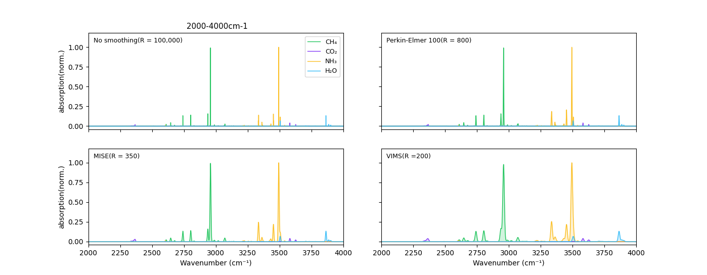

Resolving power: VIMS vs MISE VS PE-100
R = $\frac{λ}{∆λ}$ (changes with wavenumber)
HITRAN: quantum transitions
Enceladus conditions
‘Simulates’ instrument performance
Limitation: HITRAN uses gasses
Resolving power
Resolving Power | VIMS, MISE, PE-100
Notes:
Effect of resolving power: compare lab equipment to VIMS to Europa Clipper
Glasses analogue:

Slide 9
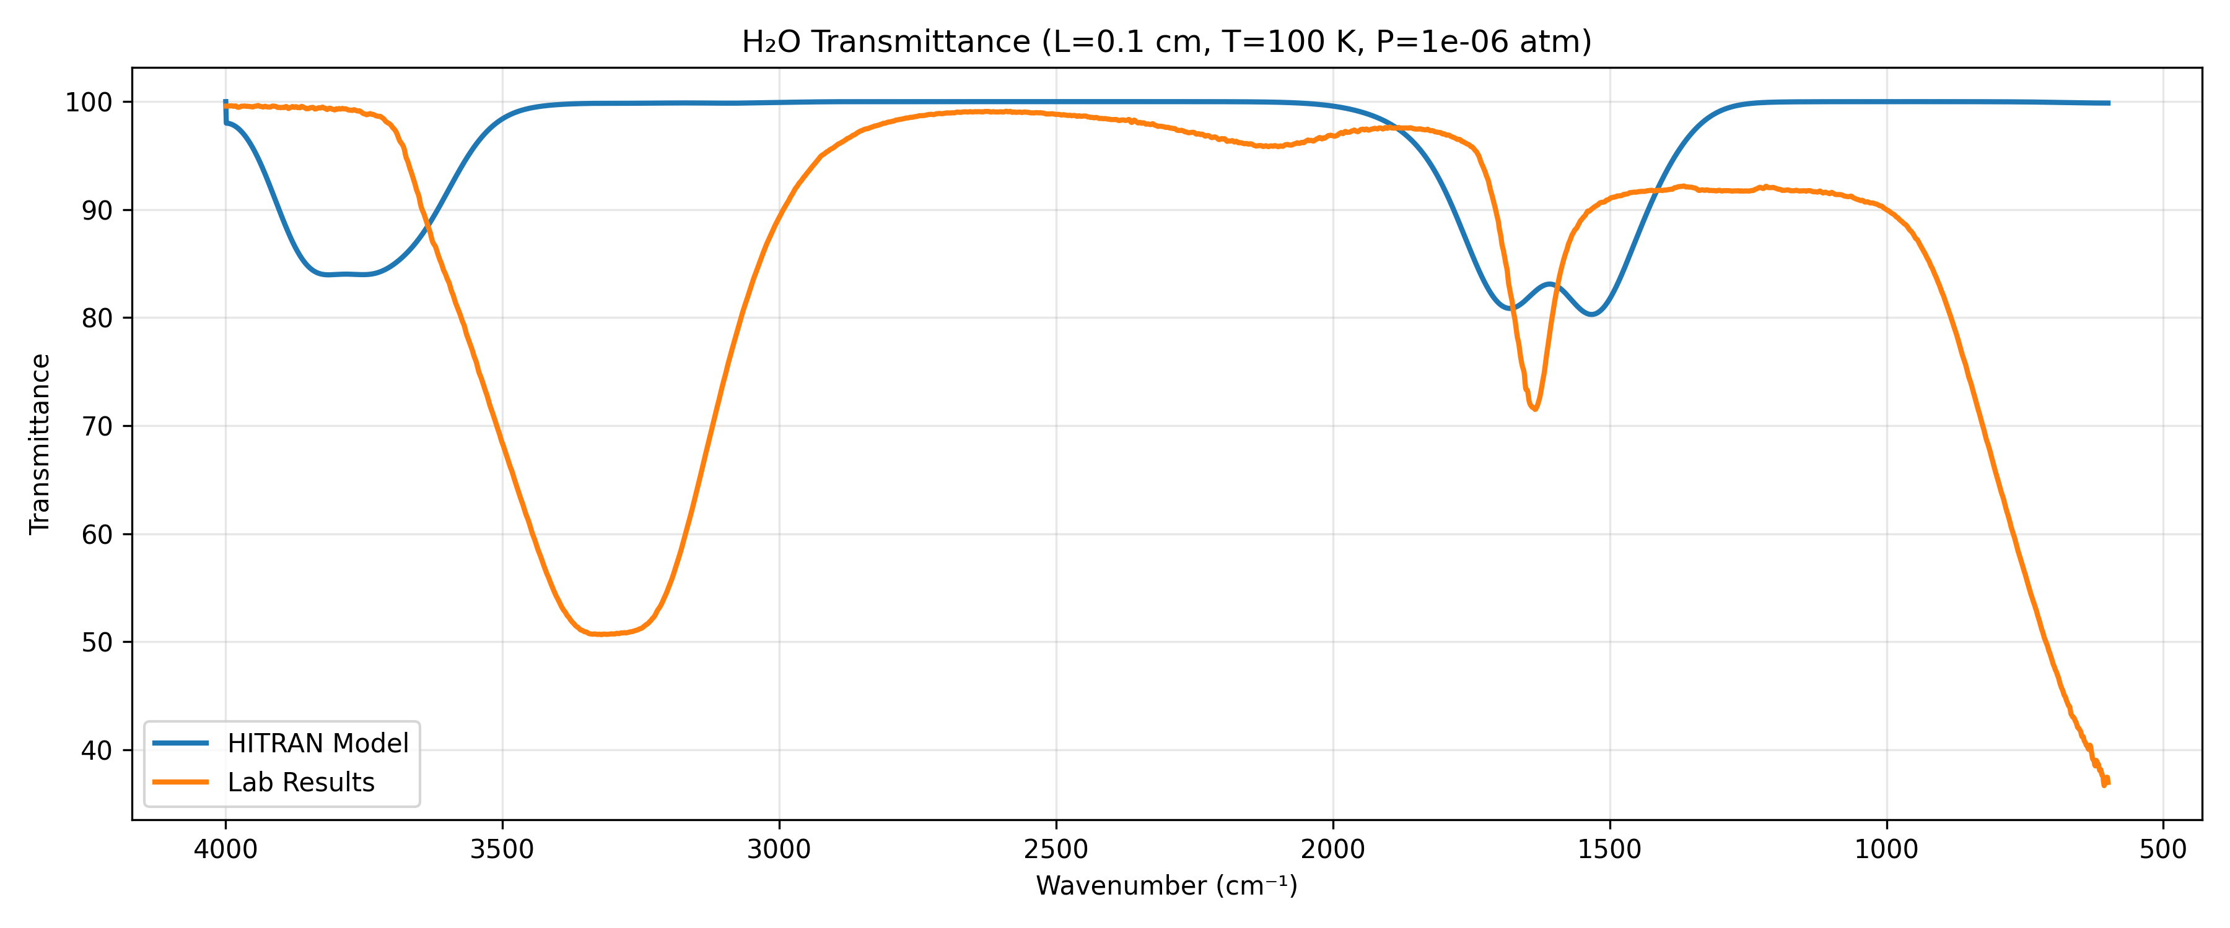
Verification: H2O LAB vs HITRAN
Verification: H2O
Large features are there
Lab:
T = 290K
liquid
HITRAN:
T = 100K
Gaseous
Therefore we see broadening+ shift!
Resolving Power | VIMS, MISE, PE-100
Notes:
Verification of HITRAN and Lab results
Quite big difference: expected
But large features are there
Glasses analogue:

Slide 10
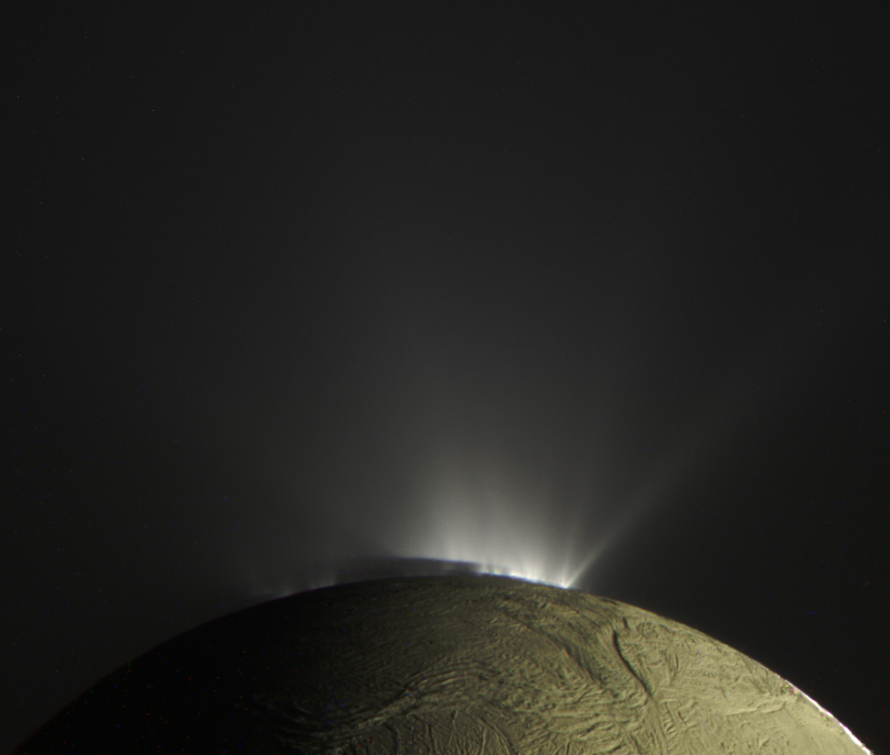
Plume Analysis
In-situ instrument on orbiter possible:
Transmission IR
Raman Spectrometer
Mass Spectrometer
Europa clipper: high radiation flux (flyby needed to reduce exposure)
Enceladus orbiter possible
Plumes
Interpretation
X-Ray Diffraction | Instrument: XRD | 2θ range: 2–70°

Slide 11
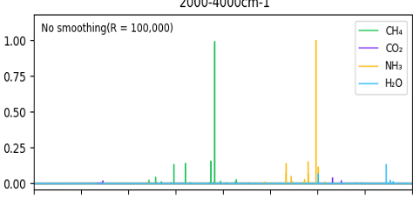
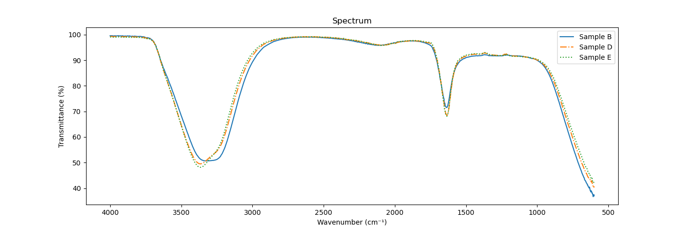
How can we establish the required resolution?
Planetary analogue
VNIR spectrum
Convolution
Compound | Volume (%)
CO2 | 1
Methane | 1.5
Methanol | 0.02
Formaldehyde | 0.3
Ammonia | 1
Challenging factors
Ice affects features; tests should be performed at cryogenic conditions
The acquired spectrum has already been convolved with the lab equipment
Mixed sample
Notes:
We know there are organics, but we struggle to detect them using VIMS. Why? Relate to large amount of water, features falling outside measured spectrum. What features fall within spectrum?

Slide 12
Conclusion
Organics
Organics are present in Enceladus’ plumes, but we struggle to detect them on the surface using VIMS.
Accuracy
Measurements are affected by different types of resolution: spectral, spatial and intensity.
Limitations
Even with our most modern equipment, it might not be possible to detect these materials using surface observation techniques.
Lab work
This can be established by performing VNIR measurements on laboratory analogues and convolving these with the resolving power of Europa Clipper.
Notes:
Convolve results from lab work with Europa Clipper. If still too faint, then work backwards from there.

Slide 13
Thank you
Questions?
Delft University of Technology | 13/03/2026

Slide 14
References
Waite, J. H., Jr., Combi, M. R., Ip, W.-H., Cravens, T. E., McNutt, R. L., Jr., Kasprzak, W., Yelle, R., Luhmann, J., Niemann, H., Gell, D., Magee, B., Fletcher, G., Lunine, J., & Tseng, W.-L. (2006). Cassini Ion and Neutral Mass Spectrometer: Enceladus Plume Composition and Structure. Science, 311(5766), 1419–1422. https://doi.org/10.1126/science.1121290
Waite Jr, J., Lewis, W., Magee, B. et al. Liquid water on Enceladus from observations of ammonia and ⁴⁰Ar in the plume. Nature 460, 487–490 (2009). https://doi.org/10.1038/nature08153
Hodyss, R., Parkinson, C. D., Johnson, P. V., Stern, J. V., Goguen, J. D., Yung, Y. L., & Kanik, I. (2009). Methanol on Enceladus. Geophysical Research Letters, 36(17). https://doi.org/10.1029/2009gl039336
Dhingra, D., Hedman, M. M., Clark, R. N., & Nicholson, P. D. (2017). Spatially resolved near infrared observations of Enceladus’ tiger stripe eruptions from Cassini VIMS. Icarus, 292, 1–12. https://doi.org/10.1016/j.icarus.2017.03.002
R.V. Kochanov, I.E. Gordon, L.S. Rothman, P. Wcislo, C. Hill, J.S. Wilzewski, HITRAN Application Programming Interface (HAPI): A comprehensive approach to working with spectroscopic data, J. Quant. Spectrosc. Radiat. Transfer 177, 15-30 (2016) [Link to article] [ADS].

Slide 15
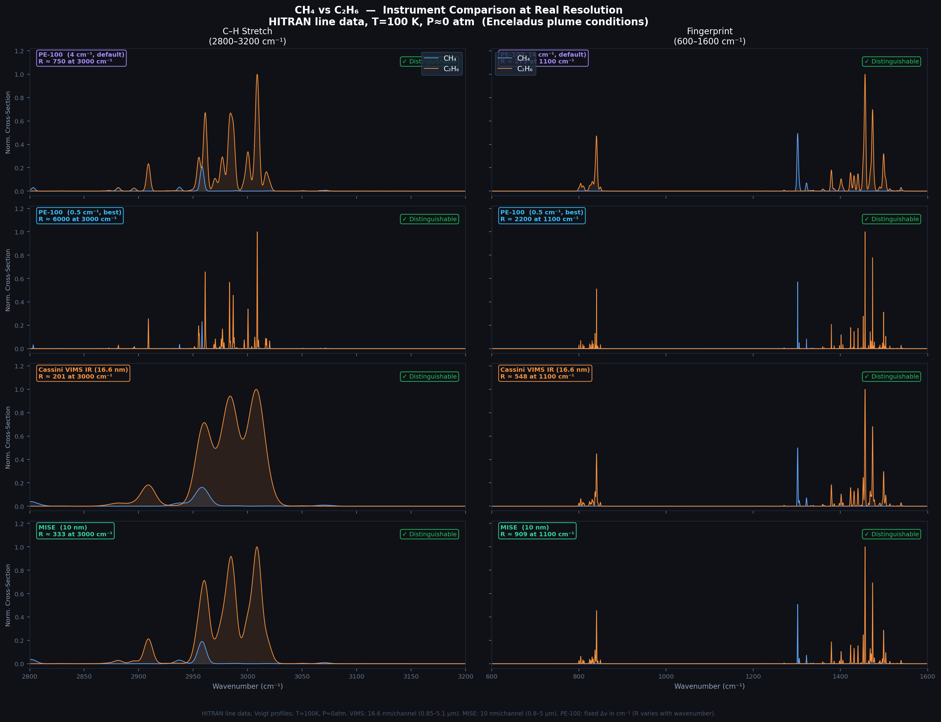
extra
Early attempt:
Ethane/methane

