Slide 1
GameOfLife++
Thomas Dooms, Ward Gauderis, Mano Marichal, Olivier Bierbooms

Slide 2
GameOfLife++
GUI
Cellulaire Automaat
Simulatie
Manueel
Automatisch
FSM
Cellen
DFA++
Convertie en Minimalisatie
Algoritmes
TFA++, Unie en Doorsnede
DFA
NFA
eNFA
PA
DPDA
TM
States
Manuele Invoer
Invoer
Pseudocode

Slide 3
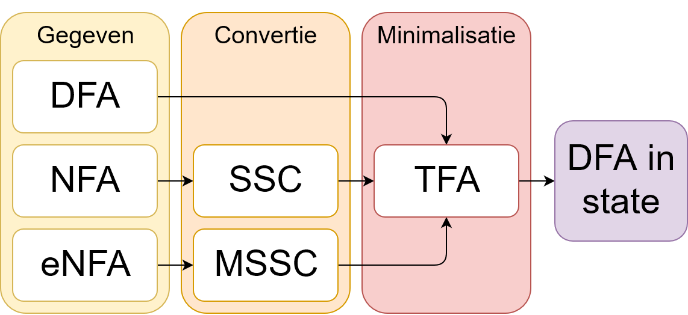
Convertie en minimalisatie DFA/NFA/eNFA

Slide 4
Invoer
;EXAMPLE INI - MANUAL
[ General ]
mode=manual
width=200
height=200
layout="./input/layout_example.csv"
inputs=(0, 0), (0, -1), (0, -2), (-1, 0), (1 ,0), (0, 1), (0, 2)
[ States ]
amount=4
state1=alive, #ffffff, ./input/enfa.json
state2=dead, black, ./input/pda.json
state3=zombie, random, ./input/tm.json
state4=temp, epsilon, ./input/dfa.json
[ Transitions ]
alive=alive, temp
dead=dead, zombie
zombie=zombie, dead
temp=zombie, dead
;EXAMPLE INI - GOL AUTOMATIC
[ General ]
mode=automatic
laws=./GOL.law
//EXAMPLE LAW - GOL AUTOMATIC
states
(alive): white, dead
(dead): black, dead
alive
(alive == [2-3]): alive
dead
(alive == 3): alive

Slide 5
DFA++ per cel
DFA++: D = (Q, Σ, δ, q0, Ω)
Met Ω de verzameling van ‘soorten’ states {A, B, …, F, ...}
Ω is dus een partitie van Q
TFA++:
BG: ∀ p ∈ F, q ∉ F : p !≡ q met F ∈ Ω
Inductie: ∃ a ∈ Σ : δ(p, a) !≡ δ(q, a) ⇒ p !≡ q

Slide 6
Automatische Modus
//EXAMPLE LAW - AUTOMATIC
states
(alive): white, alive
(dead): #ffffff, dead
(zombie): random, dead
alive
(0 == dead): dead
(dead == 4): zombie
dead
([1-5]& == alive): dead
([1-5]| == dead): alive
(zombie == [5-7]): alive
zombie
(([2-8]& == dead) && (alive == 4)): alive
((1 == dead) || (alive == [1-3])): zombie
(!(0 == dead)): dead
((!((alive == [3-5]) || !([0-5]& == dead)) && (alive = 5)): dead
Elementaire condities
Samengestelde condities

Slide 7
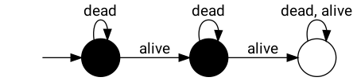
Proces
//EXAMPLE LAW - AUTOMATIC
states
(alive): white, alive
(dead): black, dead
alive
((alive == [0-1]) || (alive == [4-8])): dead
(2 == dead): alive
dead
(alive == 3): alive

Slide 8
Proces
//EXAMPLE LAW - AUTOMATIC
states
(alive): white, alive
(dead): black, dead
alive
((alive == [0-1]) || (alive == [4-8])): dead
(2 == dead): alive
dead
(alive == 3): alive

Slide 9
Proces
//EXAMPLE LAW - AUTOMATIC
states
(alive): white, alive
(dead): black, dead
alive
((alive == [0-1]) || (alive == [4-8])): dead
(2 == dead): alive
dead
(alive == 3): alive

Slide 10
Proces
//EXAMPLE LAW - AUTOMATIC
states
(alive): white, alive
(dead): black, dead
alive
((alive == [0-1]) || (alive == [4-8])): dead
(2 == dead): alive
dead
(alive == 3): alive

Slide 11
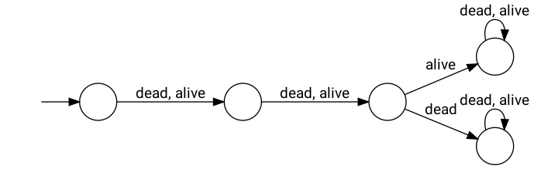
Proces
//EXAMPLE LAW - AUTOMATIC
states
(alive): white, alive
(dead): black, dead
alive
((alive == [0-1]) || (alive == [4-8])): dead
(2 == dead): alive
dead
(alive == 3): alive

Slide 12
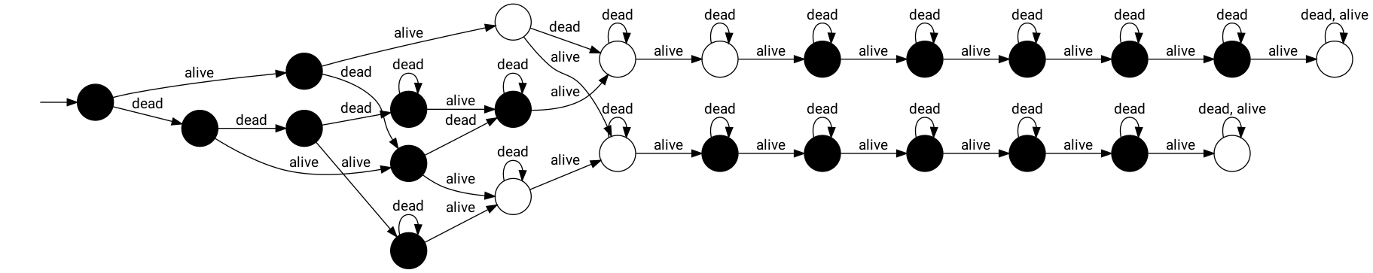
Proces
//EXAMPLE LAW - AUTOMATIC
states
(alive): white, alive
(dead): black, dead
alive
((alive == [0-1]) || (alive == [4-8])): dead
(2 == dead): alive
dead
(alive == 3): alive

Slide 13
Proces
//EXAMPLE LAW - AUTOMATIC
states
(alive): white, alive
(dead): black, dead
alive
((alive == [0-1]) || (alive == [4-8])): dead
(2 == dead): alive
dead
(alive == 3): alive

Slide 14
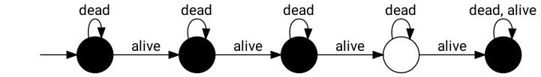
Proces
//EXAMPLE LAW - AUTOMATIC
states
(alive): white, alive
(dead): black, dead
alive
((alive == [0-1]) || (alive == [4-8])): dead
(2 == dead): alive
dead
(alive == 3): alive

Slide 15
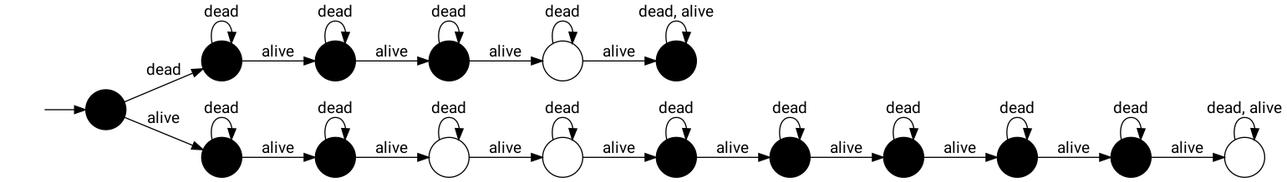
Proces
//EXAMPLE LAW - AUTOMATIC
states
(alive): white, alive
(dead): black, dead
alive
((alive == [0-1]) || (alive == [4-8])): dead
(2 == dead): alive
dead
(alive == 3): alive

