Slide 1
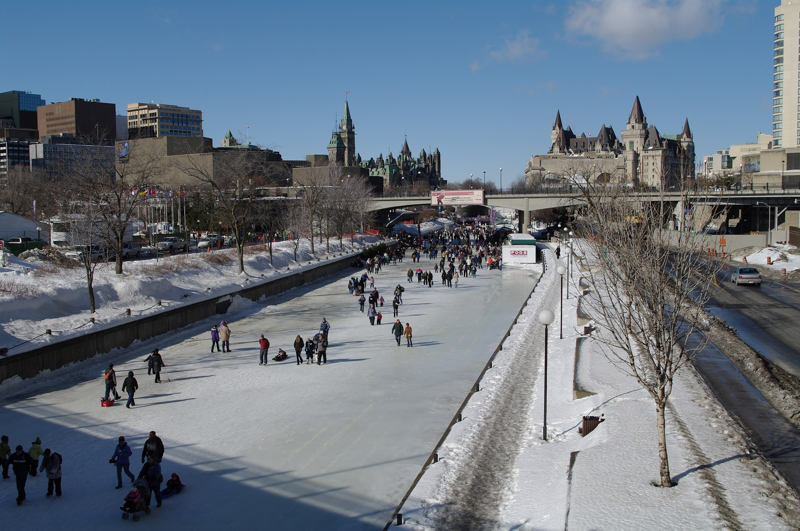
Lord of the Rinks
A CMS-style Blogging App to share experiences about skating on the Rideau Canal in Ottawa

Slide 2
The Rideau Canal is the longest outdoor skating rink in the world. Every year, thousands of people skate on the canal, to stroll, to train or even to get to, and from, work. You could say Ottawa has a community of skaters.
As a skater you want to connect with fellow skaters. What better way to do so than by sharing experiences, good or bad, through posts, comments on posts and voting.
Our App, a CMS-style blogging App provides a safe environment for the Ottawa skating community to connect, meet new friends, and stay informed of what’s happening on the Canal.
Elevator Pitch

Slide 3
Motivation
Being part of a community empowers people through sharing of information, experiences and stories. It fosters feelings of belonging and connectedness.
User story
AS A skater on the Ottawa Rideau Canal, I WANT to be able to connect with the skating community SO THAT I CAN share my experiences.
Requirements
WHEN I go to the sign-up page, THEN I can create a secure account that is password-protected;
WHEN I go to the home-page, THEN I can view blog posts;
WHEN I log in, THEN I can create my own posts, comment on other users’ posts, and upvote comments made by other users;
WHEN I create a post, THEN I can select the type of skates I rented.
Our Concept

Slide 4
Back-end: Node.js
"bcrypt": "^5.0.1",
"connect-session-sequelize": "^7.1.2",
"dotenv": "^16.0.0",
"express": "^4.17.3",
"express-handlebars": "^6.0.2",
"express-session": "^1.17.2",
"morgan": "^1.10.0",(This is popular HTTP request logger that provides insight into how your app is used and information about potential issues or errors)
"mysql2": "^2.3.3",
"sequelize": "^6.17.0"
Front-end:
Javascript,
Handlebars, CSS,
Animate,
Deployed on Heroku with JawsDB
Technologies

Slide 5
Unlike project 1, timing was tight with no holiday break. This made it difficult for most group members to devote time to the project.
MySQL was causing some problems for some.
We started with 5 tables in our db, but it created problems.
Establishing some of the routes was challenging.
We came together and got it done!
We helped each other with the re-installation of MySQL.
We figured out 4 tables was sufficient and more efficient.
We succeeded with trial and error (and help from Gabe!)
Challenges
Successes

Slide 6
Ward Vanlaar:
Group leader, GitHub admin;
User-story;
C: all routes; Morgan
M: models and MySQL database;
V: handlebars, Javascript, CSS
Dalia:
User-story
C: skate-type route
V: handlebars, Javascript
Tasks & Roles
Shareef:
User-story
V: CSS
Nathan:
User-story
V: CSS

Slide 7
Live demo
https://lord-of-the-rinks.herokuapp.com/

Slide 8
What’s next
Enhance user experience by adding other options to select besides types of skates used, like level of proficiency, where you are from, etc.
Add content analysis module to mine post data so that National Capital Commission (NCC; responsible for Canal) can improve the overall experience of skating on the Canal.
Add an administrator Dashboard from where content can be moderated, content analysis can be run, results can be reviewed and shared with the community.

Slide 9
Important links
Source code: https://github.com/WardVanlaar/lord-of-the-rinks
App: https://lord-of-the-rinks.herokuapp.com/

