Slide 1
Omnifood Website

Slide 2
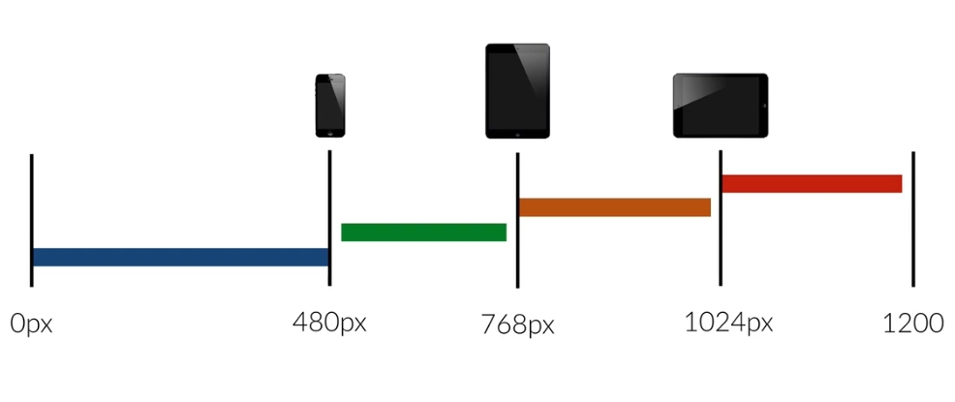
Media Quires and Breakpoints
Notes:
Breakpoints are screen width and at which we want our website to change the face look.
In the entire web page we define all the font-size in %ages which means that all the font sizes are based on the base font size.
But in media query we will use ‘px’ to decrease them automatically.

