Slide 1
Omnifood Website

Slide 2
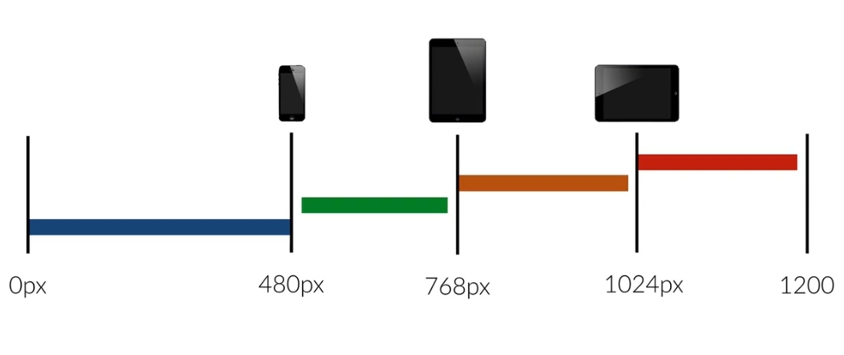
Media Quires and Breakpoints
Notes:
Breakpoints are screen width and at which we want our website to change the face look.
In the entire web page we define all the font-size in %ages which means that all the font sizes are based on the base font size.
But in media query we will use ‘px’ to decrease them automatically.

Slide 3
JQuery
Is used for some dynamic effects.
Jquery is the most popular JavaScript library in the world.
It is completely free and opens source software.
Jquery makes it incredibly easy to:
Select and manipulate HTML elements.
Create animation.
Develop Ajax applications.
Notes:
For example: Is used for finding an element in HTML document with the certain properties like all H1 elements and then changing one or more its CSS attribute and making it respond to an event like mouse click.

Slide 4
Jquery Plugins
A jQuery plugin is simply a new method that we use to extend jQuery's prototype object. By extending the prototype object you enable all jQuery objects to inherit any methods that you add. As established, whenever you call jQuery() you're creating a new jQuery object, with all of jQuery's methods inherited
Notes:
http://dimsemenov.com/plugins/magnific-popup/
http://iamceege.github.io/tooltipster/
https://maplacejs.com/
https://steven.codes/typerjs/
http://www.thepetedesign.com/demos/onepage_scroll_demo.html

Slide 5
For Example
$(document).ready(function() {
$(‘h1’).click(function() {
$(this).css(‘background-color’, ‘#ff0000’)
});
});
Notes:
$ is selector.
Select the document and then ready to perform function that is given.
Select h1 tag and call click function then
Select this(means that h1) and on click change the color.

Slide 6
Sticky Navigation
$(document).ready(function(){ $('.js--section-features').waypoint(function(direction) {
if (direction == "down") {
$('nav').addClass('sticky');
} else {
$('nav').removeClass('sticky');
}
}, {
offset: '60px;'
});
});
Notes:
Add a sticky class in the index.html and then coding according to what we want. Then remove that class from index.html and then call that class in the .js file. And use logic.
Add a jquery plugins waypoint from the waypoints.com then add it in the .js file.
Add a waypoint.js file in the index.html and then

