Slide 1
Laravel
Prepared By,
Miss Marium Younus

Slide 2
Laravel introduction
Laravel was developed by Taylor Otwell in July 2011 and it was released more than five years after the release of the CodeIgniter.
Laravel is a PHP based web-framework like CodeIgniter.
Laravel is one of the open source PHP frameworks.
Laravel follows the model-view-controller (MVC) architectural pattern.
Laravel is one of the most popular PHP frameworks after CodeIgniter.

Slide 3
Features
Eloquent ORM (object-relational mapping) – implements ActiveRecord
Query builder – helps you to build secured SQL queries
Restful controllers – provides a way for separating the different HTTP requests (GET, POST, DELETE, etc.)
Blade template engine – combines templates with a data model to produce views
Migrations – version control system for database, update your database easier
Database seeding – provides a way to populate database tables with test data used for testing
Pagination – easy to use advanced pagination functionalities
Forms security – provides CSRF token middleware, protecting all the forms

Slide 4
History of Laravel Releases
Version | Release | Bug Fixes Until | Security Fixes Until
V1 | June 2011 | – | –
V2 | September 2011 | – | –
v3 | February 2012 | – | –
v4 | May 2013 | – | –
5.0 | Feb 4th, 2015 | Aug 4th, 2015 | Feb 4th, 2016
5.1 (LTS) | Jun 9th, 2015 | Jun 9th, 2017 | Jun 9th, 2018
5.2 | Dec 21st, 2015 | Jun 21st, 2016 | Dec 21st, 2016
5.3 | Aug 23rd, 2016 | Feb 23rd, 2017 | Aug 23rd, 2017
5.4 | Jan 24th, 2017 | Jul 24th, 2017 | Jan 24th, 2018
5.5 (LTS) | Aug 30th, 2017 | Aug 30th, 2019 | Aug 30th, 2020
5.6 | Feb 7th, 2018 | Aug 7th, 2018 | Feb 7th, 2019
5.7 | Sep 4, 2018 | Feb 4th, 2019 | Sep 4th, 2019

Slide 5
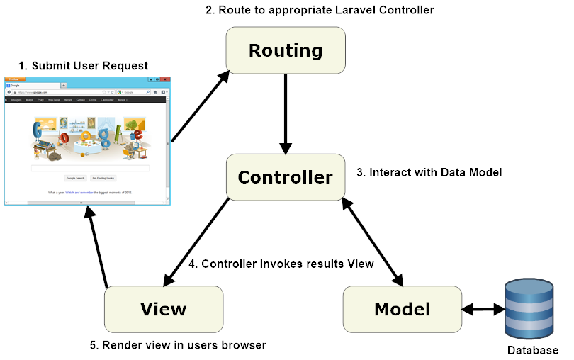
Architecture

Slide 6

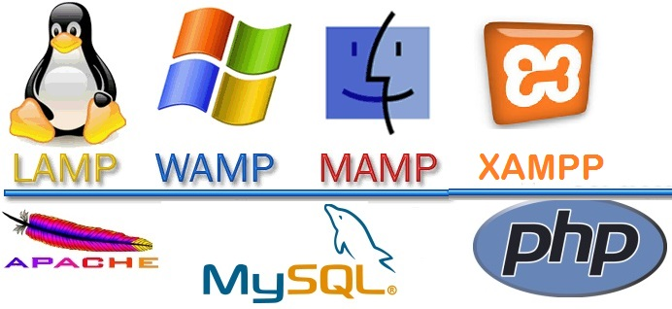


Installation of Laravel
https://laravel.com
PHP Install
https://getcomposer.org/
Note: First Install Composer and then through composer Install Laravel
Laravel utilizes Composer to manage its dependencies.
Before using Laravel, make sure you have Composer installed on your machine.

Slide 7
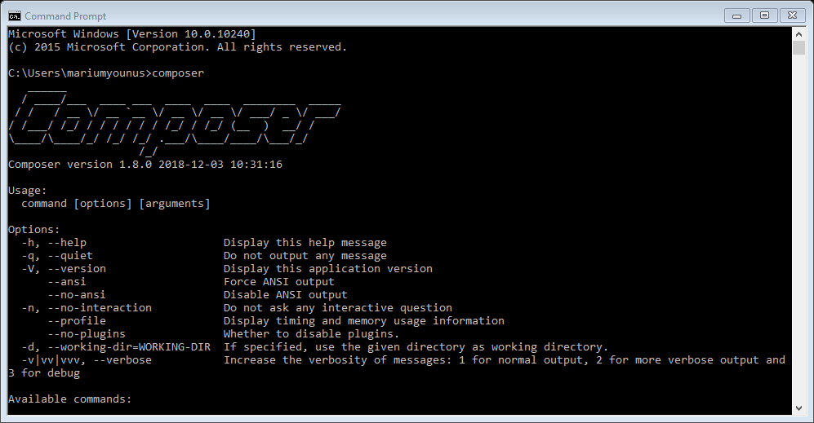
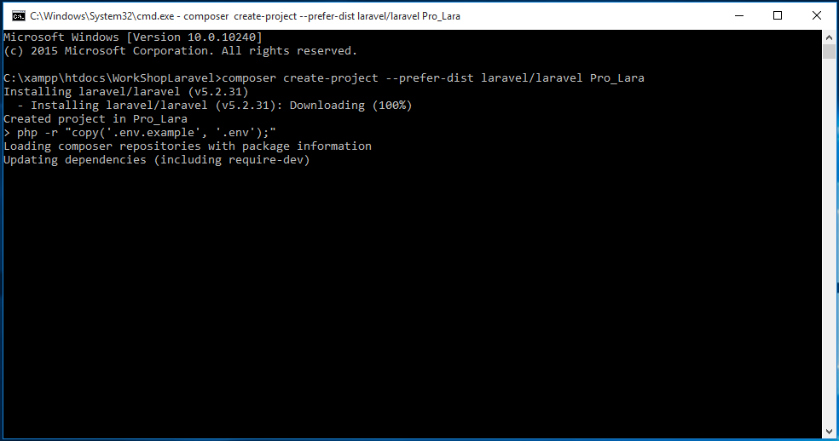
Installation Process
1:Install Composer
2:Install Laravel
First Change the Directory go to XAMPP->htdocs
and open cmd
Name of Your Project

Slide 8
Installation
You will have to follow the steps given below for installing Laravel onto your system .
Step 1 − Visit the following URL and download composer to install it on your system.https://getcomposer.org/download/
Step 2 − After the Composer is installed, check the installation by typing the Composer command in the command prompt.
Step 3 − Create a new directory anywhere in your system for your new Laravel project. After that, move to path where you have created the new directory and type the following command there to install Laravel.
composer create-project laravel/laravel PROJECTNAME
Step 4 − The above command will install Laravel in the current directory. Start the Laravel service by executing the following command.
php artisan serve

Slide 9
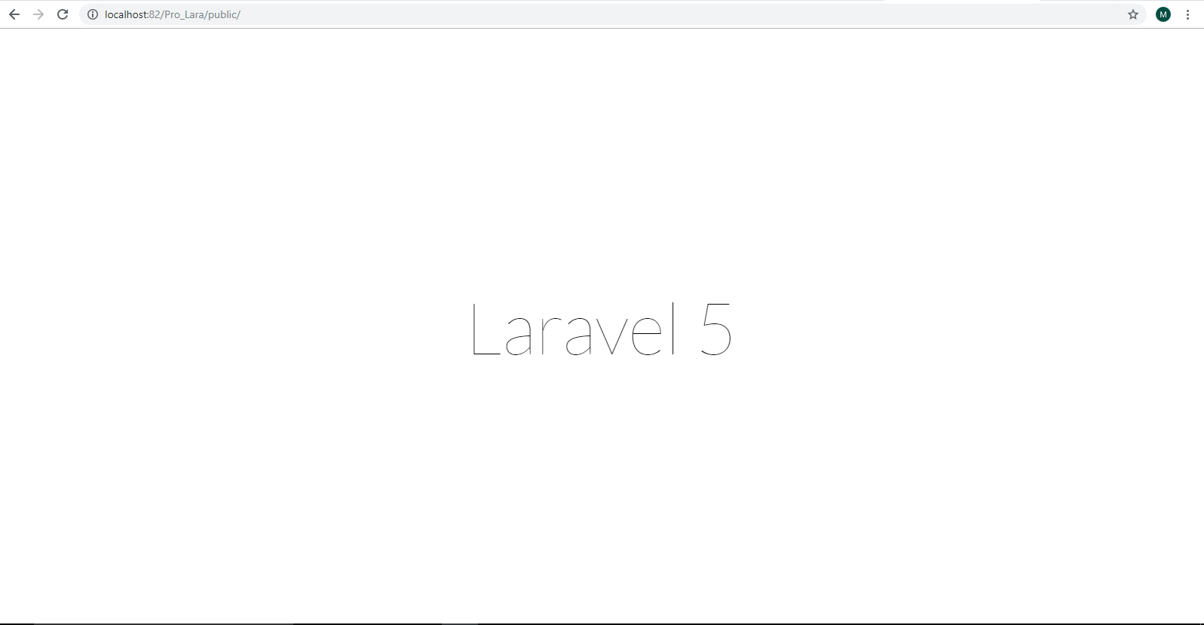
After Installation This Window Appear

Slide 10
Local Development Server
If you have PHP installed locally and you would like to use PHP's built-in development server to serve your application, you may use the serve Artisan command. This command will start a development server at http://localhost:8000:
php artisan serve

Slide 11
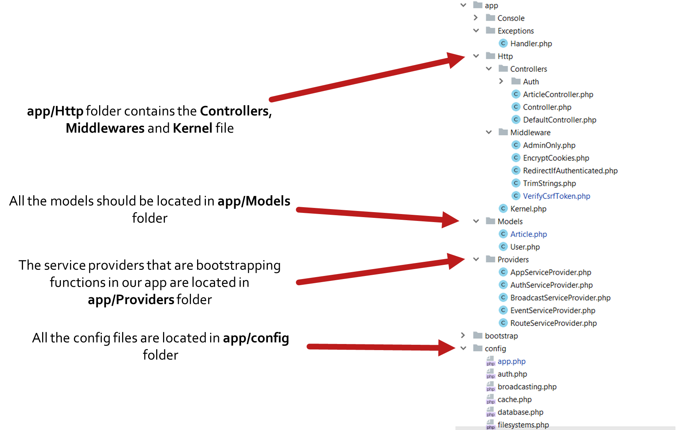
Structure

Slide 12
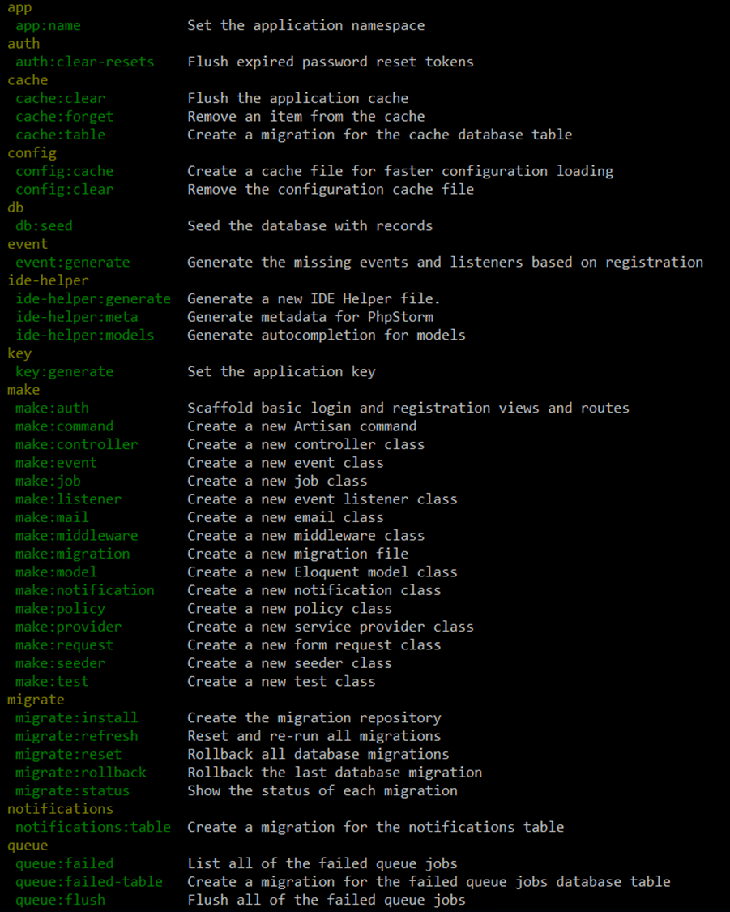
Artisan
Artisan is command-line interface for Laravel
Commands that are saving time
Generating files with artisan is recommended
Run php artisan list in the console

Slide 13
Routing
The best and easy routing system.
Routing per middleware / prefix or namespace
Routing per request method (GET, POST, DELETE, etc.)
ALWAYS name your route .
Be careful with the routing order .

Slide 14
Routing
Basic Routing:
The most basic Laravel routes accept a URI and a Closure, providing a very simple and expressive method of defining routes:
Route::get('foo', function () {
return 'Hello World';
});

Slide 15
Routing
Default Route Files
All Laravel routes are defined in your route files, which are located in the routes directory. These files are automatically loaded by the framework.
The routes/web.php file defines routes that are for your web interface.
These routes are assigned the web middleware group, which provides features like session state and CSRF protection.
The routes in routes/api.php are stateless and are assigned the api middleware group.
Example:
Route::get('/user', 'UserController@index');

Slide 16
Routing
Available Router Methods
The router allows you to register routes that respond to any HTTP verb:
Route::get($uri, $callback);
Route::post($uri, $callback);
Route::put($uri, $callback);
Route::patch($uri, $callback);
Route::delete($uri, $callback);
Route::options($uri, $callback);

Slide 17
Routing
CSRF Protection
Any HTML forms pointing to POST, PUT, or DELETE routes that are defined in the web routes file should include a CSRF token field. Otherwise, the request will be rejected.
<form method="POST" action="/profile"> @csrf ...
</form>

Slide 18
Routing
Route Parameters:
Sometimes you will need to capture segments of the URI within your route. For example, you may need to capture a user's ID from the URL. You may do so by defining route parameters:
Route::get('user/{id}', function ($id) { return 'User '.$id; });
You may define as many route parameters as required by your route:
Route::get('posts/{post}/comments/{comment}', function ($postId, $commentId) { // });

Slide 19
Blade
Blade is the powerful template engine provided by Laravel
All the code inside blade file is compiled to static html file
Supports plain PHP
Saves time
Better components mobility, extend and include partials
Let’s take a look at few examples

Slide 20
Eloquent & Database
The Eloquent ORM (Object-relational mapping) provides simple ActiveRecord implementation for working with the database
$article = new Article();
$article->title = ‘Article title’;
$article->description = ‘Description’;
$article->save();
INSERT INTO `article` (`title`, `description`) VALUES (‘Article title’, ‘Description’);

Slide 21
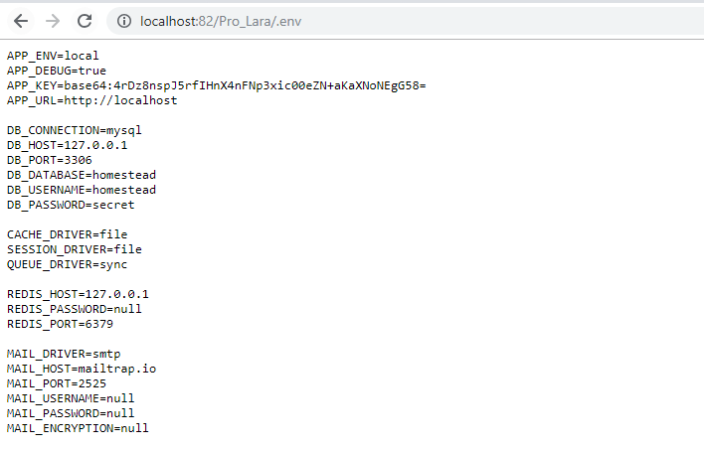
Remove Public in URL
Copy the .htaccess file in the public folder and paste it into the root directory
Copy the server.php file in the root directory and paste it into the same directory and rename it index.php
Note: After removing public in URL you will type .env in the URL like this Here security issue raised b/c you will see the full configuration of the application so you also fix .env issue

Slide 22
Secure .env file
# Disable index view
Options All –Indexes
# Hide a specific file
<Files .env>
Order allow,deny
Deny from all
</Files>

Slide 23
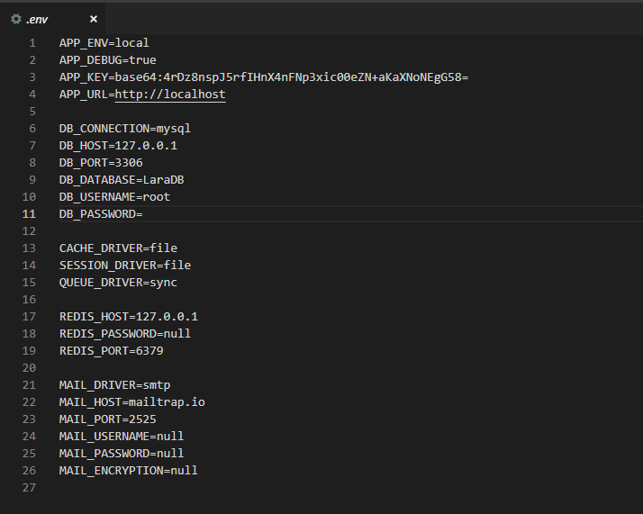
Connect Database in Laravel using .env file

