Slide 1
Git

Slide 2
Git
Git is a version control system, a tool to manage your source code history.
Git is a free and open source distributed version control system designed to handle everything from small to very large projects with speed and efficiency.
Git is easy to learn and has a tiny footprint with lightning fast performance. It outclasses SCM tools like Subversion, CVS, Perforce, and Clear Case with features like cheap local branching, convenient staging areas, and multiple workflows.
Git Hub
GitHub is a hosting service for Git repositories.
Note : They are not the same thing: Git is the tool, GitHub is the service for projects that use Git.

Slide 3
What is Version control ?
Version Control is the management of changes to documents, computer programs, large websites and other collection of information.
There are three types of VCS:
Local Version Control Systems (LVCS):
Centralized Version Control System (CVCS)
Distributed Version Control System (DVCS)

Slide 4
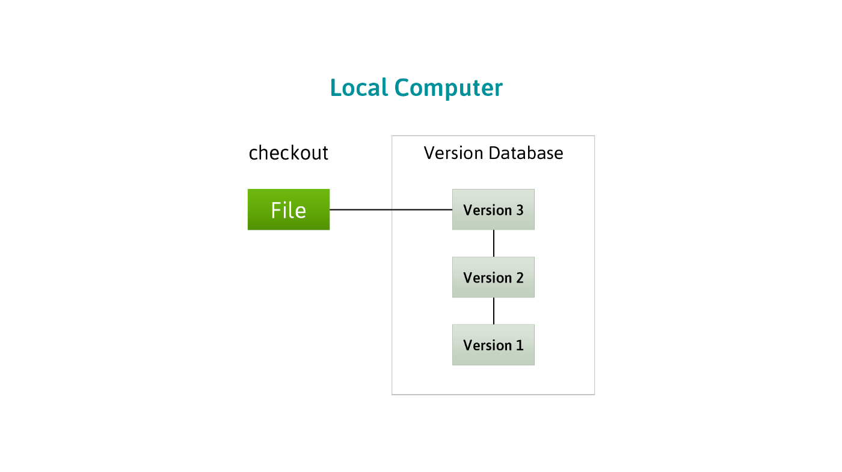
Local Version Control Systems (LVCS):
This approach was built on the traditional meaning of sharing, where files were individually copied from each computer into another directory, which may be time-stamped for more control. This form is still popular and distributed with many computers today. The changes are saved in form of patch sets, where the patch sets are dated and time-stamped. So, in case the code breaks, the patch sets can be combined to re-create what the file previously looked like.

Slide 5
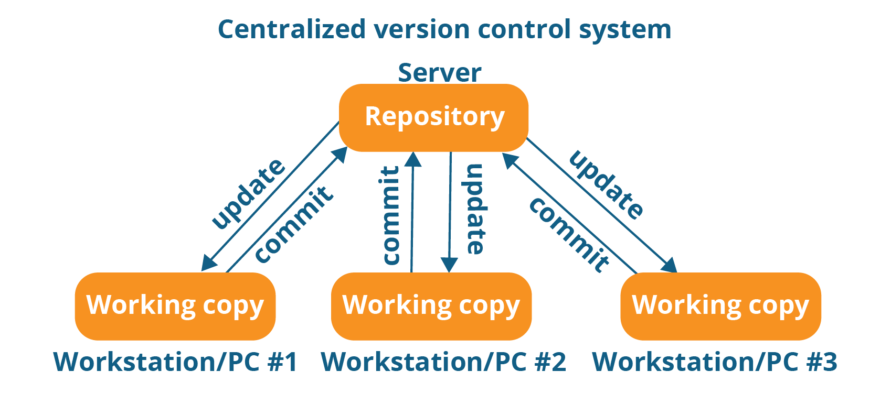
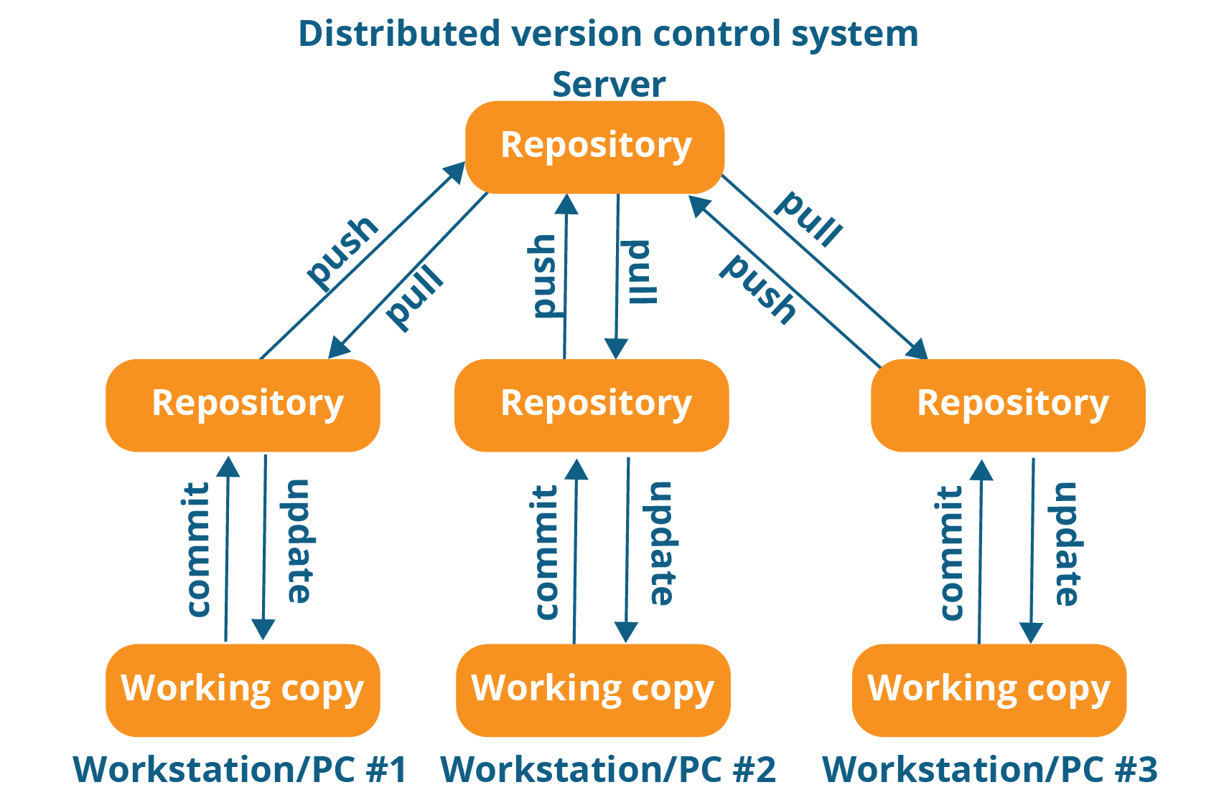
Centralized version control system (CVCS)
Distributed VCS
(DVCS)
Centralized version control system (CVCS) uses a central server to store all files and enables team collaboration. It works on a single repository to which users can directly access a central server.
In Distributed VCS, every contributor has a local copy or “clone” of the main repository i.e. everyone maintains a local repository of their own which contains all the files and metadata present in the main repository.

Slide 6
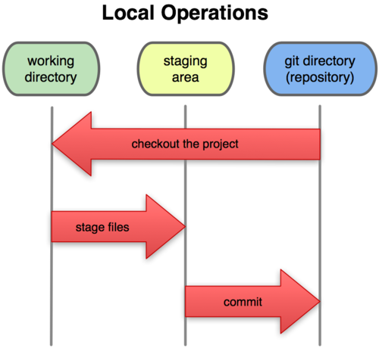
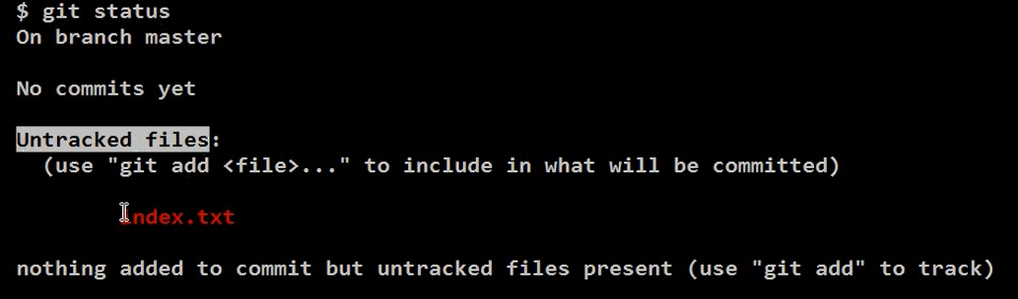
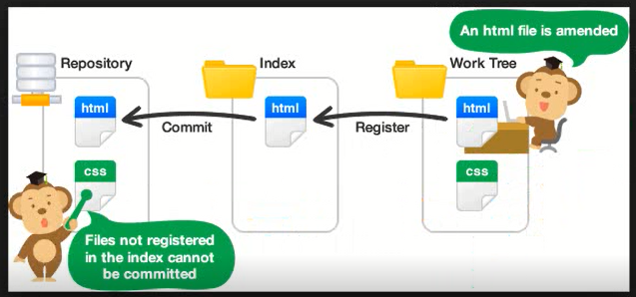
ComMand
1.To initialized git empty repository
git init
2. Create a file name index.txt
3. Check status of the file
git status

Slide 7
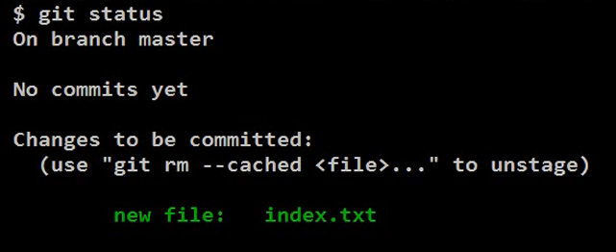
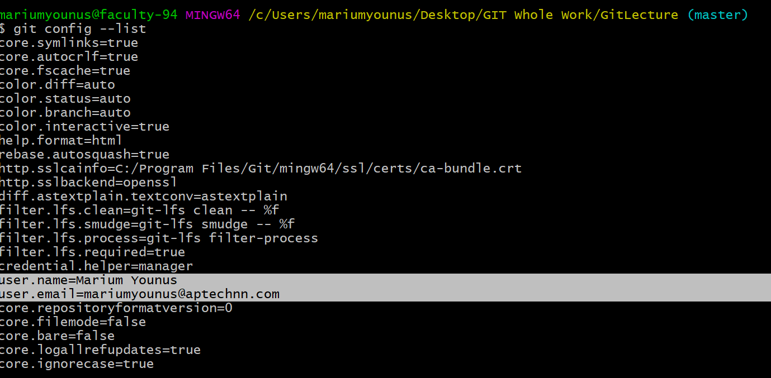
4. git add index.txt
5. Now again check status
git status
6. git commit –m “Your Message”
git commit –m “Master, created index file”
7. Create username and email
git config –global user.name “Marium Younus”
git config –global email “mariumyounus@aptechnn.com”
8. To find the user and email create or not
git config --list

Slide 8
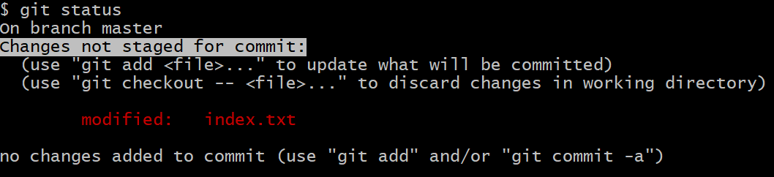
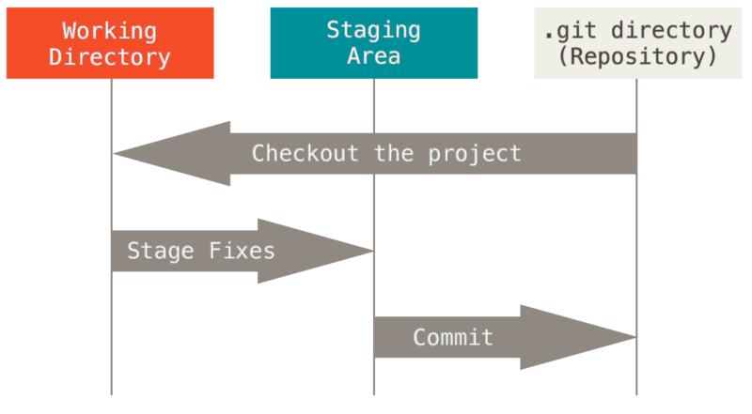
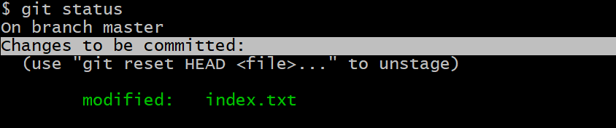
9. Write text on a index.txt file
Welcome to my first git class
10. Again Check Status
git status
11.To apply the save changes on staging area
git add index.txt

Slide 9
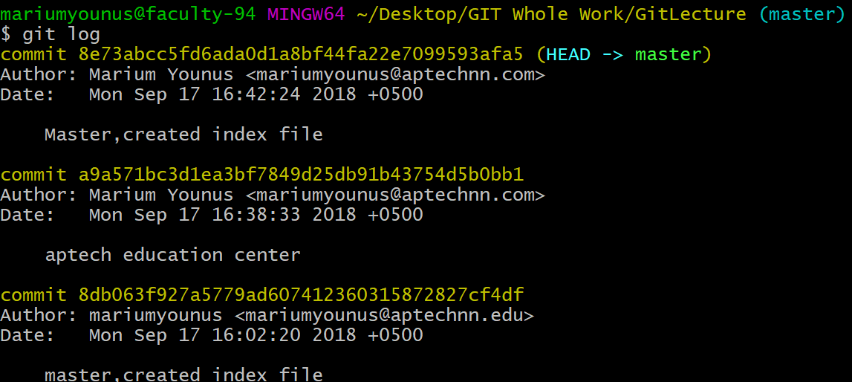
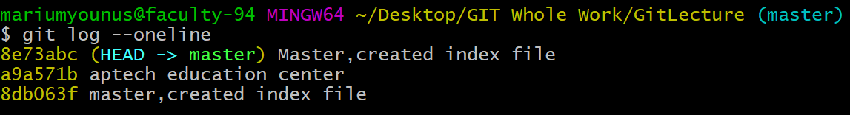
12. To apply Comment on the work
git commit –m”master ,created index file”
13.To Check comment apply in precise way
git log
14.To Check comment apply in precise way
git log –oneline

Slide 10
15.To switch to the branch(git checkout 8db063f)
16.To switch to the branch(git checkout master)
17.To create directory(mkdir abc)
18.To Change a directory(cd abc)
19.To create a file(touch index.txt)
20.To Write a file open the file(vi contact.txt)
21.Save the file using :wq!
22.To remove the file (rm contact.txt)(git rm --cached contact.txt)
24.To check status and find Changes not staged for commit: then write git add .
25.Back to the directory using (cd ..)
26.To check working order (git diff --staged)

