Slide 1
Master of Science
Applied Data Science
Portfolio Milestone
Cal Wardell ID: 889182165
June 2022
Syracuse University

Slide 2
Introduction
The Applied Data Science program at Syracuse University is designed to give students the skills necessary to become professionals who can analyze data to solve problems.
These skills include:
Data collection, transformation, and storage
Knowing how to visualize the data to both see trends and patterns and report findings
Using supervised and unsupervised machine learning to gain understanding of the data and make predictions
Reporting the findings and tailoring them to the understanding of individuals with various technical backgrounds
Making recommendations from the analysis to the business/organization/management/shareholders

Slide 3
Introduction (cont)
The following projects demonstrate the skills I have learned in various classes of my program:
IST 687 Introduction to Data Science
IST 659 Database Administration & Database management
IST 719 Information Visualization
IST 652 Scripting for Data Analysis

Slide 4
IST 687 Introduction to Data Science
Goal: Determine which factors correlate with individual income to be greater or less than $50,000 per year.
About the data: The data for the analysis is extracted from the 1994 census, retrieved from the UCI Machine Learning Repository website (Dua, 2019). It provides over 32,000 rows containing the demographics of people and if they made greater or less than $50,000 annually. My group and I examined the data, removed null values, and transformed the needed columns to factors to be used in the machine learning model.
https://github.com/WardeCal/IST782-MSADS/tree/main/IST687_IntroToDataScience_Code
Notes:
Demographics include the individual’s age, working class, education, marital status, occupation, relationship to head of household on the census, race, sex, hours per week worked, native country,

Slide 5
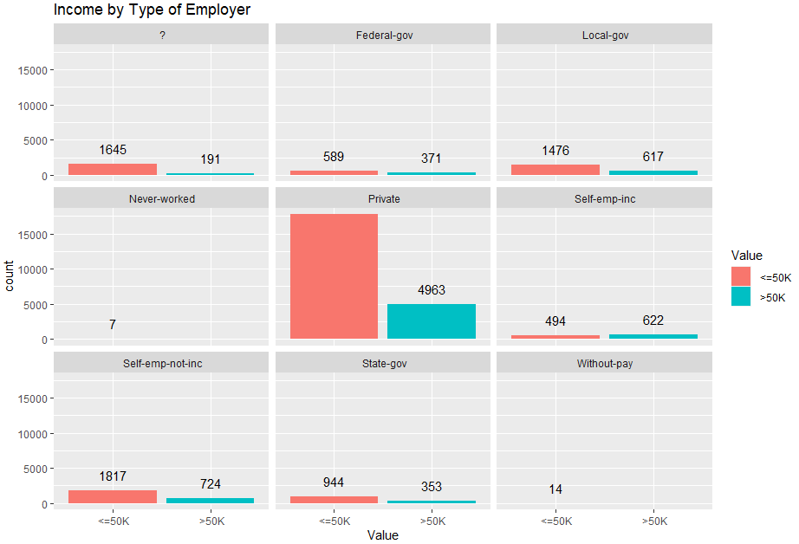
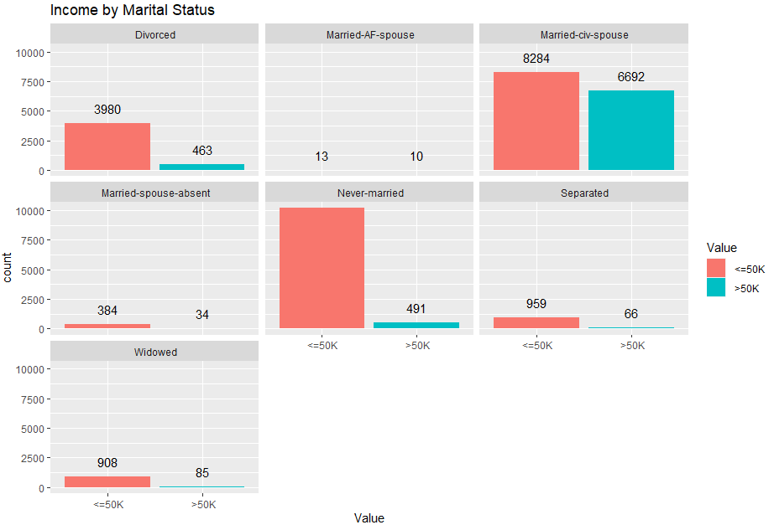
Visualize the data
https://github.com/WardeCal/IST782-MSADS/tree/main/IST687_IntroToDataScience_Code

Slide 6
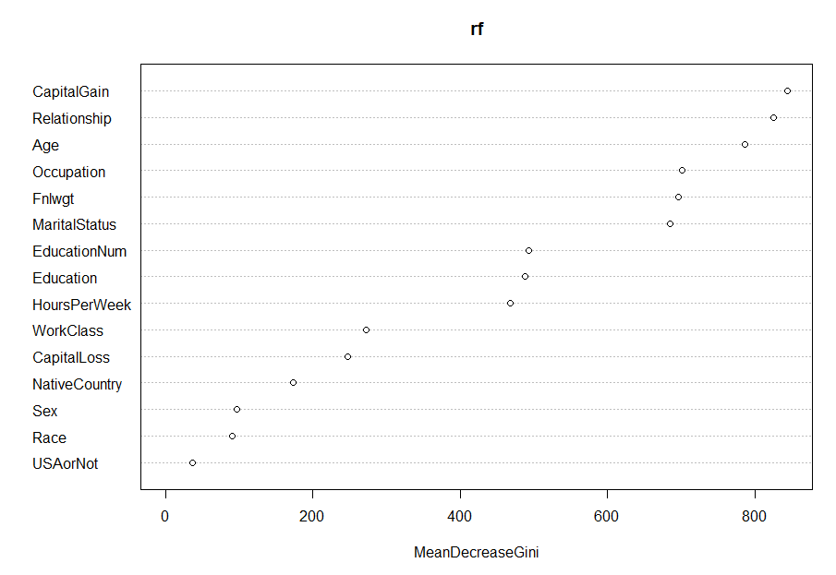
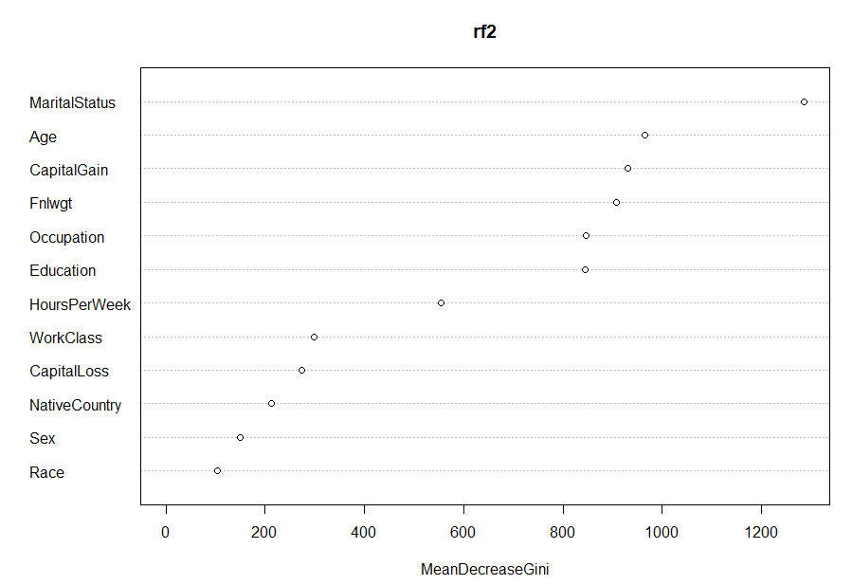
Which variables had the greatest effect?
https://github.com/WardeCal/IST782-MSADS/tree/main/IST687_IntroToDataScience_Code
Notes:
This is from our random forest model

Slide 7
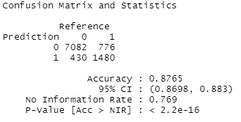
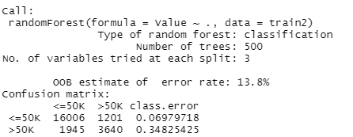
Create and test model
https://github.com/WardeCal/IST782-MSADS/tree/main/IST687_IntroToDataScience_Code

Slide 8
Conclusion
Our models were around 87% accurate at predicting if an individual would make greater or less than $50,000 annually. The most influential variable to determine whether a person makes more or less than $50,000 was marital status. The graphs suggest that married individuals had a better chance of making greater than $50,000 than those who are not married. Our recommendation is to increase programs and incentives that encourage individuals to get married, as this will increase the likelihood of earning $50,000 or more annually.
Skills learned from this project:
Load, clean, and prepare data for analysis
Create useful visuals from our dataset
Train and test Random Forest and XGBoost models and visualize which variables are most influential in the models
Make recommendations from findings in the analysis
https://github.com/WardeCal/IST782-MSADS/tree/main/IST687_IntroToDataScience_Code

Slide 9
IST 659: Database Administration & Database Management
Goal: Create a database of players who have appeared in the National Basketball Association (NBA) All-Star Games to determine which schools/leagues are producing the top players in the NBA.
About the data: This database had information on each of the players in the 2019 and 2020 All-Star Game. The data I collected includes: the player’s position, NBA team, college/high school/overseas league they played for before joining the NBA, and which All-Star Games they played. My main two questions were:
Which college/high school/overseas organization provided the most NBA All-Stars?
Does a college/high school/overseas organization produce more NBA All-Stars who play a certain position?
https://github.com/WardeCal/IST782-MSADS/tree/main/IST659_DatabaseAdministration_Code

Slide 10
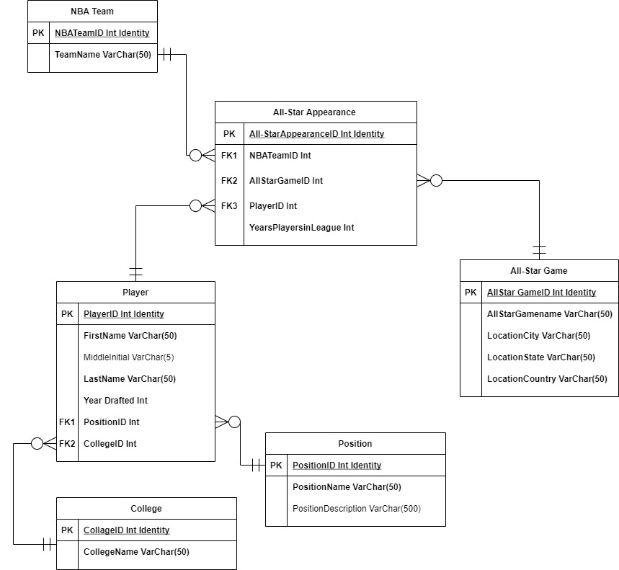
Build Entity Relationship Diagram
https://github.com/WardeCal/IST782-MSADS/tree/main/IST659_DatabaseAdministration_Code

Slide 11
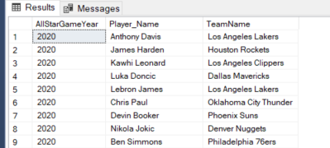
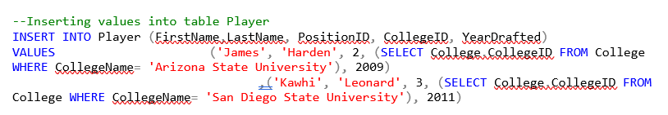
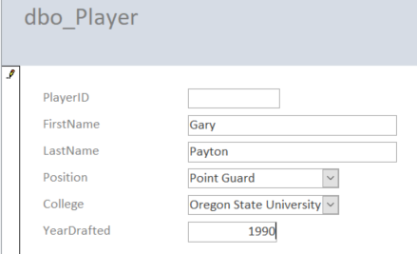
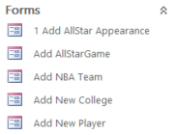
Create database front and back end
SQL Server Management Studio served as back end for the data base
Microsoft Access was the front end
https://github.com/WardeCal/IST782-MSADS/tree/main/IST659_DatabaseAdministration_Code

Slide 12
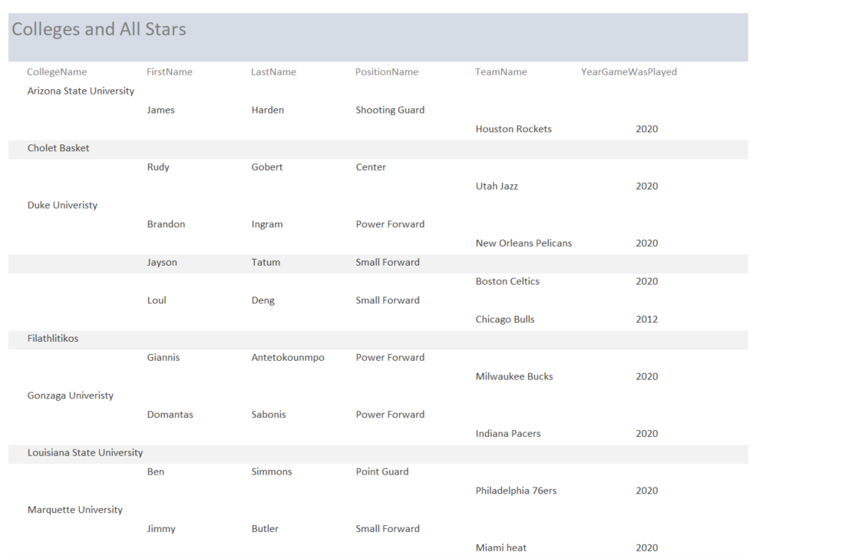
Generate report
https://github.com/WardeCal/IST782-MSADS/tree/main/IST659_DatabaseAdministration_Code

Slide 13
Conclusion
From the section depicted from the previous slide (which comes from the 2019 and 2020 All-Star Games), we see that Duke University produced several All-Star players at the forward position. A team that needs players in this position could use this information to search for and draft players from Duke.
Skills learned from this project:
Design a database using an ERD
Build the database and insert data using SQL
Create a report from the database to generate insight
https://github.com/WardeCal/IST782-MSADS/tree/main/IST659_DatabaseAdministration_Code

Slide 14
IST 719: Information Visualization
Goal: Through visualization, answer various questions about cars being sold in Poland to obtain the best value for the price of a car.
About the data: This data set comes from Kaggle.com (Glotov, 2022). It contains the following information on cars being sold in Poland: make, model, generation, year, mileage, engine size in cc’s, engine type, city in Poland, region of Poland, and price of the car in Polish złoty (PLN). My top two questions were:
How does mileage affect the price of a car?
Which car makes have the cheapest selection of cars?
Upon looking at the data, I noticed some bad values; for example, ‘)’ was a location. I filtered these bad values out. I also wanted to focus on the regions of Poland that had the greatest selection of vehicles, because more options provide a better probability of getting a good deal. So, I filtered out the regions that had a very low selection of cars.
https://github.com/WardeCal/IST782-MSADS/tree/main/IST719_InformationVisualization_Code

Slide 15
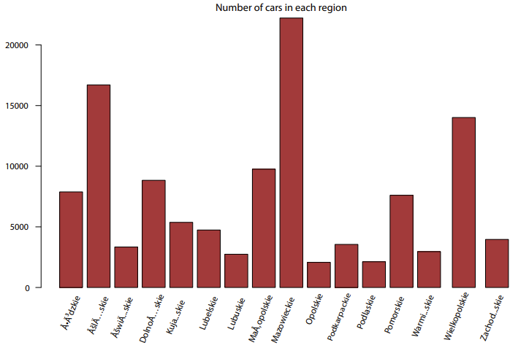
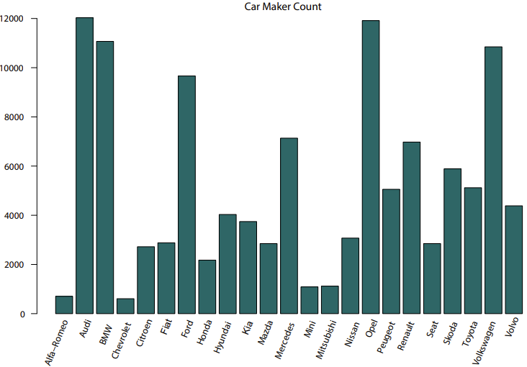
Create single dimensional plots
https://github.com/WardeCal/IST782-MSADS/tree/main/IST719_InformationVisualization_Code

Slide 16
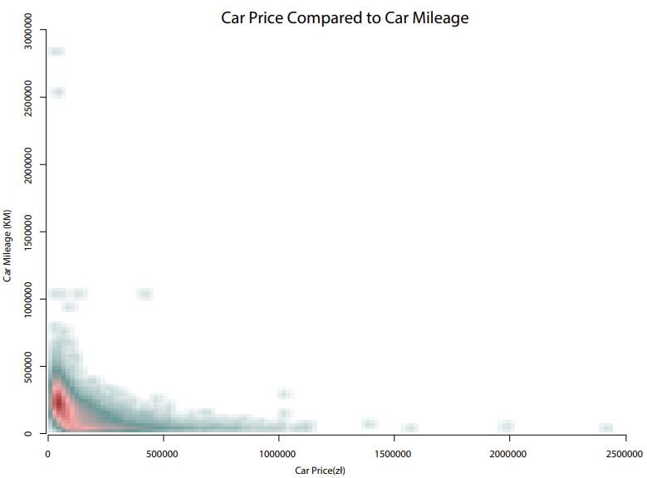
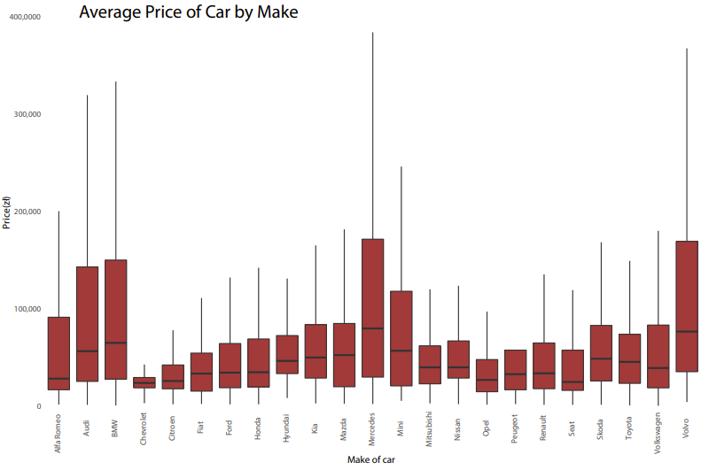
Create multi dimensional plots
https://github.com/WardeCal/IST782-MSADS/tree/main/IST719_InformationVisualization_Code

Slide 17
Conclusion
Finding a good deal on a car can be difficult, but visualizing the data offers quick and efficient insight to help our decisions. The recommendation I would make to an individual searching for a good deal on a new car would be to look at a Ford in the Mazowiekie region of Poland. This make has a low price range and has many cars for sale. In addition, the Mazowiekie region has the largest selection of vehicles in Poland, providing customers with a better chance at finding a good deal. Finally, because the data suggests that low mileage correlates with higher cost, I would recommend looking for a car with relatively low mileage but not at a very high price.
Skills learned from this project:
Create visuals in R to gain insight about data
Use functions in base R, ggplot, and smoothscatter packages for visuals
Edit in Adobe Illustrator to enhance visuals
https://github.com/WardeCal/IST782-MSADS/tree/main/IST719_InformationVisualization_Code

Slide 18
IST 652: Scripting for Data Analysis
Goal: Answer questions about the National Football League (NFL) by analyzing play-by-play data from all regular season games during years 2009 to 2018.
About the data: The data set came from a CSV downloaded from Kaggle.com (Horowitz, 2017). It is detailed play-by-play data from regular season games during years 2009 to 2018. The data has over 350,000 rows and 100 columns. Some of the columns in the data set include which team has the ball, type of play, result of the play, time left in the game, and current score at the time of the play. As this was a group project, my responsibility was to answer the following questions:
What is the winning percentage for quarterbacks in games they throw over 40 times? (This question is to help us know if I should recommend that teams have their quarterbacks throw the ball more.)
Which leads to more points: runs or throws? (Knowing if runs or throws generate more points will lead to our recommendations for teams to throw the ball or run more.)
https://github.com/WardeCal/IST782-MSADS/tree/main/IST652_ScriptingforDataAnalysis_Code

Slide 19
About the data (cont.)
To clean the data, we removed several unnecessary columns for our analysis, such as player IDs and probabilities (e.g., touchdown probability, extra point probability). Next, we corrected some team names due to changes over the years (e.g., the Chargers changed from San Diego to Los Angles and their abbreviation changed from SD to LAC).
https://github.com/WardeCal/IST782-MSADS/tree/main/IST652_ScriptingforDataAnalysis_Code

Slide 20
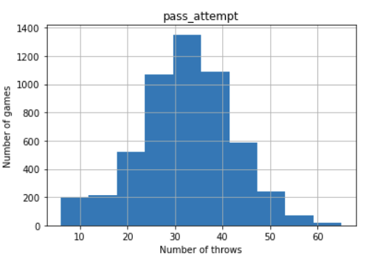
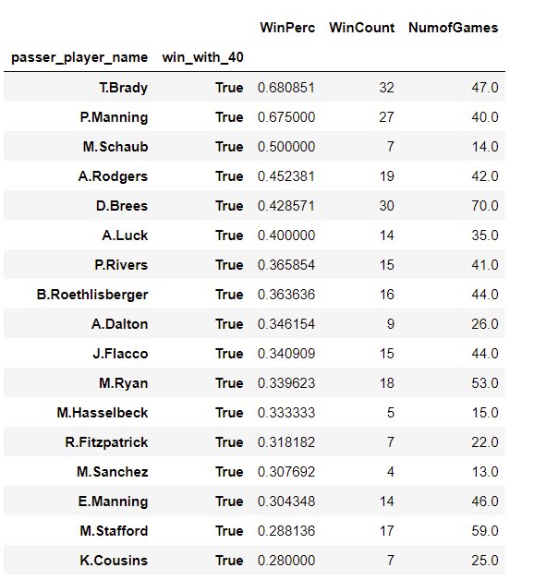
Winning percentages of quarterbacks in games they throw over 40 times
https://github.com/WardeCal/IST782-MSADS/tree/main/IST652_ScriptingforDataAnalysis_Code

Slide 21
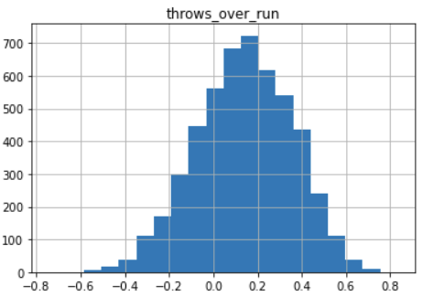
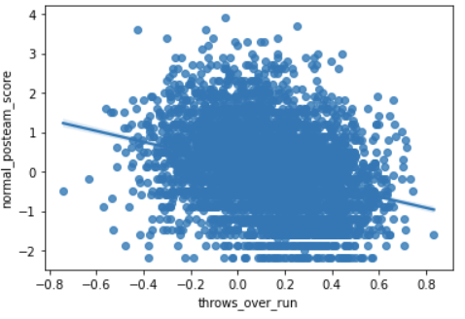
Which leads to more points: runs or throws?
https://github.com/WardeCal/IST782-MSADS/tree/main/IST652_ScriptingforDataAnalysis_Code

Slide 22
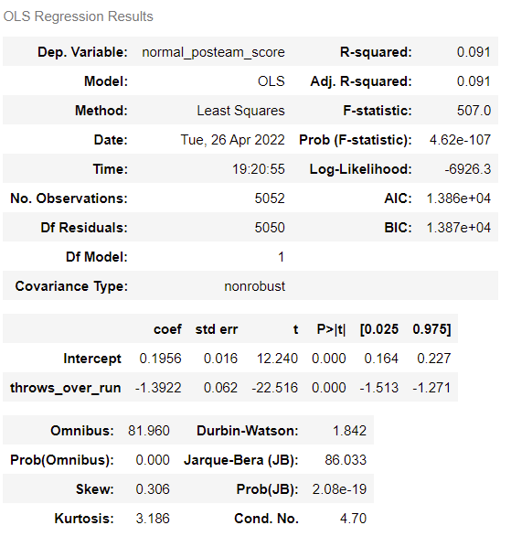
Which leads to more points: runs or throws? (cont.)
https://github.com/WardeCal/IST782-MSADS/tree/main/IST652_ScriptingforDataAnalysis_Code

Slide 23
Conclusion
For question one, out of the 366 quarterbacks in our dataset, only two had winning records when throwing over forty times a game. My recommendation is to not increase the number of throws per game to increase chances of winning, as most quarterbacks have losing records when doing so. In question two, the trend of the data suggests that running the ball leads to more points than throwing. However, with an R-squared of 0.091, it is too low to confidently say that running the ball will lead to more points. I recommend further research with other variables to understand which leads to more points per game.
Skills learned from this project:
Organize, subset, and aggregate data to perform analyses
Create visuals in Python
Run and interpret linear regression model
https://github.com/WardeCal/IST782-MSADS/tree/main/IST652_ScriptingforDataAnalysis_Code

Slide 24
Reflection on the Program
During this program’s classes, I learned how to gain insights from data and make recommendations to businesses and other organizations using visuals, statistical analysis, machine learning and other analytical tools. I would like to thank all my professors, classmates, and advisors for helping me through this program and preparing me for my future career in data science.

Slide 25
References
Dua, D. and Graff, C. (2019). UCI Machine Learning Repository [http://archive.ics.uci.edu/ml]. Irvine, CA: University of California, School of Information and Computer Science
Aleksandr Glotov, (2022), Car Prices Poland, Version 1, Retrieved February 2022 from https://www.kaggle.com/datasets/aleksandrglotov/car-prices-poland
Max Horowitz, (2017), Detailed NFL Play-by-Play Data 2009-2018, Version 6, Retrieved September 2021 from https://www.kaggle.com/datasets/maxhorowitz/nflplaybyplay2009to2016

